Slide 1


Using Expert Knowledge to Inform the Design of Ambient Healthcare Applications
Marcela D. Rodríguez
Autonomous University of Baja California, UABC, Mexicali, México
marcerod@uabc.edu.mx

Slide 2
Questions to address
Why knowledge of experts is important to consider when designing AHA?
How expert knowledge can be used to abstract design principles for AHA?

Slide 3
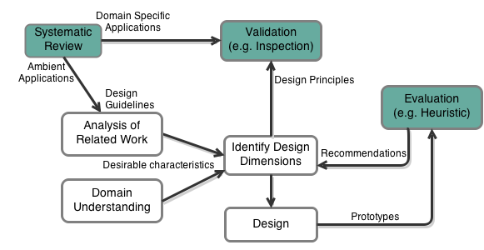
Techniques for using expert knowledge

Slide 4
Outline
Approaches for using expert knowledge
  Systematic Reviews
  Heuristic Evaluations
AIS for Elderly Medication
Design Dimensions for AIS
Conclusions
Notes:
Approaches for using expert knowledge
Systematic Reviews
Heuristic Evaluations
Interaction Design of Ambient Healthcare Applications (AHA)
Assisting elderly to medicate
Using AI techniques for developing AHA:
Autonomous Agents
Ontologies

Slide 5
Systematic Review (SR)
Essential tool for summarising evidence accurately and reliably.
Collate empirical evidence that fits pre-specified eligibility criteria to answer a research question.
Provides reliable findings from which conclusions can be drawn and decisions made.
Notes:
The term Systematic Review (SR) is used to refer to a specific methodology of research, developed in order to gather and evaluate the available evidence pertaining to a focused topic.
A systematic review attempts to collate all empirical evidence that fits pre-specified eligibility criteria to answer a specific research question. It uses explicit, systematic methods that are selected with a view to minimising bias, thus providing reliable findings from which conclusions can be drawn and decisions made.184 185 The key characteristics of a systematic review are (a) a clearly stated set of objectives with an explicit, reproducible methodology; (b) a systematic search that attempts to identify all studies that would meet the eligibility criteria; (c) an assessment of the validity of the findings of the included studies, such as through the assessment of risk of bias; and (d) systematic presentation and synthesis of the characteristics and findings of the included studies.

Slide 6
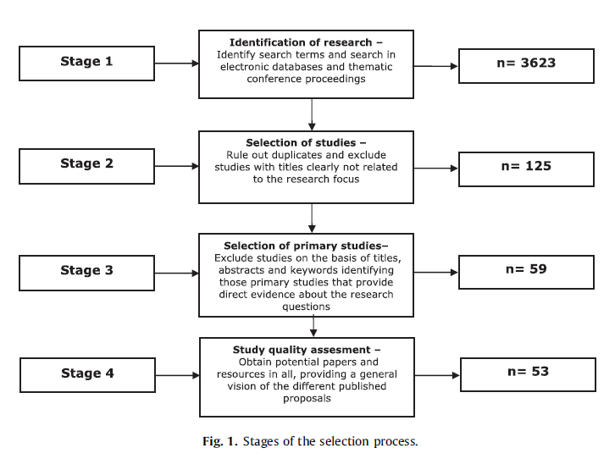
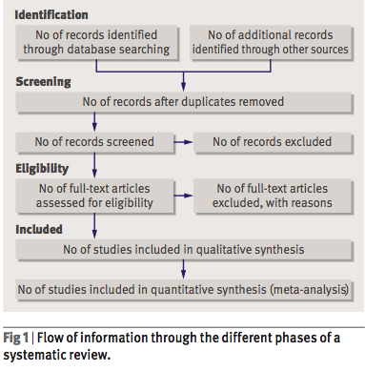
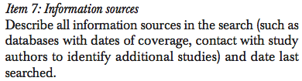


Systematic Reviews
PRISMA [Liberati et al, 2009]: 27-item checklist and a four-phase flow diagram
Notes:
Systematic reviews and meta-analyses are essential tools for summarising evidence accurately and reliably.

Slide 7
Type of Synthesis in SR
The researcher may look for each study and counting them as “votes” about the question focus.
  Ie., in a specific SR conducted in the field of medicine, the researcher found that, among 35 valid studies, 29 showed a positive result, while 5 showed no result, and one study showed a negative result.
Internal comparison of studies, based on their specific parameters:
  i.e. the negative effect must be due to a different dosage scheme, while the five studies that showed no result were conducted in subjects that had a different age distribution in comparison to the 29 positive ones.
Notes:
different kinds of syntheses can be done. The election mode allows the researcher to look for each study separately and counting them as “votes” about the question focus. For instance, in a specific SR conducted in the field of medicine, the researcher could find that, among 35 valid studies, 29 showed a positive result, while 5 showed no result, and one study showed a negative result. Internal comparison of studies, based on their specific parameters, can show contrasts and other kinds of differences that may elucidate distinct aspects of the question. In the same example, one could find that the negative effect must be due to a different dosage scheme, while the five studies that showed no result were conducted in subjects that had a different age distribution in comparison to the 29 positive ones.

Slide 8
Type of Syntesis in SR
Meta-analysis [optional]:
  the original individual studies are treated as if they were parts of one larger study
  single and final result summarizes the whole evidence.
It is important to include descriptive evaluation of each study
  tabular format or tables including population, oucomes, evaluation, etc.
  This help to determine if the studies results can be pooled to a metaanalysis
Notes:
meta-analysis, where the original individual studies are treated as if they were parts of one larger study, by having their data pooled together in one single and final result that summarizes the whole evidence.
The initial step for this process in- volves a simple descriptive evaluation of each study, com- monly presented in tabular format. Tables should include the population under study, the interventions, and out- comes. Methods and biases can also be included. The de- cisions about items to include in the description relate back to the research question. Review of such tables can help determine if results from different studies can be pooled and subjected to a metaanalysis.

Slide 9
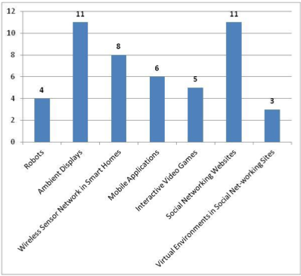
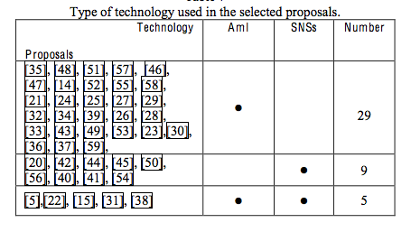
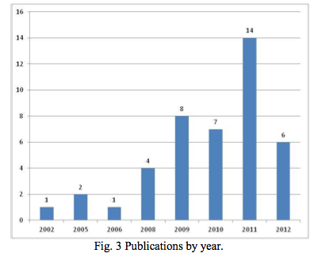
Example [Martinez-Rebollar et al]

Slide 10
Steps of a SR
Formulation of a research question.
Define elegibility criteria
Exhaustive searching of literature
Assessing the literature for elegibility
Data extraction.
Summary and synthesis of study results (me-
ta-analysis).
Interpretation of the results.

Slide 11
Usability Inspection
Set of methods that are all based on having evaluators inspecting a user interface.
Identify Usability Problems
Inspectors evaluate the UI to check that it conforms with a set of design characteristics
Inspector: domain and usability expert
  Non-experts: Colleague, potential users
Notes:
Inspectors will identify most of the usability defects as they walk through the interface during the evaluation session. This is different from the data collection form for user observaion, where the usability defects are identified during the analysis of the data.
In general, heuristic evaluation is difficult for a single individual to do because one person will never be able to find all the usability problems in an interface. Luckily, experience from many different projects has shown that different people find different usability problems. Therefore, it is possible to improve the effectiveness of the method significantly by involving multiple evaluators. It is recommended to use three to five evaluator.

Slide 12
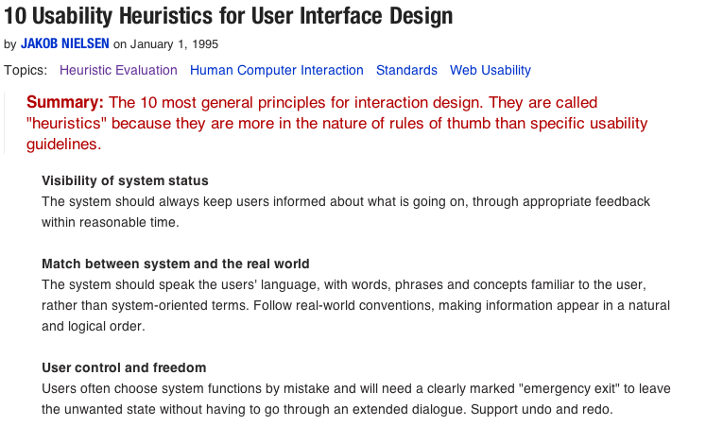
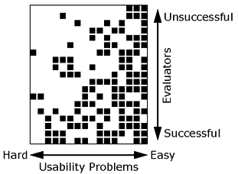
Heuristic Evaluation
“A small set of evaluators (3-5) examine the interface and judge its compliance with recognized usability principles (the heuristics)” [Nielsen, 1994]
Different evaluators identify different UP
More evaluators, more UP
http://www.nngroup.com/articles/ten-usability-heuristics/
Notes:
No necesariamente hay una convergencia en los problemas
Evaluadores más experimentados, encuentran problemas más relevantes
Algunos problemas serán evidentes, y percibidos por la mayoría de los evaluadores
No se requiere proveer un sistema funcional: prototipos en papel, escenarios (p.ej. videos)

Slide 13
Conducting a Heuristic
Evaluation
Prepare tasks descriptions
Individual Inspection Session
  1-2 hour session, double revision
  Each inspector prepare a list of UP
Analysis of Heuristic Inspection Data
  Integrated list of UP
Interpretation of Heuristic Inspection Data
  Set of Design Recommendations
Notes:
Prepare information describing the system
Individual inspection of the system
1-2 hour session
Recomendable una doble revisión al sistema
Para entender la interacción con la interfaz
Para identificar los PU
Resultado: lista de PU por evaluador
Preparar una lista integrada de los PU
Sesión con el conjunto de expertos
Discuten los PU, acuerdan la lista final
Proponen recomendaciones de diseño
Discuten los aspectos positivos del diseño
-------------
Analysis of Heuristic Inspection Data: The analysis of your data follows the same process as for user observation. In theory, collating and summarizing data from a heuristic inspection is a relatively simple matter of gathering together the forms that the inspectors have used. However, because inspectors do not always have the same opinion , you may wantt to get the inspectors to review each others forms and discuss any differences between them, perhaps going back over the interface collectively to resolve any disagreements.
Interpretation of HID: The interpretation of your data follows the same process as fou user observation. When you produce your recommendations, you may want to invite the inspectors back to review your recommendations or the whole of your report to check that they agree with your interpretation.

Slide 14
Benefits of inspections
Less expensive than users observation
Experts tend to suggest solutions
Large number of (obvious) errors are discovered before users observation
Inspections complement users observation
Notes:
Inspections can sometimes be less expensive than user observation, especially if you have to recruit and pay participants for the latter.
During an inspection, inspectors more often than not suggest solutions to the usability defects that they identify.
It can be annoying to discover a large number of obvious errors during a user-oaservation evaluation session. Inspecting the UI first can help to reveal these defects.
In a user observation, you ask the paticipant to attempt tasks with the interface and to comment from his or her own point of view. In a heuristic inspection, you ask the inspectors to consider each heuristic individually and to justify any defects they find by identifying which heuristic has been broken. Heuristic inspections do not yield evaluation data from the perspective of a user, as users o user representatives are not always involved. Inspections, therefore, complement user observarion. In a user observation, the evaluator observes wht the participant does. In a heuristic inspection, inspectors obsrve themselves- notiving where typical users might look and trying to predict what a typical user might do. In a user observation, you usually ask the participant to describe his or her thoughts in a think-aloud or retrospective protocol. In heuristic inspections, the inspectors asks themserves questions such as “” Is this a simple and natural dialogue?” Finally, in user observation, the key measurements are often effectiveness (can the user do this task?) and efficiency (how long does it take?). Inheuristic inspection, the key measurements is “How many violations of heuristics are there in this UI?”
”

Slide 15
Limitations of Inspections
Rely on the inspectors ability to predict the kind of usability problems.
Ideally, an inspector is expert in HCI and the domain.
Make false assumptions of what actual users will do with the UI.
Inspectors may have their own preferences and views toward the UI design.
Notes:
ESTE SLIDE LO PODRIA PRESENTAR COMO CONCLUSION DE LA EVAL HEURISTIA QUE LOS SIAS. Y DANDO EJEMPLOS DE CADA LIMITACION.
VER. PAG. 531-532
Ideally, an inspector is an expert in HCI and the domain of the system. These skills are rarely available in one person. It is also difficult for anyone, no matter how expert, to give equal attention to a variety of heuristics and domain knowledge. It is therefore more usual to find two or more inspectors with different backgrounds. The insufficient knowledge, can affect the validity of the evaluation data as some domain- or task- specific usability defects might be missed during an inspection (EXPLICAR COMO ESTE ASPECTO LO ABORDAMOS EN NUESTRA EVALUACION, HACIENDO UN ANALISYS DE LOS DEFECTOS IDENTIFICADOS. ALGUNOS DE ELLOS SE CONTRAPONIAN, PERO DECIDIMOS EN ESTOS CASOS DAR MAS CREDITO A AQELLOS CON MAS EXPERIENCIA EN USABILIDAD O EL DOMINIO, SEGÚN SEA EL CASO. VER SI PODRIA DAR EJEMPLOS)
An usability inspections often do not involve real or representative users, it is easy to make mistakes in the prediction of what actual users will do with the UI. However, real users can find the heuristics difficult to understand and the atmosphere of an inspection session to be unrealistic, thus limiting the data obtained.
Inspectors may have their own preferences , biases, and views toward the design of user interfaces design, which in turn may bias the evaluation data.

Slide 16



Design Dimensions of
Ambient Systems to Support Elderly Medication
Instructor:
Marcela D. Rodríguez (UABC, México)
marcerod@uabc.edu.mx

Slide 17
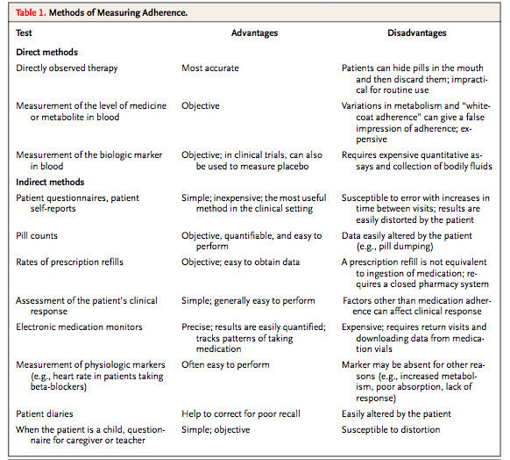
Medication Adherence
Definition: ”taking the prescribed number of pills each day, within a prescribed period”
It is reported as the % of medication taken
Patients with chronic conditions has a low adherence
Rates of adherence drops most dramatically after 6 months of therapy
Notes:
Adherence to (or compliance with) a medication regimen is generally defined as the extent to which patients take medications as pre- scribed by their health care providers. The word “adherence” is preferred by many health care providers, because “compliance” suggests that the patient is passively following the doctor’s orders and that the treatment plan is not based on a therapeutic alliance or contract established between the patient and the physician. Both terms are imperfect and uninformative descriptions of medication-taking behavior.
Rates of adherence for individual patients are usually reported as the percentage of the prescribed doses of the medication actually taken by the patient over a specified period. Some investigators have further refined the definition of adherence to include data on dose taking (taking the prescribed number of pills each day) and the timing of doses (taking pills within a prescribed period). Adherence rates are typically higher among patients with acute conditions, as compared with those with chronic conditions; persistence among patients with chronic conditions is disappointingly low, dropping most dramatically after the first six months of therapy.2-4 For example, approximate- ly half of patients receiving hydroxymethylglutaryl–coenzyme A reductase inhibitor therapy will discontinue their medication within six months of starting the therapy.5
Persons who are over 65 years have higher rates of non-adherence, and those living alone who take more than three medications are prone to medication errors[6]. It is estimated that 26% to 59% of older adults have lower drugs compliance due to cognitive and perceptual changes that co-occur with age, make them susceptible to medication errors such as forgetting to take their drugs, taking incorrect doses, or to terminate drug-taking prematurely if they feel better [6].

Slide 18
Elderly Medication Problems
26% to 59% of older adults have lower drugs compliance [Orwing et al, 06]
Elders living alone, and taking more than 3 medicines are prone to medication errors
Forgetting to take their drugs, taking incorrect doses, and to terminate drug-taking prematurely[Lison et al, 2006].
Notes:
Persons who are over 65 years have higher rates of non-adherence, and those living alone who take more than three medications are prone to medication errors[6]. It is estimated that 26% to 59% of older adults have lower drugs compliance due to cognitive and perceptual changes that co-occur with age, make them susceptible to medication errors such as forgetting to take their drugs, taking incorrect doses, or to terminate drug-taking prematurely if they feel better [6].

Slide 19
Designing for the context of use
Use a familiar language (Fisk et al, 2003).
Easy to comprehend
Based on their abilities and necessities (Rogers & Mynatt, 2003)
Aesthetic
Assistive Technology
Easy to use
Elders prefer aesthetic assistive producst (Forlizzi, 2004) (Hirsch et al, 2000).
Integrated
into the environment
Integrated into their ADLs

Slide 20
Ambient Information Systems
They are aesthetically pleasing applications
that provide valued information through ambient
changes and abstract representations,
that are easy to comprehend:
Ambient Displays
(Wisneski et al, 1998)
Peripherical
Displays
(Matthews et al, 2004)
Notification
Systems
(McCrikard et al, 2001)
AIS
Notes:
They are aesthetically pleasing applications that provide valued information through ambient changes and abstract representations, that are easy to comprehend:”
Peripheral Displays: allow users to monitor non-critical information without burdening them;
Ambient Display: transmit information by using the physical environment as interface;
Notification Systems: deliver critical information without introducing unwanted interruptions.
AIS can work as i) Peripheral Displays if they are out of the focus of attention, since they allow users to monitor information without distracting or burdening them; as ii) Ambient Displays that make use of the entire physical environment as an interface to digital information; thus, the term Ambient Display emphasizes the physicality or tangibility of the displays which transmit information often in the users periphery [4]; and finally as iii) Notification Systems if they are used in a divided-attention, multitasking situation, attempting to deliver current and valued information wit hout introducing unwanted interruption to a primary task

Slide 21
Case of Study
17 older adults between 65 and 86 years old, who take between 3 and 10 medicines
40-minute contextual interviews (MedMaIDE index)[Orwing 06]:
What elders know about their medication
  The place where they medicate
  supporting resources they use for medicating
  involved community.

Slide 22
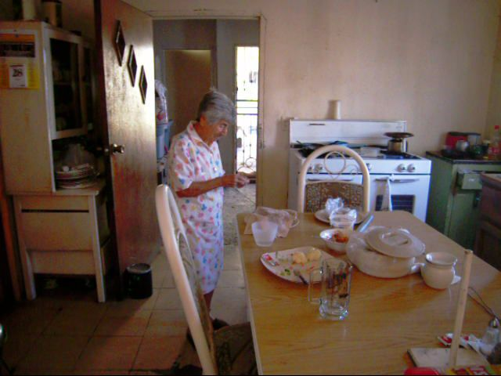
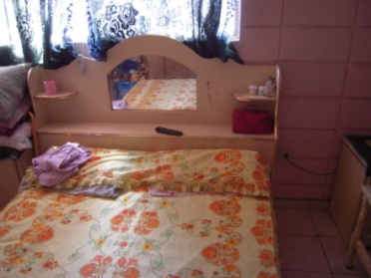
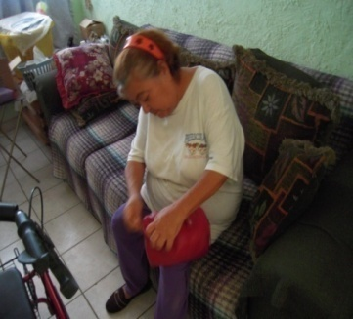
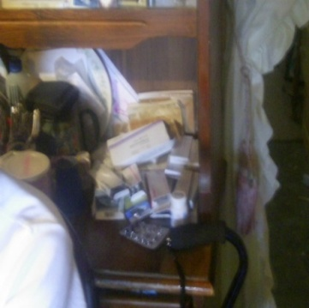
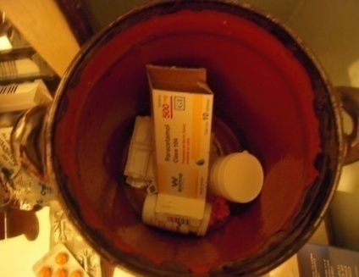
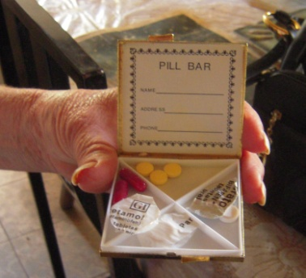
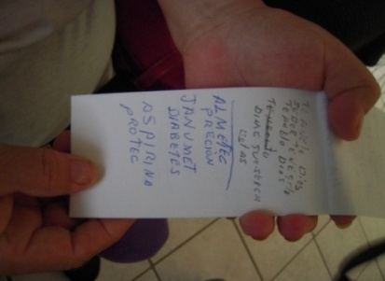

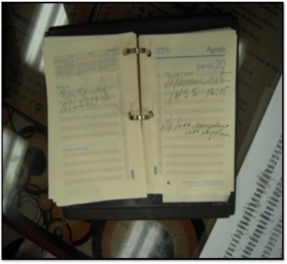
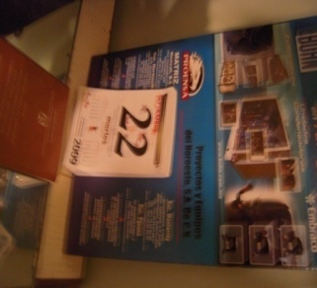
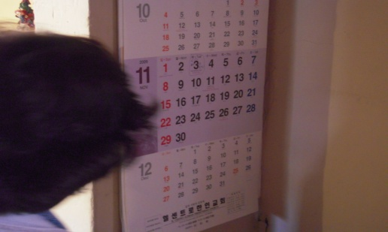
Study findings
Elders’ Strategies
Goal
Evidence
Have a specific place to medicate
Not forget taking their medicines.
Have the objects they need to medicate
(4/17) Bedroom
(11/17) Kitchen
(2/17) Living room
Sort their medicines
Avoid taking incorrect doses or medicines
(6/17) use containers
Write down notes indicating the medicine purpose
Remember the health problem addressed by their medicines
(3/17) write the medicine purpose
Visit periodically to their doctors
Remember the appointment to refill the medicines
(17/17) use calendars or agendas

Slide 23
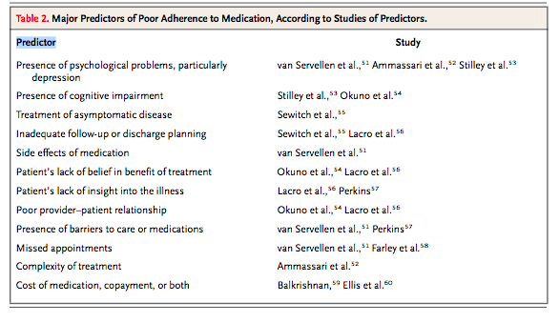
Strategies to Assist Medication
Presence of psychological problems, particularly
depression
Presence of cognitive impairment
Treatment of asymptomatic disease
Motivators
Side effects of medication
Patient’s lack of belief in benefit of treatment
Reminders
Guidance
Missed appointments
Complexity of treatment
Complexity of treatment
Notes:
Persons who are over 65 years have higher rates of non-adherence, and those living alone who take more than three medications are prone to medication errors[6]. It is estimated that 26% to 59% of older adults have lower drugs compliance due to cognitive and perceptual changes that co-occur with age, make them susceptible to medication errors such as forgetting to take their drugs, taking incorrect doses, or to terminate drug-taking prematurely if they feel better [6].

Slide 24
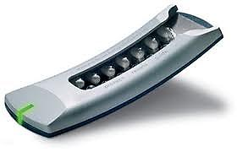
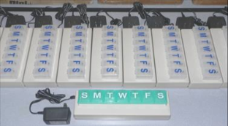
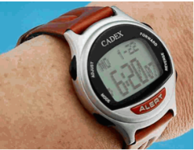
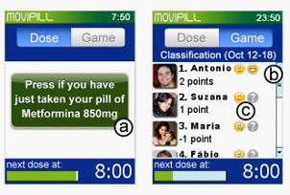
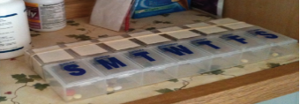
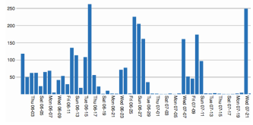
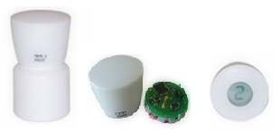
Technologies for Medication
Technological Approaches
Electronic medication- monitoring devices
Reminder systems
Persuasion through social games
Promote reflexion
MEMS www.aardex.com
MEMS www.aardex.com
MEMS www.aardex.com
MEMS www.aardex.com
Helping Hand (Bleser et al, 2010
Helping Hand (Bleser et al, 2010
Helping Hand (Bleser et al, 2010
Helping Hand (Bleser et al, 2010
Medtracker (Hayes et al, 2009)
Medtracker (Hayes et al, 2009)
Medtracker (Hayes et al, 2009)
Medtracker (Hayes et al, 2009)
Cadex www.e-pill.com
Cadex www.e-pill.com
Cadex www.e-pill.com
Cadex www.e-pill.com
Movipill
(Oliveira et al, 2010)
Movipill
(Oliveira et al, 2010)
Movipill
(Oliveira et al, 2010)
Movipill
(Oliveira et al, 2010)
Dispositivo para dar seguimiento
Dispositivo para dar seguimiento
Dispositivo para dar seguimiento
Dispositivo para dar seguimiento
Representación de lo datos
Representación de lo datos
Representación de lo datos
(Lee y Dey, 2011)
Representación de lo datos
(Lee y Dey, 2011)
Notes:
Through

Slide 25
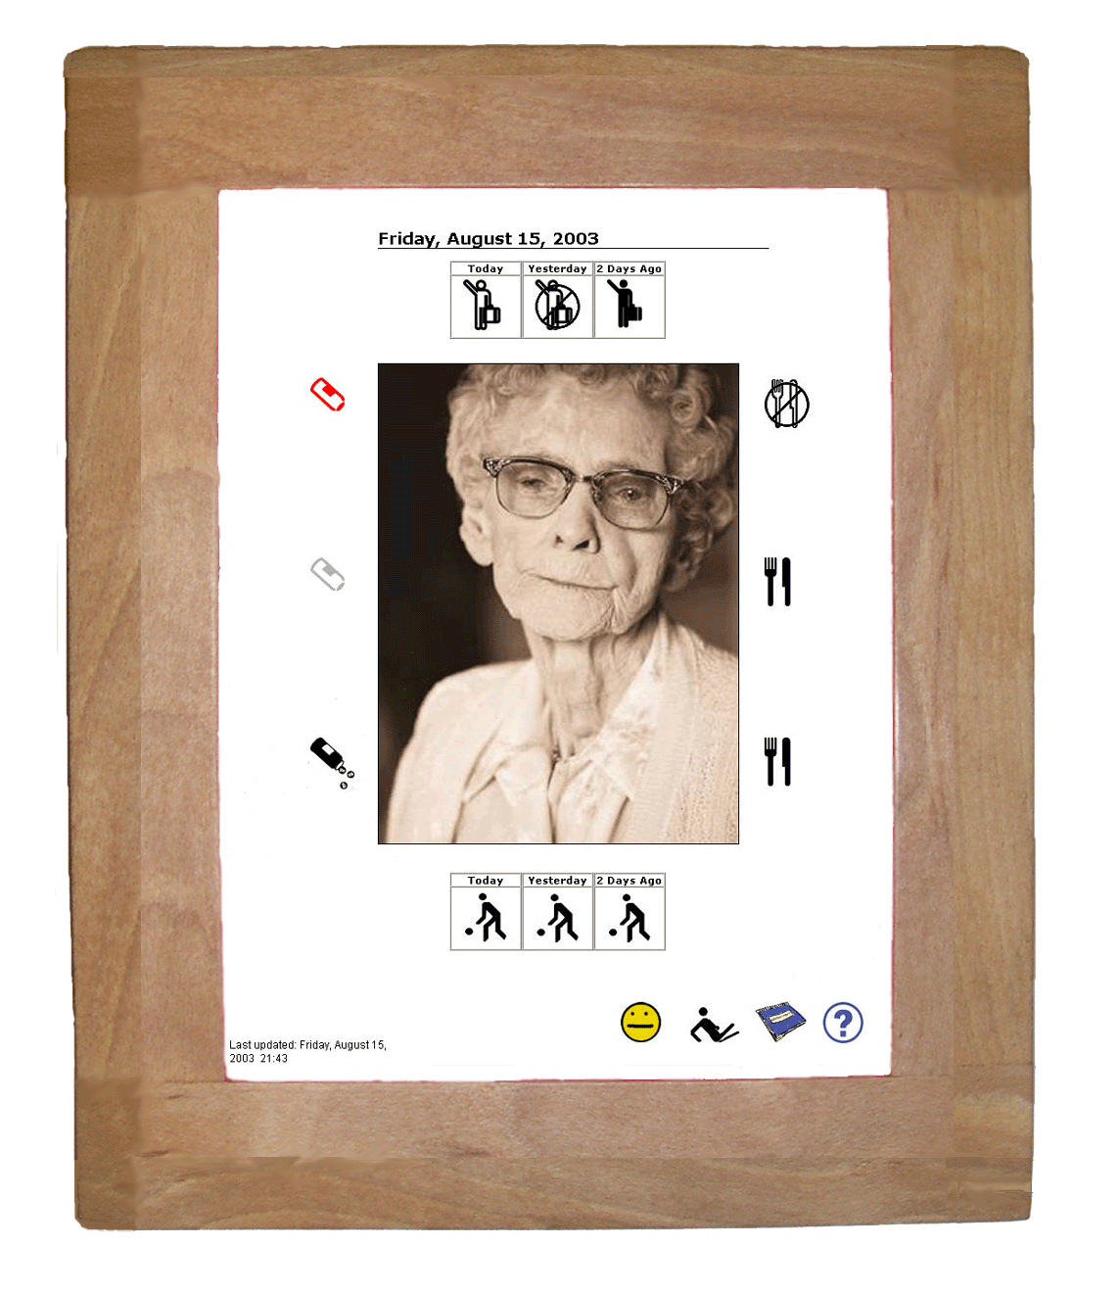
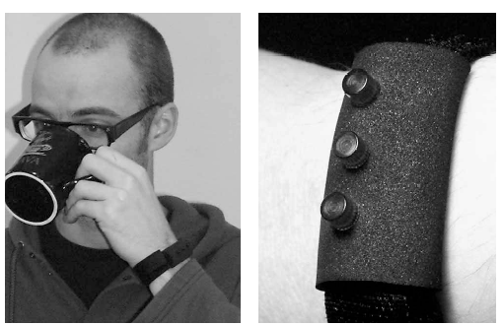

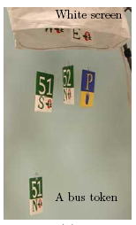

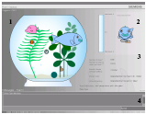
Ambient Information Systems
AIS for making users aware of the status of relevant and unpredictable events.
AIS that notify of predictable or scheduled events.
AIS to motivate a change on the users behavior.
UbiFitGarden
(Consolvo et al, 2008)
CareNet Display
(Mynatt, 2003)
Reminder Bracelet (Hansson et al 2000)
CareNet Display
Fish’n’Steps
(Lin et al 2006)
The Orb
BusMobile
(Mankoff et al 2003
Notes:
aim of raising users’ consciousness about how they have to take the responsibility for caring for their own health, in a similar way that they gladly take care of their pets.

Slide 26
Design Dimensions of AIS
Low cognitive effort, easy to monitor (Mattews et al, 2004)
Use of semiotics (Pousman y Stasko, 2006).
Promote reflexion of users abour their behavior (Consolvo, et al, 2009)
Aesthetic design
Modalities for grasping appropriate amount of users attention
Modalities to represent information
How to apply or adapt these AIS design attributes to support elders medication?
AIS should be perceived for the information provided (Mankoff et al, 2003).
Use few sources of information (Pousman & Stasko, 2006)
Consider the users’ life style, and cultural aspects (Jafarinaimi, et al 2005)
Five notification levels for managing user attention (Pousman 06; Matthews et al, 2004).
Criteria for measuring user’s interruption, reaction and comprehension (McCrickard et al, 2001)
Notes:
To our knowledge, there are no design principles or guidelines for developing AIS for older adults, such as those found for designing web based interactive systems [7]. Even though several research works have identified design dimensions of AIS from the analysis of existing ambient displays and notification displays, there is a lack of understanding about how these attributes should be adapted for designing effective AIS to assist the elderly.
they do not provide guidelines that help to identify how to apply and combine these design attributes for supporting users activities of a particular context of use, such as elders managing their medication.

Slide 27
Strategies to support through AIS
Remind
Guide
To not abandon the therapeutic treatment:
Psicological and persuasive techniques
Abstract representations
Historical information and reflection
Reinforcements
AIS Strategies
Motivate
Notes:
Remind:
Proveen un estímulo para atraer la atención del usuario (McCrickard el al, 2003)
Emplean diversos mecanismos de transición para hacer consciente al usuario de información crítica (Hanson et al, 2001, Hermann et al, 2007).
Adicionalmente pueden proporcionar información detallada de la notificación (Hansson et al, 2001; Mankoff et al, 2003)
Mortivate:
Basan su diseño en técnicas psicológicas y persuasivas (Fogg, 2003; Consolvo et al, 2008, Ko et al, 2007, Lin et al, 2006)
La representación debe ser abstracta y reflexiva por lo que emplean metáforas (Jafarinaimi et al 2005, Consolvo et al 2009).
Información histórica para fomentar la reflexión del usuario sobre su comportamiento (Lee y Dey 2011; Consolvo et al, 2009)
Proporcionar reforzamientos para incentivar el buen comportamiento (Lin et al, 2006 , Nakajima, 2008 , Consolvo, et al, 2009)

Slide 28
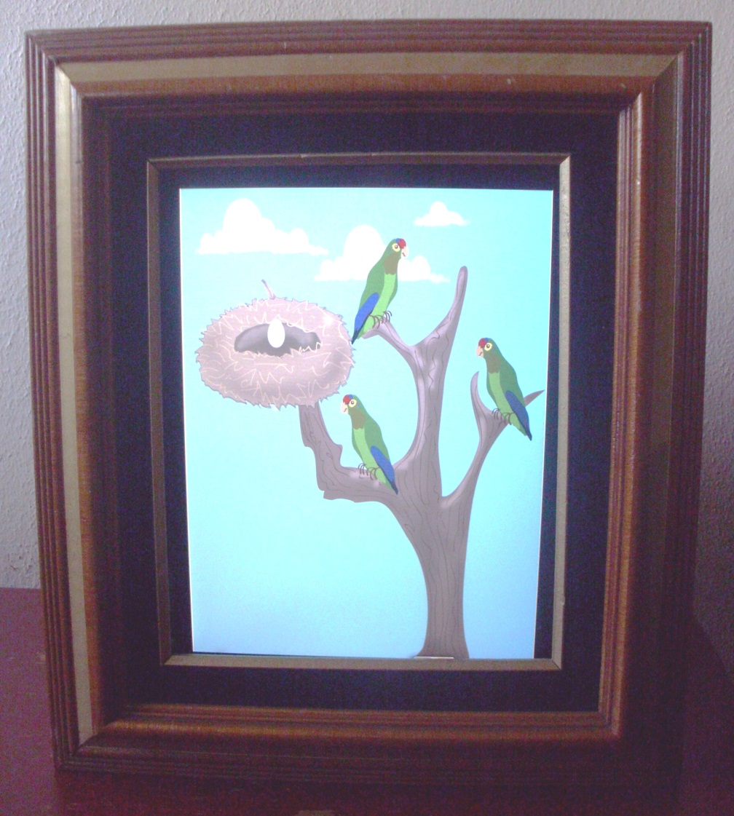




CARe-Me (Context Aware Representation for Medicating)
A stylized representation of medication adherence
Metaphor: Birds growth to symbolize repercussions on elders health.
Current medication week
Rewards:
“Periquito Curro”
3 2 1 0
Medication adherence during the 3 past weeks
Growth levels
Notes:
CARe_Me es un visualizador ambiental que se encuentra empotrado, en este caso, en un portarretrato. Tiene el objetivo de motivar al adulto mayor con su medicación. Para lograr esto, se utiliza la estrategia del concientizar al adulto mayor sobre su propia responsabilidad de cuidar su salud, tal como adquiere gustosamente la responsabilidad de cuidar mascotas. En este caso, son cuatro pericos en una jaula virtual que representan en forma estilizada el cumplimiento de la medicación de las ultimas cuatro semanas. Los pericos podrán presentar hasta cuatro niveles de crecimiento. Como se muestra en la figura. El inicio de la semana de medicación corresponde al nivel cero, que estará representado por el nacimiento de un perico (huevo sobre el nido). El crecimiento del perico sobre el nido (niveles del 1 a 3) representa el cumplimiento de la medicación de la semana actual, mientras que los pericos sobre el árbol representan el cumplimiento de las semanas anteriores. Al finalizar la semana actual de medicación, el perico sobre el nido volará al tronco.
Adicionalmente, CARe-me motiva a los adultos mayores otorgándoles recompensas semanales por haber cumplido son su medicación. Estas consisten de frases que emiten los pericos, indicando que la semana anterior el adulto mayor se medico correctamente. A continuación se presenta un escenario de uso del sistema CARe-Me.

Slide 29
Strategies to support through AIS
Remind
Guide
Initiate the activity:
Provide a stimulus to demand user’s attention
Make elder’s aware of the importance of medicating.
AIS Strategies
Motivate
Notes:
Remind:
Proveen un estímulo para atraer la atención del usuario (McCrickard el al, 2003)
Emplean diversos mecanismos de transición para hacer consciente al usuario de información crítica (Hanson et al, 2001, Hermann et al, 2007).
Adicionalmente pueden proporcionar información detallada de la notificación (Hansson et al, 2001; Mankoff et al, 2003)
Mortivate:
Basan su diseño en técnicas psicológicas y persuasivas (Fogg, 2003; Consolvo et al, 2008, Ko et al, 2007, Lin et al, 2006)
La representación debe ser abstracta y reflexiva por lo que emplean metáforas (Jafarinaimi et al 2005, Consolvo et al 2009).
Información histórica para fomentar la reflexión del usuario sobre su comportamiento (Lee y Dey 2011; Consolvo et al, 2009)
Proporcionar reforzamientos para incentivar el buen comportamiento (Lin et al, 2006 , Nakajima, 2008 , Consolvo, et al, 2009)

Slide 30
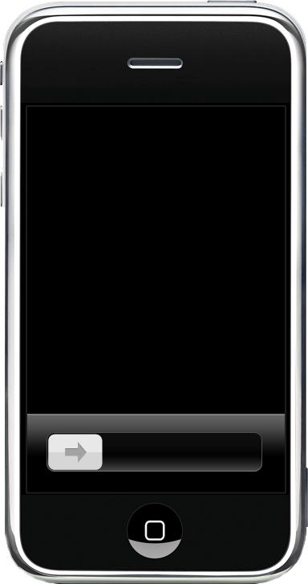
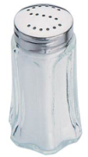
Remind-Me (Remind elders to Medicate)
Timely auditory reminders
Visual notifications with critical information
Medicine
Enalapril
Health problem
20:00
Doses

Slide 31
Strategies to support through AIS
Remind
Guide
Complete the activity:
Atract users attentions to the containers medicines
Provide critical information to correctly take the medication.
AIS Strategies
Motivate
Notes:
Información que indican los pasos de la actividad y las últimas acciones realizadas (Tran et al, 2005)
Información crítica para cumplir fácilmente con una meta (Fogg, 2009)

Slide 32
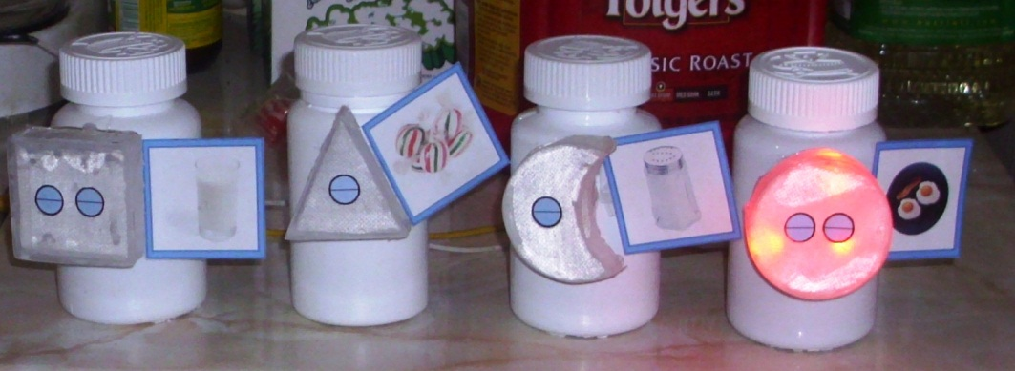
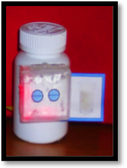


GUIDE-Me (Geometric User Interfaces to Display aids for the Elderly when Medicating)
AIS attached to medicines to make elders aware of how to carry out the activity.
Doses
Fre quency
Health-problem

Slide 33
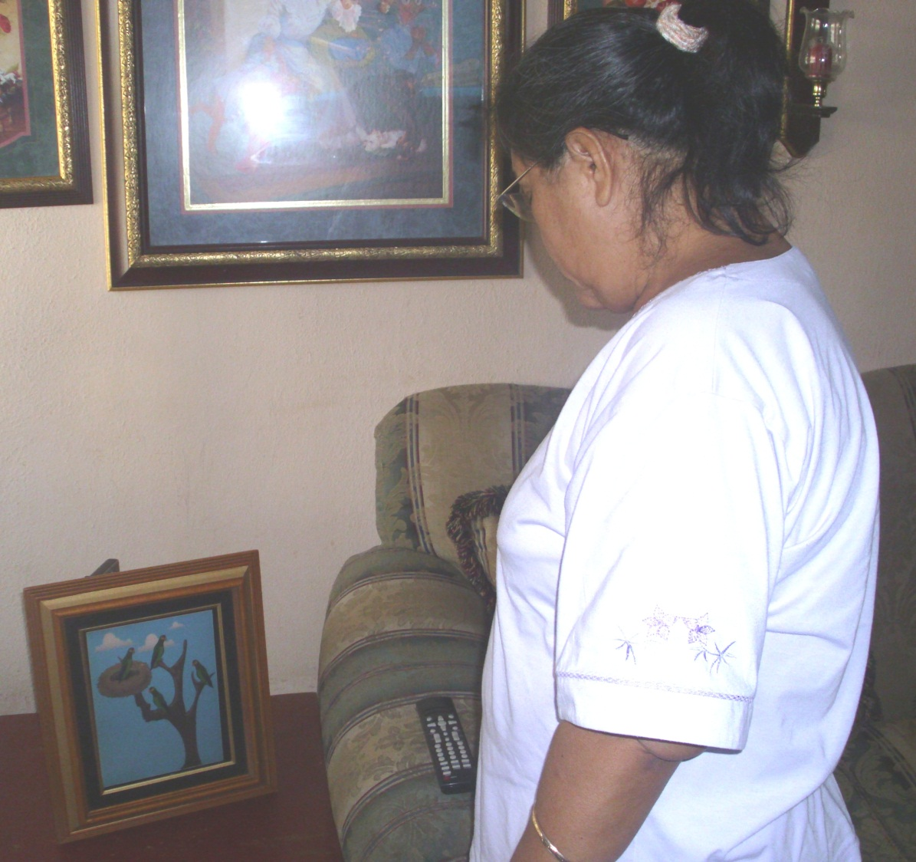
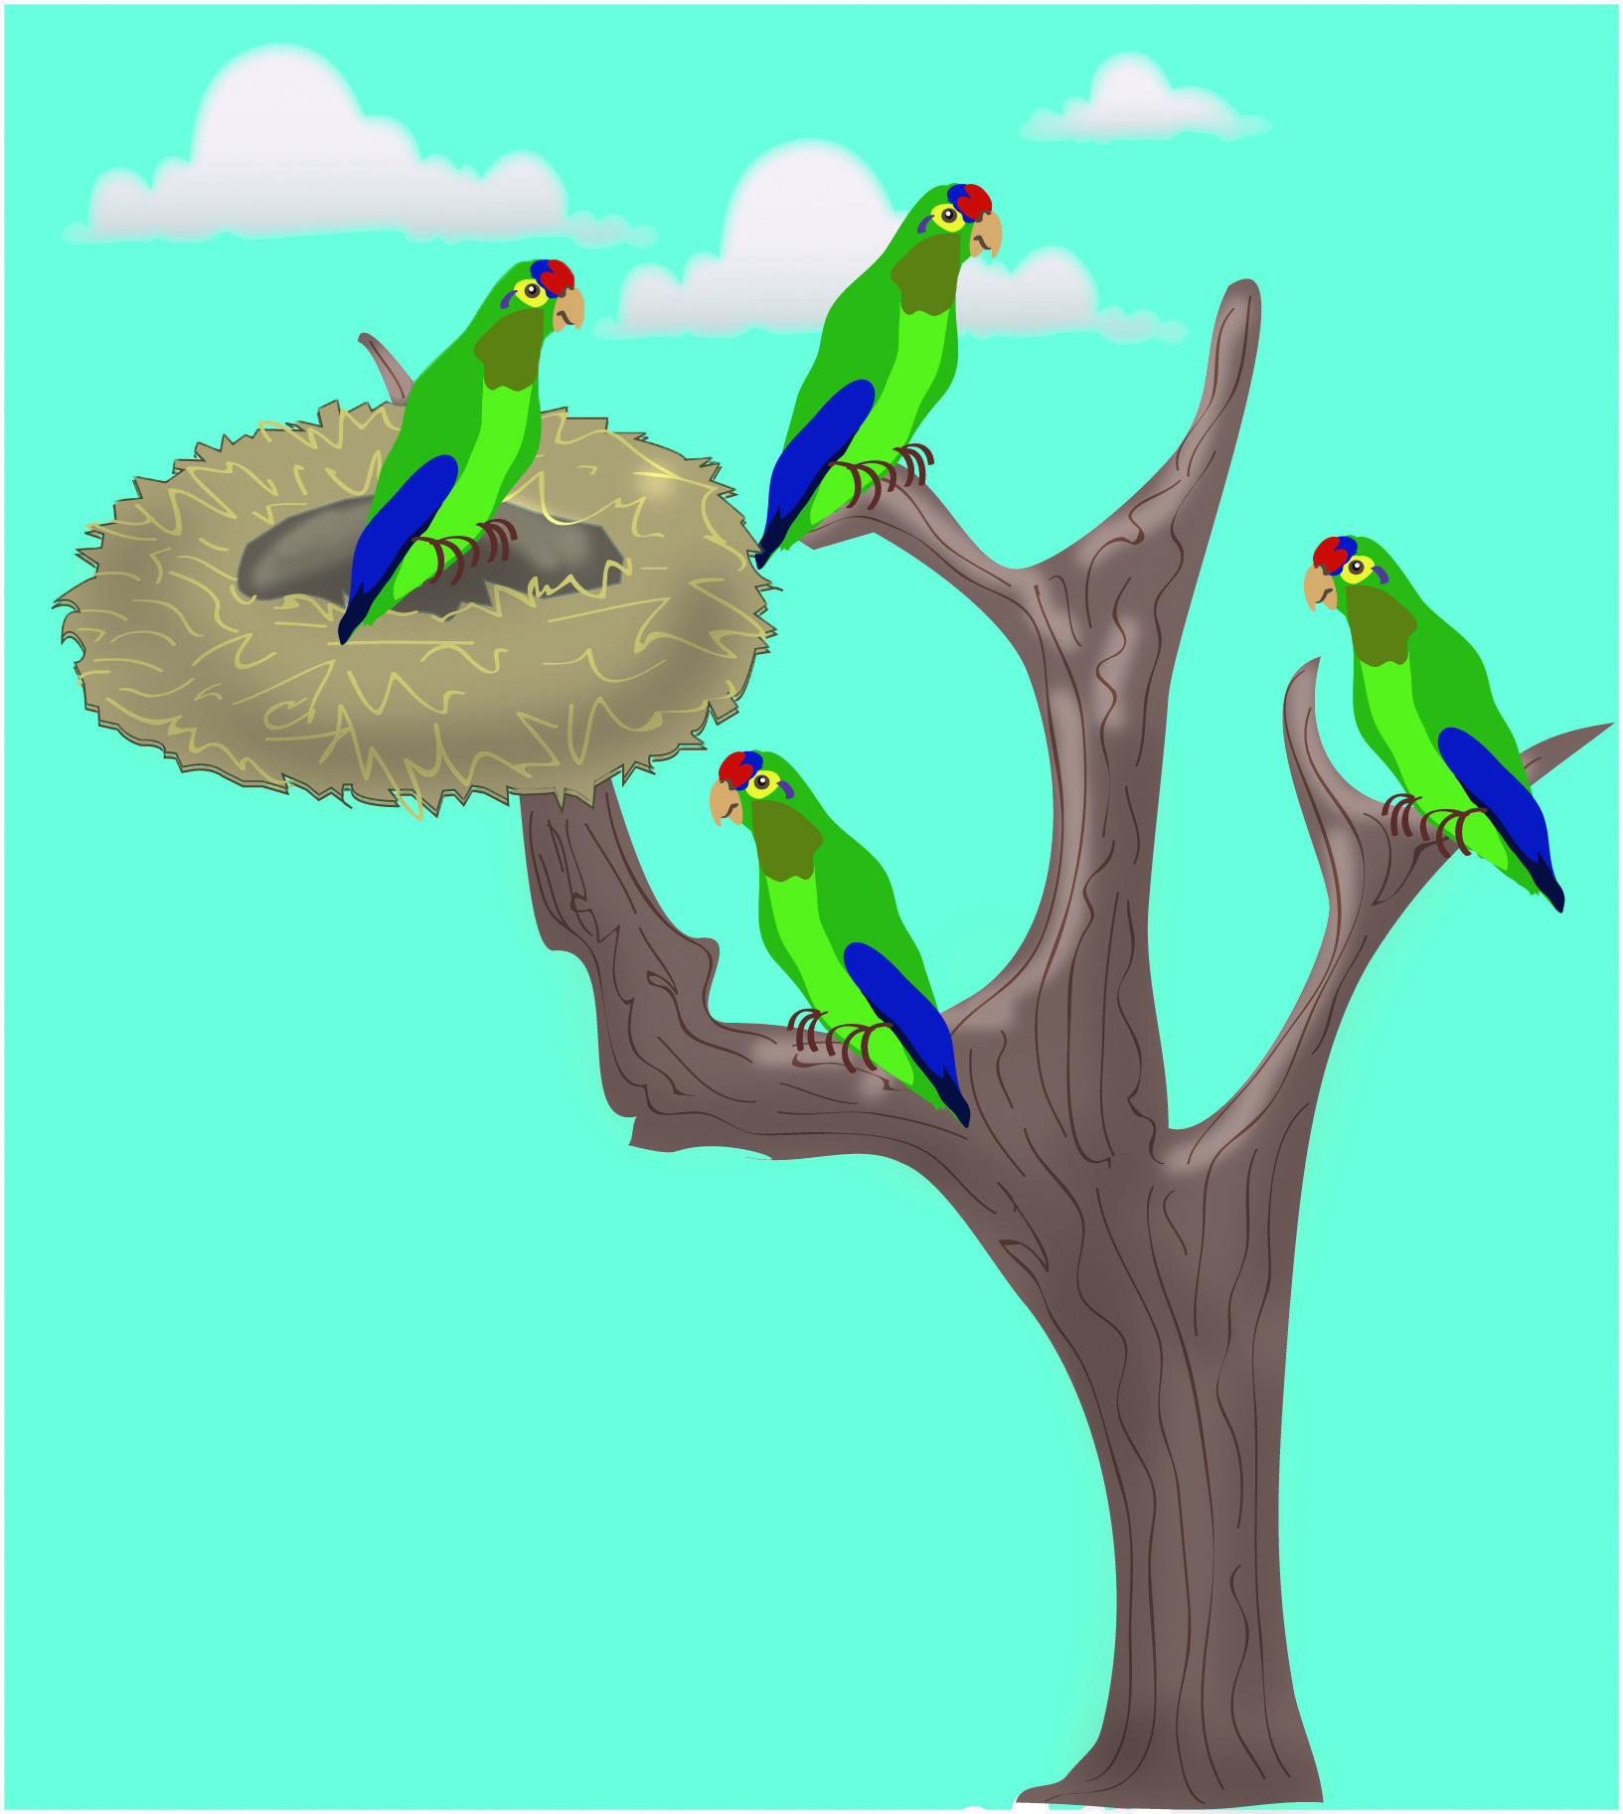
Scenario of use (Care-Me)
Periquito curro
Notes:
La Sra Ana se encuentra en su sala buscando el control remoto de su televisión, cuando escucha que sus pericos han aprendido una de sus frases favoritas «Periquito curro»

Slide 34
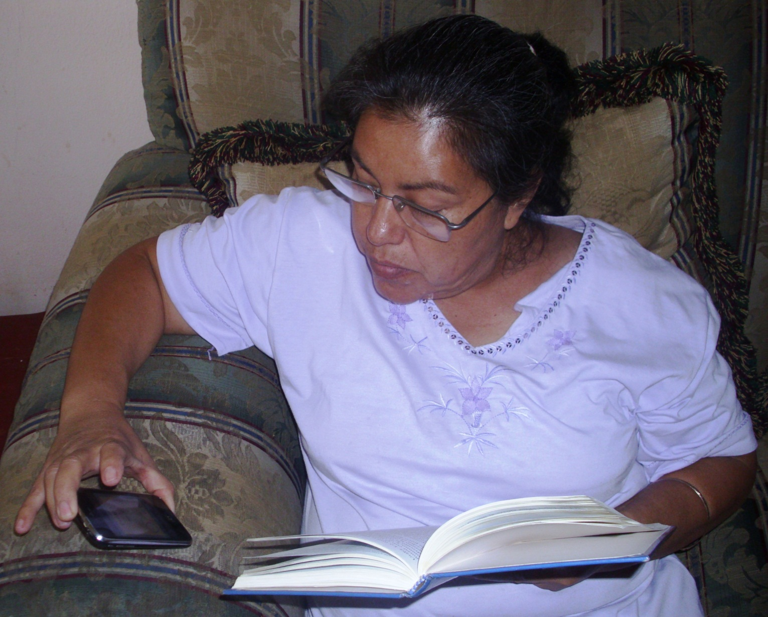
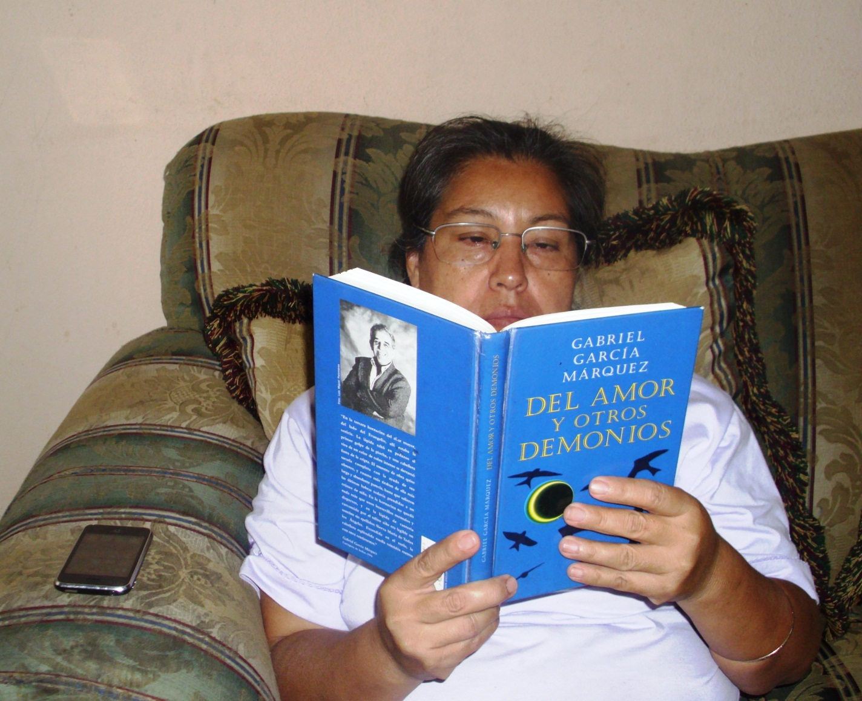
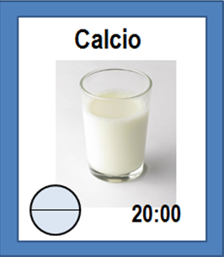
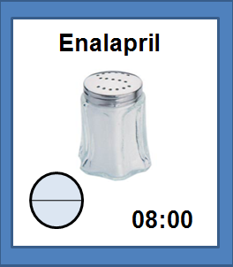

Scenario of use (Remind-Me)
21:00
La Sra. Ana leyendo su novela
34
Notes:
Decide continuar con su lectura. Sin embargo una hora mas tarde, el sistema Remind-Me le recuerda que debe tomar el medicamento para

Slide 35
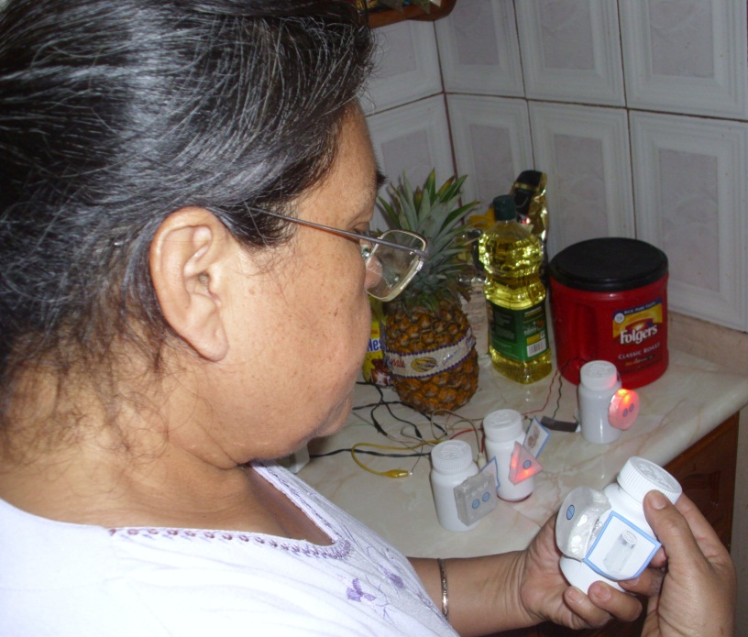
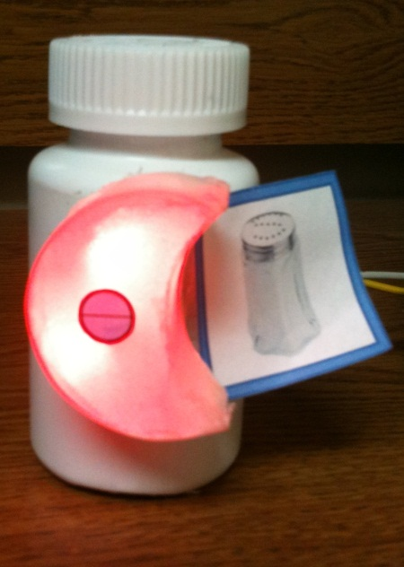
Scenario of use (GUIDE-Me)
Notes:
Después toma el medicamento con la interfaz lunar, se da cuenta que es el medicamento que recientemente le recetaron para controla su presión arterial, por lo que observa la interfaz para conocer cuantas pastillas debe tomar de su segunda dosis del día.

Slide 36
Heuristic Evaluation
Objective:
  Identify usability problems
  Design recomendations
  Validate design dimensions
17 Inspectors:
  5 Domain Experts (DE): Elderly healthcare specialists
  7 Novice Experts (NE): Computer Engineering or Master Degree in Computer Science
  5 Advanced Experts (AE): kwnoledge on usability engineering; C.Sc. Doctoral students

Slide 37
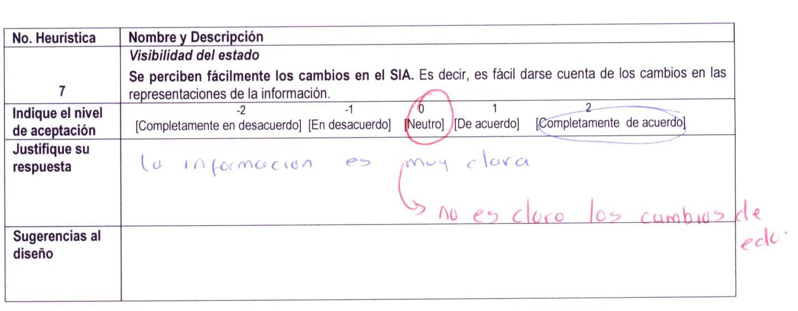
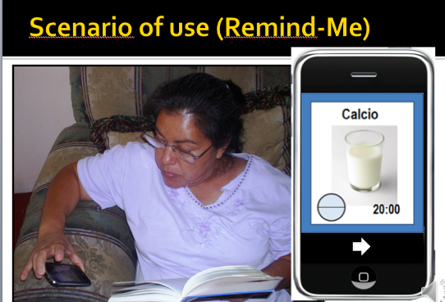
Heuristic Evaluation Steps
Introduce
evaluation
Explanation
of the systems
Individual
Inspection
Group
Discussion
Feature check list (Mankoff 03):
C1- Useful and relevant information
C2- Peripherality
C3- Match between system and
real world
C4- Sufficient information design
C5- Consistent and intuitive mapping
C6- Easy transition
C7- Visibility of status
C8- Aesthetic and pleasing design
C9- Strategy to assist
C10- Target object of the AIS
Discussion of:
  Usability problems
  Recommendations
  Barriers elders face to adopt systems
Notes:
We carried out an inspection review based on the feature inspection method [11] in which experts, with different backgrounds and level of expertise, checked if the ambient information systems conform with a set of features. Seventeen experts (17) participated in the evaluation: seven of them (7/17), who had a master degree or were graduate students in Computer Science, were categorized as novice experts (N); five (5/17) were advanced experts (E) since they were PhD students or researchers in Computer Science working in projects related in HCI and Ubiquitous Computing; and finally, five (5/17) were medical doctors and researchers in Geriatrics who were categorized as domain experts (G). Thus, domain experts can be users representatives, since they know the elders’ needs and problems for medicating and for interacting with the proposed computer-based systems.
In this inspection method the evaluator has simply look through the system whether the features on a checklist are available or not. Thus, the method is simpler than other inspection methods (i.e heuristic evaluations) since the evaluator does not have to use or develop any metrics while testing. Additionally, this method enabled us to collect qualitative and quantitative data to identify design issues of the AIS and to assess the design attributes we presented in Table 1. We designed a feature checklist based on the design principles for ambient displays proposed by Mankoff et al [12] and incorporated some of our proposed design dimensions that we considered were not directly validated with these design principles, such as the object target used for embedded the AIS.
----
Our motivation to design AIS that support the elders independent living
Present a scenario of use of each AIS
Specify an acceptance level on each design feature by using a 5 point-Likert scale (-2 to 2)
Discussion session

Slide 38

Usability Problems: Care-Me
Frecuency | Problem
12/17 | Dificulty for perceiving changes on the parakeets; therefore it is not easy to associate the parakeets behavior with the elderly medication compliance.
DE5(0)-C6: “Identifying the multiple levels of growth is difficult for the patients”
AE1-C5-R: “Include other parakeet behaviour characteristics: such as emotions, make the parakeet seem seek”
3 2 1 0
Growth levels

Slide 39
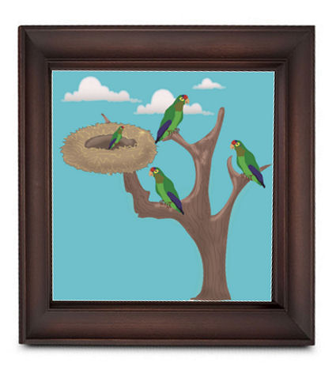
Usability Problems: Care-Me
Frecuency | Problem
5/17 | It is difficult to identify the medication week represented by each parakeet.
AE5(0)-C6: “It will not be easy for an older adult to identify in which week he correctly or incorrectly take his medications”
AE1-C1-R: “use different colors for each parakeet”

Slide 40
Usability Problems: Care-Me
DE2(1)-C1: “It would be useful and more relevant to provide explicit information indicating the medicines taken and not taken, and schedules”
Frecuency | Problem
5/17 | The system should provide feedback when taken or omitted the taken of the medication.
6/17 | The system should provide reinforcements daily.
DE4-C4-D: “elders need to receive an immediate reinforcement associated with their actions…”
DE1-C5-D: “Provide personalized feedback: ¡Arthur, you did it; “…based on the compliance situation”

Slide 41
Usability Problems: Remind-Me
Frecuency | Problem
7/17 | Using images of food, may cause elderly associate them with medication instructions, instead of associating it with the health problem.
DE4-D: “… the salt image may confuse al older adult; he may think that ir is time to consume salt”
Enalapril
AE3-C5-R: “I suggest to modify the image to include a symbol to indicate if it is a recommended or restricted food”
20:00

Slide 42
Usability Problems: Remind-Me
Frecuency | Problem
5/17 | Using high frequency auditory notification, may not be perceived by older adults.
3/17 | The system does not makes elders aware about thei medication complizance.
DE1-C3-D: “some elder’s present presbycusis, loss of ability to perceive high frequency sounds or distinguish between tones, therefore they may not distinguihed this auditory notifications”
AE3(0)-C6-D: “The system does not allow to get additional information sbout my medication compliance”.

Slide 43
Usability Problems: Guide-Me
Frecuency | Problem
13/16 | Asociate the geometric figures with the medication frequency is a complex task.
8/16 | The system design is not pleasant
6/16 | Interpreting the meaning of the highlited sides is a complex task
4/16 | The luminosity intensity of the sides, may not be perceived by older adults

Slide 44
Recommendations
CARE-Me should reinforce the elders’ behavior towards the activity.
  It is important to represent more detailed and additional information (Sufficient information, C4=0.81; Easy transition, C6=0.52)
  Daily representations of the medication compliance and present instructions for medicating (12/17).
  Daily rewards instead of weekly: parakeets notify appropriate and inappropriate behavior (5/17).
Notes:
This attribute refers to provide information to enable elders to reinforce their learnability regarding of how to carry out a complex activity

Slide 45
Recommendations
Remind-Me is appropriate to demand elders to timely execute an important activity.
  Audio alerts demand elders to timely execute an activity (11/17) (Peripherality, C2=-0.17)
  Mobile devices aren’t common objects used by elders (Harmony with the environment, C3=0.99), however elders may get used to take them anywhere (13/17).
  Information is sufficient and relevant (C4=1.24), but (9/17) some experts suggested to provide elders with additional information (i.e pre-conditions)

Slide 46
Recommendations
Tuning of ambient information to elders’ perceptual characteristics.
  Adjust the fidelity of information representation (metaphors) and notification modality (auditory).
  6/17 evaluators (all geriatricians) stated that the parakeet whistle may be unpleasant and not easily heard.
  The AIS should not be in highly harmony with the elders environment to avoid they stop perceiving the ambient information (2 advanced experts).
  Include the elder’s name in the rewards phrases: to grasp her attention and open a trust linkage (all geriatricians)
Notes:
Tuning the ambient information to elders’ perceptual characteristics was identified as a result of the evaluation.
Fidelity of information representation and Modality of notification [2]. The Representation of fidelity attribute refers to providing information that is easy to read and interpret “at glance”; to reach this end, designers should use semiotics language, such as iconic signs which have some similarity with the represented information object, i.e. metaphors, and indexical signs which are highly related to the information to communicate. The Modality of notification attribute refers to how information is presented to be perceived through any of the human senses,
Six (6/17) evaluators (which included all geriatric specialists) stated that the parakeet whistle may be unpleasant and not easily heard by some elders. Evaluators suggested using low frequency sounds for providing notifications, since the elders’ ability to hear simple tones shows reliable age declines. A discussion of two (2) advanced experts centered in that AIS should not be designed to be in highly harmony with the elders environment in order to avoid that elders stop of perceiving the ambient information that devices provide to assist them, in a similar way in which we stop of perceiving some of the sounds of our home environment, such as the meowing of a cat. Additionally, the geriatrics specialists suggested including the name of the elder in the rewards phrases which may have twofold advantages: to grasp the elders’ attentions and to open a trust linkage between the elder and her AIS.

Slide 47
Recommendations
Basic objects used to guide the activity, should present enough information to influence elders to carry out a current action adequately.
C1- Useful and relevant information
C2- Peripherality
C3- Match between system and
real world
C4- Sufficient information design
C5- Consistent and intuitive mapping
C6- Easy transition
C7- Visibitily of status
C8- Aesthetic and pleasing design
C9- Strategy to assist
C10- Target object of the AIS
GUIDE-Me

Slide 48
Design Dimensions
Strategy to assist:
  P1- Remember to take their medicines by timely making elderly aware of taking them
  P2- Guide medication intake by providing the necessary information to properly perform the medication routine
  P3- Motivating elders not to leave their medication by encouraging them to take their medicines and not to interrupt the recommended therapy
Notes:
Strategy to assist It refers to the strategies that are useful to help elderly to take their medicines: 1) Re- member to take their medicines by timely making elderly aware of taking them; 2) Guide medication intake by providing elderly with the necessary infor- mation to properly perform the medication routine (e.g. medicine name and doses); 3) Motivating elders not to leave their medication by encouraging them to take their medicines and not to interrupt the recom- mended pharmacological therapy.

Slide 49
Design Dimensions
Activity orientation:
  P4- Demand to execute an activity through a stimulus and critical information that indicate the importance of performing the activity
  P5- Make elders aware of critical information to complete properly their medication
  P6- Provide daily reinforcement to motivate elders to medicate routinely
  P7- Provide immediate feedback to make elders aware about the medication success or failure
Notes:
Activity orientation It refers to the kind of informa- tion that AIS should provide to assist elders to start and perform their medication intake, as well as, to motivate them not to leave their medication. In this direction, the following design principles were pro- posed: 1) Demand to execute an activity through a stimulus and critical information that indicate the importance of performing the activity; 2) Make eld- ers aware of critical information to perform properly their medication; 3) Provide daily reinforcement to motivate elders to medicate routinely; and 4) Provide immediate feedback to make elders aware about the success or failure on taking the medicines.

Slide 50
Design Dimensions
Tuning ambient information
  P8- Auditory notifications should be adjusted to the frequency range in which elders hear (presbycusis)
  P9- Use pictograms to express the rules to follow for medicating. They are stylized figurative drawings that refer directly to an object to communicate.
  P10- Using visual metaphors to raise awareness about medication compliance; e.g. metaphors based on the care of pets or plants to provide immediate feedback and daily reinforcements on medication compliance.
Notes:
Tuning ambient information. To develop AIS to be easy to use by elders, the changes associated with their perceptual and cognitive capabilities must be considered. These changes affect the elder’s ability to detect, interpret and respond appropriately to infor- mation provided by the system. The following three design principles were proposed to provide design recommendations for using auditory and visual mod- alities to represent information that is critical for me- dicating: 1) Using an auditory modality to remember medicate. Auditory notifications should be adjusted
to the frequency range in which elders can hear, be- cause some elder’s present presbycusis, loss of abili- ty to perceive high frequency sounds or distinguish between tones; 2) Using visual modalities to guide medication. Use pictograms to express the rules to follow for taking medicines, since they are stylized figurative drawings that refer directly to an object or idea to communicate, and are characterized by being easy to perceive, interpret and understand compared with texts; and 3) Using visual metaphors to raise awareness about medication compliance. For in- stance, it is recommended using metaphors based on the care of pets or plants to provide immediate feed- back and daily reinforcements on medication com- pliance. These kinds of metaphors are considered therapeutic treatments, which bring multiple health benefits, such as improving the emotional state, cog- nitive ability and reduced loneliness of the elderly.

Slide 51
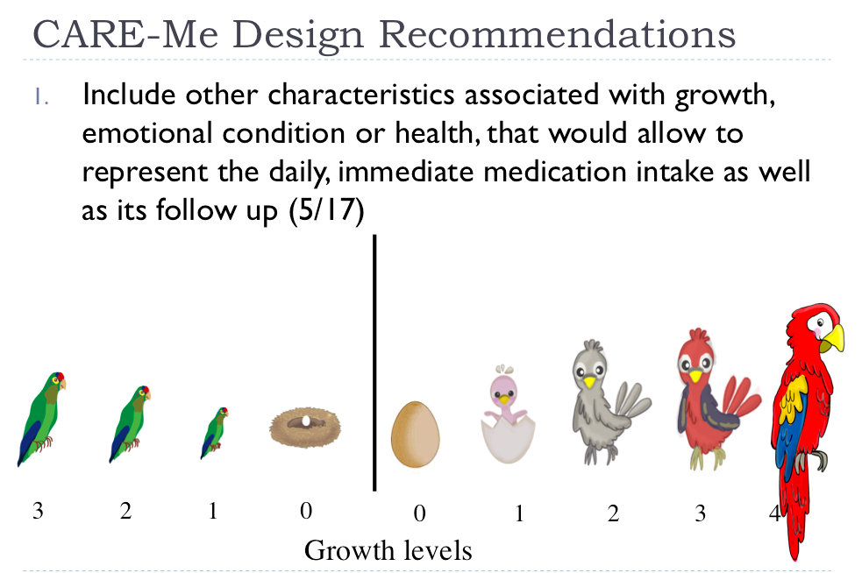
AIS Design Modifications

Slide 52
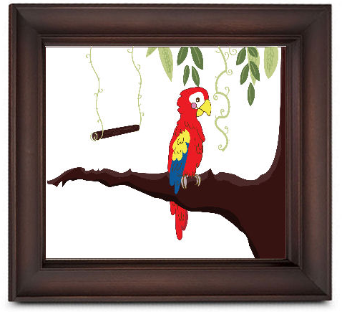
AIS Design Modifications
CARE-Me | Enhanced Design
Recompensa
Semanal
Immedate Reinforcement

Slide 53


AIS Design Modifications
Remind-Me | Enhanced Design

Slide 54
Utility of the Design Principles
Guide the design
Evaluate a design
Clasify systems
Identify design patterns
Characterize systems by using the Design Dimensions proposed
Notes:
Los principios de diseño no solo permiten guiar el diseño de un sistema, sino también han sido utilizados en evaluaciones, ya sea para identificar problemas de usabilidad [22], para clasificar sistemas de acuerdo a sus características e incluso para identificar patrones de diseño [15].
Quiere decir que realizar cualesquiera de estas actividades, me ayudaría a validar los principios de diseño. Consideremos que todas estas indican requieren que proveamos evidencia (analisys cualitativo) indicando como cada sistema seleccionado cumple con estos principios.

Slide 55



Analisis of Vitally-Glowcaps
Stratey to assist:
P1- Remember to take their medicines:
Escalating alets
2 hr. window
P2- Guide medication
Indicate which medicine to take by emphasizing the cap
P3- Motivate elders not to leave their medication
“Social feedback” : reports can be accessed by the elder’s
social care network
Activity Orientation:
P4- Demand to medicate through a stimulus and critical information:
Use of different ambient modalities: lights, sounds
Increment the intensity of reminders
P5- Make elders aware of critical information to complete the medication
Only indicate which medicine to take by emphasizing the cap
P6- Provide daily reinforcement
Do not provide daily reinforcement
P7- Provide immediate feedback
Phone calls only when he missed to take the medicine
Tuning ambient information
  P8- Auditory notifications should be adjusted (presbycusis)
  P9- Use pictograms to express the rules to follow for medicating.
  P10- Using visual metaphors to raise awareness about
  medication compliance
  * Tuning of the intensity of alerts to not disturb the patient.
Notes:
P1- Remember to take their medicines by timely making elderly aware of taking them
P2- Guide medication intake by providing the necessary information to properly perform the medication routine
P3- Motivating elders not to leave their medication by encouraging them to take their medicines and not to interrupt the recommended therapy
Activity orientation:
P4- Demand to execute an activity through a stimulus and critical information that indicate the importance of performing the activity
P5- Make elders aware of critical information to complete properly their medication
P6- Provide daily reinforcement to motivate elders to medicate routinely
P7- Provide immediate feedback to make elders aware about the medication success or failure
Tuning ambient information
P8- Auditory notifications should be adjusted to the frequency range in which elders hear (presbycusis)
P9- Use pictograms to express the rules to follow for medicating. They are stylized figurative drawings that refer directly to an object to communicate.
P10- Using visual metaphors to raise awareness about medication compliance; e.g. metaphors based on the care of pets or plants to provide immediate feedback and daily reinforcements on medication compliance.
Sin embargo, se identificó que el sistema soporta el ajuste de la intensidad de las alertas, consistiendo en proveer recordatorios que varían de lo sutil a lo insistente. Esto con el propósito de no molestar al paciente con recordatorios innecesarios o por el contrario, demandarle que ejecute la actividad.

Slide 56
Current and Future Work
Systematic Review:
Conduct a systematic review to select relevant technologies that enable to validate the design dimensions of AIS

Slide 57
Research question and objectives
¿What are the design principles recommended to follow for developing technologies that support medication adherence?
Objectives:
  Identify how these technologies address the design dimensions we proposed for AIS.
  Identify additional design attributes

Slide 58
Inclusion and exclusion criteria
Journal, and Conference proceedings papers (we will exclude work in progress papers: workshops, posters, doctoral symposium)
Report an evaluation of the technology
Report technology design/functionality
Commercial available products*

Slide 59
Data Bases Selection
PubMed Central – includes NLM Catalog, NCBI databases, MEDLINE, and uses MeSH (Medical Subject Headings).
ACM – enables to search conferences and journals from IEEE, Springer, and other relevant editorials (i.e. Elsevier)
It will enable us not retrieve several instances of the same paper.
Notes:
PubMed Central (PMC) is the U.S. National Institutes of Health (NIH) free digital archive of biomedical and life sciences journal literature.
The NLM Catalog includes information about the journals in PubMed and the other NCBI databases[1]. MEDLINE database is directly searchable from NLM as a subset of the PubMed®.

Slide 60
Criteria for meta-analysis
% of papers retrieved
Type of technology approach used (mobile devices, electronic containers, web tech., etc)
Type of strategy supported
Group age
Type of evaluation (usability, effectivity)

Slide 61
Selection steps
714 Citations identified by initial electronic search
575 Articles excluded
(do not report technology to assist medication; work in progress)
139 Citations kept
13 Commercial products sold for elderly.
Selected from:
2 Articles duplicated were excluded
5 Products excluded:
4 duplicated
1 was an accesory
Articles to analyse
(meta-analysis)
? Articles excluded
? No containing description of technology
? No reporting evaluation
8 Commercial products
? Systems to review to identify design principles

Slide 62
Conclusions
Suggestion 1: Carry out at the beginning of your research a literature review based on a systematic review.
Suggestion 2: Carry out the inspection first with Domain Experts, then with HCI Experts
It is complex to identify “design principles”, there are no ideal or standard methodology

Slide 63

Persuasive Strategies for Motivating Elders to Exercise
Instructor:
Marcela D. Rodríguez (UABC, México)
marcerod@uabc.edu.mx

Slide 64
Motivation
Encouraging people to exercise has been a major challenge over the years.
Elderly who exercise on a regular basis obtain many benefits:
  to perform their daily activities
  maintain their independence
  improve their self-esteem and relationships
Notes:
- It has been identified that encouraging people to develop positive attitudes about exercise, and promoting long-term exercise has been a major challenge over the years.
- It is well known that Older adults who adopt an exercise routine obtain many benefits since they are not only able to cope with chronic diseases, but to stay strong and fit enough to perform their activities of daily living, maintain their independence, and improve their self-esteem and social relationships since exercising offers them opportunities to be with friends and family.

Slide 65




Background and Related Work
  Design strategies for persuading:
  Representations of exercise routines compliance
  Awareness of the impact of their behavior
  Reinforcements
  Support the user’s personal style
  Competition that promotes socialization
PLAY, MATE!
[Berkovsky, S. et al 2010]
Ubifit Garden
[Consolvo et al 2009]
Flowie
[Merino I. et al, 2009]
Fish n Steps
[James J. et al 2006]
Notes:
Based on psychological and behavioral theories, some strategies have been identified for designing effective persuasive technologies that encourage people to adopt healthy lifestyle habits. Some works have adopted these strategies, which include:
Abstract representations of the compliance of the physical activity routines and providing awareness of the impact of their behavior on their health,
Rewards as incentives for positive behavior, or by punishing negative behavior,
Addressing the aesthetic aspect of the technology that has to support the user’s personal style,
and games in which players compete to reach healthy goals.
are: providing positive reinforcements to encourage change
To implement the design strategies for persuasive technologies to motivate elders to exercise, we need to take into account the needs and problems they have for exercising, and the factors that negatively and positively may impact on their motivation. Additionally, we have to consider that designing appropriate awareness mechanisms for elderly could be challenging since their perceptual levels may have decreased. And, independent elders prefer products that match their aesthetic desires and that support their functional needs and independence,

Slide 66
Background and Related Work
Challenges to implement these design strategies for motivating elders to exercise:
  understand the needs and problems they have for exercising,
  identify the factors that negatively and positively may impact on their motivation.
  design appropriate awareness mechanisms according to their perceptual levels
  independent elders prefer products that match their aesthetic desires and functional needs.
Notes:
To implement the design strategies for persuasive technologies to motivate elders to exercise, we need to take into account the needs and problems they have for exercising, and the factors that negatively and positively may impact on their motivation. Additionally, we have to consider that designing appropriate awareness mechanisms for elderly could be challenging since their perceptual levels may have decreased. And, that independent elders prefer products that match their aesthetic desires and that support their functional needs.,

Slide 67
Proposal
Identify how the persuasion strategies for exercising should be adapted for the elderly.
Case study: Identify barriers and motivators to start and maintain a physical activity.
Design: Mobile Ambient Information System to motivate elders to exercise by requiring minimal cognitive effort.
Evaluation: Validate the design strategies.
Notes:
- Our aim is to identify how some of these persuasion strategies should be adapted for the elderly through AIS, which are pleasing applications that provide representations of relevant information that are easy to comprehend, and that can work as i) Peripheral displays by allowing users to monitor information without burdening them; and as ii) Notification Systems that delivers valuable information without introducing unwanted interruptions to a primary tasks.
- To reach our goal we have carried out a case study to identify barriers and motivators to maintaing a physical activity.
- And we have designed and evaluated a mobile AIS that requires minimal attention and cognitive effort from older adults to make them aware of relevant information that motivates them to exercise.

Slide 68

Case study
40 minutes semi-structured interviews
10 female and non frail adults
5 active, 5 passive
Notes:
We carried out 40 minutes semi-structured interviews with ten (10) female and non-frail adults, ranging in age from 55 to 77 years old. Only elderly women participated in this study, since the invited male elders refused our invitation to participate. Five (5/10) of these participants, were categorized as active elders (AE) because they regularly carried out a physical activity (as presented in Table 1, all of them had a walking routine), and the other five (5/10) who did not regularly exercise, were categorized as passive elders (PE).
Older adults provided information that enabled us to identify some of the factors that may motivate or impede their carrying out their physical activity, and to understand how being active or passive impacts their social relationships since it has been found that social relations integral to the exercise environment are significant determinants of well-being in older adults.

Slide 69
Case study results
Staying healthy is the main motivation of active elders (5/5)
  Coping with depression episodes (1/5)
Passive elders mentioned different reasons for not being able to exercise on a regular basis.
  It is difficult to get the habit of exercising (1/5)
  The lack of social support for exercising in late life is a key barrier among older (1/5)
Notes:
- Staying healthy is the main motivation of active elders (5/5)
- passive elders mentioned different reasons for not being able to exercise on a regular basis. One (1/5) stated that for her it is difficult to get the habit of exercising, and another one (1/5) mentioned that she does not like to walk alone. In this same sense, studies show that a lack of social support for exercising in late life is a key barrier among older [20]

Slide 70

Case study results
Active elders (a) have a more extended social network than passive elders (b).
Notes:
Finally, we identified that exercising impacts positively on the elders’ active and social life. All active elders had a social network associated to their physical activities, resulting in having a more extended social network than passive elders. This is due active elders are prone to carry out activities that enable them to interact with relatives and friends (4/5); while passive elders (5/5) participate in activities in which mainly their relatives are involved.
For instance, Fig. 1a) shows that active elder AE1, who is 61 years old, regularly takes a walk and attends a nutritional and social clubs for elders, which enable her to interact with friends. And the social network of passive elder PE1 (see Fig. 1b) depicts that she occasionally carries out activities in which she interacts with friends; however, these activities do not involve an exercise routine.

Slide 71
Design strategies of CAMMInA
Abstraction: Metaphor based on gaining virtual coins interchangeable for time for accessing games.
Triggers: daily reminders and time-based notifications to reach an exercising goal.
Notes:
- Abstraction, refers to provide abstract representations based on metaphors that increases the users consciousness about the impact of adopting healthy habits. Thus, we propose to use metaphors to represent the elders’ exercising compliance and to make them aware about the different benefits of exercising for their health through virtual coins.
Triggers: . Which are defined as alerts that should be presented to users at a moment they can perform the behavior. In this case, triggers are provided as reminders for starting the exercise routine when there is a proposed goal; and as notifications that will be provided while the elder is exercising, this with the aim to make her aware about how close she is of reaching the proposed exercising goal.

Slide 72

Design strategies of CAMMInA
Historical information and reflection: representation of the complied, and planned exercising goals.
Positive and playful reinforcement: rewards that do not make them feel punished, and promote socialization.
Notes:
Historical information and reflection, the persuasive technology should be designed to help the individual to remain focused on her commitment to change by providing her with awareness of her past behavior. To promote elders’ reflection of past and future behavior, we decided to provide a three-week representation of the complied, current and planned exercising goals through a calendar that presents the coins earned..
Finally, the system should provide Positive and playful reinforcement in order for the users perform the desired behavior. That is, they should be rewarded; on the contrary, they should not receive rewards or information that makes them feel punished. To adapt this strategy to the elderly, we decided to use the metaphor of rewarding elders with virtual coins, which could be used to play their favorite games for a period of time, Thus, the CAMMInA system provides elders with different accessing levels that limit the time for playing a set of games that they in advance associate with this application on their mobile phones. We identified up to five levels of benefits (rewards) that elders might get based on their motivation for exercising. These levels can be inferred by interpreting the three-week calendar. And the benefits include providing limited time (level 0) up to providing unlimited time (level 5) for playing games. For instance, based on the first week of the calendar, the CAMMInA system determines that the elder is partially motivated (level 3), and grants the corresponding benefits based on time for accessing games.

Slide 73
Evaluation
A formative evaluation to obtain the elders’
  perception regarding the effectiveness of the system’s persuasion strategies, and
  assessing the users’ interruption, reaction and comprehension.
One-day evaluation with 15 persons (63 to 86 years old).
We observed and interviewed the participants.
Notes:
- We carried out an evaluation to identify how elders perceived the system persuasion strategies. To reach this end, we evaluated the users interruption, reaction and comprehension of the different triggers providing for encouraging elders to reach their exercising goals. These have been identified as critical aspects that enable designers to measure the effectiveness of ambient notification systems.
Fifteen (15) persons, ranging in age from 63 to 86 years old, were trained to use the system while they were in a club one session day, during We observed, and than interviewed the participants about their perception, reaction and comprehension of the notifications

Slide 74
Results: validating the strategies
Abstraction. The metaphor was well accepted by all of them:
  enjoyed to track their goals( 6/15)
  like to obtain “gold coins or diamonds” (6/15)
  wearing the device, which “[it] is modern” (3/15)
Historical information & reflection. Participants (11/15) emphasized the calendar was useful to realize if they pursued or have proposed goals:
  “... Realizing that I did not exercise one day, it would make me to effort for the next day”.
Notes:
Abstraction. The metaphor used, based on providing coins to represent the compliance of their exercise routine, was well accepted by the elderly, since they commented that the functionalities they most enjoyed were: being able to track their goals and monitor the duration of their exercise routine (commented by 6/15 elders); realizing when they get “gold coins or diamonds” (said by 6/15); wearing the device, which “[it] is modern” (3/15).
- Historical information and reflection. Most of the participants (11/15) emphasized that the calendar was useful, since it helps them realize if they pursued their goals or if they have proposed goals, which may improve their motivation for continuing exercising:
“…. I would like to get just gold coins…. Realizing that I did not exercise one day, it would make me to effort for the next day”.

Slide 75
Results: validating the strategies
Trigger. The notifications are easy to comprehend, but the ambient noise may impede they were perceived:
  Half of the participants (8/15) perceived the audible notifications,
  However, we noticed that some participants (7/15) observed it while exercising.
Positive and playful reinforcement. Receiving access time to play games would be fun and a useful reward for motivating them (9/15).
Notes:
However, we observed that some participants (7/15) showed interest in the system, since they observed it while exercising
Positive and playful reinforcement. Nine of the elders considered that receiving access time to play games would be a useful reward for motivating them to maintain their exercise routine, since this may enable them to have fun.

Slide 76
Lessons learned
Playing games may be not an adequate motivational factor for elderly (12/15)
  5 participants suggested to use other type of rewards regarding to manage their health
  “I would like to get permission to eat food restricted to consume by my physician”; “…a desert”; “a free consultation with a nutritionist”
  7 would like to receive rewards that promote socialization out of their homes:
  “…But I would like to win trips as rewards.”; “…, going out or a meeting with friends”
Notes:
However, most of the participants suggested to use other type of rewards. These proposals could be categorized as:
a) Suggestions for healthy eating, including permission to consume food restricted by their medical doctors, as suggested by five (5/15) participants. Their comments include:
“I would like to get permission to eat food restricted to consume by my physician”; “…a desert”; “a free consultation with a nutritionist”
b) Rewards that promote socialization out of their homes. It was interested to hear the elders (7/15) suggestions that show their need of receiving rewards that in different ways promote their social interaction:
“…Improving my quality of life is my main motivation…. But I would like to win trips as rewards
“…going to a real casino, going out or a meeting with friends”

Slide 77
Lessons learned
Visualizing the goals that were not pursued were perceived (3/15), as a factor that may negatively impact their motivation
  “[I would like the system to] eliminate copper coins, since they are negative…”; “… copper coins”;
  “…I would like to see just gold coins”.
Notes:
Visualizing the goals (copper coins) that were not pursued during the past days were perceived by some elders (2/15) as a factor that may negatively impact their motivation:
“[I would like the system to] eliminate copper coins, since they are negative…”; “… copper coins”;
“…I would like to see just gold coins”.
Furthermore, some participants (5/15) also suggested that the system should present specific information regarding their exercising routine, such as, calories burned, the type of exercise that they carried out (i.e. walking, jogging) and the time spent on it:
“…. emphasizing the time that I exercised and when I did high or low intensity workout.
“ ….indicating which type of exercise I have to do and how it helps me [for my health]”

Slide 78
Conclusions
We understood that one of the main motivators for exercising is to have the opportunity to extend their current social network.
They perceived that providing representations of the compliance of their short-term goals was useful; however.
We also identified that they perceived as negative feedback to be informed of the proposed goals that were not pursued.
Notes:
We understood that one of the main motivators for exercising is that they have the opportunity, and are willing, to extend their current social network since they proposed the system provides them with rewards to participate in social activities. They perceived that providing representations of the compliance of their short-term goals was useful; however, we also identified that they perceived as negative feedback to be informed of the proposed goals that were not pursued. As future work, we plan to evaluate the efficacy of the persuasive strategies of CAMMINA to change the motivation levels of elderly; to reach this end, we will redesign CAMMINA by taking into account the results presented in this paper

Slide 79
Using Expert Knowledge to Inform the Design of Ambient Healthcare Applications
Marcela D. Rodríguez
Autonomous University of Baja California, UABC, Mexicali, México
marcerod@uabc.edu.mx

Slide 80
Evaluation Results
CARE-Me
Remind-Me
NA
GUIDE-Me
C1- Useful and relvant information
C2- Peripherality
C3- Match between system and
real world
C4- Sufficient information design
C5- Consistent and intuitive mapping
C6- Easy transition
C7- Visibitily of status
C8- Aesthetic and pleasing design
C9- Strategy to assist
C10- Target object of the AIS
Notes:
Presenting useful and relevant information (H1), Peripherality of the AIS (H2), Match between system and real world (H3), Sufficient information design (H4), Consistent and intuitive mapping (H5), Easy transition to more in-depth information (H6), Visibility of status (H7), Aesthetic and pleasing design (H8), Strategy to assist (H9), Object target of the AIS.

Slide 81
Resultados
Instructor:
Marcela D. Rodríguez
Universidad Autónoma de Baja California
Facultad de Ingeniería
Posgrado MyDCI, área Computación

Slide 82

Problemas de Usabilidad (1/2)

Slide 83


Problemas de Usabilidad (2/2)

Slide 84
Recomendaciones de diseño (1/2)

Slide 85

Recomendaciones de diseño (2/2)

