Slide 1
Tracking & fall detection using omnidirectional cameras
Lale Akarun
Boğaziçi University Computer Engineering

Slide 2
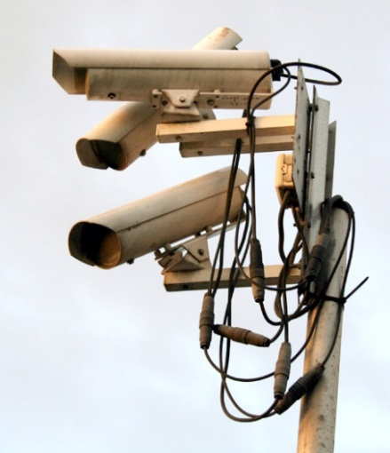
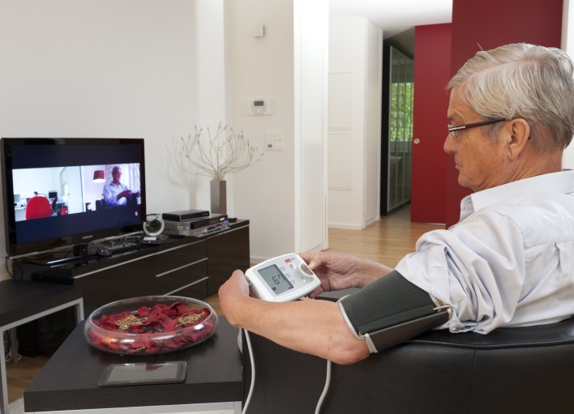
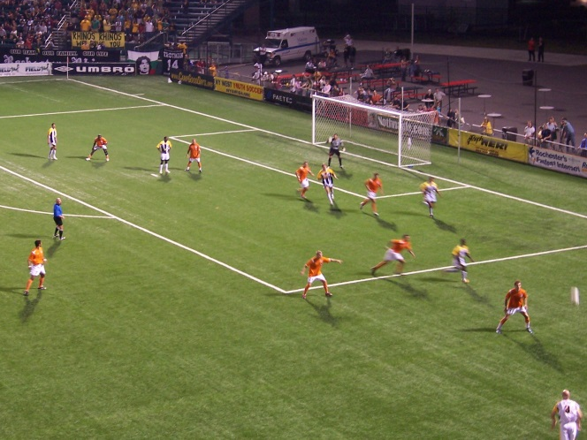
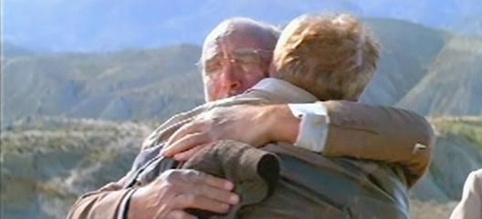
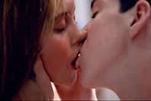
Introduction - Applications
Surveillance
Ambient living
Retail store
Sports match
Content based video retrieval

Slide 3
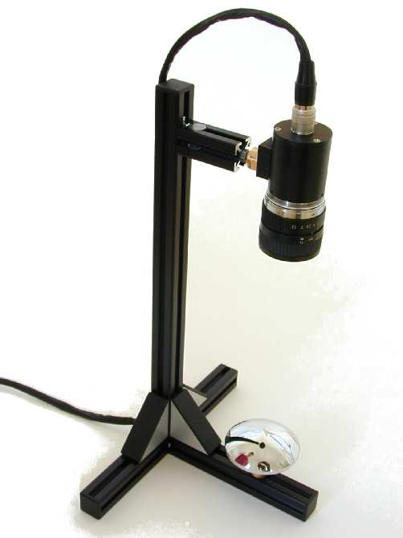
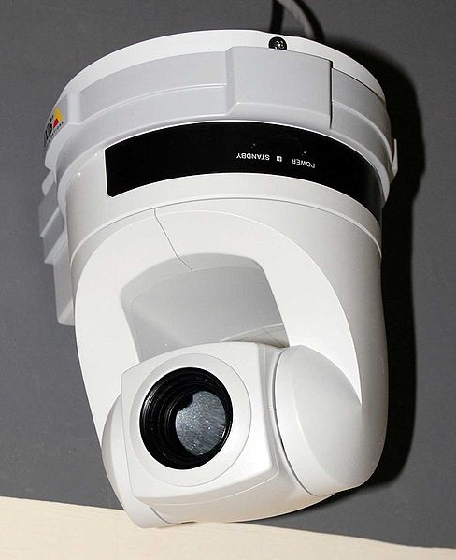
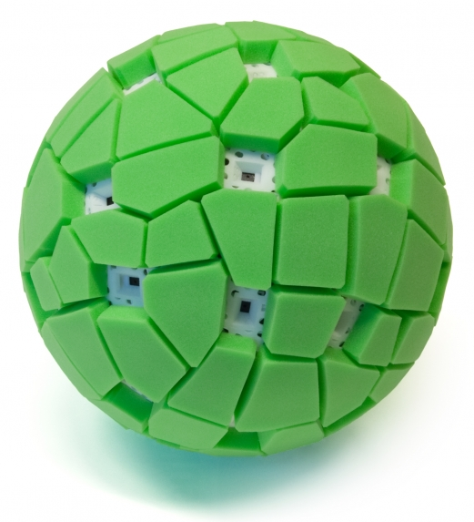
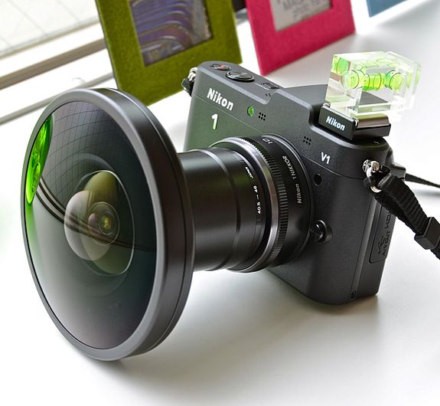
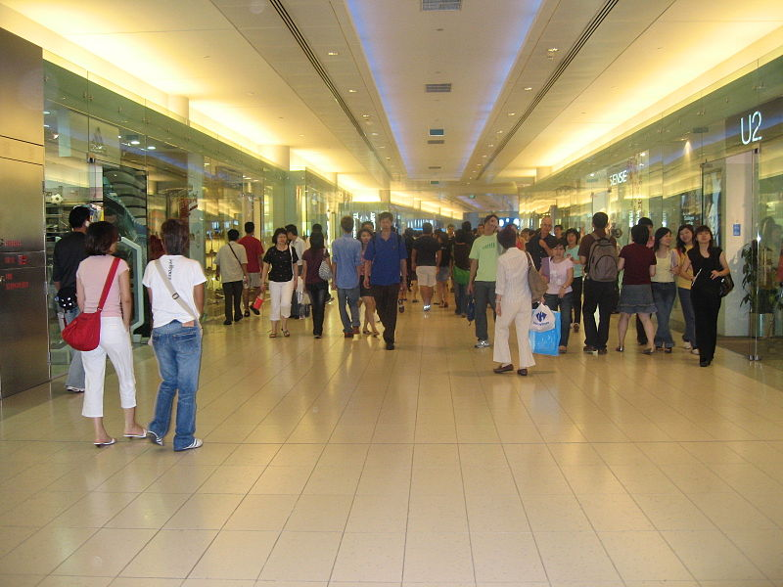
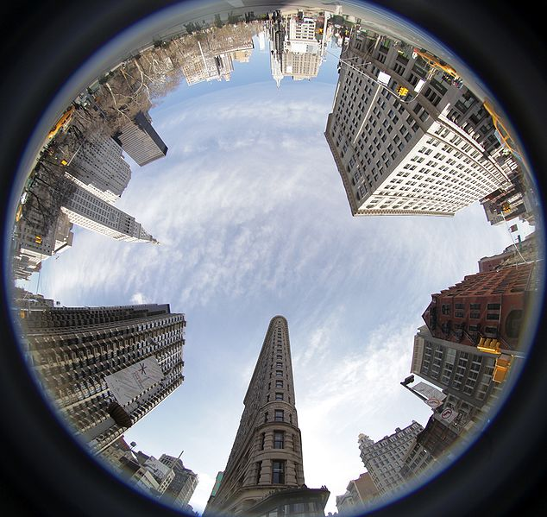
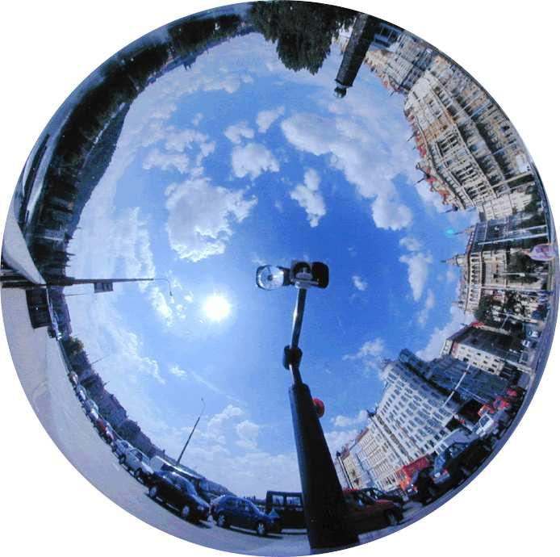
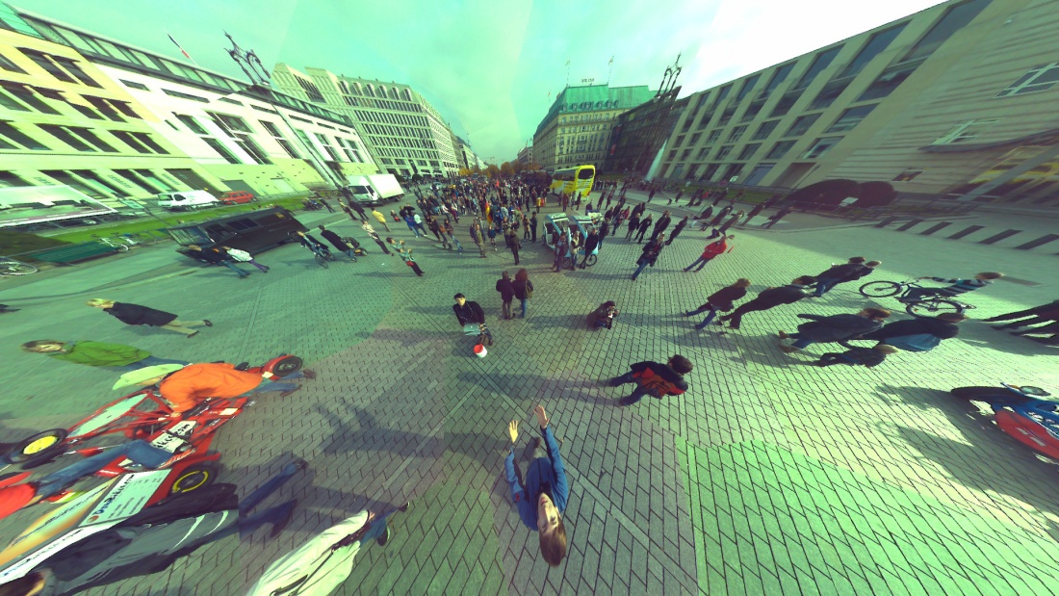
Introduction Omnidirectional camera
Catadioptric (lens+mirror)
PTZ
Multiple Images
Dioptric (lens)
Photos: Jonas Pfeil, Wikimedia commons and `B. Micusik and T. Pajdla, "Estimation of omnidirectional camera model from epipolar geometry" 2003 IEEE Computer Society Conference on Computer Vision and Pattern Recognition, 2003. Proceedings., pp. I-485-I-490, 2003.`
Notes:
Very large field of view

Slide 4
Introduction Omnidirectional camera
Catadioptric (lens+mirror)
PTZ
Multiple Images
Dioptric (lens)
Photos: Jonas Pfeil, Wikimedia commons and `B. Micusik and T. Pajdla, "Estimation of omnidirectional camera model from epipolar geometry" 2003 IEEE Computer Society Conference on Computer Vision and Pattern Recognition, 2003. Proceedings., pp. I-485-I-490, 2003.`
Notes:
Very large field of view

Slide 5
BOMNI-DB

Slide 6
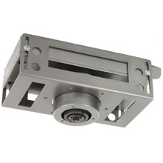
BOMNI
Boğaziçi University Multi-Omnidirectional Video Tracking Database
Recorded at eNTERFACE’11 workshop
Annotated at Bogazici University
Available at http://bit.ly/BOMNI-DB
Cameras provided by ONCAM

Slide 7
Samples from BOMNI

Slide 8
The room
Windows
Table 1
Side Cam
Table 2
Chair 1
Chair 2
Top Cam
Sink
Door

Slide 9
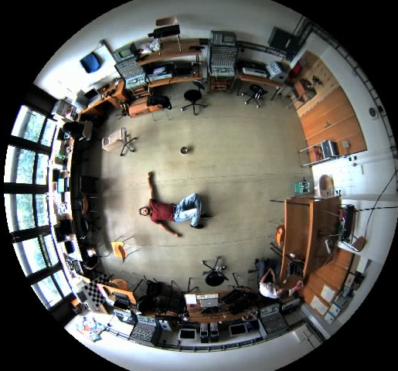
Scenario #1
Single person
6 Actions
Sitting
Walking
Drinking
Washing hands
Fainting
Opening/Closing door
5 performers (10 videos total)

Slide 10
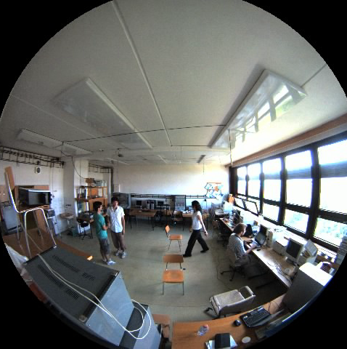
Scenario #2
3 people
5 Actions
Sitting
Walking
Standing
Handshaking
Interested in object
5 performers (36 videos in total by exchanging roles)

Slide 11
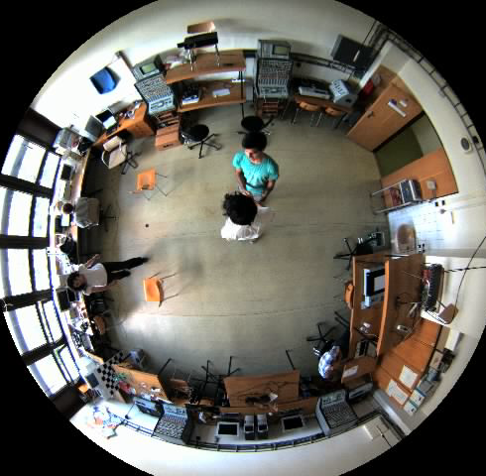
Annotations
Annotation tool used vatic*
Annotations
Bounding box of subject
State (action) of subject
C
A
B
* C. Vondrick, D. Ramanan, and D. Patterson, “Efficiently Scaling Up Video Annotation with Crowdsourced Marketplaces,” ECCV 2010, pp. 610–623, 2010.

Slide 12
Video properties
640x480 frame size
Bandwidth limitation
~8 fps
MJPEG format
Heavy
Occlusion
Noise

Slide 13
Evaluating performance
Multiple Object Tracking Precision/Accuracy MOTP and MOTA*
No protocol for action recognition yet
* K. Bernardin and R. Stiefelhagen, “Evaluating Multiple Object Tracking Performance: The CLEAR MOT Metrics,” EURASIP Journal on Image and Video Processing, vol. 2008, pp. 1–10, 2008.

Slide 14
Baseline method

Slide 15
Baseline method
Blob Formation
Interest Point Detection and Descriptor Extraction
Blob Matching and Tracking
Background/Foreground Segmentation
System Components

Slide 16
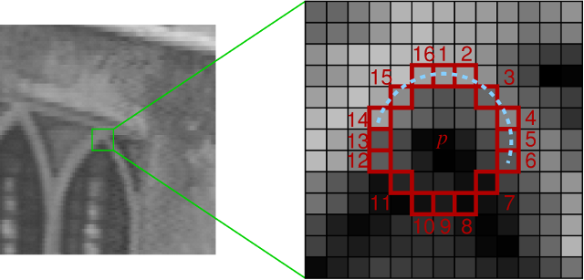
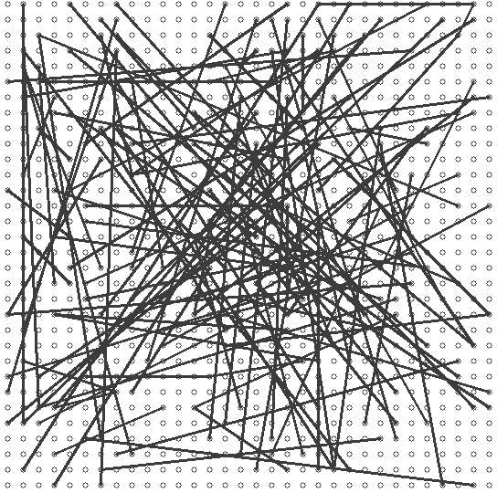
Feature Point Detection and Descriptor Extraction
FAST* corner detection
BRIEF features
extended for opponent color space
* Features from Accelerated Segment Test

Slide 17
Blob Matching and Tracking
Previous n frames
Frame
Frame
Frame
Blob
Blob
Blob
Blob
Blob
Blob
Blob
Blob
Blob
Keypoint
Keypoint
…
Keypoint
Keypoint
Keypoint
…
Keypoint
…
Keypoint
Keypoint
…
Keypoint
Keypoint
Keypoint
Keypoint
Keypoint
Keypoint
Keypoint
Keypoint
Keypoint
Keypoint
…
…
…
…
…
…
…
…
…
Keypoint
Keypoint
Keypoint
Keypoint
Keypoint
Keypoint
Keypoint
Keypoint
Keypoint
NEW FRAME
Blob
Blob
Blob
…
Keypoint
Keypoint
Keypoint
Keypoint
Keypoint
Keypoint
…
…
…
Keypoint
Keypoint
Keypoint
Optimal assignment problem, Hungarian algorithm

Slide 18
PROBABILISTIC OCCUPANCY MAP FOR OMNIDIRECTIONAL CAMERAS

Slide 19
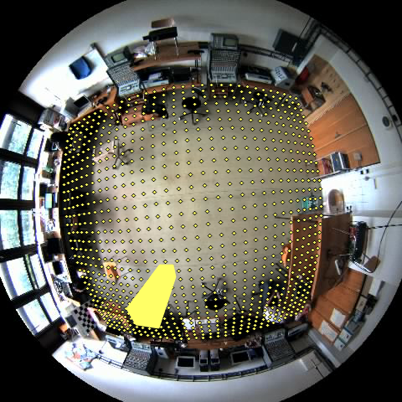
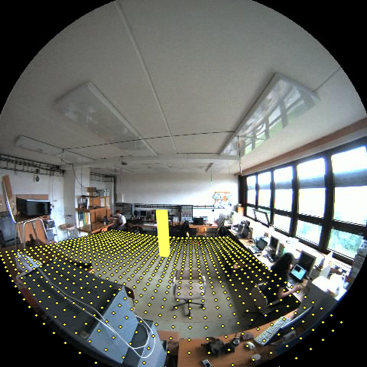
Probabilistic occupancy map for omnidirectional cameras
Fleuret et al. uses rectangles for human shape
Use cuboids in 3D for omnidirectional camera

Slide 20
Fall Detection

Slide 21
Method - Definitions
Image obtained from camera $c$ at time $t$
Foreground segmentation

Slide 23
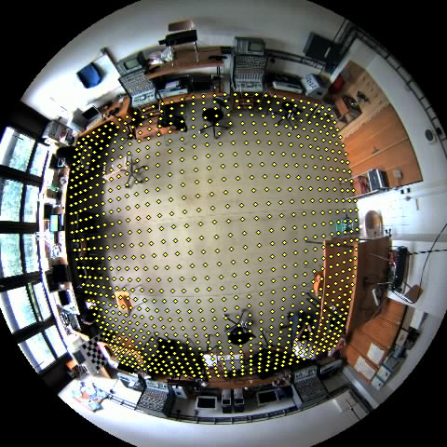
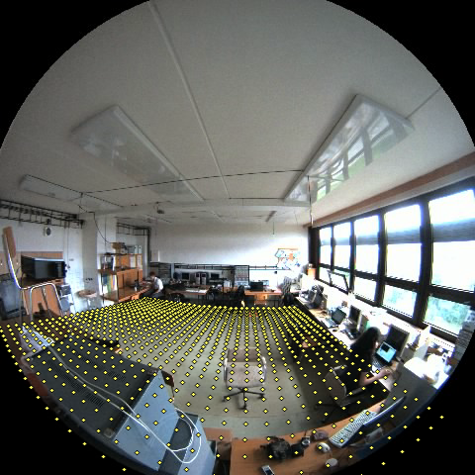
Method - Definitions
$L_{t}$ Location of person at time $t$
Discrete locations $\{1…G,H\}$

Slide 24
Method – Definitions
Hidden location handles transitions in to/out of the scene
H

Slide 25
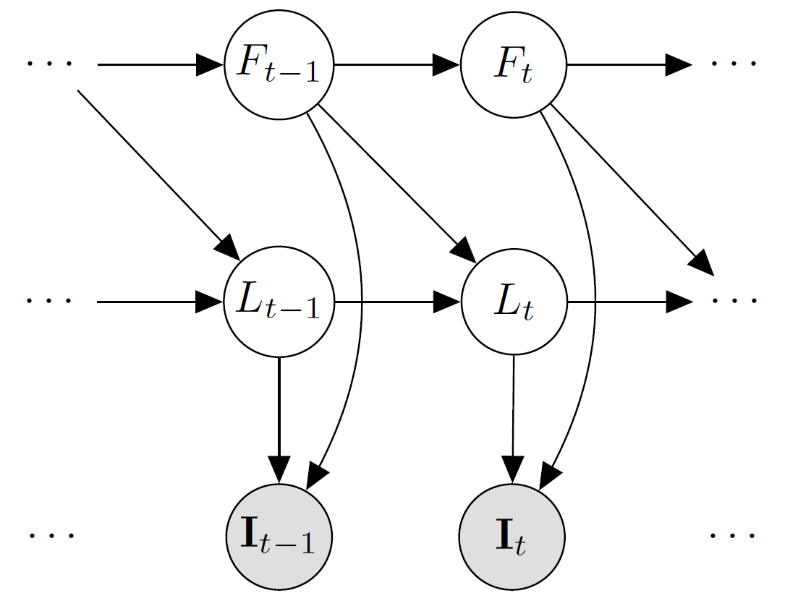
Graphical Model Hierarchical Hidden Markov Model
 | L | Location of person
 | F | Fall state of person, fallen if
 | I | Image obtained from camera

Slide 26
Ideal Segmentation Generation
Camera calibration
Internal parameters
External parameters from point correspondences
Human = Cuboid
Standing 180cm×16cm×16cm
Fallen 7cm×90cm×90cm

Slide 27
Experiment Setup
Image size: 160×120
Foreground segmentation: Mixture of Gaussians¹
Locations: Ground is divided into 31×31 grid
Enter/exit room: From hidden location to the locations near door
¹ P. KaewTraKulPong and R. Bowden, “An improved adaptive background mixture model for real-time tracking with shadow detection,” in Proc. 2nd European Workshop on Advanced Video Based Surveillance Systems, vol. 25, 2001, pp. 1–5.

Slide 29
Results
5 video pairs
video # | frame diff | err (%)
1 | 6 | 0.60
1 | 8 | 0.91
2 | 9 | 1.13
2 | 4 | 0.50
3 | 5 | 0.78
3 | 9 | 1.13
4 | 6 | 0.66
4 | 5 | 1.49
5 | 2 | 0.23
5 | 8 | 1.10
avg | 6.2 | 0.853 %
Robust
Noise
Occlusion
Missing Data

