Slide 1
Hand Gesture, Hand Shape and Articulated Hand Pose Recognition Using Depth Cameras
Cem Keskin^{1,2} Lale Akarun²
Boğaziçi University²

Slide 2
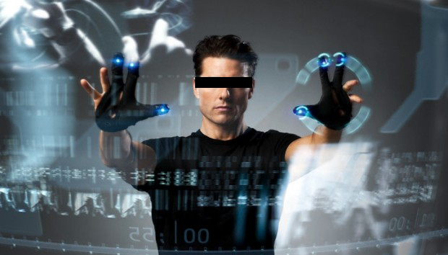
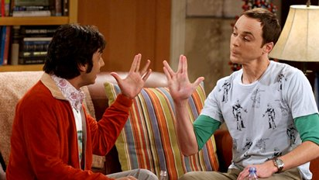
Motivation
Human computer interaction
Do everything that can be done with the hands
Sign language analysis
Analyze and recognize gestures of any complexity

Slide 3
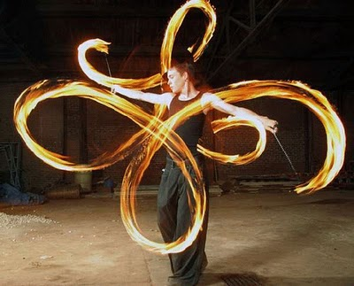
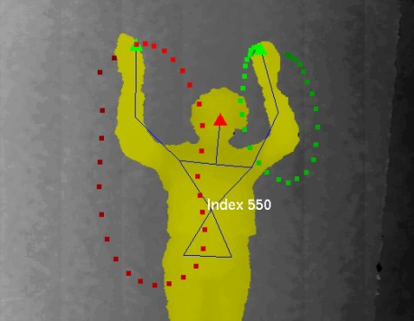
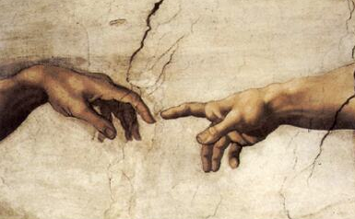
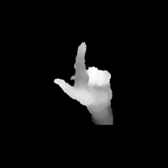
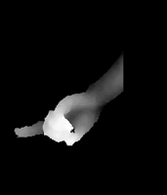
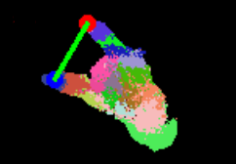
Natural Interaction with Hands
Hand trajectory
Hand shape
Articulated hand pose

Slide 4
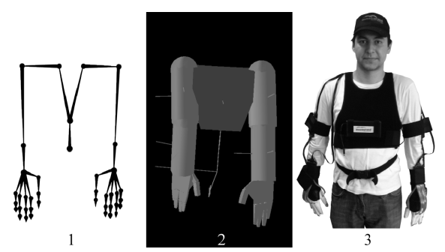
Difficult to Capture Body Pose

Slide 5
Until Kinect Came Along
Depth
Color

Slide 6
How do Depth Cameras Work?
Stereo enables depth reconstruction if correspondence of points can be established
Projected Light enables correspondence matching

Slide 7
How Does Kinect Work?
An infrared projector
A stereo infrared sensor
A color camera

Slide 8
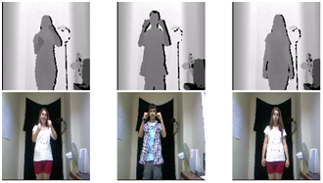
How Does Kinect Work?
The infrared pattern is sensed by the IF sensor
The color camera does not sense it

Slide 9
Libraries for Kinect
PrimeSense – OpenNI
Microsoft Library
Succesful body motion capture!

Slide 10
Shotton et. al Body Pose Library
Uses a synthetic dataset of human motions with labeled body parts for training

Slide 11
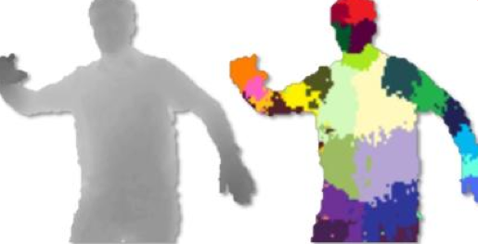
Shotton et. al Body Pose Library
Uses a Random Decision Forest to classify real images

Slide 12
Shotton et. al Body Pose Library
Find Centroids using mean shift;
Connect the dots to get skeleton

Slide 13
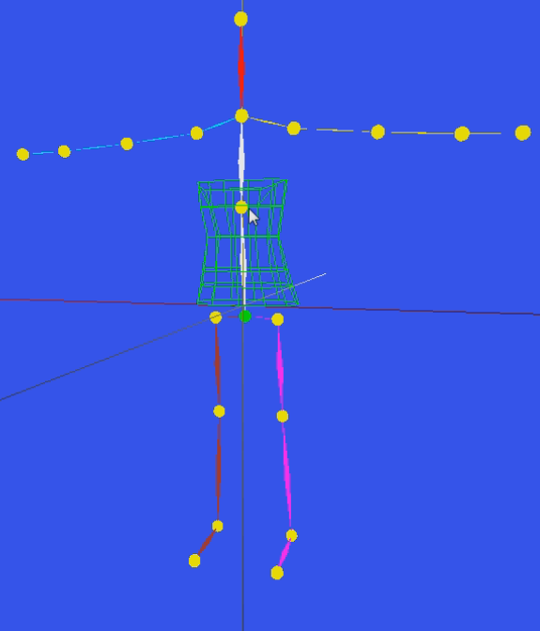
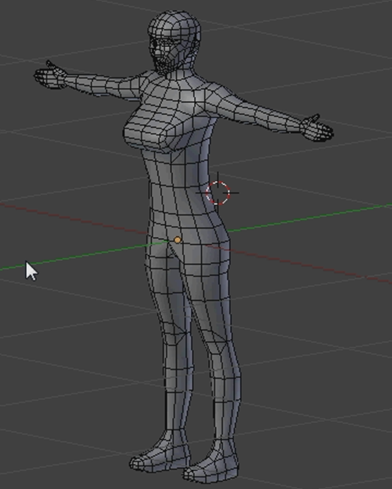
Motion Capture

Slide 14
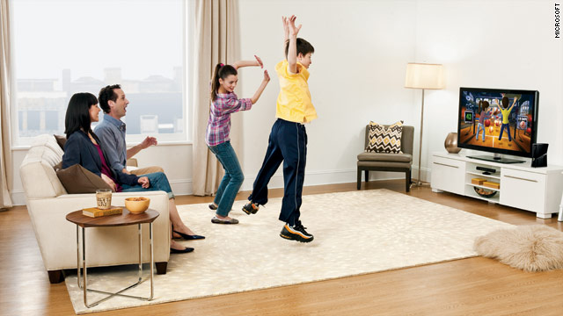
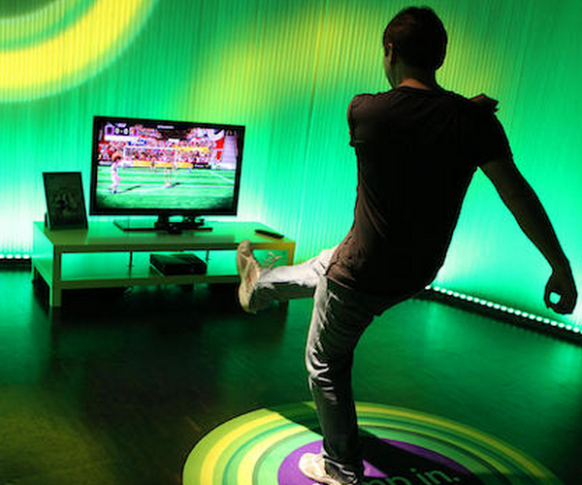
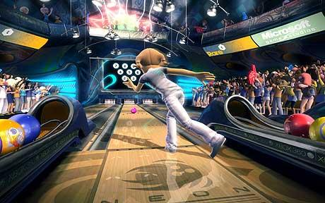
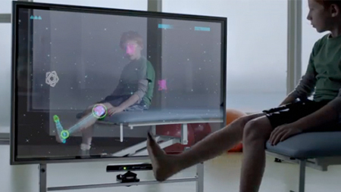
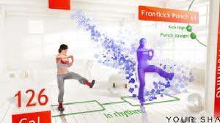
Kinect Applications
Notes:
Kinect Uygulamaları

Slide 15
Hand Gesture Recognition
Sigma NI
OpenNI Developers challenge entry – 3rd place

Slide 16
Recognition using Graphical Models
HMMs
IOHMMs
Mixtures of HMMs
CRF- HRCRF
EDM: Explicit Duration Models

Slide 17
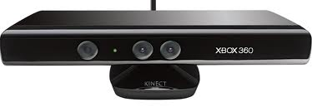
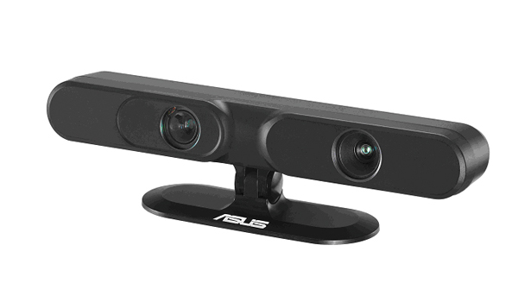
Breakthrough
Release of consumer depth cameras
Shotton et al.
“Real-Time Human Pose Recognition in Parts from Single Depth Images” [CVPR 2011]
No library for hand!

Slide 18
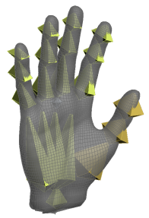
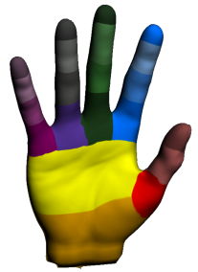
Adaptation to Hand Pose
Create a hierarchical skeleton model
Segment the hand into parts
Train RDFs and classify each pixel
Estimate the joints for each hand part
Connect the dots

Slide 19
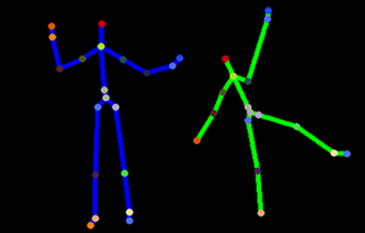
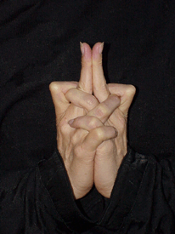
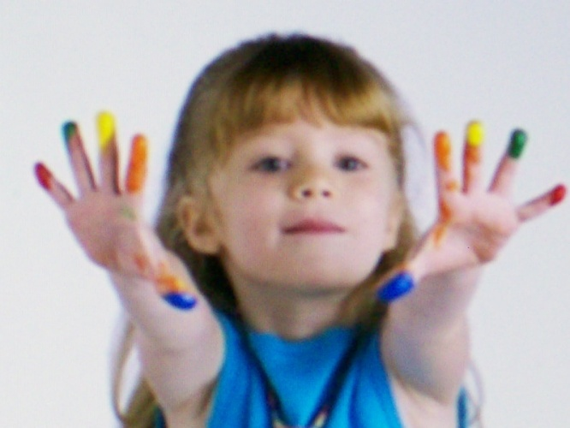
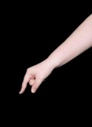
Challenges
Hand is much smaller in size than a body
Degree of freedom
Body: 22-24 (ignoring feet and hands)
Hand: 22
Self occlusion is severe and common
Hand is not always upright
Extremely hard to label real depth images

Slide 20
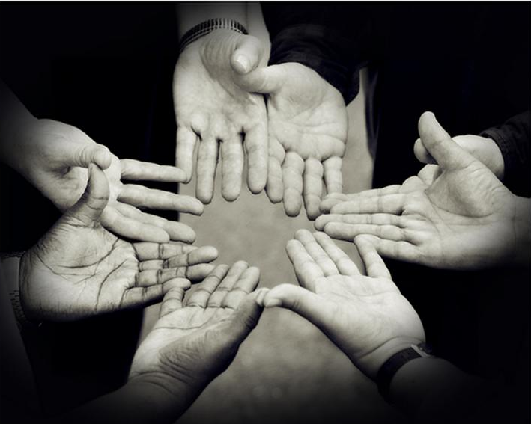
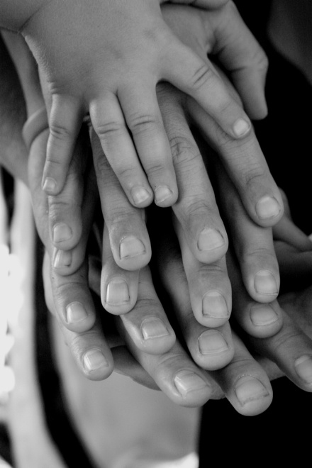
On the other hand
Shape variation is much lower for different humans, especially for depth data

Slide 21
Solution
Use synthetic images for training only
Render depth images and ground truth labels
Stand closer to the camera
Depends on the sensor depth image resolution
Restrict the usage area to 80cm – 200cm

Slide 22
Synthetic Dataset Generation

Slide 23
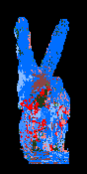
Randomized Decision Forest
F
> τ
< τ
F
F
> τ
< τ
> τ
< τ
F
F
F
F
...

Slide 24
Method Details
Depth invariant features (I: image, x: pixel):
Partitioning the data:

Slide 25
Method Details
Score of the test is the information gain:
Posterior probabilities:

Slide 26
Random Decision Forests
1 Tree
2 Trees
3 Trees

Slide 27
Joint Estimation
Joints
Skeleton
20 Seeds
Scoring

Slide 28
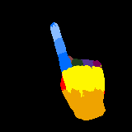
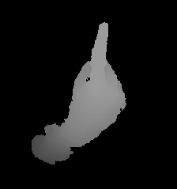
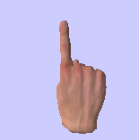
Proof of Concept: ASL Digits
Fit a skeleton, classify skeleton parameters
Generate synthetic dataset
Train RDF from dataset
Retrieve live stream
Fit a skeleton using RDF
Train SVM for ASL digits
Evaluate and classify

Slide 29
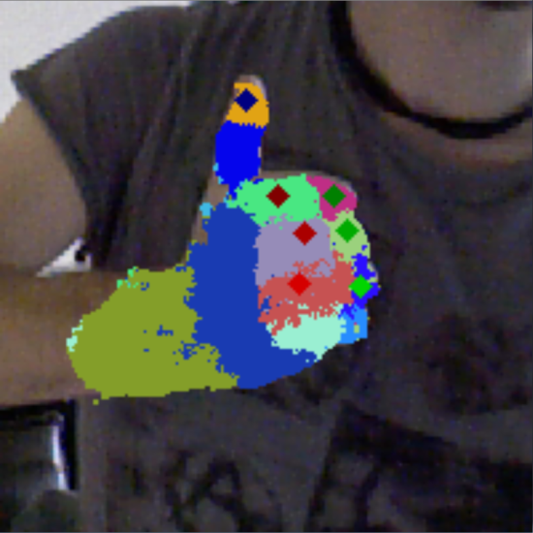
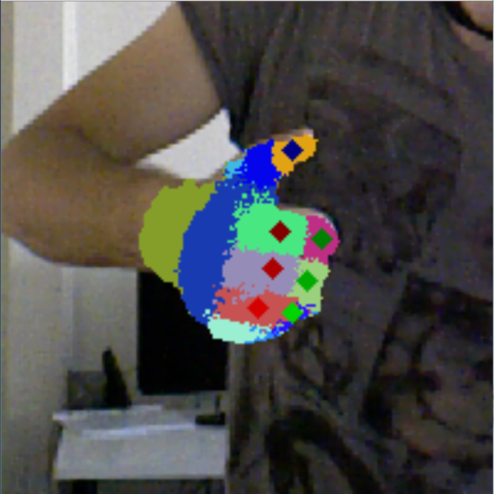
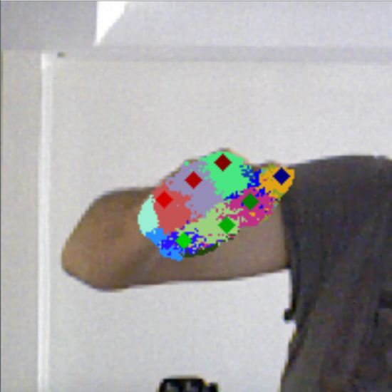
Uses of Skeleton: Virtual Joystick
Turn the hand into an analog controller by imitating a joystick:
Estimates a 3D vector, and a distance for the click event

Slide 30
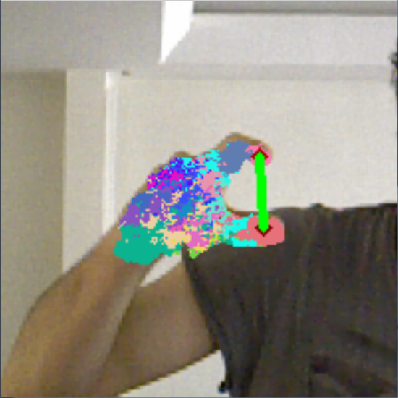
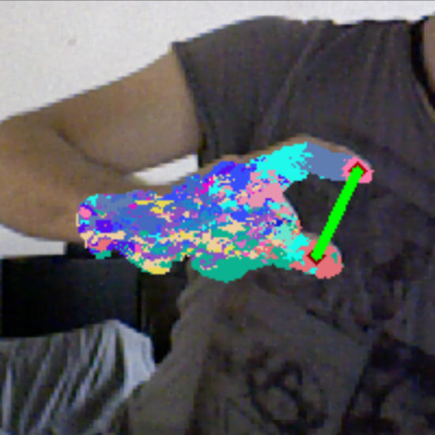
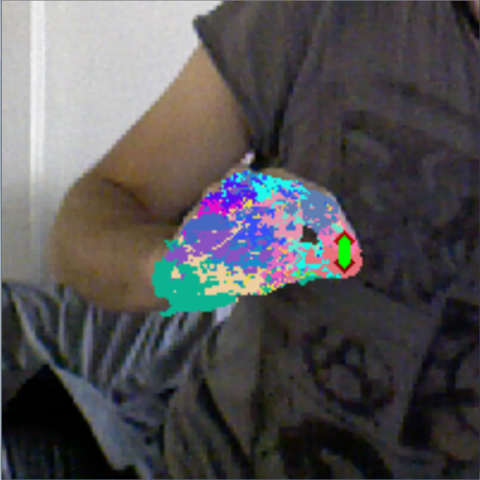
Uses of Skeleton: Virtual Mouse
Turn the hand into a mouse by imitating the left click with a pinching gesture
Estimates a location and a distance to map into mouse coordinates and click events

Slide 31
Hand Shape Recognition
Hand skeleton estimation method adapted to hand shape recognition problem
Simple idea: Label poses instead of hand parts

Slide 32
Adapting to Hand Shape
Collect real depth images for
different hand shapes
Cluster hand shapes to form classes
Label each pixel
according to the hand shape label
Train Randomized Decision Forests & Classify each pixel
Determine the class label

Slide 33
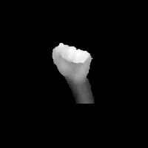
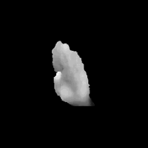
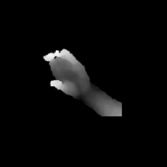
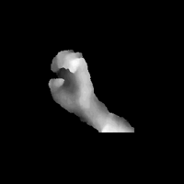
American Sign Language
Tested on a large dataset collected with Kinect (65k+ images)
Pugeault et al. - Spelling It Out: Real Time ASL Fingerspelling Recognition – CDC4CV in ICCV 2011
Achieved 99.1% success rate with 3 trees, using only depth.
Extremely fast: 30 fps with 30 trees on the CPU

Slide 34
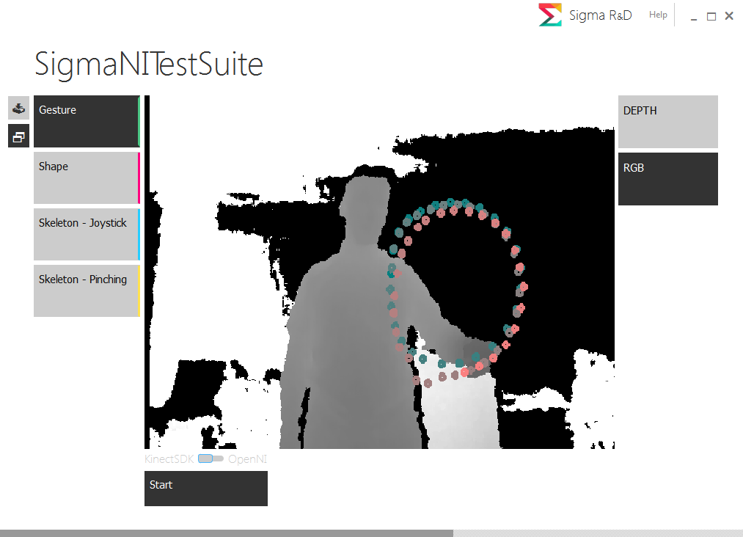
SigmaNIL Framework

Slide 35
SigmaNIL Framework
A visual toolset that aims to:
Collect, split, merge and train datasets for all the supported modalities,
Test the trained models concurrently in real time,
Define events like mouse move or key press and bind them to gesture events to control 3rd party applications
It can be used to play games, control modeling or painting tools, understand sign language etc.

Slide 36
SigmaNIL Advanced Capabilities
Recognize combinations of modalities:
Trajectory + Shape
Ex: Draw a circle while performing a “C”
Trajectory + Skeleton
Ex: Grab an object by pinching and draw a triangle to act
Shape + Skeleton
Ex: First check the shape to determine which skeleton expert to use. Joystick? Pinching? Generic hand skeleton?
All three
Determine pinching from shape and perform a gesture

Slide 37
SigmaNIL Advanced Capabilities
Use both hands:
Recognize two separate gestures,
Use two joysticks, or a joystick and a mouse,
Change the mode by performing a shape with the left hand, do something with the right hand, etc.
Unlimited flexibility for all kinds of scenarios

Slide 38
Applications

Slide 39
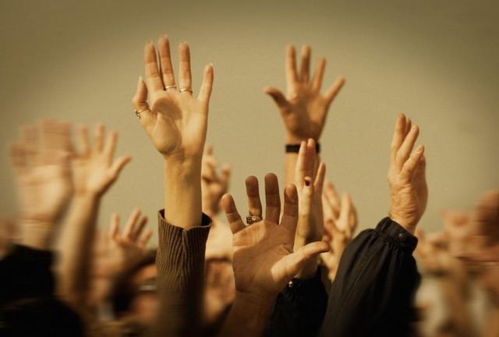
Questions?

