Slide 1


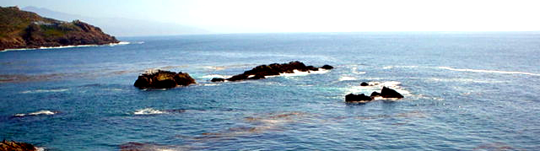
User Studies in Pervasive Healthcare Research
Jesus Favela
Mobile and Ubiquitous Healthcare Lab
Puebla, January 2013
Notes:
1

Slide 2
Applications of Pervasive Healthcare
Ambient Assisted Living
Monitoring patients with chronic diseases
Motivating people to change their behavior (exercise and eating habits)
Active ageing
Supporting hospital work

Slide 3
General Research Methodology
Scenarios
Initial understanding
Workplace study
Design/Implement Protoytpe
Evaluation
System
Insights
CLIHC., 2005

Slide 4

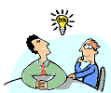



Workplace studies
Analysis
Scenarios
of Use
Modelling
Validation
Insights for
Design
Capture (Interviews, observation)
Generate
Theory
Internal medicine (2 MB,2 MI, 2E,1JP, 1TS, 1AH)
Urgencies (2 MB, 2 MI, 2E,1JP, 1TS, 1AH)
Laboratory (1JL, 1Q)
General Hospital Zona IV

Slide 5
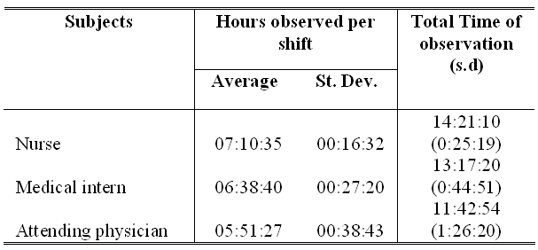
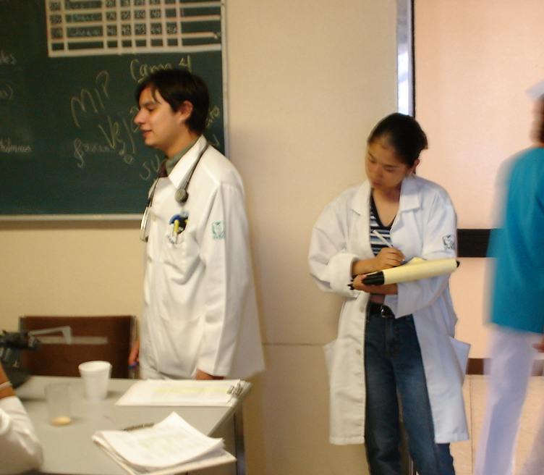
Hospital workplace study
(5)
(5)
(5)
The total time of detailed observation was about
196 hours and 46 minutes, with an average time
of observation per informant of 13 hours and 7 minutes

Slide 6
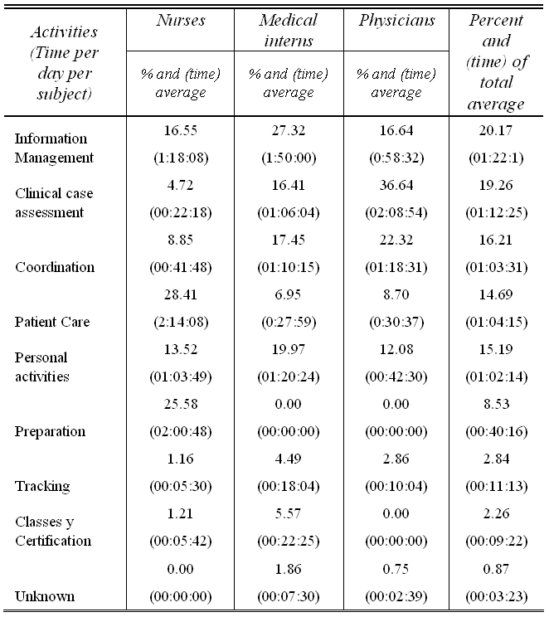
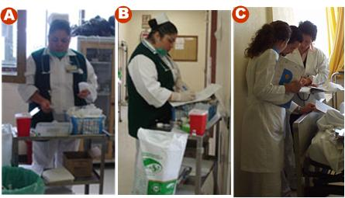
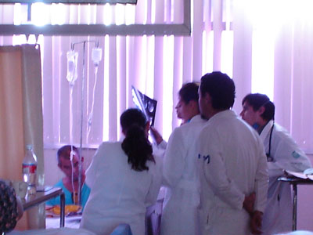
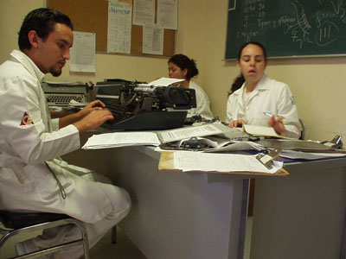
Understanding hospital work
Int. Jrnl. Electronic Healthcare, 3(1), 2007

Slide 7
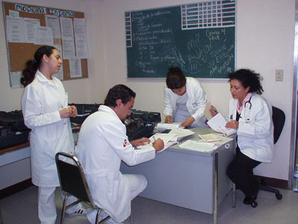
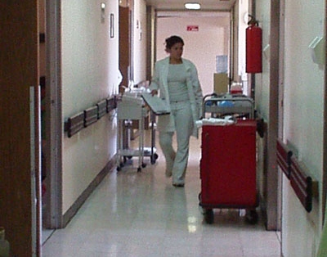
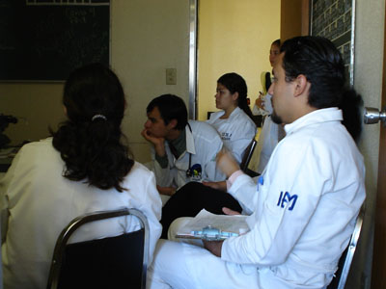
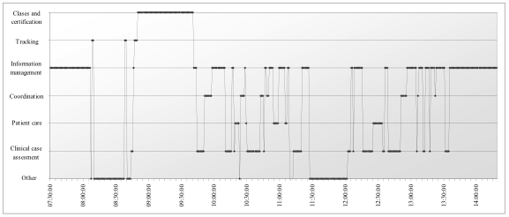
A typical day of a medical intern

Slide 8
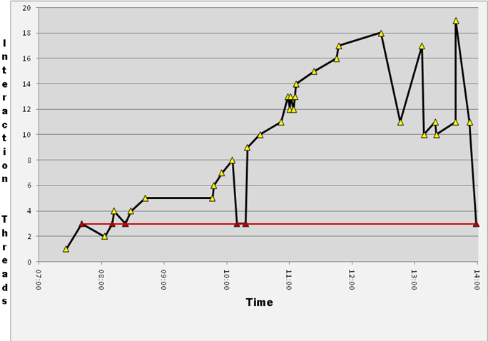
Understanding disruptions of informal communication in hospitals
Hospital workers interact almost 50 times per day on average
56% of interactions happen due to opportunistic or spontaneous encounters
40% of interactions were a continuation of a conversation initiated earlier that day
(15% from previous days)
IEEE TITB Vol. 14: 1, 2010

Slide 9
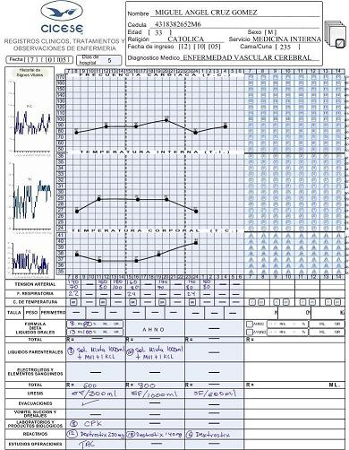
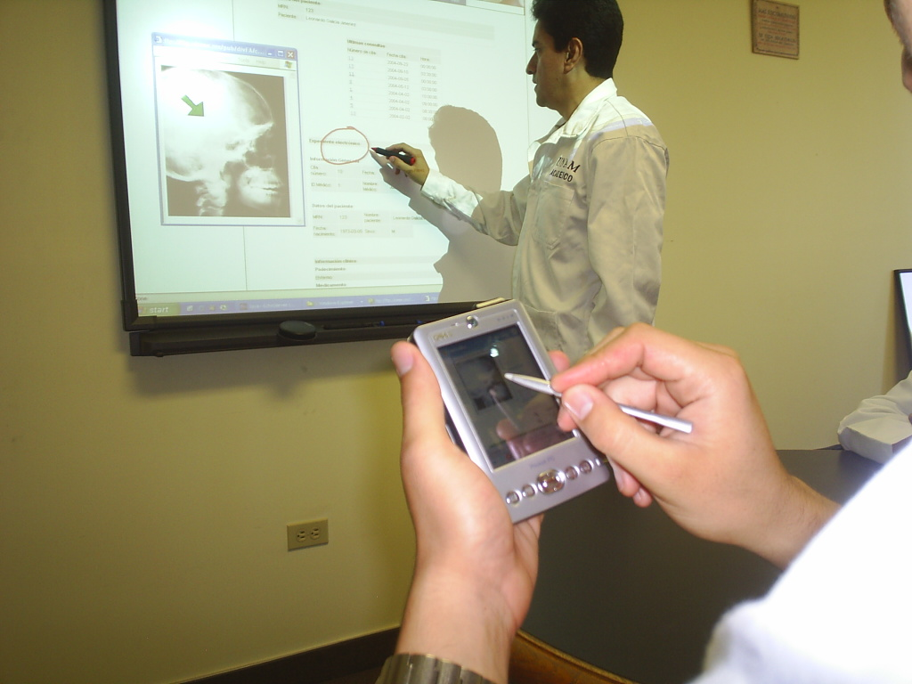
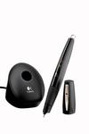
Informing design…
Integration of the physical and digital domain
Supporting face-to-face informal interaction
IEEE TITB Vol. 14: 1, 2010
IEEE Pervasive Comp., 2007

Slide 10
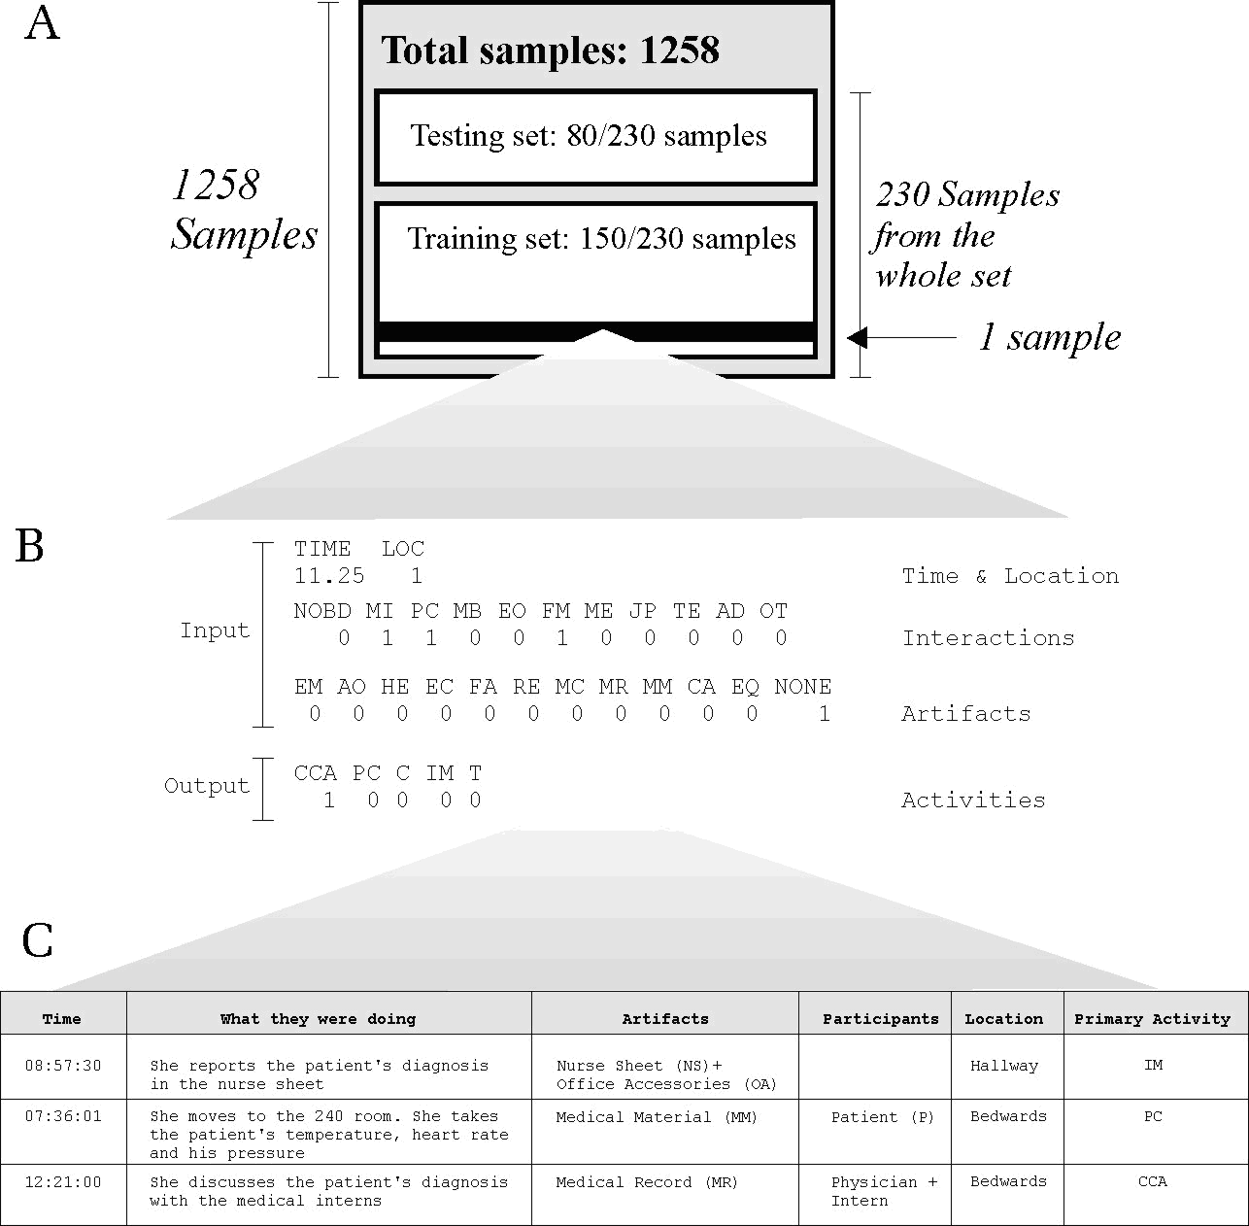
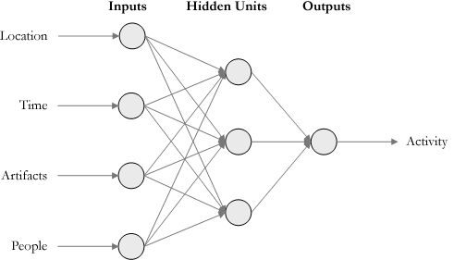
Neural networks to estimate user activities
J. MONET, 12(2), 2007

Slide 11
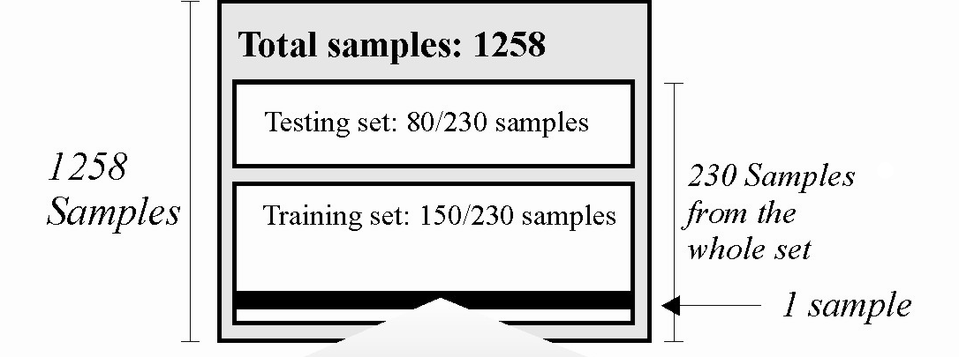
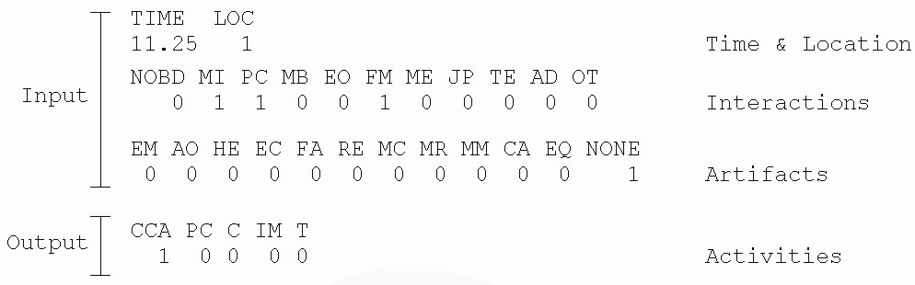
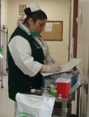
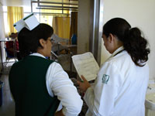
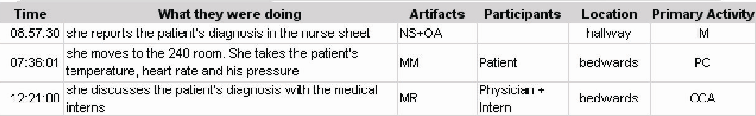
Training the neural network
Clinical Case
Assessment
Information
management
Patient Care
Coordination
…
Sample
Preparation
Sample
Sample

Slide 12
Privacy in hospital work
Personal privacy is not a concern a priori
In a medical environment privacy imposes additional demands
There is an assimetry in the perception of privacy related to information being shared
Privacy affects the perceived usefulness of the technology and influences its adoption
“Once I left the hospital for personal reasons, someone told the attending physician and he reprimended me when I came back. He yalled at me in front of everybody. This teaches you with whom you can do certain things and with whom you cannot.”
High availability, confidentiality, time spent at the hospital
“The benefits I get from these services surpass the risks of using them”
-> Quality of Privacy (QoP)
IEEE Intelligent Systems, 21(6) 2006

Slide 13
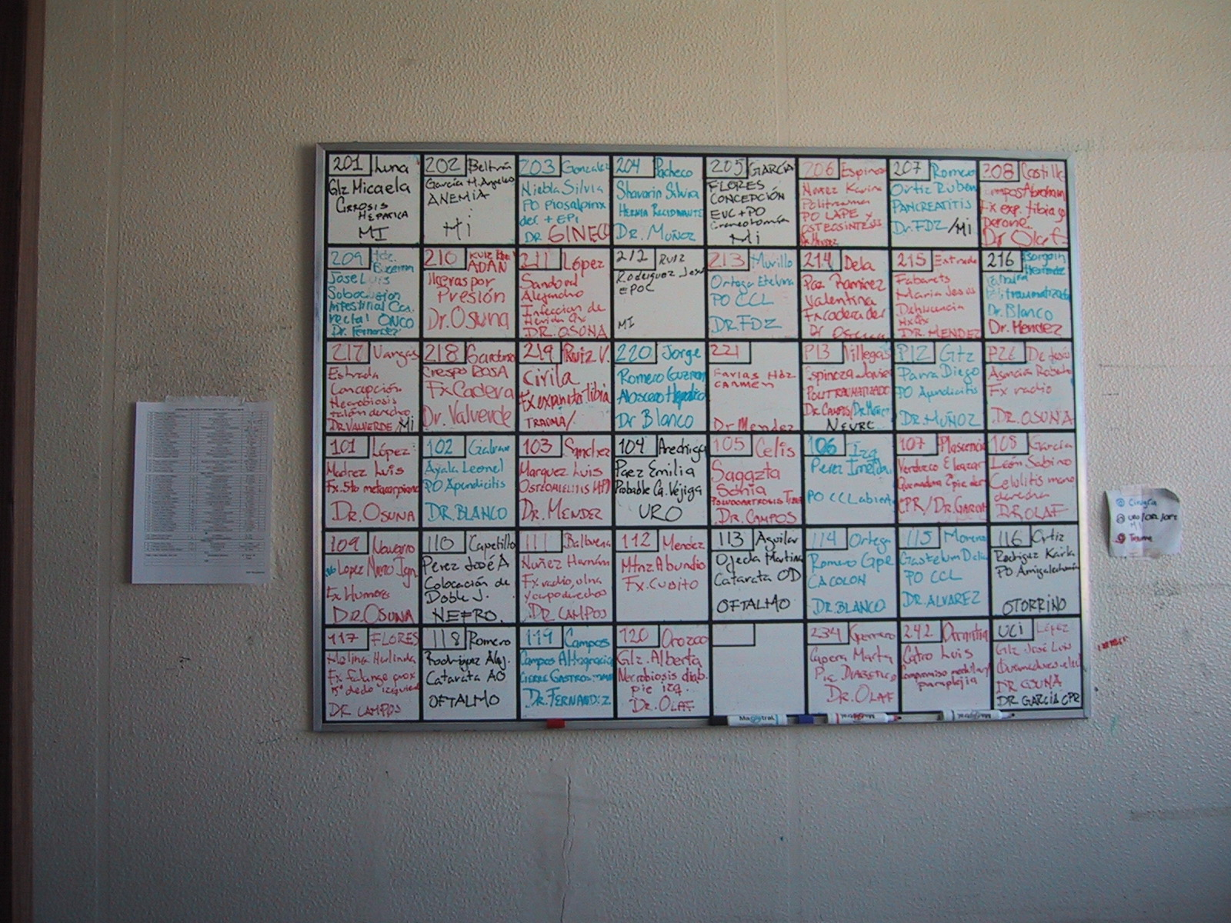
Shadowing artifacts
Notes:
Otro de los resultados del caso de estudio es:….
Esta es una nota de las observaciones hechas en el hospital
En las imágenes se ven los tres artefactos utilizados para la coordinacion medico-paciente en el área de traumatologia.
Se tiene el pintarron, el censo diario y la libreta de roles.

Slide 14
inCense: a tool for opportunistic and participatory sensing
[IEEE Pervasive Computing, to appear, 2011]

Slide 15
Ensenada Sensing Campaing
15 older adults for 20 days
November 2011 – January 2012
Android mobile phone with inCense
  Location (GPS, WiFi)
  Accelerometer
  NFC tags -> audio
  Activity log
Users already underwent a battery of tests to assess frailty

Slide 16

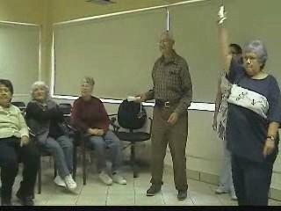
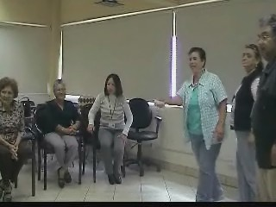
Pervasive games for early diagnosis
I felt very good... I had practiced yoga before… I forget things, I forget the words when I talk... I was afraid because I always feel that I do things wrong and I get stocked.

Slide 17
Evaluation in Healthcare
Randomized clinical trials – gold standard
Why is it difficult to evaluate the usability of pervasive technologies?
  Novel technology / novel uses
  The computer is not at the center of the user’s attention

Slide 18
Evaluation methods
User
involvement
hands on
controlled
experiment
in replica
in situ
spectator
- scenario driven
- theatrical representation
No user
- analytic
- heuristic
Realism

Slide 19
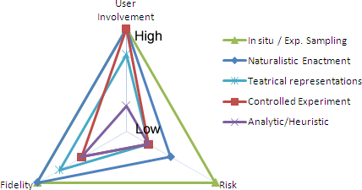
Evaluation Methods

Slide 20
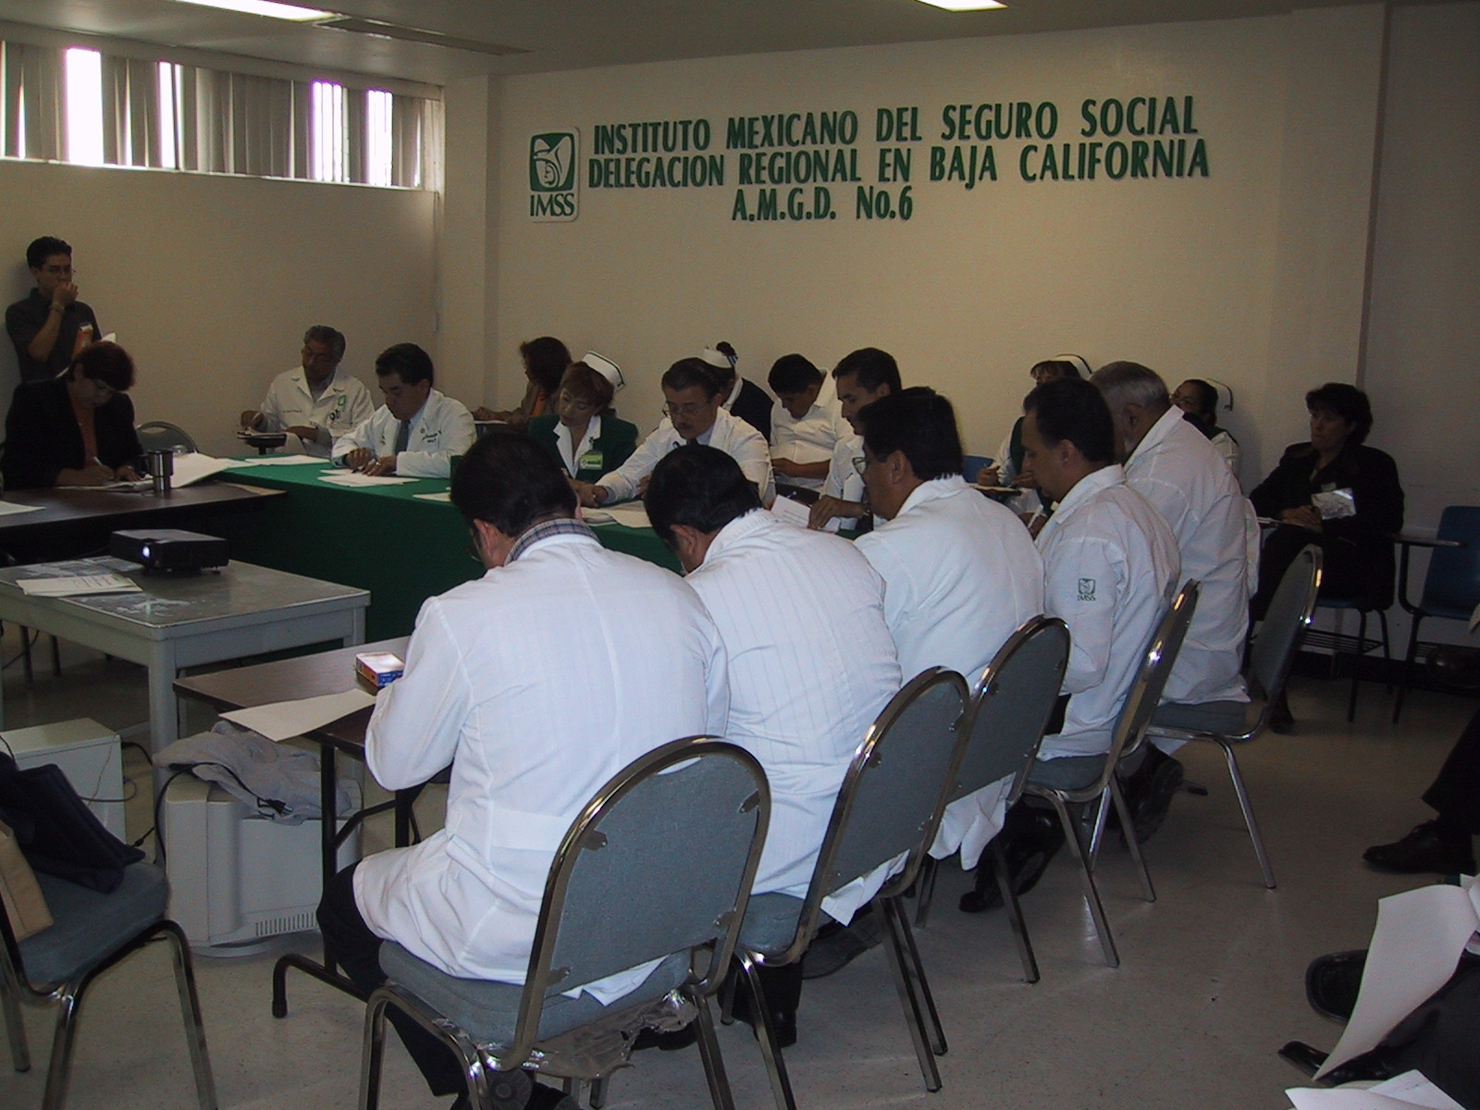
Scenarios and theatrical representations
IEEE TITB., 8(3), 2004

Slide 21
Usability evaluation
Traditionally performed in a lab
Difficult to control the experimental conditions
Data gathering might be difficult for some types of interactions with technologies
A possible solution is to simulate “real” conditions

Slide 22
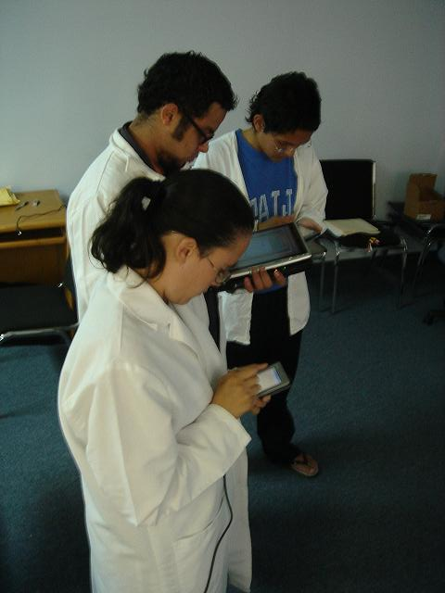
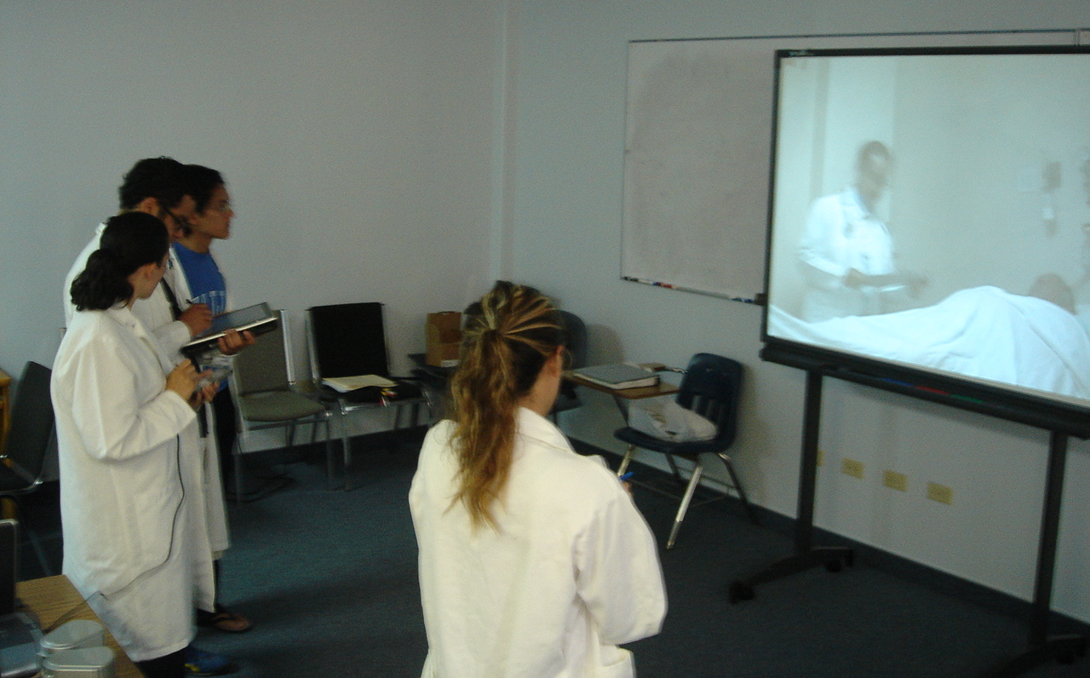
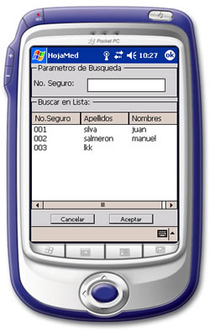
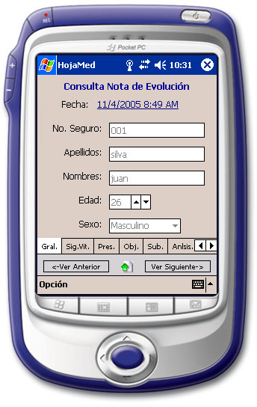
Usability in a simulated environment

Slide 23
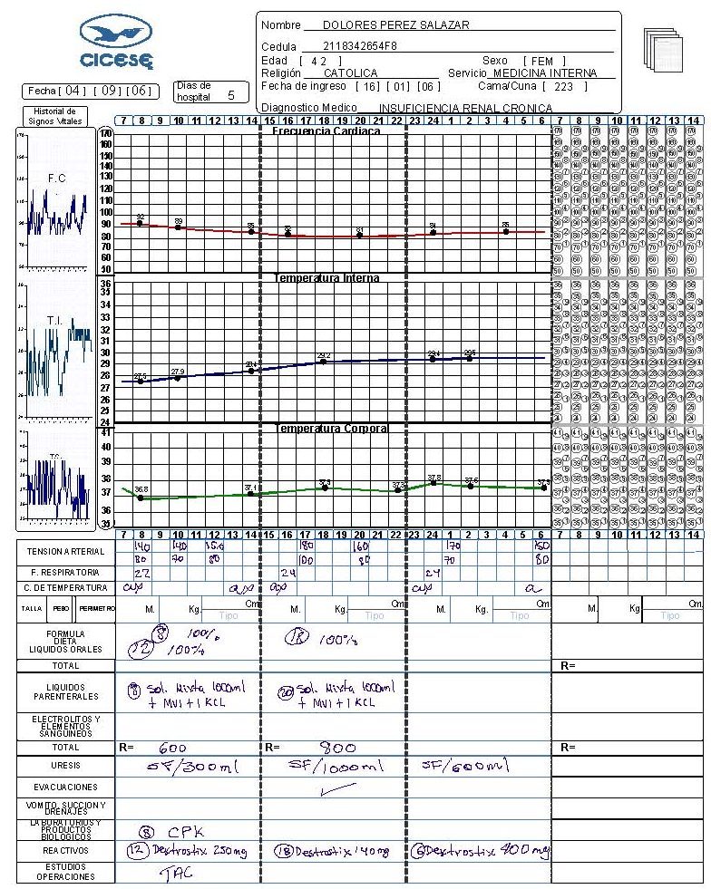
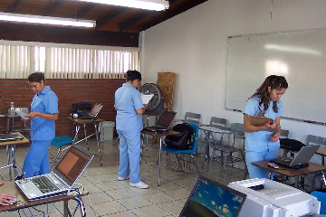
Evaluating a digital nurse sheet

Slide 24
in situ evaluation
Living laboratory
Qualitative techniques
  Observation
  Interviews
  Ethnographic analysis
Quantitative techniques
  In the field (log of use, Empirical Sampling Method, Naturalistic Enactment)
  Evaluate user performance

Slide 25
pHealthNet: Persuasive computing

Slide 26
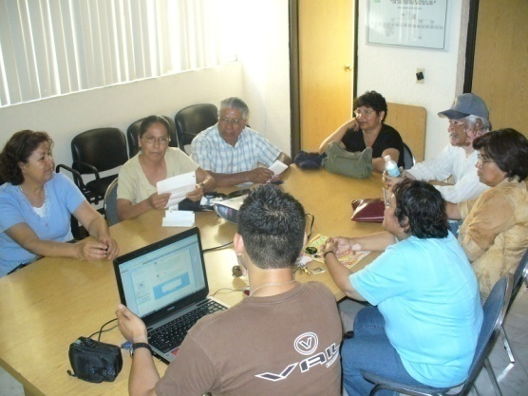

Evaluation
Participants: seven patients (5 female, 2 male, 6 completed)
Diseases: obesity (4), hypertension( 1) and diabetes (2)
Ages: between 29 and 62 years old ( µ: 50 - Std dev : 10 )
Occupations: Mason, housewife, truck driver and factory worker
11 entries
19 entries
31 entries

Slide 27


Evaluation
Patient A increased his steps by 354% and lost 9 kilograms
VS
SODHI SESSIONS
AFTER SODHI SESSIONS

Slide 28
Results
Learning
Some patients have never used a computer. However, they began learning to use it to enter the community.
                “I don’t know how use a computer, but now with this [community] I want to learn. Nobody stops me ”
Collaboration to persuade
we observed that collaboration and social support was the main feature to engage users to achieve goals
                “A [rivalry] in a good way exists because you could see the amount of exercise others have been doing, but that cheers you up because you don’t want to be left behind”.
Persuasive tools
we observed that games and the traffic light widget can motive an increase in the level of physical activity.
“the light is red, come on, do it, I was saying to myself”

Slide 29
Results
Family participation
The community helped engage relatives in the patient’s program
                “my sons help me, my sons call me from Tijuana to ask me how many steps I took and if I am dieting”

Slide 30
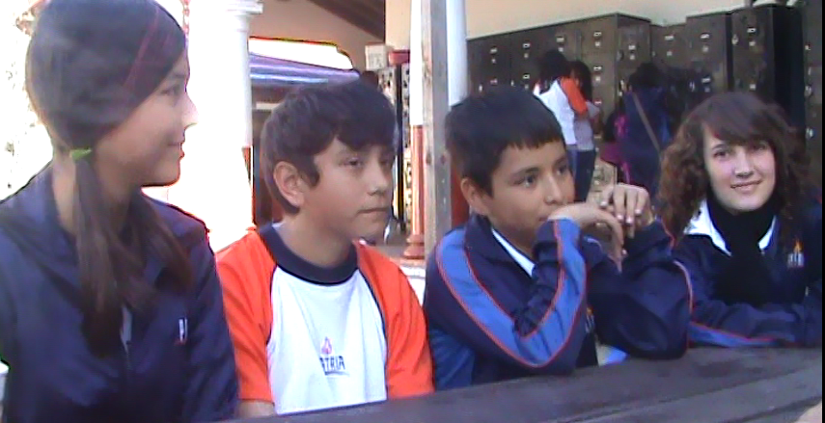
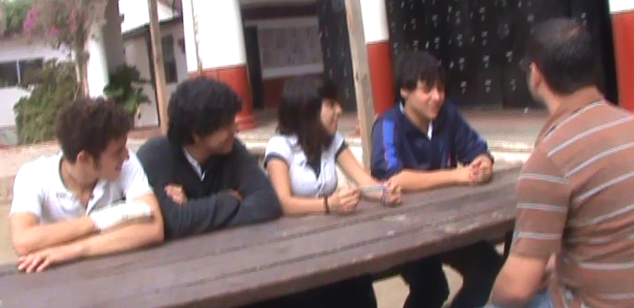
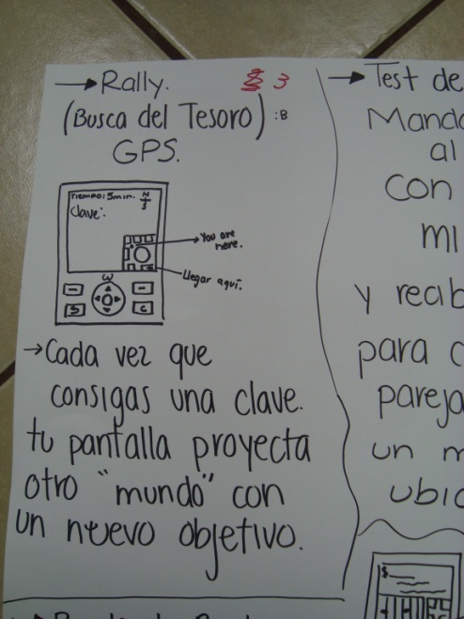
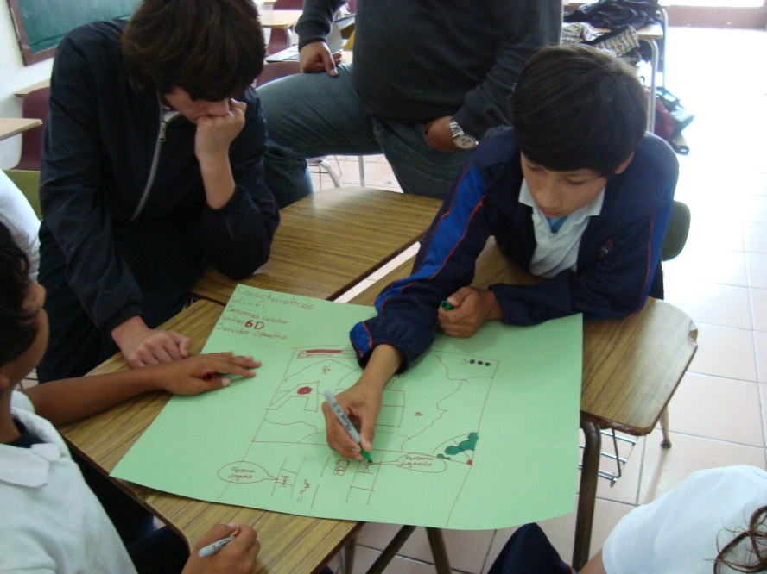
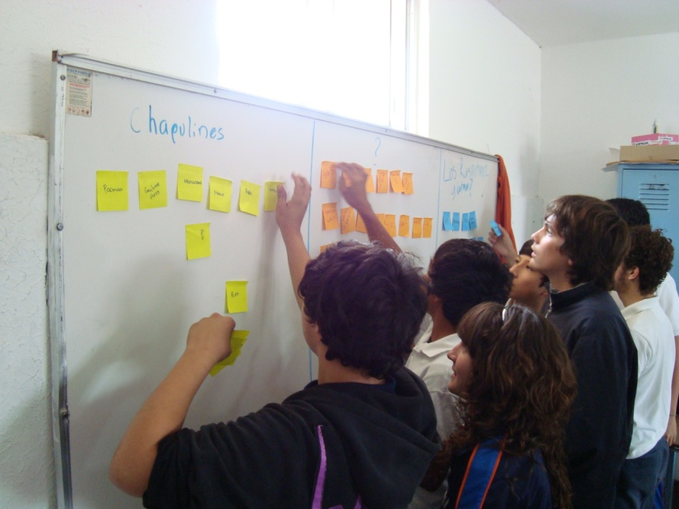
Mobile games to promote healthy habits
Two focus groups with children and teenagers
Interviews with teachers
Design workshop with 9 teenagers
Rally

Slide 31
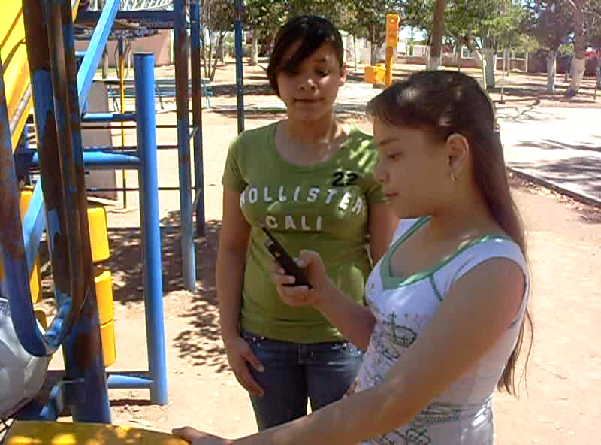
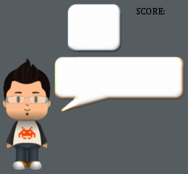

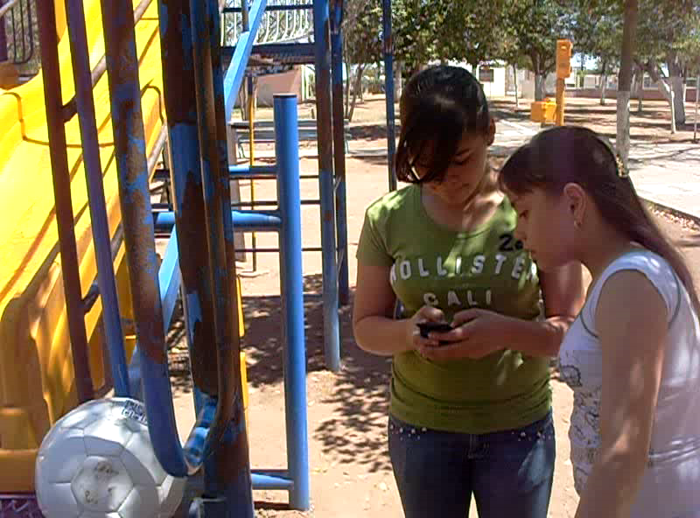
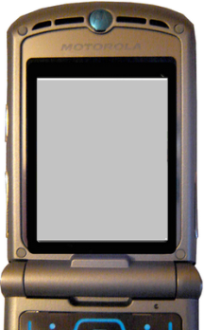
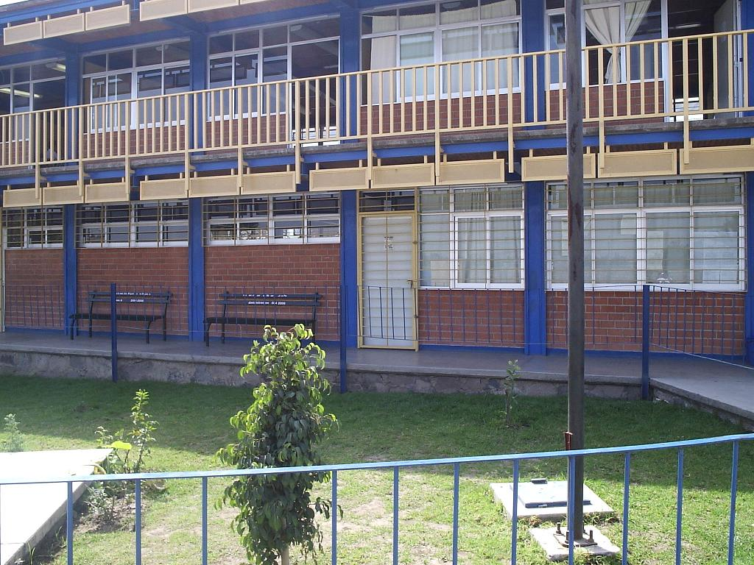

The excergame
QR codes are use to discover new challenges
Jumping or dancing can give them new opportunities to solve the problem
10
I bought this videogame by__
Jump to get another opportunity
Other passive players in the vicinity can still points. The user needs to run away from them to prevent this from happening
Warning: The robber it’s near.
Not enough. You lost 2 points
STEAL

Slide 32
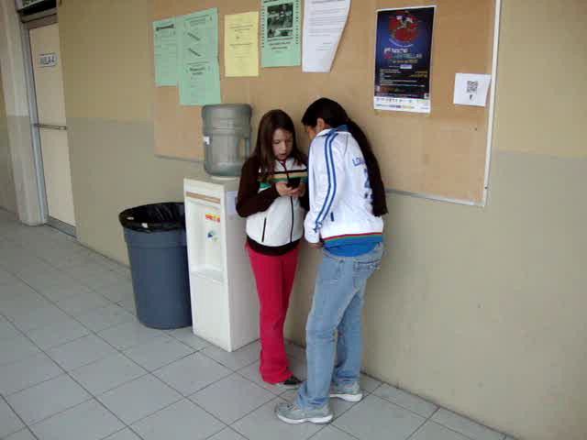

Slide 33
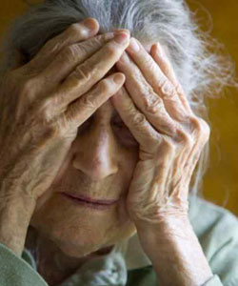
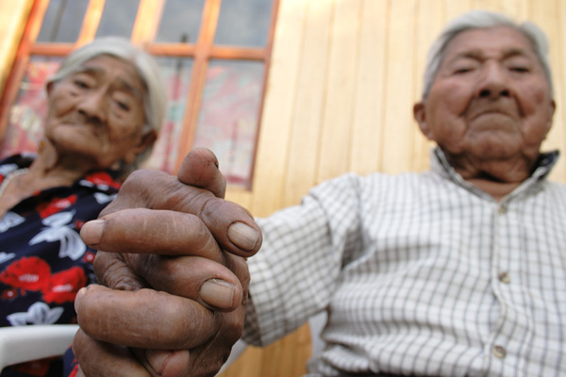
Social networks and older adults
The quality of the social network impacts on:
Quality of life (Giles et al., 2005)
Health (de Belvis et al., 2008)
Cognitive decline (Fragitlioni, 2000)
Mortality (House, 1988)
Yet, social networks decrease with age
.
Notes:
33

Slide 34
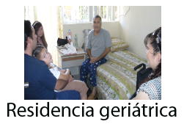
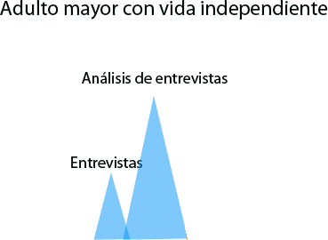


User study
Older adult living independently
Geriatric residence
Focus group

Slide 35
Case study results
Distance negatively impacts emotional bounds
Apathy to use of new technologies (i. e. cellular phones)
Strategies are followed to provide a sense of presence (photographs, calls to family members organized by therapists)
Notes:
Al igual que lo reportado en (Port et al., 2001) se encontró que la distancia geográfica que existe entre los adultos mayores en residencias geriátricas y sus familiares afecta negativamente los lazos emocionales, sin embargo, también se encontró que esta barrera produce un efecto negativo en las otras dos condiciones. Específicamente con el adulto mayor que vive con un familiar, esta barrera acentúa su efecto negativo ya que el adulto mayor manifestó apatía y desinterés en utilizar nuevos medios de comunicación debido que los encontraba complejos de utilizar. De manera similar se presentó la barrera afectiva de disponibilidad en las tres áreas estudiadas, en donde los adultos mayores en residencias geriátricas se ven más afectados ya que dependen directamente de sus familiares para iniciar el contacto.
El sentimiento de presencia, fue una estrategia afectiva utilizada tanto en la residencia geriátrica como con el adulto mayor que vive con su familiar. En esta última área de estudio se presentó de manera característica al verse apoyado indirectamente a través de un sitio de red social, cobrando mayor relevancia debido a su uso masivo por millones de usuarios alrededor del mundo.

Slide 36



Ambient social networks
CRWIG 2010
Notes:
Mi first example is the Tlatoque system. Tlatoque, which in nahuatl means “Those who speak” is designed to integrate older adults with their families, particularly younger generations that have made social networking sites their preferred communication media. Tlatoque provides a seamless interface to browse photographs shared by the older adult’s social network. With the touch of a button or a gesture, they can provide feedback, or they can use a digital pen to write a note that is uploaded to the social networking site without them having to interact directly with the computer.

Slide 37

Notes:
The video illustrates how Tlatoque is used: We see an older adult looking at photos shared by his grandson and sending an “I like” message by touching on the side of the photograph. We use Microsoft’s Kinect to allow him to interact at a distance. Advancing through photographs and even playing simple games. One such game presents him with three photographs from those uploaded by his SNS, and a comment that was made to one of those images. With a gesture, such as raising his arms, he selects the image that he thinks it corresponds to the text that is shown.
We have evaluated the use of the system in two extended families for a period of 5 months. One user was a 89 year-old woman who was connected to 20 relatives who were already Facebook users; half of whom lived in a city different from her’s. The second was an 86 year-old woman with 9 children and grandchildren using Facebook.

Slide 38










First intervention
21 weeks
Interview with the older adult every other week
Interview with
family
Interview with
older adult
ePortrait at
elder’s bedroom
ePortrait at
TV room
February
March
April
May
June
July
1st phase
2nd phase
3d phase

Slide 39
Sense of presence
“I am closer to them, if they don’t come often I still see them and remember them, and think about them, and I am up to date with what they do, where they go, as if they came to see me, if they can’t come, it’s ok, I know they still think about me, and I think about them”
89 year-old user
Notes:
We found that the use of Tlatoque provided them with a sense of presence even when they had no other contact for weeks. For instance the 89 year-old user said:

Slide 40
New conversations
“I realize that there are more things to talk about”
89 year-old user
“I go to her house and she starts talking to me, she talks about my dog and my husband, I believe this is because of the display, now we even talk about personal things”
Duagther-in-law
Notes:
The use of the display also promoted new conversations:
“I realize that there are more things to talk about”
And it strengthened relationships even with weak family-ties, such as a granddaughter-in-law who in an interview said:
These two users have no cognitive impairment. But these results have encouraged us to initiate an case study in a nursing home in a few weeks. The user will be a woman at an early stage of Alzheimer’s who was recently institutionalized. In particular, we will be looking at how the use of the system helps her maintain a connection with her grandchildren.

Slide 41





User study before deployment at a nursing home

Slide 42
Residence for elders with Alzheimer’s Disease

Slide 43
User Study
Workload per activity
Matutino
Frecuencia(Porcentaje)
1(3%)
1(3%)
7(18%)
5(13%)
7(18%)
3(8%)
1(3%)
15(38%)
13(28%)
10(22%)
6(13%)
3(7%)
0
12(26%)
2(4%)
“You remember at what time was the resident sent to the hospital?”
Tiempo | D | R | M | O | H | A | C | TP | S | I
Matutino | - | -/0:03 | -/0:02 | 0:49/0:20 | 0:18/0:40 | 0:22/0:28 | 0:17/0:07 | -/0:03 | 1:23/1:44 | 0:03/-
Nocturno | -/0:03 | -/0:10 | 0:13/0:18 | 0:11/0:14 | 0:18/0:06 | -/0:02 | 0:13/0:03 | - | 2:13/2:17 | 0:41/0:32
Nocturno
Frecuencia(Porcentaje)
2(3%)
3(5%)
9(15%)
6(10%)
2(3%)
1(2%)
3(5%)
0
26(42%)
10(16%)
3(8%)
6(17%)
5(14%)
0
5(14%)
0
13(36%)
4(11%)
Notes:
Comparando la carga de trabajo por turnos, se pudo determinar que el manejo de información queda desplazado a los horarios en los que disminuye la carga de trabajo, por lo que existe la posibilidad de perdida de información por depender de la capacidad de memoria de los cuidadores, a la hora de hacer los registros.

Slide 44

NFC tags
Medication
Eating
Bath
Toilet
Lay dowm/Wake up
Exit residence
With nurse.
Registro manual:
Vital signs
Mood
Reacreative activity
Visit
Abnormal behavior

Slide 45

Results: Documentation of events
Notes:
Primeramente se presentó un análisis de los registros totales realizados en el sistema en comparación con el formato tradicional, donde se pudo observar un incremento en el número de registros realizados en el sistema conforme iba transcurriendo el tiempo, así como la desaparición de la utilización del formato tradicional. Es importante destacar que en el período de uso del sistema (del 1 al 16 de agosto) presentado en la primer figura se incrementó el número de registros realizados en el sistema en comparación con el formato tradicional, a excepción de 2 días en particular donde el día 14 solo se realizaron registros por 2 cuidadoras en el horario matutino cuando normalmente eran 3 cuidadores. El día 16 también se registró una disminución considerable por lo que al analizar los registros se detecto que ese día participaron 2 cuidadoras que no participaron en la etapa de capacitación (cuidadoras 13 y 14) por lo que estaban poco familiarizados con el uso del sistema.
Al realizar el análisis en relación a los adultos mayores comparando el formato tradicional con la utilización del sistema en las etapas de capacitación y uso, se pudo determinar un incremento considerable en los registros realizados de cada uno de los residentes que se pregunta en la segunda figura.

Slide 46



Security risks: SeniorWatch
Need for specialized care
Risky behaviors not detected

Slide 47
Case study results
Guest activities | Caregiver activities
Medicine administration | Caring for guests
Feeding | Feeding guests
Entertainment | Medicating guests
Walking | Taking vital signs
Change position | Hygiene
 | Assisting guests to move
Notes:
Primeramente, de la evaluación del esquema de codificación con el encargado de la residencia, dio como resultado lo siguiente: de las actividades realizadas por el huésped el encargado de la residencia seleccionó manejar medicamentos y alimentarse como las más relevantes, también seleccionó la de entrenamiento de las actividades recreativas, y caminar y cambiar de posición relacionadas con las de movilidad. Respecto a las actividades realizadas por el cuidador se consideraron de interés aquellas relacionadas a los cuidados generales al huésped tales como higiene, toma de signos vitales, administración de medicamentos, administración de alimentos, movilidad, realizar terapia y asistencia. Durante la entrevista el encargado de la residencia comentó
Por último los eventos que consideró interesantes fueron los de contacto físico afectivo, acciones negativas, accidentes y sonido. Respecto a estos eventos el encargado comento:

Slide 48

What makes a scene relavant?
Scene | Rating | Comment
Patient screams | 2 | The caregiver did not assisted her
Patient screams | 3 | Scream, something happened
Patient screams | 1 | The same as always
Patient screams | 4 | Where is the caregiver? The patient cannot be left alone, possible accident
Notes:
En base a esta información, se segmentaron manualmente algunas escenas de video que caían dentro de estas categorías. Una vez que se realizó la segmentación de las escenas, estas se le presentaron al encargado de la residencia para confirmar que el contenido de estas era interesante. El encargado observó cada una de las escenas y les asignó una calificación de acuerdo a un grado de interés de 1 a 5, junto con esta calificación agregó un comentario con el cual explicó porque era interesante.
Como se puede observar, a pesar de que en la escena el evento que ocurre es el mismo (por ej. Huésped empieza a gritar), la calificación entre estas varía, dependiendo de lo que el encargado consideró interesante durante el transcurso de la escena.

Slide 49

A record of events of interest
“At times I asked myself what hapened with certain guests, why one of them was crying… also with another guest who was very anxious, he used to break thngs and now I can see this on video”.
Notes:
Una de las razones por la cual el sistema de consulta se desarrolló fue la necesidad del participante de contar con un registro de las actividades que realizan los huéspedes en la residencia.

Slide 50

Train caregivers
“Look at this video, you have to make sure that they take their medicines, not just leave them on the table”.
Notes:
Se observó que en la residencia existe una constante rotación de personal, por lo que el participante consideró utilizar el sistema de consulta para dar instrucciones a nuevos cuidadores de cómo brindar un mejor cuidado a los huéspedes.
Durante la evaluación el participante utilizó el sistema para mostrar algunos videos a dos de los cuidadores. Mientras les mostraba los videos el participante les hacia observaciones acerca de cómo realizar mejor esa actividad

Slide 51
Naturalistic Enactment
To provide in-situ stimulus
  Elicit feedback based on actual user experience
  Obtain impromptu reactions “in the wild”
Controlled experiments could not offer appropriate stimulus
Using real patients posed additional challenges
  Instead, four researchers acted as patients
Good compromise between providing actual user experience and controlling the experiment
mobileHCI, 2011

Slide 52



The mobile triage application
Method of deciding who gets medical attention first depending on how seriously someone is injured
Includes 27 protocols typically afflicting geriatric patients
Questions are asked to the patient to assess the severity of his condition

Slide 53
Methodology

Slide 54
Intervention
7 geriatric nurses trained with the protocols
4 clinical cases
7 phone calls in a period of 48 hours

Slide 55
Pauses in Patient-Nurse Conversations
 | N1 | N2 | N3 | N4 | N5 | N6 | N7
C1 | 0 | 0 | 0 | 1 | 2 | 0 | 0 | 0.4
C2a | 3 | 0 | 4 | 3 | 6 | 2 | 1 | 2.7
C2b | 0 | 1 | 0 | 3 | 3 | 2 | 3 | 1.7
C2c | 0 | 0 | 0 | 5 | 2 | - | 0 | 1.2
C3 | 0 | 0 | 0 | 13 | 8 | 6 | 2 | 4.1
C4a | 0 | 0 | 0 | 2 | 2 | 6 | 0 | 1.4
C4b | 0 | 1 | 1 | 1 | 0 | 2 | 2 | 1.0
 | 0.4 | 0.3 | 0.7 | 4.0 | 3.3 | 3.0 | 1.1

Slide 56
Effectiveness of Diagnoses (CC4)
Differs from the protocol
N2: “We need you to go and see a psycho-therapist, apart from your physician, because that medication you are taking can be causing you to feel down in the dumps. Keep on eating well and try to go to work, do some activity, go out of the house, or go have a walk around, because that’s going to be of great help”
N3: “Don’t eat any chocolate and turn off the TV at night. Try reading something or listening to music right there in your bedroom before going to sleep. Do some relaxation exercises. “
N4: “Let’s try to set an appointment with your physician. I will try to locate your next to kin so we can see that and you can have some support”
According to the protocol
N5: “I think that it would be appropriate at this moment to get in touch with your daughter or some member of the family to share a little bit what you are feeling. It’s also important to consider reducing the intake of alcohol and tobacco or any other drug because it won’t help. I suggest that you go and look for some activity outside your house, something that distracts you. I don’t know, you can go with your neighbor Panchito or go spend some time at Don Luis’s store to buy that bread that you like so much.”
N7: “Try to do activities that tire you out. Have a light dinner and do not have a tea at night so you can have some rest. Do not let these physical factors affect you”
N1: “Try to contact some of your friends, or your son while I go to check you out. Please try to remain calm in the meantime.”
N6: “Do an intra-familiar activity, watch a movie. It’s good to be out. The day it’s really nice. It’s good that you are eating well. I’m really glad!”

Slide 57
Implications of Use
Emergency calls were received in personal space/time
Before the experiment, nurses not aware of the implications of receiving such calls
When attending another patient:
  “It’s like you feel uncomfortable to put on hold the conversation with the patient, then you don’t know whom [to attend]… ” (N4)
  “I briefly explained to the other patient that he was as important as the other person on the phone and he understood it very well. I liked it because he also saw the protocols and that I was going to be assisted by a device” (N5)

Slide 58
Some remarks…
There seems to be a positive correlation between the number of pauses and the home care recommendations
  The more pauses, the more diverted the instructions
Some nurses used their personal criteria
  Supervisor carried out further training sessions
Ipod vs. paper: The size of the Ipod is convenient but no difference in quality or efficiency

Slide 59
Using Naturalistic Enactment…
… contributed to providing actual user experience (Using the system “in the wild”)
… got nurses immersed in the conversations
  Making up characters & facts
… uncovered aspects that could have been easily overlooked
  Interruptions of activities
As opposed to controlled experiments where focus is mainly on speed, efficiency, & effectiveness, we put emphasis on pragmatic ones that are often made apparent only after the system is used in real settings

Slide 60

Notes:
The following video shows the system in action. The caregiver uploads a few dozen photographs from the home of the user, particularly of those areas with objects that might be annotated. At any time, new photos can be added or removed. The user can then select a room and from it a photograph with an object of interest, like the microwave oven. By drawing the contour of the object the user creates a note. The system automatically proposes new photos where the object is found, allowing the user to refine the tag by selecting the object with more precision.
The user writes text or records the audio that will be played when the object is recognized and indicates the dates and times when the tag will be active. New tags can be created or edited at anytime.
Here we see the user wearing the smartphone that detects the fridge where his lunch was left by the caregiver, and then the microwave where he should heat his meal.

Slide 61



Evaluation: Methods
3 grups ata school of children with autism
12 children with autism (3-7 years) and teachers
Observation during object discrimination therapy
Data gathered for 8 weeks (pre-deployment - 2 weeks; MOBIS- 5 weeks; post-deployment - 1 week)
Weekly interviews

Slide 62


Slide 63

Attention
Attention increased on average 65% (p=.003)
+
Before the children payed no attention when you talked to them. Now, becuase of the sound, visuals, for all that, the children pay more attention” (Belinda, maestra)
Notes:
Encontramos que el uso de MOBIS…***(leer)
Como podemos se muestra en la gráfica…
(Explicar gráfica)
--en el eje x son los estudiantes….en el y es el tiempo promedio total de atención
-- la línea en azul es antes de usar MOBIS, la roja es usando MOBIS….y la verde es después de haber usado MOBIS
En todos los casos el tiempo promedio de atención incrementó
*El caso promedio de Nicolás
Esto resalta la importancia del uso de TACs ubicuas dentro de terapias en situaciones supervisadas por un maestro

Slide 64

Sustained attention
Sustained attention improved on average 20% (p=.0005)
Subject N
Notes:
MOBIS también impactó en la atención sostenida de los estudiantes
Como se muestra aquí en la gráfica con el caso de Nicolás
--En el eje x tenemos el tiempo total de duración de la terapia, y en el eje y los días de la intervención en orden secuencial, resaltando los días en cada una de las fases
--***(Encontramos que MOBIS no solo aumentó la atención si no también el tiempo de atención fue más continuo)***
--Antes de MOBIS el tiempo de atención era más segmentado
-- Y después de MOBIS se volvió a segmentar pero con periodos más largos de atención

Slide 65

Manerism and physical help
-
Manerisms were reduced on average 59% (p=0.0002)
Physical help reduced on average 63% (p=0.0002)
  “Yes! Students are more patient, they don’t get frustrated during therapy. They no longer spend the time moving their hands,…in general there were fewer manerisms” (Adriana, teacher)
Notes:
Encontramos que MOBIS redujo el tiempo promedio de manerismos un 59%
Y Redujo la ayuda física que proporcionan las maestras un 63%
Como podemos ver en la gráfica en el eje X tenemos los estudiantes y en el Y el tiempo promedio de manerismos
La barra roja que es usando MOBIS está por debajo de las otras dos fases…
--Los que es interesante en esta gráfica es que el tiempo promedio de manerismos antes y después de MOBIS es casi igual, solo en algunos casos después de MOBIS se mantuvieron por debajo que antes de MOBIS
--Esto demuestra la importancia del uso de una TAC ubicua en terapias cognitivas supervisadas

Slide 66

Behavioral and psychological symptoms of dementia (BPSD)
Symptoms of disturbed perception,
Psychological
  Anxiety, depression, psychosis
Behavior
  Agitation, aggression, apathy, disinhibition, wandering
Present in 80-90% of PwD
Problematic to the PwD and caregiver
Background
factors
Proximal
factors
BSPD

Slide 67

Ambient-assisted Interventions (AaIS)
To enact or recommend interventions to opportunistically address a BPSD
Tailored to the progressive evolution of elders’ needs
Based on the caregivers’ perspective
Notes:
Using pervasive technologies to detect problematic behaviors in PwDs in order
a) to enact interventions in an overly-disruptive environment,
b) suggest interventions to the caregiver, or prompt the PwD to carry out comforting activities.
These interventions aim at reducing the frequency of incidences of BSPD, and ultimately stimulating
definite changes in behavioral patterns in the PwD and the caregiver.

Slide 68


Slide 69


Case study 2: medication reminder
77 year old women
MMSE = 21
PB: Forgets to take medicine

Slide 70
Change in behavior
Apathy
  “She slept more, normally would wake up at Noon, and now she has a better attitude”
  “She is now alert of when the alarm goes on and she sleeps less”
Independence
  Before: “I have to give her everything, not even to take a glass of water she comes”
  Now: “Now I can even tell her to take a shower while I go to the clinic”

Slide 71


Case study 5: Disorientation
Phase 1: Use of traditional memory aids (May 3-24)
66 year old men
MMSE = 17
PB: Apathy, disorientation, repetitive questions

Slide 72



Case study 5: Disorientation
Phase 2: Electronic memory aids (ongoing since May 24)

Slide 74
Evaluation grid for pervasive healthcare
IJHCI, Vol 26 (5), 2010

Slide 76
To conclude…
Increasing opportunities for HCI research in healthcare
New methods and tools are needed
User studies can uncover new opportunities for technologies
Even brief user studies can prove useful to inform design

Slide 78

Jesus Favela
favela@cicese.mx

