Slide 1
Clinical and Epidemiological Research on Aging
Dra. Carmen García-Peña
Research Unit on Aging,Head.
Mexican Institute of Social Security
carmen.garcia@imss.gob.mx
mcgarciapena@gmail.com
Notes:
I represent the Research Unit on Aging. Aging is a topic that in the last 10 years has increasingly gained importance for several reasons.

Slide 2
Demographics,
Epidemiological transition
Health services implications
The Challenges of Aging
Geriatric Syndromes
Frailty
Activities of Daily Living
Research on Aging: Top priorities

Slide 3
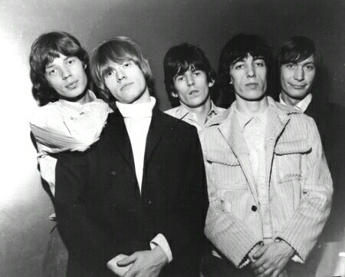
The Challenges of an Aging Population – Why it matters

Slide 4
The speed of population aging in selected countries
(Number of years required or expected for the percentage of the population aged 65 and
older to rise from 7% to 14% percent)
DEVELOPED COUNTRIES
DEVELOPING COUNTRIES
France(1865-1980)
115
Azerbaijan (2004-2037)
33
Sweden (1890-1975)
85
México (2011-2030)
28
Australia (1938-2011)
73
Chile (1998-2025
27
United States (1944-2013)
69
China (2000-2026)
26
Canadá (1944-2009)
65
Sri Lanka (2002-2026)
24
Hungary (1941-1994)
53
Tunisia(2008-2032)
24
Spain (1947-1992)
45
Thailand(2002-2024)
22
United Kingdom (1930-1975)
45
Brazil (2011-2032)
21
Poland (1966-2011)
45
Colombia (2017-2036)
19
Japan(1970-1996)
26
Singapore (2000-2019)
19
Source: Kinsella and Gist, 1995: and U.S. Census Bureau, International Data Base, accesed on March 24, 2008
Notes:
First of all, the speed of the process. Aging has proceeded more gradually in Western Nations. It took 115 years for the proportion of France´s population age 65 years or older to increase from 7 to 14 percent but the process has been incredibly fast in Mexico and other Latin America countries. The same change will take only 28 years.

Slide 5
Demographic Transition in Mexico. 2000-2050
Edad
2000
100
95
90
Hombres
Mujeres
85
80
75
70
65
60
55
50
45
40
35
30
25
20
15
10
5
0
1.2
1.0
0.8
0.6
0.4
0.2
0.0
0.0
0.2
0.4
0.6
0.8
1.0
1.2
Millones de personas
Edad
2030
Edad
2050
100
100
95
Hombres
Mujeres
95
Hombres
Mujeres
90
90
85
85
80
80
75
75
70
70
65
65
60
60
55
55
50
50
45
45
40
40
35
35
30
30
25
25
20
20
15
15
10
10
5
5
0
0
1.2
1.0
0.8
0.6
0.4
0.2
0.0
0.0
0.2
0.4
0.6
0.8
1.0
1.2
1.2
1.0
0.8
0.6
0.4
0.2
0.0
Millones de personas
0.0
0.2
0.4
0.6
0.8
1.0
1.2
Millones de personas
Source: Estimaciones de población de CONAPO- 2000.

Slide 6
Evolution of main causes of death 1940-2010
 | 1940 | 1950 | 1960 | 1970 | 1980 | 1990 | 2000 | 2009 | 2010
1 | Diarrhea and enteritis | Diarrhea and enteritis | Diarrhea and enteritis | Pneumonia and Influenza | Accidents | Heart Disease | Heart Disease | Heart Disease | Heart Disease
2 | Pneumonia and Influenza | Pneumonia and Influenza | Pneumonia and Influenza | Diarrhea and enteritis | Diarrhea and enteritis | Cancer | CAncer | Diabetes Mellitus | Diabetes Mellitus
3 | Malaria | Chilhood Diseases | Chilhood Diseases | Accidents | Pneumonia and Influenza | Accidents | Diabetes Mellitus | Cancer | Cancer
4 | Measles | Malaria | Heart Disease | Heart Disease | Heart Disease | Diabetes Mellitus | Accidents | Accidents | Accidents
5 | Homicides | Heart Disease | Accidents | Pregnancy Causes | Cancer | Perintal | Liver Diseases | Liver Diseases | Liver Diseases
6 | Bronchitis | Homicides | Cancer | Cancer | Stroke | Pneumonia and Influenza | Stroke | Stroke | Stroke
7 | Liver Diseases | Accidents | Homicides | Stroke | Liver Diseases | Diarrhea and enteritis | Perinatal | Homicides y violencias | Homicides y violencias
8 | Congenital Diseases | Pertussis | Bronchitis | Measles | Diabetes Mellitus | Stroke | Pneumonia and Influenza | COPD | COPD
9 | Heart Disease | Tuberculosis | Tuberculosis | Liver Cirrhosis | Homicides and violence | Liver Diseases | COPD | Pneumonia and Influenza | Pneumonia and Influenza
10 | Tuberculosis | Bronchitis | Liver Cirrhosis | Tuberculosis | COPD | Homicides and violence | Homicides and violence | Perinatales | Perinatal

Slide 7
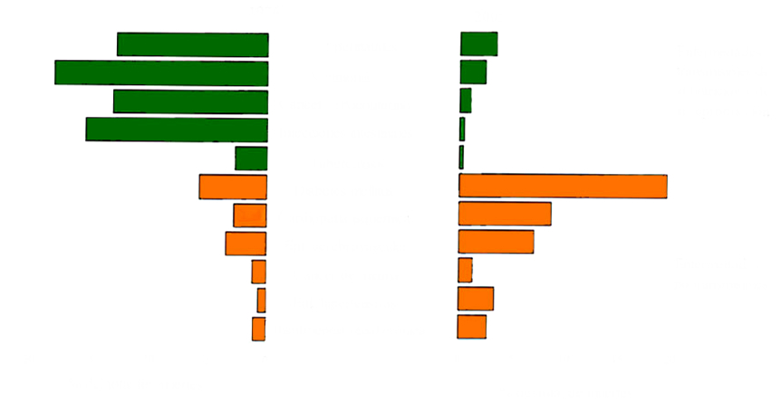
Mortality by selected causes 1976-2008
1976
2009
Perinatal mortality
Infectious diseases, malnutrition and reproductive health
Pneumonia
Cervical cancer
Diarrheal diseases
Tuberculosis
Diabetes
Ischemic heart disease
Stroke
Breast cancer
Chronic diseases
Hypertension complications
Chronic renal failure
20
15
10
5
0
0
5
10
15
20
% of total deaths
% of total deaths
Source: IMSS-SSA

Slide 8
Prevalence of overweight and obesity among IMSS affiliates
80
Obesity
69.9
Overweight
61.3
62.1
60
%
40
30.9
20
9.5
0
Children
Adolescents
Men
Women
Older adults
Source: ENCOPREVENIMSS 2006

Slide 9
Prevalence of Diabetes Mellitus by age group 2000-2011
In the year 2000, there were 2.8 millions of patients with diabetes in Mexico.
In 2006 the figure increased to 4.2 millions
Source: SSA-INSP Encuesta Nacional de Salud, México 2000. SSA-INSP Encuesta Nacional de Salud y Nutrición, México 2006

Slide 10
Prevalence of hypertension by sex and age group IMSS and National
80
70
60
50
%
40
30
20
10
0
20 a 29
30 a 39
40 a 49
50 a 59
60 a 69
70 a 79
80 y mas
Age group
Men
Women
Men-National
Women-National
Source: ENSANUT 2006.

Slide 11
Higher utilization rates in groups of age 60 and older
Men
Women
> 80
75 A 79
70 A 74
65 A 69
60 A 64
55 A 59
50 A 54
45 A 49
40 A 44
35 A 39
30 A 34
25 A 29
20 A 24
15 A 19
10 A 14
5 A 9
< 5
80,000
60,000
40,000
20,000
0
0
20000
40000
60000
80000
TASA X 100,000 HABITANTES
AGE GROUP
TASA X 100,000 HABITANTES
Private
Other
Other social security
ISSSTE
IMSS
SSA
Source: ENSA, 2000.

Slide 12
Index of ambulatory visits by age groups. IMSS 1986-2011
Age Group
Source: División Técnica de Información en Salud, IMSS

Slide 13
Speed of Population Aging in Selected Countries.
Number of years required for percent of population age 65 or older to rise from 7% to 14% will be faster in Mexico
Epidemiological transition.
Diabetes mellitus, cancer, cardiovascular diseases are the main reasons of mortality and morbidity
Financial and health services challenges.
Only 3/10 persons older than 60 years receive a contributory pension
Higher health services utilization rates in groups of age 60 and older:
In Family Medicine level 1/3 medical consultations are given to patients older than 60 years old
At General Hospital level, 23.2% of the total discharges corresponds to people older than 60% (6.6% in 1986)
Source:
Kinsella and Gist, 1995: and U.S. Census Bureau, International Data Base, accesed on March 24, 2008
Encuesta Nacional de Empleo y Seguridad Social ENESS, 2009

Slide 14
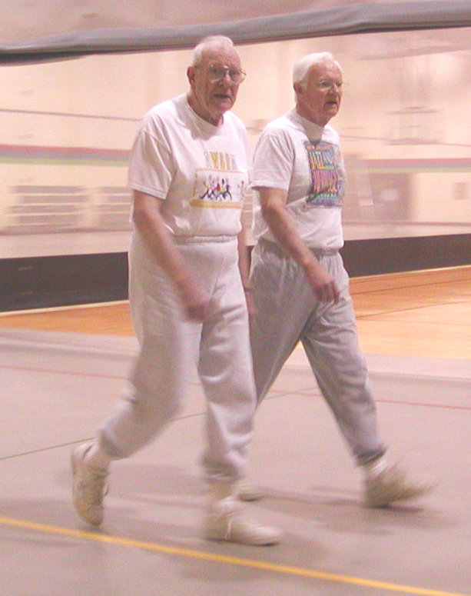
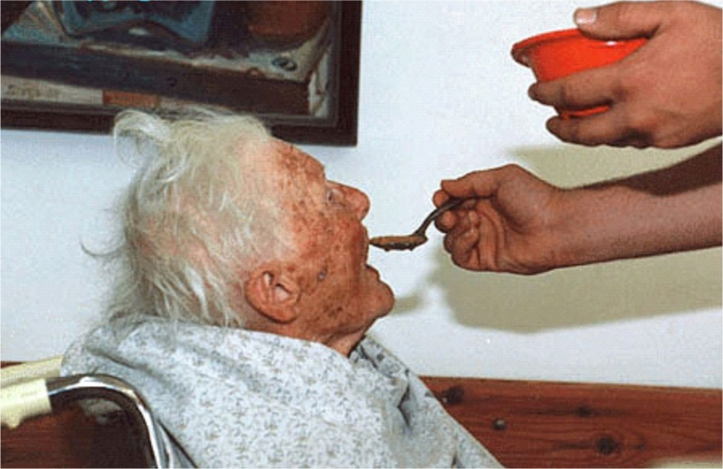
The Challenges of Aging –
How older patients are different from all other patients
As people age, some physiologic changes are inevitable but:
Chronologic age and physiologic age are not the same
Individuals “age” at different rates and there is significant variability
Physiologic changes
Universal
Not Universal
Psycho-Social changes

Slide 15
Physiologic Changes Associated with Aging
Examples of universal changes
Decreased night vision
Decreased muscle mass
Loss of hair pigment
Decreased lung vital capacity
Decreased height
Decreased gait speed
Examples of changes (including diseases) not universal, evitable,
Hearing loss
Macular degeneration
Hypertension
Heart disease
Cancer
Parkinson’s disease
Dementia

Slide 16
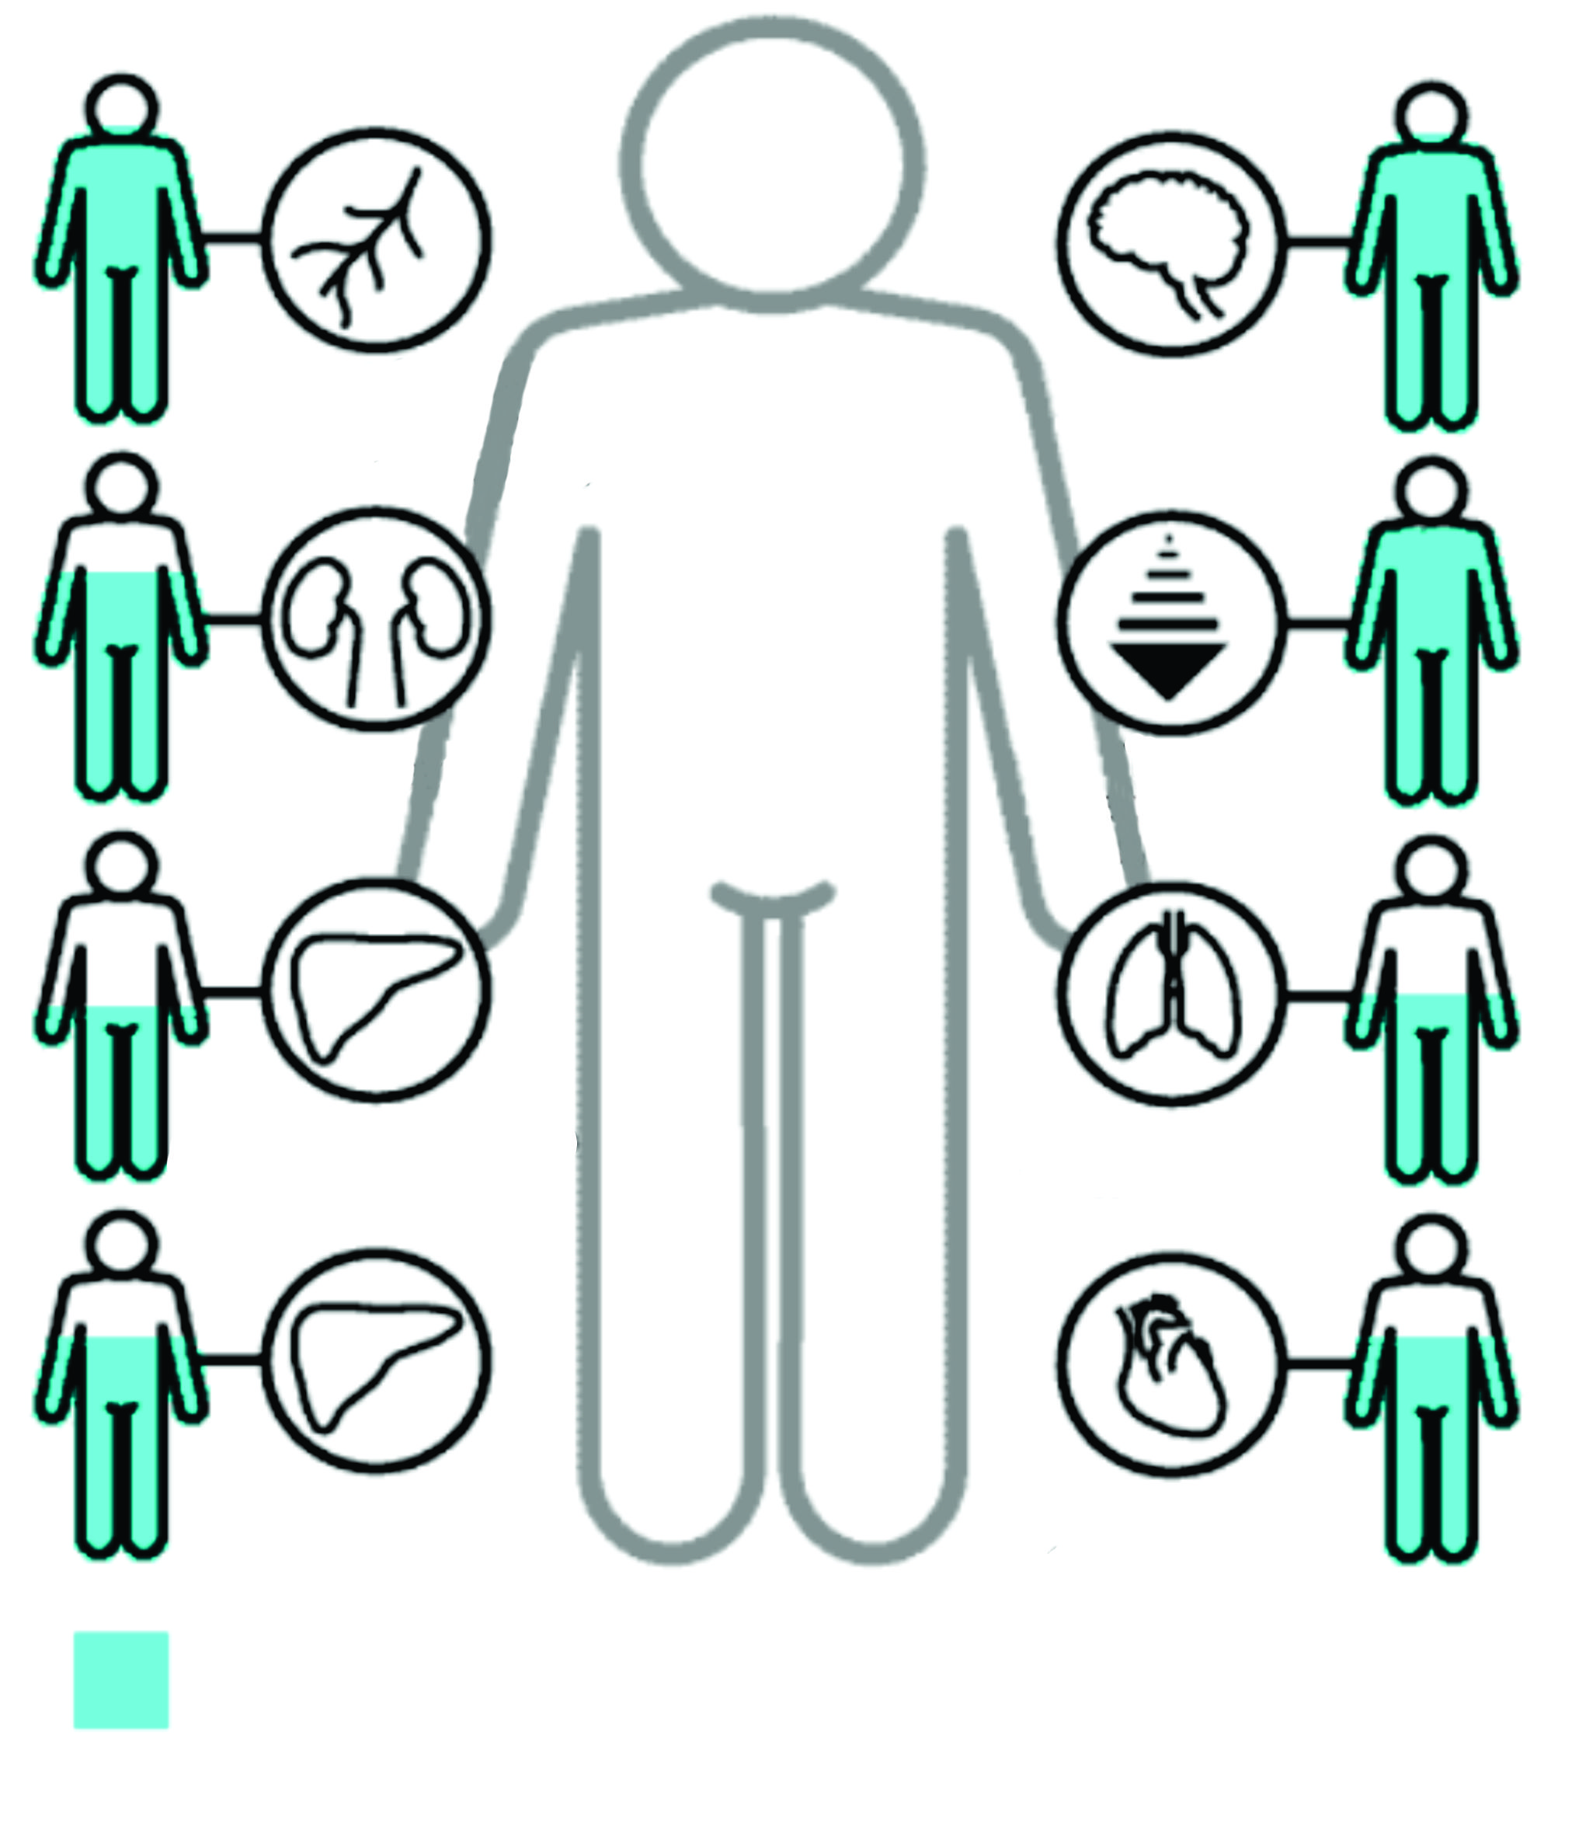
Weight of brain
56%
Blood supply to brain
80%
Velocity of nerve impulse 90%
Glomerular filtration rate
69%
Metabolism
65%
Hepatic Blod Flow
50%
Vital capacity
56%
Liver weight
65%
Output of heart
as rest
70%
LOSS OF STRUCTURE AND FUNCTION IN AGING
Figures represent percentage of a given function remaining in an average 75-year-old man compared with that found in an average 30-year-old man, the latter value taken as 100%.

Slide 17
Psycho-Social Problems More Common with Aging
Loss of income
Loss of close family
Loss of community
Social isolation

Slide 18
Why we age differently?
Functional Reserve!
Most of the body’s organ systems have some degree of redundancy – for instance, there are more kidney cells than absolutely needed so that kidney function can continue even if cells are lost to disease or other insult
As people age, functional reserve diminishes so that an acute insult can have much more severe consequences, whether it is in kidney function or cognitive function or even social function:
Geriatric Syndromes -- Frailty -- Functional Decline

Slide 19
Geriatric Syndromes
Conditions, not diseases
Common in the elderly
Typically:
Multifactorial
Share risk factors
Linked with functional decline, increasing frailty and poor health outcomes
Sensory Impairment
(Visual and Hearing)
Gait Impairment
Falls
Incontinence
Dementia
Depression
Delirium
Polypharmacy
Sleep Problems
Pressure Ulcers

Slide 20
Frailty in Older Adults
Biologic syndrome of decreased reserve and resistance to stressors, resulting from cumulative declines across multiple physiologic systems, and causing vulnerability to adverse outcomes.
Frailty:
It is progressive,
Usually it is associated to chronic diseases,
Worsens with age,
Leads to dependence on others, and shortened survival
Fried LP, Tangen CM, Walston J et al. Frailty in older adults: evidence for a phenotype. J Gerontol A Biol Sci Med Sci 2001; 56 (3): M146–M156.

Slide 21
What is not Frailty?
It is not synonymous with aging
Aging is a universal and irreversible process
Frailty is not universal and it is possible to intervene
It is not synonymous with disability
Only 28% of disable persons are fragile
Frail elderly:
60% dependent for instrumental ADL
27% dependent for basic ADL

Slide 22
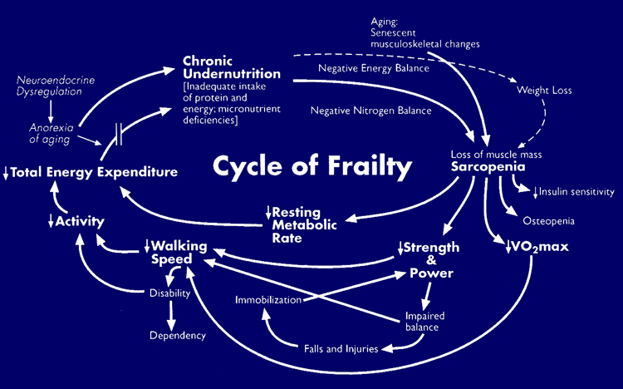
Marco conceptual de la fragilidad
Envejecimiento: cambios
Enfermedad
músculo esqueléticos
asociados al envejecimiento
Alteraciones
Desnutrición
Crónica
neuroendocrinas
Balance energético
negativo
(Ingesta inadecuada de
Pérdida de peso
proteínas y energía,
deficiencia de
Balance
Anorexia del
envejecimiento
micronutrientes)
nitrogenado
negativo
Gasto
energético total
Sarcopenia
(Pérdida de masa muscular)
Tasa metabólica
basal
Actividad
Fuerza y poder
muscular
VO2 máx
Velocidad
de la marcha
(consumo máximo de oxígeno)
Discapacidad
Fried LP, Walston J. Frailty and failure to thrive. In: Hazzard WR, Blass JP, Ettinger WH jr, Halter JB, Ouslander J, eds. Principles of Geriatric Medicine and Gerontology, 4th ed. New York McGraw Hill; 1998:1387-1402.
Dependencia funcional
(Fried and Walston, 1998)

Slide 23
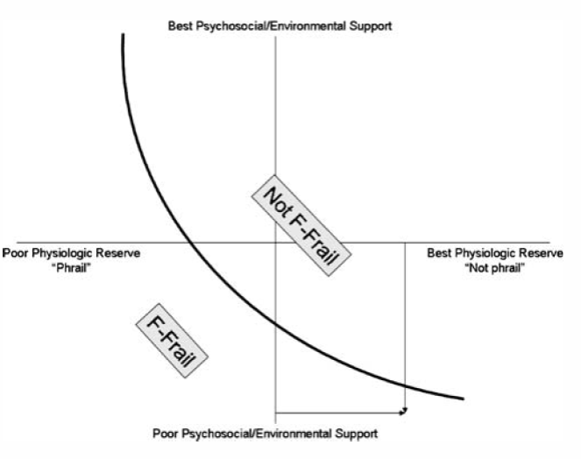

Slide 24
Functional Decline: Activities of Daily Living: (ADL’s) & Instrumental Activities of Daily Living (IADL’s)
What are they?
ADL’ Activities of Daily Living
Eating
Walking
Using the toilet
Dressing
Bathing
Getting in & out of bed

Slide 25
ADL’s & IADL’s
IADL’s: What are they?
Instrumental Activities of Daily Living
Cooking
Shopping
Using a phone
Doing housework
Getting outside the home
Managing money

Slide 26
ADL’s & IADL’s
Level of ADL’s & IADL’s is directly related to:
Autonomy, their ability to continue to live in their home setting
Caregivers’ ability to continue to provide care in the home for their elders
OR
Need for nursing home care

Slide 27
ADL’s & IADL’s
Usually, elders need help with IADL’s before they need help with ADL’s
Usually bathing is first ADL that the elder identifies as needing help with
Abilities for Eating & toileting are the last ones that someone loses and represent serious functional decline

Slide 28
A few words about Aging Research Priorities:
MECHANISMS
Aetiology
Allostasis
Biomarkers
Genetics
Systems
Models
SOCIO-ECONOMIC
Value of Healthy Ageing
Life course transitions
Autonomy & Purpose
Healthy Behaviours
Health Services
Emotional well-being
Assisted Technologies
TRANSLATION INTO BEST PRACTICE
HUMAN HEALTHY AGING
FOAD
Epidemiology
Genes & Environment
Understanding reversibility
Interventions
Personal vs. population
AGE-RELATED DISORDERS
Cancer
Respiratory diseases
Cardiovascular disease
Neurodegenerative disorders
Musculoskeletal diseases
Sensorial dysfunction
End of life care
Geriatric care
Modified from: BMC Geriatrics 2007, 7:10
Notes:
As a research group we have tried to follow or to cover four dimensions of aging research. Even when we are an epidemiological group, basically, we also work together with other biomedical research groups trying to answer how genetics are related with some responses, and how biomedical factors interact with the aging process, either pathologic or successful. We also cover some topics in the clinical, health services and economics area

Slide 29
European Consensus: Research Priorities
Healthy Aging for More Life in Years
Maintaining and Regaining Mental Capacity
Inclusion and Participation in the Community and in the Labour Market
Guaranteeing the Quality and Sustainability of Social Protection Systems
Aging Well at Home and in Community Environments
Unequal Aging and Age-Related Inequalities
Biogerontology: from Mechanisms to Interventions

Slide 30
1. Healthy Aging
To extend life expectancy and to reduce avoidable mortality
Quality of life and y years of life lived free of disability
Frailty
How and when to screen for frailty
How to delay frailty
How to help and support frail old people?, how to find adaptive mechanisms?
How to measure frailty in an objective way?
Speed, grip strength, physical activity

Slide 31
Interventions to promote health
Exercise, social interaction, nutrition
Smoking, alcohol, obesity and malnutrition
Novel interventions to sustain the effects and to motivate old people
Content of interventions, effect of different schemes (balance, strenght).
Effect of exercise along life course.
To validate diagnostic parameters in Mexican population for obesity, frailty, sarcopenia

Slide 32
2. Maintaining and Regaining Mental Capacity
Role of context for enhancing cognitive engagement
How strong is the effect size of social and physical environments as compared to person factors related to mental capacity development?
Can improvements in the work environment lead to the maintenance or enhancement of mental capacity of aging employees?
How are older adults dealing with cognitive decline in everyday life? What are efficient compensatory and optimising strategies and what can we learn from such real world analysis for maintaining mental capacity at large?
Transitions from normal to pathological processes related to mental capacity

Slide 33
3. Inclusion and participation in the community
and in the labour market
Ageism
Migration
Overcoming the digital divide
What role can ICT and virtual networks play in facilitating social inclusion?
What are the effects of ICT-tools in terms of intra- and intergenerational relationships?
Which measures are most effective in reducing or preventing the digital divide in using new technologies?
And this especially in fields like long-term care, where they represent a crucial support tool for both formal and informal care providers?
Mobility and accesibility
Work
Informal care
When do we have to retire?
ICT = Information and Communications Technology

Slide 34
4. Guaranteeing the quality and sustainability of
Social protection systems
Pensions
Informal care and long term care
What is the role of ICT-based solutions in improving the quality of long-term care provided by informal carers, as well as their quality of life?
Which impact can ICT have in reducing the direct and indirect costs attached to informal care giving?
Which ICT-solutions are most easily transferrable and implementable on a large scale, also in contexts in which no strong tradition nor digital competences exist in using ICT?
Financial sostenibility
Access to care
Can ICT improve knowledge about the services available, and to some degree can it release some of the burden on social and health services?
ICT = Information and Communications Technology

Slide 35
5. Ageing well at home and in community environments
Healthy home and community environments for old people
Environments that promote autonomy
Is there evidence for cohort-related changes in what home environments and neighbourhoods mean to older adults?
Will technology, for example home-based robotic systems, be accepted better by future older adults as a means to support and enrich quality of life?
What meaning do specific places (e.g. kitchen, garden) hold as people age, and is there a change of the role and function of such places over time?
To stay at home as long as it is possible?

Slide 36
The development and use of multidisciplinary research are crucial to the production of data that can support better public policies.
Longitudinal research should be conducted to understand the complex interrelationships between social variables (work, family structure, economics), and other clinical variables.
Clinical and Epidemiological Researchers have to work with computational Scientifics to discover better solutions. Evaluation of health impacts and sustainability are two of the issues in discussion
Elders perspective and ethical issues have to be involved.

Slide 37
Ageing research is an area of great social, political and economic importance for the European Union... We want to re-focus research and innovation polices very clearly on developing a coherent strategic research agenda which will tackle the grand societal challenges, which include both the promotion of healthy living and healthy ageing... These challenges can only be confronted if innovative and multi-disciplinary approaches are taken.
M. Geoghegan-Quinn, ‘Healthy Ageing – A European Priority’, European Parliament, 15 April 2010.

