Slide 1
Special Topics in Text Mining
Manuel Montes y Gómez http://ccc.inaoep.mx/~mmontesg/
mmontesg@inaoep.mx
University of Alabama at Birmingham, Spring 2011

Slide 2
Semi-supervised text classification

Slide 3
Agenda
Problem: training with few labeled documents
Semi-supervised learning
Self-training
Co-training
Using the Web as corpus
Set-based document classification

Slide 4
Supervised learning
Supervised learning is the current state-of-the-art approach for text classification.
A general inductive process builds a classifier by learning from a set of pre-classified examples.
Pre-classified examples are, for this task, manually labeled documents.
As expected, the more the labeled documents are, the better the classification model is .

Slide 5
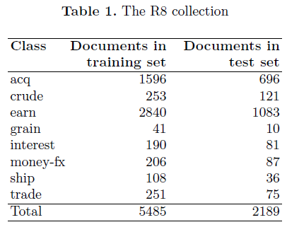
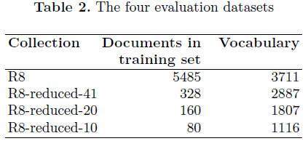
Some interesting results
Important drop in accuracy (27% )

Slide 6
The problem
One of the bottlenecks of classification is the labeling of a large set of examples.
Construction of these training sets is:
Very expensive
Time consuming
For many real-world applications labeled document sets are extremely small.
How to deal with this situation?
How to improve accuracy of classifiers?
Another source of information?

Slide 7
Semi-supervised learning
Idea is learning from a mixture of labeled and unlabeled data.
For more text classification tasks, it is easy to obtain samples of unlabeled data.
For many cases, Web can be seen as a large collection of unlabeled documents
Assumption is that unlabeled data provide information about the joint probability distribution over words and collocations.

Slide 8
Goal of semi-supervised learning
Semi supervised learners take as input unlabeled data and a limited source of labeled information, and, if successful, achieve comparable performance to that of supervised learners at significantly reduced costs
Two questions are important to answer:
For a fixed number of labeled instances, how much improvement is obtained as the number of unlabeled instances grow?
For a fixed target level of performance, what is the minimum number of labeled instances needed to achieve it, as the number of unlabeled instances grow?

Slide 9
Self-training algorithm
Based on the assumption that “one’s own high confidence predictions are correct”.
Main steps:
Use a set of labeled documents to construct a classifier
Apply the classifier to unlabeled data
Take the predictions of the classifier to be correct for those instances where it is most confident
Expand labeled data by incorporation of the selected instances
Train a new classifier
Iterate the process until a stop condition is met.

Slide 10
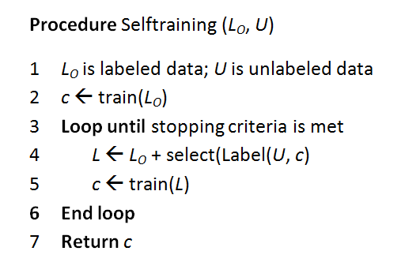
Self-training algorithm (2)
Which classifier is adequate?
When to stop?
How to select the more confident instances?

Slide 11
Parameters and variants
Base learner: any classifier that makes confidence-weighted predictions.
Stopping criteria: a fixed arbitrary number of iterations or until convergence
Indelibility: basic version re-labels unlabeled data at every iteration; in a variation, labels from unlabeled data are never recomputed.
Selection: add only k instances to the training at each iteration.
Balancing: select the same number of instances for each class.

Slide 12
Self-training: final comments
Uses its own predictions to teach itself
Advantages
The simplest semi-supervised learning method.
Almost any classifier can be used as base learner
Disadvantages
Early mistakes could reinforce themselves.
Heuristic solutions, e.g. “un-label” an instance if its confidence falls below a threshold.
Cannot say too much in terms of convergence.

Slide 13
Applications of Self-training
It has been applied to several natural language processing tasks.
Yarowsky (1995) uses self-training for word sense disambiguation.
Riloff et al. (2003) uses it to identify subjective nouns.
Maeireizo et al. (2004) classify dialogues as ‘emotional’ or ‘non-emotional’.
Zhang et al. (2007), Zheng et al., (2008), Gúzman-Cabrera et al. (2009) apply it to text classification.

Slide 14
Co-training
It also considers learning with a small labeled set and a large unlabeled set.
But, it uses two classifiers. Specifically, each classifier is trained on a different sub-feature set.
The idea is to construct separate classifiers for each view, and to have the classifiers teach each other by labeling instances where they are able.

Slide 15
General assumptions
Features can be split into two sets
Have two different views of the same object
Similar to having two different modalities
Each sub-feature set is sufficient to train a good classifier.
The two sets are conditionally independent given the class.
High confident data points in one view will be randomly scattered in the other view

Slide 16
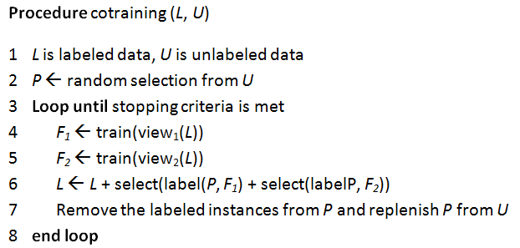
Co-training algorithm
Blum, A., Mitchell, T. Combining labeled and unlabeled data with co-training. COLT: Proceedings of the Workshop on Computational Learning Theory, Morgan Kaufmann, 1998, p. 92-100.

Slide 17
Co-training parameters
Similar variants to those from self-training.
There is no method for selecting optimal values; that is its main disadvantage.
Select examples directly from U is not as good as using a smaller pool U´
Typically several tens of iterations are done
Commonly it selects a small number of instances
Smaller changes at each iteration
The selected values tend to maintain the same original data distribution.

Slide 18
Finding related unlabeled documents
Semi-supervised methods assume the existence of a large set of unlabeled documents
Documents that belong to the same domain
Example documents for all given classes
If unlabeled documents do not exists, then it is necessary to extract them from other place
Main approach: using the web as corpus.
How to extract related documents from the Web?
How to guarantee that they are relevant for the given problem?

Slide 19
Self-training using the Web as corpus
Using the Web as Corpus for Self-training Text Categorization. Rafael Guzmán-Cabrera, Manuel Montes-y-Gómez, Paolo Rosso, Luis Villaseñor-Pineda. Information Retrieval, Volume 12, Issue3, Springer 2009.

Slide 20
How to build good queries?
Good queries are formed by good terms
What is a good term?
Term with low ambiguity
Term that helps to describe some class, and helps to differentiate among classes
Simple solution:
Frequency of occurrence greater than the average (in one single class)
Positive information gain

Slide 21
How to build good queries? (2)
Observations:
Long queries are very precise but have low recall.
Short queries are to ambiguous; they retrieve a lot of irrelevant documents.
Simple solution:
Queries of 3 terms
Generate all possible 3-term combinations
But, are all these queries equally useful?

Slide 22
Web search
Measure the significance of a query q = {w₁, w₂, w₃} to the class C as follows:
Determine the number of downloaded examples per query in a direct proportion to its Γ-value.
Frequency of occurrence and information gain of the query terms
Total number of snippets to be download

Slide 23
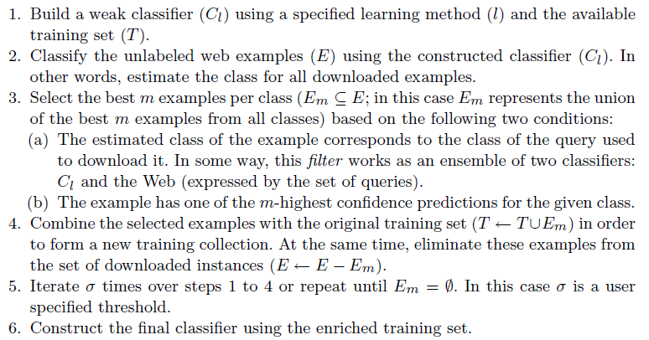
Adapted self-training

Slide 24
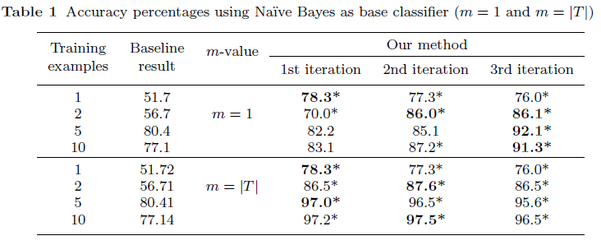
Experiment 1: Classifying Spanish news reports
Four classes: forest fires, hurricanes, floods, and earthquakes
Having only 5 training instances per class was possible to achieve a classification accuracy of 97%

Slide 25
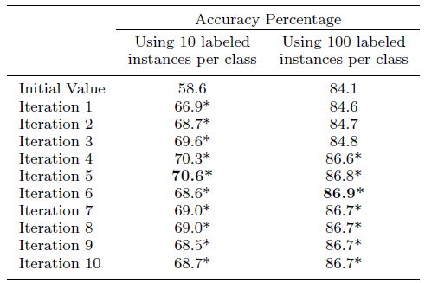
Experiment 2: Classifying English news reports
Experiments using the R10 collection (10 classes)
Higher accuracy was obtained using only 1000 labeled examples instead of considering the whole set of 7206 instances (84.7)

Slide 26
Experiment 3: Authorship attribution of Spanish poems
Poems from five different contemporary poets
282 training instances, 71 test instances.
Surprising to verify that it was feasible to extract useful examples from the Web for the task of authorship attribution.

Slide 27
Classification without labeled documents
Most text classification techniques assume manually-labeled documents are handy and can be used for training.
An assumption sometimes not quite realistic in practical experience.
However, in all cases there is information about the name of the classes.
Considering that the Web is a valuable data source for almost all subjects, the questions are:
How to exploit the richness of Web resources?
How to obtain relevant examples for the given classes?

Slide 28
Some proposed solution
Train classifiers through Web corpora based on user-defined class topics
Send the names of the classes as queries to search engines
Use the top-returned search results pages as the initial training corpus → initial labeled data set
Cluster each one of the classes’ datasets in order to find some relevant sub-concepts, and represent them by a set of keywords.
Send several queries using the new keywords as queries
Use the top-returned search results as unlabeled corpus
Incorporate more confident unlabeled documents to the training set by means of self-training
Repeat steps 3-6 a fix number of iterations

Slide 29
Final comments
This method has great potential, since no labeled training data is required.
It will increase the availability of text classification in many real world applications
Main feature: very flexible
Can be easily adapted for various purposes
Some challenges:
Consider ambiguity of terms (name classes)
Consider temporal factors

Slide 30
Set-based text classification

Slide 31
Motivation
Machine learning approach for text classification:
Learn a classifier from a given training set
Use the classifier to classify new documents (one by one)
Several applications consider the classification of a given set of documents.
There is a collection of documents to classify and not an isolated document.
How to take advantage of all this information during the class assignment process?

Slide 32
Related idea
Set classification problem
Predict the class of a set of unlabeled instances with the prior knowledge that all the instances in the set belong to the same (unknown) class.
A need to predict the class based on multiple observations (examples) of the same phenomenon (object).
Face recognition based on pictures obtained from different cameras
Simple solution: determine the class for the set by taking into account the consensus predictions of individual instances.

Slide 33
Set-based text classification
Supported on the idea that similar documents must belong to the same category
Classifies documents by considering not only their own content but also information about the assigned category to other similar documents from the same target collection
Also useful for alleviating the problem of lacking labeled data.

Slide 34
Difference with semi-supervised learning
Semi-supervised learning
The goal is to improve the classifier, by incorporation more training information
Inputs: set of labeled data, unlabeled data
Applied at the training phase (iterative)
Set-based classification
The goal is to improve the classification performance by a given poor classifier
Inputs: a classifier
Applied at the classification phase (Non-iterative)

Slide 35
General approach
Document class assignment depends on:
Own content
The content of other similar documents
It is a kind of expansion of the given document
Similarity between documents
Class information determined from own content
Class information determined by the content of similar documents

Slide 36
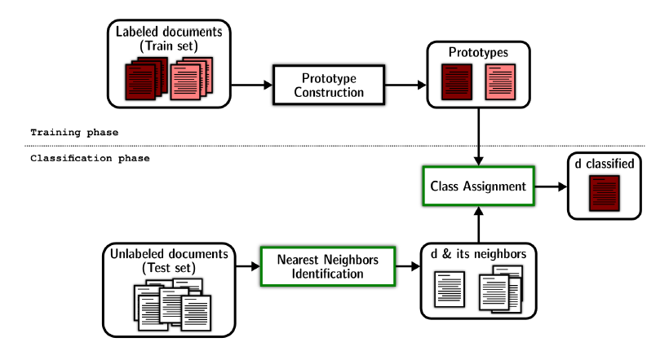
Implementation based on prototypes

Slide 37
Construction of prototypes
Prototypes are constructed from the available labeled documents.
As in the traditional prototype-based approach
Given a set of labeled documents D_{j} , we build a prototype P_{j} for each class j as follows:

Slide 38
Identification of nearest neighbors
This process focuses on the identification of the N nearest neighbors for each document of the test set.
It firstly computes the similarity between each pair of documents from the test set
We used the cosine formula
Then, based on the obtained similarity values, selects the N nearest neighbors for each document.

Slide 39
Class assignment
Given a document d from the test set in conjunction with its |V^{d}| nearest neighbors, this process assigns a class to d using the following formula:
sim is the cosine similarity function
|V^{d}| = N, is the number of neighbors considered to provide information about document
[lambda] is a constant used to determine the relative importance of both, the information from the own document (d) and the information from its neighbors

Slide 40
Results on small training sets (1)

Slide 41
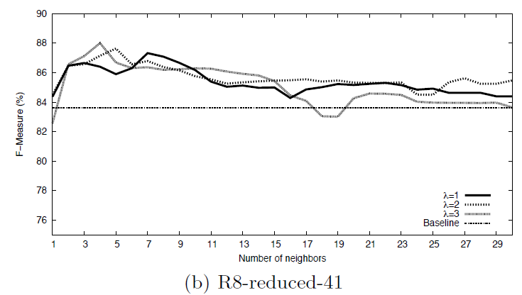
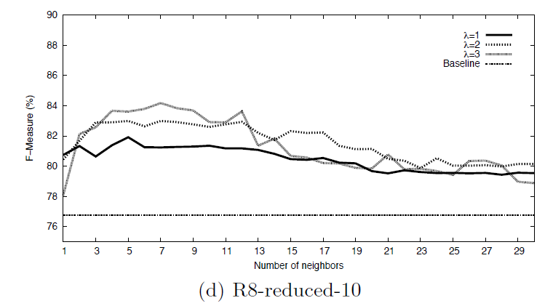
Results on small training sets (2)

Slide 42
Final comments
The method seems to be very appropriate for tasks having a small number of training instances.
Results indicate that using only 2% of the labeled instances (i.e., R8-reduced-10), it achieved a similar performance than Naive Bayes when it employed the complete training set (i.e., R8).
It can be used in combination with semi-supervised methods
It may also be appropriate for classifying short text documents

