Slide 1
Special Topics in Text Mining
Manuel Montes y Gómez http://ccc.inaoep.mx/~mmontesg/
mmontesg@inaoep.mx
University of Alabama at Birmingham, Spring 2011

Slide 2
Techniques to improve document clustering

Slide 3
Cluster ensembles

Slide 4
Definition of the task
Clustering ensembles combine multiple partitions generated by different clustering algorithms into a single clustering solution
The goal is to improve robustness, stability and accuracy of clustering solutions.
What does it mean this?
It has been noticed that a random choice of an ensemble is not as hazardous as a random choice of a single clustering algorithm

Slide 5
Advantages of cluster ensembles
Robustness: Better average performance across the domains and datasets
Novelty: Finding a combined solution unattainable by any single clustering algorithm.
Stability: Clustering solutions with lower sensitivity to noise, outliers, or sampling variations.
They also have the ability to integrate solutions from multiple distributed sources of data or features (multimodal applications?)

Slide 6
Two main issues
Clustering ensembles are two stage algorithms. First, they store results of several clustering algorithms. Then, they use a specific consensus function to find a final partition from the data.
Two main issues:
Design of the individual clustering algorithms so that they form potentially an accurate ensemble
Design of different ways to combine the outputs of individual clustering algorithms

Slide 7
General architecture
Clustering
Algorithm 1
Raw data
Clustering
Algorithm 2
Final partition
Consensus Function
:
Clustering
Algorithm N
Which clustering method(s) to consider?
How to combine their outputs?

Slide 8
Individual clustering algorithms
Two important factors:
Diversity within the ensemble
Accuracy of individual clustering algorithms
To achieve diverse clustering outputs:
Using different clustering algorithms
Changing initialization or other parameters of a clustering algorithm
Using different features
Partitioning different subsets of the original data



Slide 9
Combination of partitions
A primary design element of a consensus clustering algorithm is the aggregate representation that is constructed for the ensemble of partitions.
According to the used representation, there are methods that:
Induce a similarity-based structure from a given ensemble
View the ensemble partitions in a categorical feature-space representation
Derive a voting-based aggregated partition, which is a soft partition, to represent a given ensemble

Slide 10
Co-association matrix
It represents pairwise similarities between each pair of data objects.
It corresponds to an undirected graph where nodes represent objects and edges are weighted according to a defined measure of similarity.
In this matrix, similarities reflect the frequency of co-occurrence of each pair of objects in the same cluster throughout the ensemble.
It is the average of the adjacency matrices of the different individual clustering outputs

Slide 11
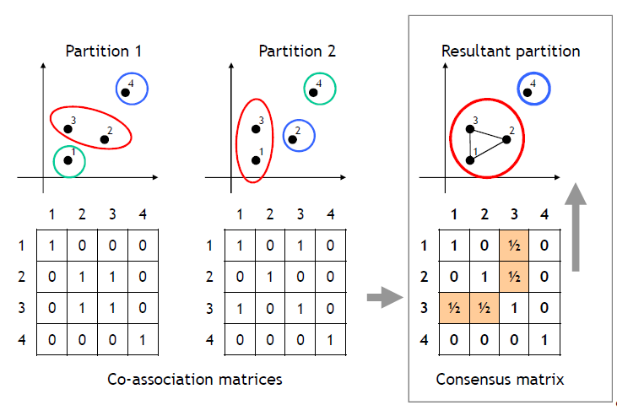
Example of the co-association matrix
How to build the final partition based on the co-association matrix?

Slide 12
Using the co-association matrix
The co-association matrix (M) has been used in a number of different ways to extract a consensus partition:
As similarity matrix
It can be directly used by any clustering algorithm
If distances are necessary, then use 1 – M.
As a data representation
Each one of the N documents is represented by N features
Use this matrix to compute a similarity matrix. That means a second order computation of similarities.

Slide 13
Using the co-association matrix (2)
M
N
Similarity Computation
N
Clustering Algorithm
N
Document-feature
matrix
Document similarity
matrix
N
N
Clustering Algorithm
Co-association
matrix
N
N
N
Similarity Computation
N
Clustering Algorithm
Co-association
matrix
Document similarity
matrix

Slide 14
Final remarks
From the two options, using the co-association matrix as data has reported the best results.
Some disadvantages of this approach are:
It has a quadratic complexity in the number of objects
There are no established guidelines concerning which clustering algorithm should be applied.
An ensemble with a small number of clusterings may not provide a reliable estimate of the co-association values

Slide 15
Final remarks (2)
Useful to apply document cluster ensembles:
To handle high-dimensionality: aggregate results obtained from different subsets of features
To take advantage of features from different modalities; e.g., thematic and stylistic features, content and link features, etc.
To achieve multilingual document clustering in parallel or comparable corpora.

Slide 16
Feature selection

Slide 17
Motivation
Most document clustering applications concern large and high-dimensional data
Several documents, thousands of features
Because the high dimensionality there is also a problem of data sparseness.
The problem for clustering is that the distance between similar documents is not very different than the distance between more dissimilar documents.
How to solve this problem?

Slide 18
Dimensionality reduction
Feature
Extraction
Extracts a set of new features from the original features through some functional mapping, such as principal component analysis, or word clustering → not a clear meaning.
Dimensionality reduction
Supervised approaches
For applications where class information is available
Feature
Selection
Filter
methods
Unsupervised approaches
Wrapper
methods

Slide 19
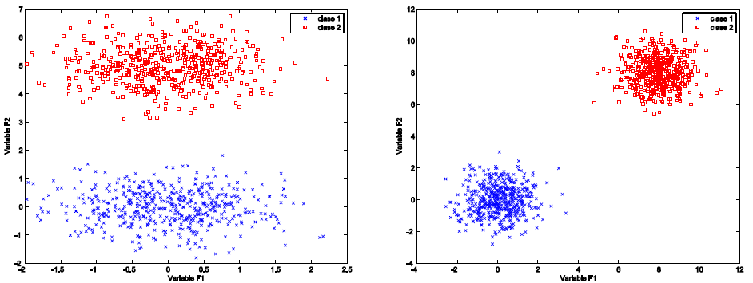
Two variables for feature selection
FS is typically carried out considering:
Feature relevance. Ability to differentiate between instances from different clusters
Feature redundancy. Correlation between the values of two features

Slide 20
Two approaches for feature selection
Filters
Rank features individually using an evaluation function, and eliminates those with an inadequate score → using some threshold or number of features
Wrappers
Assume that the goal of clustering is to optimize some objective function which helps to obtain ’good’ clusters, and use this function to estimate the quality of different feature subsets
Iterative process; high computational complexity
They require: a search strategy, a clustering algorithm, evaluation function, stop criteria.
Some ideas?

Slide 21
Filter methods for document clustering
Document frequency
Simplest criterion; penalizes rare terms
Term frequency variance
Favors frequent terms; penalizes terms with uniform distributions.

Slide 22
More filter methods
Term strength
Indicates the conditional probability that a term occurs in a document j given that it appears in a related document i.
β is a user specified value.
It can be enhanced by considering the probability of a term to occur in two not-similar documents

Slide 23
More filter methods
Entropy based feature ranking
Two documents clearly belonging to the same or to different clusters will contribute to the total entropy less than if they were uniformly separated.
Low and high similarities are associated to small entropy values.
The idea is to evaluate the entropy after the removal of each one of the features; and eliminate the features causing more disorder.

Slide 24
More filter methods
Term contribution
Clustering depends on documents similarity; and their similarity relies on their common terms.
This measures indicates the contribution of a term to the global document’s similarity.
It is an extension of DF, where terms have different weights.

Slide 25
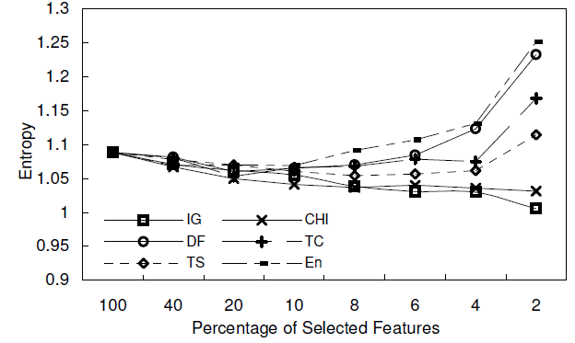
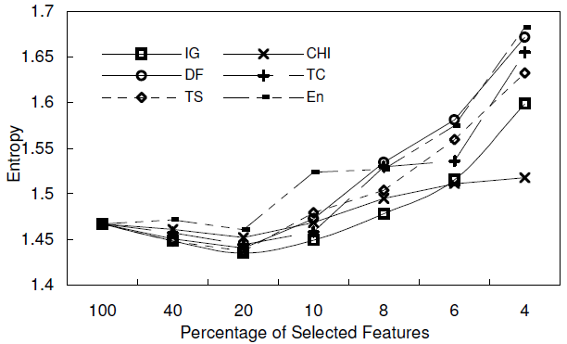
How good are unsupervised filter methods?
Results on news clustering, and their comparison against supervised approaches
Very good for reductions smaller than 80%; TS showed the best performance.
Reuters collections
20 News groups

Slide 26
Clustering short texts

Slide 27
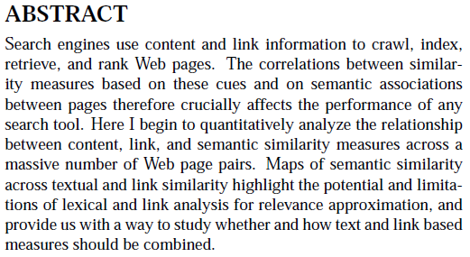
Short text difficulties
It is difficult to statistically evaluate the relevance of words
Most of them have frequencies equal to 1 or 2
The BoW representations from the documents result in very sparse vectors
Each document only has a small subset of the words
The distance between similar documents is not very different than the distance between more dissimilar documents

Slide 28
Another difficulty: narrowness
Clustering documents from a narrow domain is difficult since they have a high vocabulary overlapping level.
Sports
Not very high intersection in the vocabulary
Simple to cluster/classify even if they are short texts
politics
Entertainment
Very high intersection in the vocabulary
Complex to cluster/classify; more complex if they are short texts
Information
Retrieval
Text classification
Document Clustering

Slide 29
How to deal with these texts?
How to know when texts are short?
How to know if they are narrow-domain?
How to improve the clustering of these documents?
A better representation?
A different similarity measure?
Another clustering algorithm?
Ideas?

Slide 30
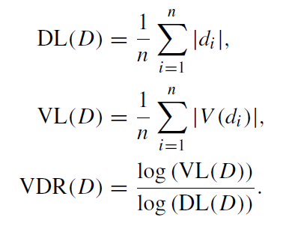
Shortness evaluation
Are the documents from a given collection short?
Arithmetic mean of document lengths
Arithmetic mean of the vocabulary lengths
The radio of vocabulary average to the document length average.
What measure is better?
Advantages and disadvantages?

Slide 31
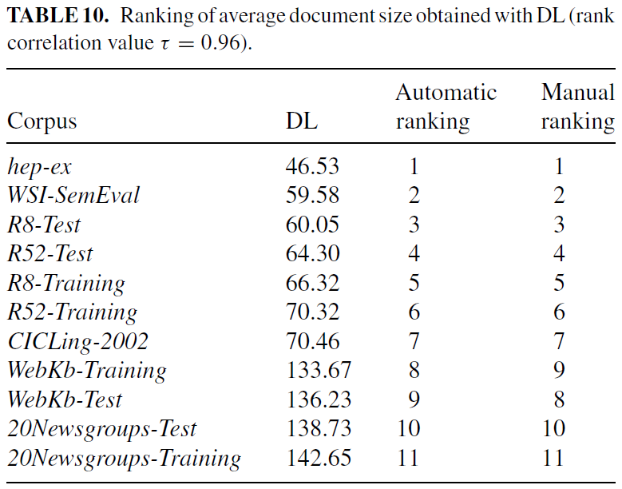
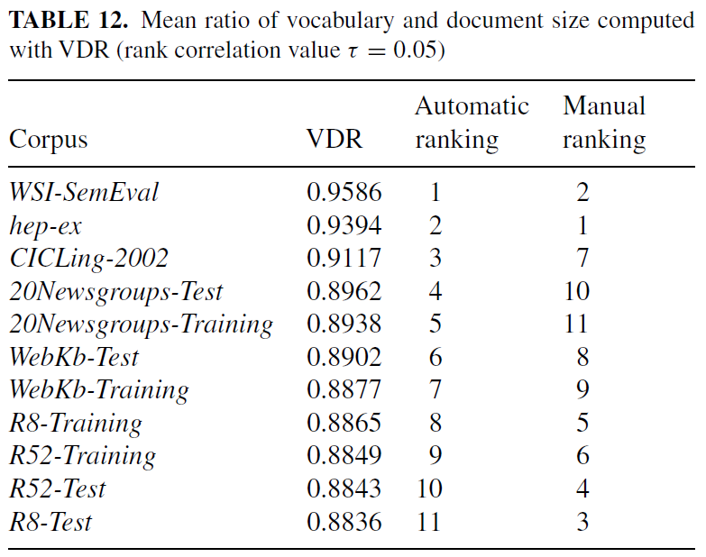
Some results
DL and VL better to evaluate the shortness of documents
It seems that VDR assesses the complexity of the corpus and not exactly the shortness.
Pinto, D., Rosso, P., Jim´enez-Salazar, H.: A self-enriching methodology for clustering narrow domain short texts.
The Computer Journal (2010). DOI 10.1093/comjnl/bxq069

Slide 32
Broadness evaluation
If the distribution of words (n-grams) is similar for different subsets of the collection, then it is narrow-domain
In a narrow domain documents share a greater number of vocabulary terms

Slide 33
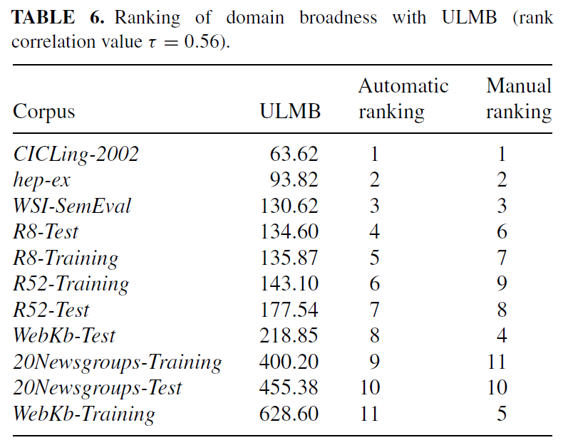
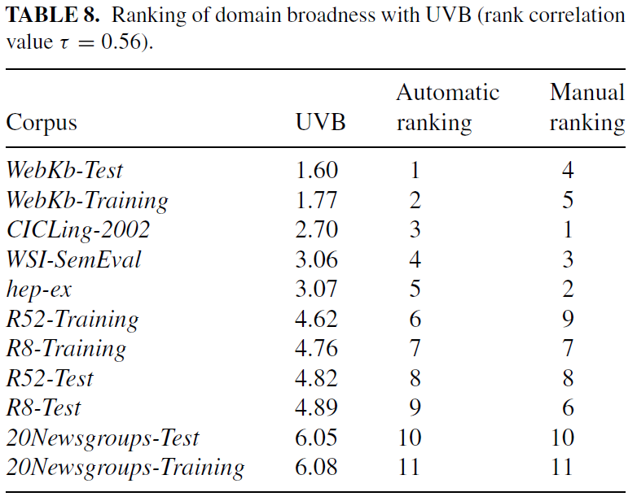
Some results
Both show a strong agreement with the manual ranking (correlation of 0.56)
For its simplicity, UVB seems a better option than UMLB
Both agree on the fact that scientific documents are narrow domain and news reports belong to a wide domain.

Slide 34
Dealing with short texts
Main approach consists in expand the documents by including related information
The related information has been extracted from:
The own document collection
Wordnet (or other thesaurus)
Wikipedia
How to do that?

Slide 35
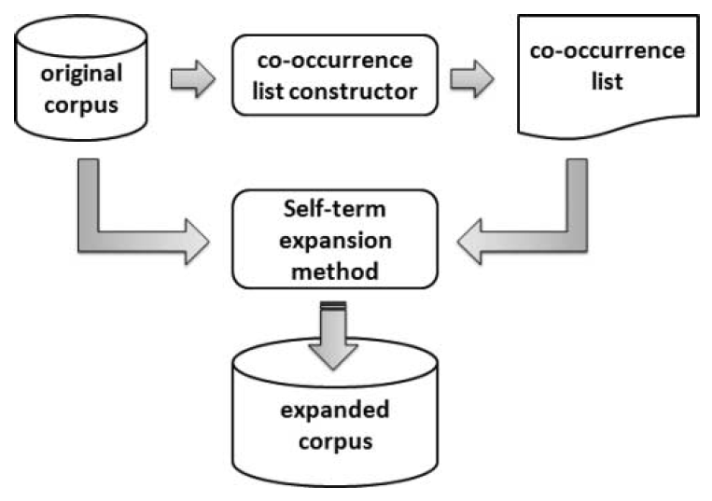
Self-term expansion
It consist of replacing terms of a document with a set of co-related terms
Term co-occurrence is measured by the pointwise mutual information method.
In order to obtain the new documents each original term is enriched by adding its corresponding set of related terms
It is important to notice that this method does not modify the dimensionality of the feature space

Slide 36
Expansion using Wordnet
Most clustering methods only relate documents that use identical terminology, while they ignore conceptual similarity of terms
The idea of these approach is to represent the documents by synsets and not by the words
A synset is a set of synonym words such as {car, auto, automobile, machine, motorcar}
It seems a very good idea to reduce the dimensionality and sparseness of the representation, but …
Problems?

Slide 37
Disadvantages of Wordnet-based expansion
Some languages do not have a Wordnet or have a very reduced version.
Clustering in Spanish vs. clustering in English
Specific domain knowledge tend to be poorly covered by Wordnets
Clustering news vs. clustering scientific papers
The main problem is to achieve a correct word sense disambiguation
Bank → represented by “financial institution” synset → represented by “sloping land” synset

Slide 38
Expansion using Wikipedia
Motivated by the fact that there are Wikipedias in more languages than Wordnets
The method is very simple:
Index all Wikipedia pages using BoW representation
Search for the k most similar pages for each short document of the given collection
Expand the documents using the title’s words from the k retrieved pages
Perform some unsupervised feature selection procedure to eliminate irrelevant (rare) words
Problems of this approach?

