Slide 1
Novel representations and methods in text classification
Manuel Montes, Hugo Jair Escalante
Instituto Nacional de Astrofísica, Óptica y Electrónica, Mexico. http://ccc.inaoep.mx/~mmontesg/
http://ccc.inaoep.mx/~hugojair/
{mmontesg, hugojair}@inaoep.mx
7th Russian Summer School in Information Retrieval Kazan, Russia, September 2013

Slide 2
Concept-based representations for Text categorization
Novel represensations and methods in text classification

Slide 3
Outline
BoW representation: characteristics and limitations
The bag-of-concepts
Distributional term representations (DTRs)
Using DTRs in short-text classification
Random indexing
Incorporating syntactic information
Results in text classification
Concise semantic analysis
Concise semantic analysis for author profiling
Meta-features for authorship attribution
Other bag-of-concept approaches

Slide 4
Distributional term representations
Novel represensations and methods in text classification

Slide 5
Bag-of-words representation
Many text classification methods adopt the BoW representation because its simplicity and efficiency.
Under this scheme, documents are represented by collections of terms, each term being an independent feature.
Word order is not capture by this representation
There is no attempt for understanding documents’ content

Slide 6
The BoW representation
Vocabulary from the collection (set of different words)
 | t₁ | t₁ | … | t_{n}
d₁
d₂
: |  | w_{i,j}
d_{m}
All documents
(one vector per document)
Weight indicating the contribution of word j in document i.

Slide 7
Main problems
BoW ignores all semantic information; it simply looks at the surface word forms
Polysemy and synonymy are big problems
Polysemy introduces noise into the BOW representation
Plant
d₁
Plant
1
Agriculture
Plant
1
d_{n}
Industry

Slide 8
Main problems
BoW ignores all semantic information; it simply looks at the surface word forms
Polysemy and synonymy are big problems
Synonymy splits the evidence in the BOW representation
PC
Computer
d₁
PC
1
Technology
Computer
1
d_{n}
Technology

Slide 9
Main problems
BoW tend to produce very sparse representations, since terms commonly occur in just a small subset of the documents
This problem is amplified by lack of training texts and by the shortness of the documents to be classified.
Very difficult to find classification patterns!

Slide 10
Main problems
BoW ignores all semantic information; it simply looks at the surface word forms
Polysemy and synonymy are big problems
BoW tend to produce very sparse representations, since terms commonly occur in just a small subset of the documents
This problem is amplified by lack of training texts and by the shortness of the documents to be classified.
We need representations at concept level!

Slide 11
Bag-of-concepts
Addresses the deficiencies of the BoW by considering the relations between document terms.
BoC representations are based on the intuition that the meaning of a document can be considered as the union of the meanings of their terms.
The meaning of terms is related to their usage; it is captured by their distributional representation.
Document occurrence representation (DOR)
Term co-occurrence representation (TCOR)
Alberto Lavelli, Fabrizio Sebastiani, and Roberto Zanoli. Distributional term representations: an experimental comparison. Thirteenth ACM international conference on Information and knowledge management (CIKM '04). New York, NY, USA, 2004

Slide 12
Document occurrence representation (DOR)
DOR representation is based on the idea that the semantics of a term may be view as a function of the bag of documents in which the term occurs.
Each document being an independent feature
Terms are represented as vectors in the space of documents
Two terms are related if they show similar distributions across the documents
Representation of terms
 | d₁ | d₂ | … | d_{n}
t₁
t₂
: |  | w_{i,j}
t_{m}

Slide 13
Intuitions about the weights
DOR is a dual version of the BoW representation, therefore:
The more frequently t_{i} occurs in d_{j}, the more important is d_{j} for characterizing the semantics of t_{i}
The more distinct the words d_{j} contains, the smaller its contribution to characterizing the semantics of t_{i}.
 | d₁ | d₂ | … | d_{n}
t₁
t₂
: |  | w_{i,j}
t_{m}

Slide 14
Representing documents using DOR
DOR is a word representation, not a document representation.
Representation of documents is obtained by the weighted sum of the vectors from their terms.
Word representation
Word–Document matrix
Document representation
Document–Document matrix
 | d₁ | d₂ | … | d_{n}
t₁
t₂
: |  | w_{i,j}
t_{m}
 | d₁ | d₂ | … | d_{n}
d₁
d₂
: |  | w_{i,j}
d_{n}
SUM

Slide 15
Term co-occurrence representation (TCOR)
In TCOR, the meaning of a term is conveyed by the terms commonly co-occurring with it; i.e. terms are represented by the terms occurring in their context
Terms are represented as vectors in the space of terms (vocabulary of the collection)
Two terms are related if they show similar co-ocurring distributions with the rest of the terms
Representation of terms
 | t₁ | t₂ | … | t_{m}
t₁
t₂
: |  | w_{i,j}
t_{m}

Slide 16
Intuitions about the weights
TCOR is the kind of representation traditionally used in WSD, therefore:
The more times t_{k} and t_{j} co-occur in, the more important t_{k} is for characterizing the semantics of t_{j}
The more distinct words t_{k} co-occurs with, the smaller its contribution for characterizing the semantics of t_{j}.
 | t₁ | t₂ | … | t_{m}
t₁
t₂
: |  | w_{i,j}
t_{m}

Slide 17
Representing documents using TCOR
TCOR, such as DOR, is a word representation, not a document representation.
Representation of documents is obtained by the weighted sum of the vectors from their terms.
Word representation
Word–Word matrix
Document representation
Document–Word matrix
 | t₁ | t₂ | … | t_{m}
t₁
t₂
:
t_{m}
 | t₁ | t₂ | … | t_{m}
d₁
d₂
:
d_{n}
SUM

Slide 18
BOW vs DOR vs TCOR
BOW
High dimensionality
Very sparse
DOR
Lower dimensionality than BOW
Not sparse
TCOR
Same dimensionality than BOW
Not sparse
 | t₁ | t₂ | … | t_{m}
d₁
d₂
:
d_{n}
 | d₁ | d₂ | … | d_{n}
d₁
d₂
: |  | w_{i,j}
d_{n}
DOR and TCOR do a kind of expansion of the documents

Slide 19
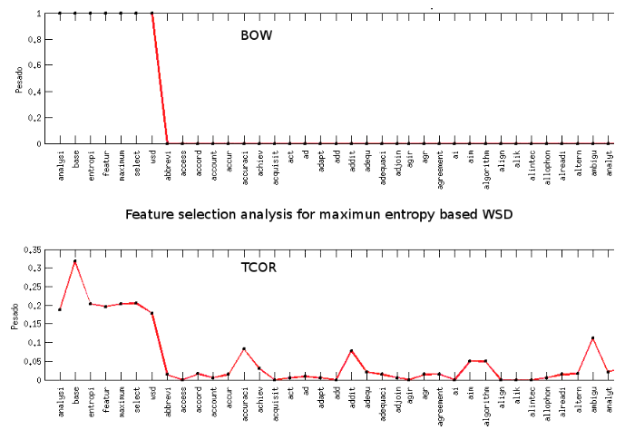
TCOR representation of a paper title

Slide 20
DOR/TCOR for text classification
Juan Manuel Cabrera, Hugo Jair Escalante, Manuel Montes-y-Gómez. Distributional term representations for short text categorization. 14th International Conference on Intelligent Text Processing and Computational Linguistics (CICLING 2013). Samos, Greece, 2013.

Slide 21
Experiments
Short-text categorization based on distributional term representations (DOR and TCOR)
They reduce the sparseness of representations and alleviates, to some extent, the low frequency issue.
Our experiments aimed to:
Verify the difficulties of the BoW for effectively representing the content of short-texts
Assess the added value offered by concept-based representations over the BoW formulation

Slide 22
Evaluation datasets
We assembled two types of collections:
Whole documents for training and test
Whole documents for training and titles for test
Reuters-R8
EasyAbstracts
Cicling 2002

Slide 23
Short-text classification with BoW

Slide 24
Conclusions (1)
Acceptable performance was obtained when regular-length documents were considered
SVM obtained the best results for most configurations of data sets and weighting schemes
The performance of most classifiers dropped considerably when classifying short documents
The average decrement of accuracy was of 38.66%
Results confirm that the BoW representation is not well suited for short-text classification

Slide 25
Using DOR/TCOR for short-text classification

Slide 26
Conclusions (2)
DOR and TCOR clearly outperformed BoW for most configurations.
In 62 out of the 90 results the improvements of DTRs over BoW were statistically significant
In average, results obtained with DOR and TCOR were very similar.
DOR is advantageous over TCOR because it may result in document representations of much lower dimensionality.

Slide 27
Bag of concepts by random indexing
BoC approaches tend to be computationally expensive.
They are based on a co-occurrence matrix of order w×c; w = terms, and c = contexts (terms or documents)
Random indexing produce these context vectors in a more computationally efficient manner: the co-occurrence matrix is replaced by a context matrix of order w×k, where k << c.
Magnus Sahlgren and Rickard Cöster. Using bag-of-concepts to improve the performance of support vector machines in text categorization. 20th international conference on Computational Linguistics (COLING '04). Stroudsburg, PA, USA, 2004.

Slide 28
Random indexing procedure (1)
First step: a unique random representation known as “index vector” is assigned to each context.
A context could be a document , paragraph or sentence
Vectors are filled with -1, 1 and 0s.
0 k
D₁
1
-1
D₂
1
-1
D_{n}
1
-1
k << n
Index Vectors (IV)
Documents

Slide 29
Random indexing procedure (2)
Second step: index vectors are used to produce context vectors by scanning through the text
Same idea than DOR: terms are represented by the documents they occur.
The context vector includes information from all documents containing the term
D₁: Towards an Automata Theory of Brain
D₂: From Automata Theory to Brain Theory
1
-1
1
-1
0 k
The context vector for brain
1
1
-1
-1

Slide 30
Random indexing procedure (2)
Third step: build document vectors by adding their terms’ context vectors.
As in DOR and TCOR, the representation of the documents is obtained by the weighted sum of the context vectors of their terms.
It is like having a new code bar for each document which summarize all its information
d_{i}: “From Automata Theory to Brain Theory”
CV₁ CV₂ CV₃ CV₂
d_{i} will be represented as the weighted sum of these vectors:
a₁CV₁+a₂CV₂+a₃CV₃+a₂CV₂ a₁, a₂, a₃ are idf-values

Slide 31
Limitations of BoC representations
BoC representations ignore the large amount of syntactic data in the documents not captured implicitly through term context co-occurrences
Although BoC representations can successfully model some synonymy relations, since different words with similar meaning will occur in the same contexts, they can not model polysemy relations.
Solution: a representation that encodes both the semantics of documents, as well as the syntax of documents

Slide 32
Random indexing with syntactic information
Multiplicative bidding procedure:
For each PoS tag, generate a unique random vector for the tag of the same dimensionality as the term context vectors.
For each term context vector, we perform element-wise multiplication between that term’s context vector and its identified PoS tag vector to obtain our combined representation for the term.
Finally, document vectors are created by summing the combined term vectors.
Jonathan M. Fishbein and Chris Eliasmith. Methods for augmenting semantic models with structural information for text classification. 30th European conference on Advances in information retrieval (ECIR'08). Glasgow, UK, 2008.

Slide 33
An alternative procedure
Circular convolution procedure:
For each PoS tag, generate a unique random vector for the tag of the same dimensionality as the term context vectors
For each term context vector, perform circular convolution, which binds two vectors :
Finally, document vectors are created by summing the combined term vectors
term
tag
term-tag

Slide 34
Circular convolution as binding operation
Two properties that make it appropriate to be used as a binding operation:
The expected similarity between a convolution and its constituents is zero, thus differentiating the same term acting as different parts of speech in similar contexts.
Gives high importance to syntactic information
Similar semantic concepts (i.e., term vectors) bound to the same part-of-speech will result in similar vectors; therefore, usefully preserving the original semantic model.
Preserves semantic information

Slide 35
Results on text classification
The goal of the experiment was to demonstrate that integrating PoS data to the text representation is useful for classification purposes.
Experiments on the 20 Newsgroups corpus; a linear SVM kernel function was used; all context vectors were fixed to 512 dimensions

Slide 36
Final remarks
BoC representations constitute a viable supplement to word based representions.
Not too much work in text classification and IR
Recent experiments demonstrated that TCOR, DOR and random indexing results outperform those from traditional BoW; in CLEF collections improvements have been around 7%.
Random indexing is efficient, fast and scalable; syntactic information is easily incorporated.

Slide 37
References
Ron Bekkerman, Ran El-Yaniv, Naftali Tishby, and Yoad Winter. Distributional word clusters vs. words for text categorization. Journal of Machine Learning Research. March 2003.
Juan Manuel Cabrera, Hugo Jair Escalante, Manuel Montes-y-Gómez. Distributional term representations for short text categorization. 14th International Conference on Intelligent Text Processing and Computational Linguistics (CICLING 2013). Samos, Greece, 2013.
Jonathan M. Fishbein and Chris Eliasmith. Methods for augmenting semantic models with structural information for text classification. 30th European conference on Advances in information retrieval (ECIR'08). Glasgow, UK, 2008.
Alberto Lavelli, Fabrizio Sebastiani, and Roberto Zanoli. Distributional term representations: an experimental comparison. Thirteenth ACM international conference on Information and knowledge management (CIKM '04). New York, NY, USA, 2004.
Magnus Sahlgren and Rickard Cöster. Using bag-of-concepts to improve the performance of support vector machines in text categorization. 20th international conference on Computational Linguistics (COLING '04). Stroudsburg, PA, USA, 2004.
Dou Shen, Jianmin Wu, Bin Cao, Jian-Tao Sun, Qiang Yang, Zheng Chen, and Ying Li. Exploiting term relationship to boost text classification. 18th ACM conference on Information and knowledge management (CIKM '09). New York, NY, USA, 2009.
Peter D. Turney and Patrick Pantel. From Frequency to Meaning: Vector Space Models of Semantics. Journal of Artificial Intelligence Research, vol. 37, 2010.

Slide 38
Concise semantic analysis
Novel represensations and methods in text classification

Slide 39
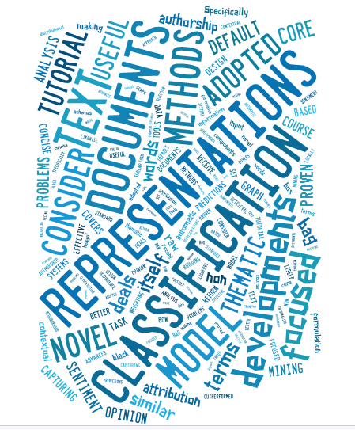
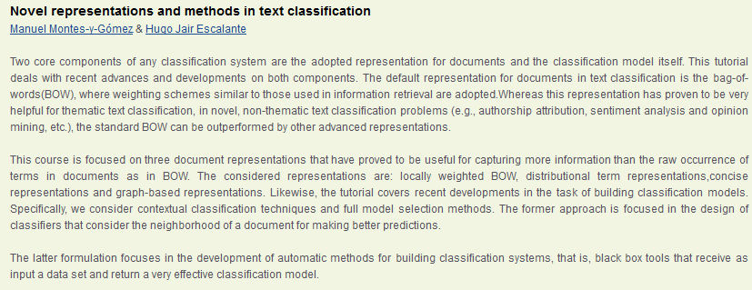
Bag of concepts (again)
Under the bag-of-concepts formulation a document is represented as a vector in the space of concepts
Concepts can be defined/extracted in different ways
Categorization
Text
Representation
Document
Novel
Methods

Slide 40
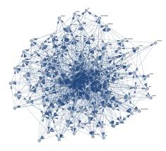
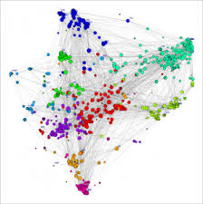
Bag of concepts (again)
So far we have seen representations that are unsupervised: techniques proposed for other tasks than classification and that do not take into account information of labeled examples
Can we define concepts that take into account information from labeled documents?

Slide 41
Bag of concepts (again)
Supervised bag-of-concepts: encode inter-class and/or intra-class information into concepts
A simple (yet very effective) approach for building concepts/features in a supervised fashion:
Concise semantic analysis: associate a concept with a class

Slide 42
Concise semantic analysis
Underlying idea: to associate a concept with each class of the categorization problem.
After all, in text categorization classes are usually tied with words/topics/concepts.
E.g., when classifying news into thematic classes: politics, religion, sports, etc.
Implicitly CSA reduces dimensionality, sparseness and incorporate document-term and term-class relationships
L. Zhixing , X. Zhongyang, Z. Yufang, L. Chunyong, L. Kuan. Fast text categorization using concise semantic analysis. Pattern Recognition Letters 32 (2011) 441–448.

Slide 43
Concise semantic analysis
Two stage process (as before, e.g., with DOR/TCOR)
Represent a term in the space of concepts
Represent documents in the space of concepts
Concept-based representation
Terms
. . .
Accommodation Steinhausen - Exterior View Blumenau, Brazil
October 2004
Accommodation:
. . .
Representation
for
terms
+
. . .
. . .
Steinhausen:
Document
. . .
. . .
Representation for
document
. . .

Slide 44
Concise semantic analysis
Two stage process (as before, e.g., with DOR/TCOR)
Represent a term in the space of concepts
Represent documents in the space of concepts
Concept-based representation
Terms
. . .
Accommodation Steinhausen - Exterior View Blumenau, Brazil
October 2004
Accommodation:
. . .
Representation
for
terms
+
. . .
. . .
Steinhausen:
Document
. . .
. . .
Representation for
document
. . .
Concepts

Slide 45
Concise semantic analysis
Stage 1: Represent a term in the space of concepts
term-concept matrix
 | C₁ | C₁ | … | C_{k}
t₁
t₂
: |  | w_{i,j}
t_{|V|}
Intuition: Measures the association of term t_{i} with class C_{j}

Slide 46
Concise semantic analysis
Stage 2: Represent documents in the space of concepts:
document-concept matrix
 | C₁ | C₁ | … | C_{k}
d₁
d₂
: |  | w_{d(i,j)}
d_{N}
a: # Positive documents that contain t_{j}
c: # Documents that contain t_{j}
Intuition: Measures the association of terms in the document with class C_{j}

Slide 47
Concise semantic analysis
Stage 2: Represent documents in the space of concepts:
document-concept matrix
 | C₁ | C₁ | … | C_{k}
d₁
d_{i}
: |  | w_{d(i,j)}
d_{N}
a: # Positive documents that contain t_{j}
c: # Documents that contain t_{j}
Intuition: Measures the association of terms in the document with class C_{j}

Slide 48
Concise semantic analysis
CSA for text categorization:

Slide 49
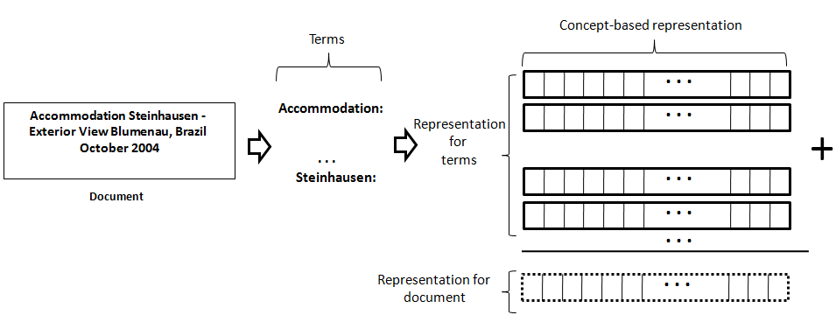
Concise semantic analysis
CSA for text categorization:

Slide 50
A variant of CSA for Author Profiling
The Author Proling (AP) task consists in knowing as much as possible about an unknown author, just by analyzing a given text
How much can we conclude about the author of a text simply by analyzing it?
Applications include business intelligence, computer forensics and security
Unlike Authorship Attribution (AA), on the problem of AP we does not have a set of potential candidates. Instead of that, the idea is to exploit more general observations (socio linguistic) of groups of people talking or writing

Slide 51
A variant of CSA for Author Profiling
Initially some works in AP have started to explore the problem of detecting gender, age, native language, and personality from written texts
AP can be approached as a single-label multiclass classification problem, where profiles are the classes to discriminate
From the point of view of text classification, we would have a set of training documents, labeled according to a category (e.g., man and woman).

Slide 52
A variant of CSA for Author Profiling
Stage 1: Represent a term in the space of concepts (one concept per profile)
term-concept matrix
 | C₁ | C₁ | … | C_{k}
t₁
t₂
: |  | w_{i,j}
t_{|V|}
Adrián Pastor López-Monroy, Manuel Montes-y-Gómez, Luis Villaseñor-Pineda, Jesús Ariel Carrasco-Ochoa, and José Fco. Martínez-Trinidad. A New Document Author Representation for Authorship Attribution. MCPR 2012, LNCS 7329, pp. 283--292 , Springer, 2012.

Slide 53
A variant of CSA for Author Profiling
Stage 2: Represent documents in the space of concepts (one concept per profile):
document-concept matrix
 | C₁ | C₁ | … | C_{k}
d₁
d₂
: |  | w_{d(i,j)}
d_{N}
Adrián Pastor López-Monroy, Manuel Montes-y-Gómez, Luis Villaseñor-Pineda, Jesús Ariel Carrasco-Ochoa, and José Fco. Martínez-Trinidad. A New Document Author Representation for Authorship Attribution. MCPR 2012, LNCS 7329, pp. 283--292 , Springer, 2012.

Slide 54
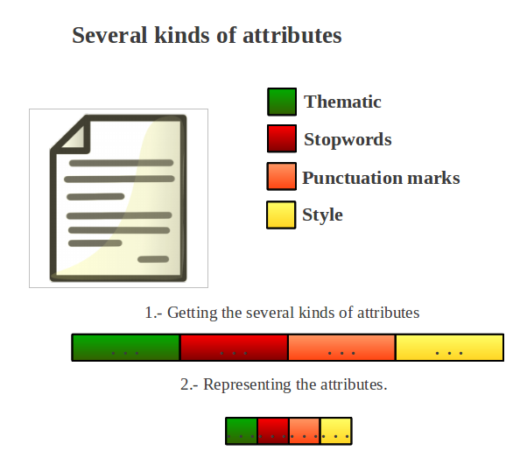
A variant of CSA for Author Profiling
AP is not a thematic task and therefore the use of simple word occurrences may not work. Thus we also considered several non-thematic attributes as well
Concepts were generated for each modality separately and we concatenated the space of multimodal concepts
P. López-Monroy, M. Montes-y-Gómez, H. J. Escalante, L. Villaseñor, and E. Villatoro-Tello. INAOE’s participation at PAN’13: Author Profiling task. Notebook for PAN at CLEF 2013. Valencia, España, Sep-tember 2013.

Slide 55
PAN13’s Author Profiling task
The proposed representation was evaluated in the PAN AP 2013, track:
Two corpora English and Spanish
To determine the gender (male or female) and age (13-17, 23-27, 33-47) for each document.
A linear SVM classifier was used for classification
 | Instances | Blogs | Vocabulary
English | 236,000 | 413, 564 | 180, 809, 187
Spanish | 75,900 | 125,453 | 21,824,190
http://www.pan.webis.de/

Slide 56
A variant of CSA for Author Profiling
PAN’13 – AP official results:
The proposed representation obtained the best result for the PAN’13-AP track (avg. performance)
For the English corpus our method was 166% faster than the top-ranked approach and 454% faster than the method below us
P. López-Monroy, M. Montes-y-Gómez, H. J. Escalante, L. Villaseñor, and E. Villatoro-Tello. INAOE’s participation at PAN’13: Author Profiling task. Notebook for PAN at CLEF 2013. Valencia, España, Sep-tember 2013.

Slide 57
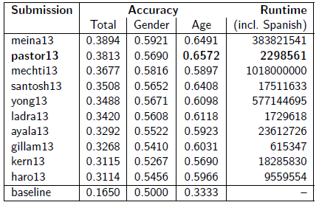
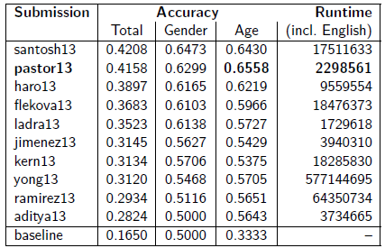
A variant of CSA for Author Profiling
Top-10 ranked participants at PAN’13 – AP (out of 66 teams that participated in the track)
P. López-Monroy, M. Montes-y-Gómez, H. J. Escalante, L. Villaseñor, and E. Villatoro-Tello. INAOE’s participation at PAN’13: Author Profiling task. Notebook for PAN at CLEF 2013. Valencia, España, Sep-tember 2013.

Slide 58
A variant of CSA for Author Profiling
Top-10 ranked participants at PAN’13 – AP (out of 66 teams that participated in the track)
P. López-Monroy, M. Montes-y-Gómez, H. J. Escalante, L. Villaseñor, and E. Villatoro-Tello. INAOE’s participation at PAN’13: Author Profiling task. Notebook for PAN at CLEF 2013. Valencia, España, Sep-tember 2013.

Slide 59
A variant of CSA for Author Profiling
Top-10 ranked participants at PAN’13 – AP (out of 66 teams that participated in the track)
P. López-Monroy, M. Montes-y-Gómez, H. J. Escalante, L. Villaseñor, and E. Villatoro-Tello. INAOE’s participation at PAN’13: Author Profiling task. Notebook for PAN at CLEF 2013. Valencia, España, Sep-tember 2013.

Slide 60
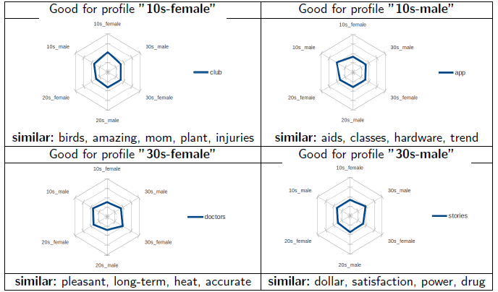
Sample concept-representations for terms

Slide 61
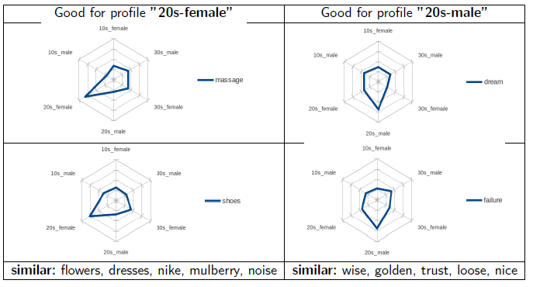
Sample concept-representations for terms

Slide 62
Sample concept-representations for terms

Slide 63
Conclusions (1)
The proposed representation obtained the best result for the PAN’13-AP track (avg. performance was evaluated)
Besides our proposal is much more efficient than most formulations (it was less efficient than two other approaches only)
Too much potential on the use of CSA for non-thematic tasks
There are other ways of expanding the concept space to encode useful information

Slide 64
Multimodal concepts
Multimodal information resulted very effective for AP
Are there other ways of encoding multimodal information into the document representation?
Basic approaches: late fusion / early fusion of multimodal attributes
Meta-features based concepts: associate a feature/concept with the similarity to multimodal prototypes

Slide 65
Multimodal meta-features
Idea: to extract features from first-level attributes to derive a multimodal representation that can improve the performance of first-level attributes
First level attributes: attributes/representations obtained from text directly (e.g., BoW, ngrams, POS-based features, stylistic)
Process:
Extract first-level attributes
Obtain multimodal prototypes
Meta-features: Estimate the similarity of documents to each prototype
T. Solorio, S. Pillay, S. Raghavan and M. Montes y Gomez. Modality Specific Meta Features for Authorship Attribution in Web Forum Posts. In Proceedings of the 5th International Joint Conference on Natural Language Processing , (IJCNLP-2011).

Slide 66
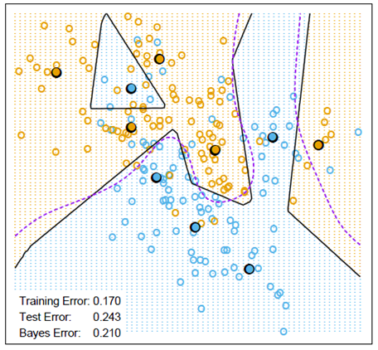
Multimodal meta-features
First level attributes are clusted (e.g. via k-means)
For each modality k-clusters are generated
The centers of each cluster define multimodal prototypes
…
…

Slide 67
Multimodal meta-features
Meta-features for a document are derived by estimating the similarity of the document to each of the m*k prototypes
S_{m,k}

Slide 68
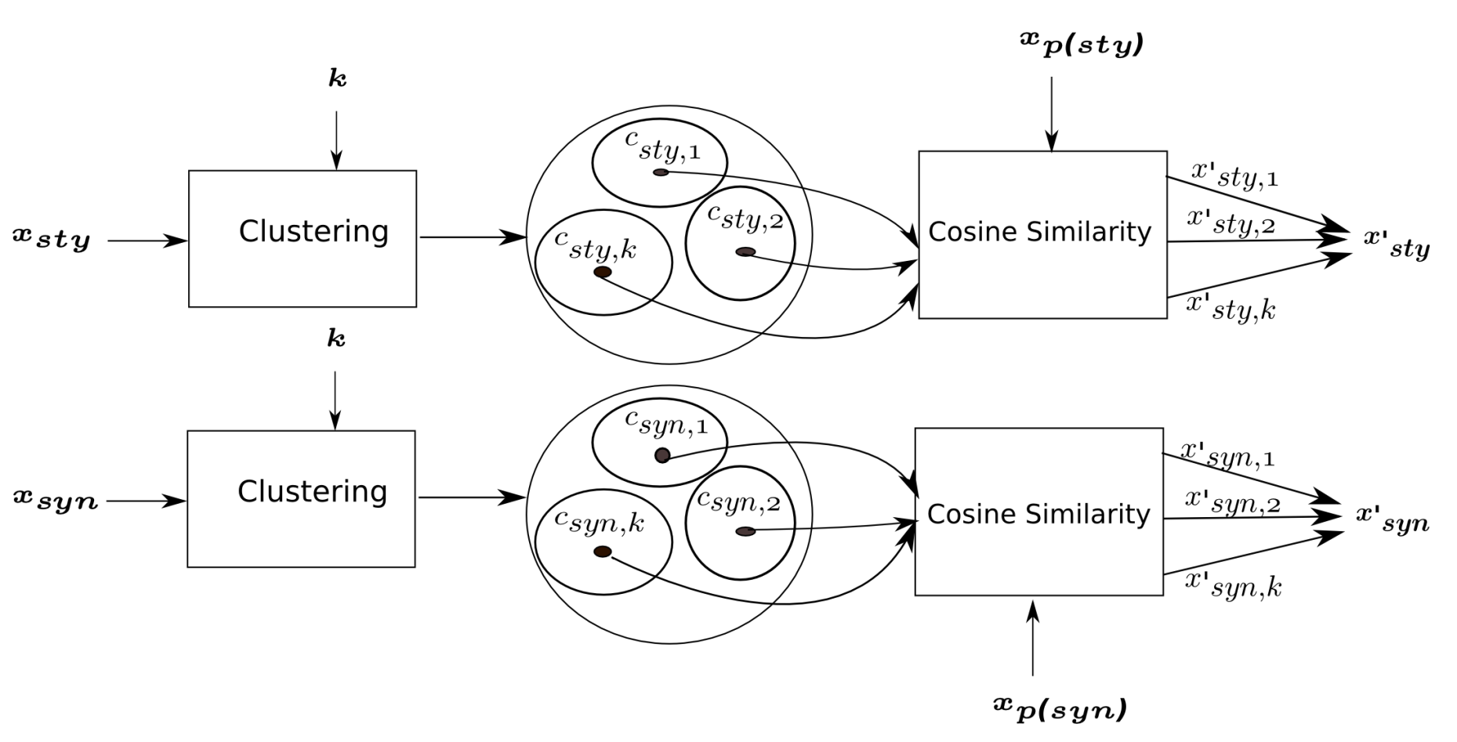
Multimodal meta-features
U. Sapkota, T. Solorio, M. Montes y Gómez, P. Rosso. The use of Orthogonal Similarity Relations in the Prediction of Authorship. CICLing 2013, pp 463-475.

Slide 69
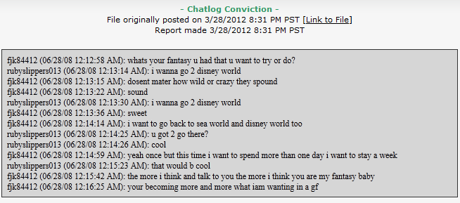
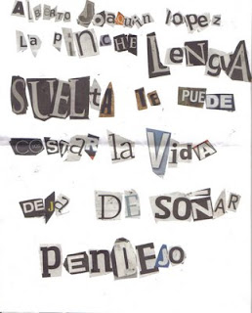
Multimodal meta-features for authorship attribution
Authorship attribution: Given texts of uncertain authorship and texts written by a set of candidate authors, the task is to map the uncertain texts onto their true authors among the candidates.
Applications include: fraud detection, spam filtering, computer forensics and plagiarism detection

Slide 70
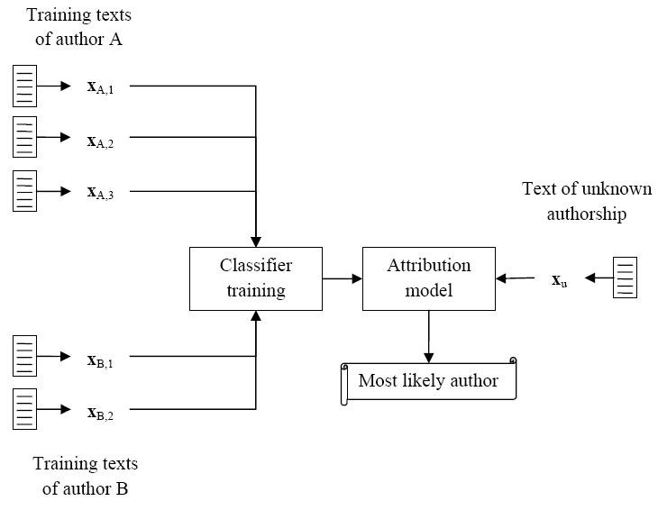
Multimodal meta-features for authorship attribution
Instance-based approach to authorship attribution (~text categorization)

Slide 71
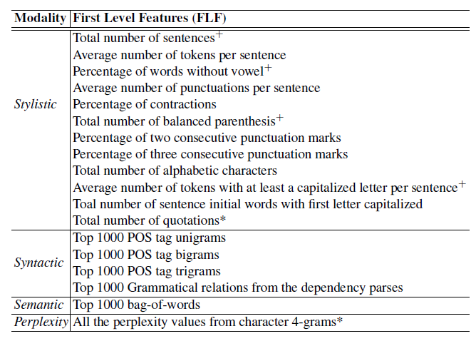
Multimodal meta-features for AA
Application to authorship attribution. First level features:

Slide 72
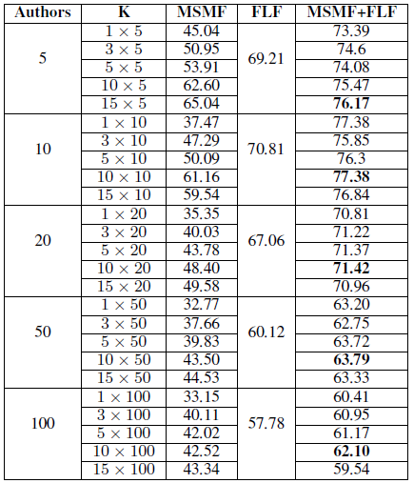
Multimodal meta-features for AA
Some experimental results:
First-level + meta-features obtained the best results
The more clusters are considered the better the performance
Better results than related works
T. Solorio, S. Pillay, S. Raghavan and M. Montes y Gomez. Modality Specific Meta Features for Authorship Attribution in Web Forum Posts. In Proceedings of the 5th International Joint Conference on Natural Language Processing , (IJCNLP-2011).

Slide 73
Multimodal meta-features for AA
Some experimental results:
First-level + meta-features obtained the best results
The more clusters are considered the better the performance
Better results than related works
T. Solorio, S. Pillay, S. Raghavan and M. Montes y Gomez. Modality Specific Meta Features for Authorship Attribution in Web Forum Posts. In Proceedings of the 5th International Joint Conference on Natural Language Processing , (IJCNLP-2011).

Slide 74
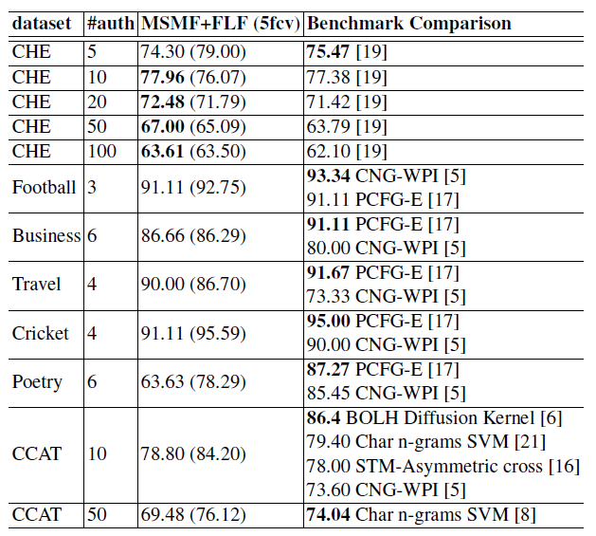
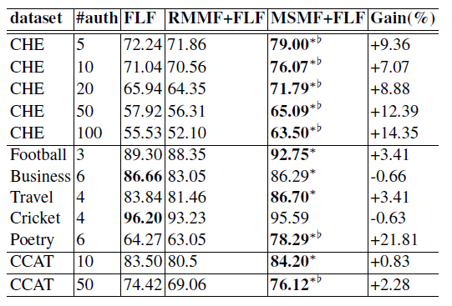
Multimodal meta-features for AA
Some experimental results

Slide 75
Conclusions (2)
Multimodal and similarity-based metafeatures aim to represent a document by its similarity with documents of the same and different classes
Metafeatures (combined with first-level features) resulted very effective for AA
Higher improvements were observed when more authors are involved in the problem
Metafeatures can be considered a type of concepts

Slide 76
Relation with other approaches
Latent semantic indexing: Concepts are derived via SVD, concepts are the principal components of the term-document matrix
Topic models: Concepts are probability distributions over words, they can be obtained in different ways (pLSI, LDA, etc.)
Deep learning: Concepts are the outputs of hierarchical neural networks that aimed to reconstruct documents

Slide 77
Final remarks
Concept-based representations encode useful information into the representation of terms/documents
This useful information can be defined in different ways, depending on what we want to emphasize or characterize from documents
Term/document occurrence/co-occurrence
Inter-intra class information
Multimodal similarity
….

Slide 78
References
L. Zhixing , X. Zhongyang, Z. Yufang, L. Chunyong, L. Kuan. Fast text categorization using concise semantic analysis. Pattern Recognition Letters 32 (2011) 441–448.
Adrián Pastor López-Monroy, Manuel Montes-y-Gómez, Luis Villaseñor-Pineda, Jesús Ariel Carrasco-Ochoa, and José Fco. Martínez-Trinidad. A New Document Author Representation for Authorship Attribution. MCPR 2012, LNCS 7329, pp. 283--292 , Springer, 2012.
P. López-Monroy, M. Montes-y-Gómez, H. J. Escalante, L. Villaseñor, and E. Villatoro-Tello. INAOE’s participation at PAN’13: Author Profiling task. Notebook for PAN at CLEF 2013. Valencia, España, Sep-tember 2013.
T. Solorio, S. Pillay, S. Raghavan and M. Montes y Gomez. Modality Specific Meta Features for Authorship Attribution in Web Forum Posts. In Proceedings of the 5th International Joint Conference on Natural Language Processing , (IJCNLP-2011).
U. Sapkota, T. Solorio, M. Montes y Gómez, P. Rosso. The use of Orthogonal Similarity Relations in the Prediction of Authorship. CICLing 2013, pp 463-475.
David M. Blei, Andrew Y. Ng, .Michael Jordan. Latent dirichlet allocation. Journal of Machine Learning Research Vol. 3, pp., 993-1022, 2003
Deerwester, S., et al, Improving Information Retrieval with Latent Semantic Indexing. Proceedings of the 51st Annual Meeting of the American Society for Information Science 25, 1988, pp. 36–40.

Slide 79
Questions?

