Slide 1
Schema Networks: Zero-shot Transfer with a Generative Causal Model of Intuitive Physics[1]
Article Revision
Author:
Arquímides Méndez Molina
[1] Kansky, K., Silver, T., Mély, D. A., Eldawy, M., Lázaro-Gredilla, M., Lou, X., ... & George, D. (2017, August). Schema networks: Zero-shot transfer with a generative causal model of intuitive physics. In Proceedings of the 34th International Conference on Machine Learning-Volume 70 (pp. 1809-1818). JMLR. org.

Slide 2
Outline
About the authors and the presented work
Introduction and overview (Video)
Contributions
Schema Networks
Model Representation
Learning Algorithm
Planning as Inference
Experiments and Results
Conclusions

Slide 3
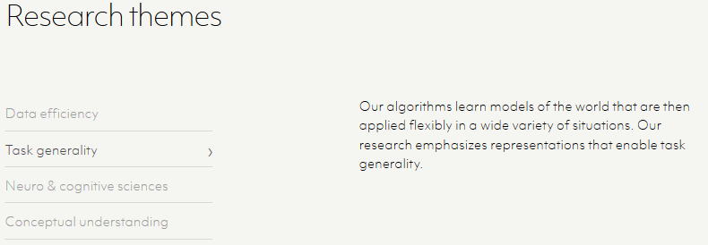
About the authors and the presented work
Screenshots of the Vicarious web site https://www.vicarious.com

Slide 4
Introduction an overview
https://www.youtube.com/watch?v=QHcAlAprFxA

Slide 5
Introduction an overview – Contributions*
A probabilistic, causal-oriented model for general game playing
Model structure is learned to recover the game dynamics
Learned model can simulate the environment and plan to achieve rewards
Outperforms A3C at zero-shot transfer to game variations
* Taken from the authors' presentation at CML2017 https://vimeo.com/237275311

Slide 6
Introduction an overview – Contributions*
* Taken from the authors' presentation at CML2017 https://vimeo.com/237275311

Slide 7
Schema Networks - Model representation
A schema Network is a structured generative model of an MDP
Model Architecture informally:
An image input is parsed into a list of entities
All entities share the same collection of attributes
An entity-attribute is represented by a binary variable
An entity-state is an assignment of states to all attributes of an entity
A complete model state is the set of all entity-states

Slide 8
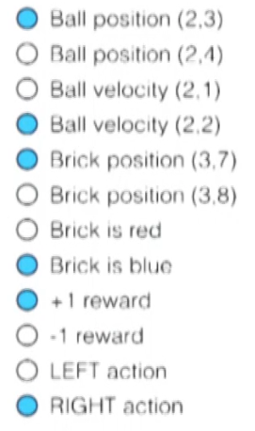
Schema Networks - Model representation

Slide 9
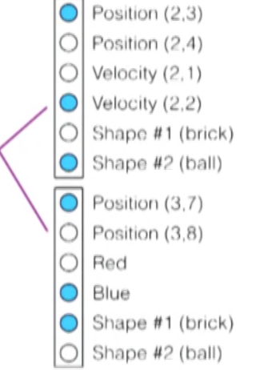
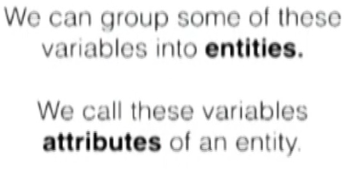
Schema Networks - Model representation
In general, an entity can be any visual feature with a trackable position. Ex: Objects, Part of Objects, Object Boundaries, Surfaces and Contours.

Slide 10
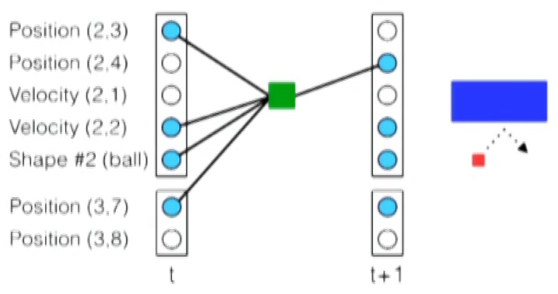
Schema Networks - Model representation
grounded schema (binary variable)
preconditions
AND
A grounded schema is a binary variable associated with a particular entity-attribute in the next timestep, whose value depends on the present values of a set of binary entity-attributes (any). Grounded schemas may also predict rewards and may be conditioned on actions(optional)

Slide 11
Schema Networks - Model representation
Grounded schemas are instantiated from ungrounded schemas, which behave like templates for grounded schemas to be instantiated at different times and in different combinations of entities
Example: and ungrounded schema could predict the “position” attribute of Entity $x$ at time $t + 1$conditioned on the “position” attribute of Entity$y$at time$t$and the action “UP” at time $t$; this ungrounded schema could be instantiated at time $t = 4$with $x =1$ and $y = 2$to create a grounded schema.

Slide 12
Schema Networks - Model representation
A Schema Network is a factor graph that contains all grounded instantiations of a set of ungrounded schemas over some window of time
A factor graph is a bipartite graph representing the factorization of a function. In probability theory and its applications, factor graphs are used to represent factorization of a probability distribution function

Slide 13
Schema Networks - Model representation
Figure 2. Architecture of a Schema Network. An ungrounded schema is a template for a factor that predicts either the value of an entity-attribute (A) or a future reward (B) based on entity states and actions taken in the present. Self-transitions (C) predict that entity-attributes remain in the same state when no schema is active to predict a change. Self-transitions allow continuous or categorical variables to be represented by a set of binary variables (depicted as smaller nodes). The grounded schema factors, instantiated from ungrounded schemas at all positions, times, and entity bindings, are combined with self-transitions to create a Schema Network (D).
Notes:
An entity-attribute is active at the next time step if either a schema predicts it to be active or if its self-transition variable is active

Slide 14
Schema Networks - Model representation
Construction of entities and attributes: a vision system is responsible for detecting and tracking entities in an image. Depending on the task, Schema Networks could learn to reason flexibly at different levels of representation. For example, using entities from surfaces might be most relevant for predicting collisions, while using one entity per object might be most relevant for predicting whether it can be con-trolled by an action.
The experiments in the paper utilize surface entities. Augmenting the three-color channels of the image with 34 additional channels.

Slide 15
Schema Networks – Learning Algorithm
Given a series of actions, rewards and images, they represent each possible action and reward with a binary variable, and they convert each image into a set of entity states.
Given a dataset of entity states over time, they preprocess the entity states into a representation that is more convenient for learning.
For $N$entities observed over $T$ timesteps, they wish to predict $α_{i,j}^{(t)}$ based on the attribute values of the $i^{th}$entity and its spatial neighbors (no actions or reward so far) at time t - 1 (for $1 ≤ i ≤ N$and $2 ≤ t ≤ T$)

Slide 16
Schema Networks – Learning Algorithm
The attribute values of $E_{i}^{(t−1)}$ and its neighbors can be represented as a row vector of length $MR$, where $M$is the number of attributes and $R − 1$is the number of neighbor positions of each entity, determined by a fixed radius.
Let $X ∈ {\left\{\text{0}\text{, }\text{1} \right\}}^{D×D^{′}}$ be the arrangement of all such vectors into a binary matrix, with $D=NT$ and $D^{′}=MR$. Let y$∈ {\left\{\text{0}\text{, }\text{1} \right\}}^{D}$be a binary vector such that if row $r$ in $X$ refers to $E_{i}^{(t−1)}$, then $y=α_{i,j}^{(t)}$. Schemas are then learned to predict $y$ from $X$ using the method described later.
While gathering data, actions are chosen by planning using the schemas that have been learned so far.
An $ε−greedy$ is used to encourage exploration, taking a random action at each timestep with small probability.

Slide 17
Schema Networks – Learning Algorithm
With X and y defined above, the learning problem is to find a mapping
Objective function :
To reduce as much as possible the number of connections each schema have
This is an NP-hard problem for which we cannot hope to find an exact solution, except for very small environments.

Slide 18
Experiments and Results

Slide 19
Planning
The goal is to select actions to maximize cumulative rewards. This is a MAP (Maximum a posteriori) inference problem in a loopy graph.
Planning is divided in two inference steps.

Slide 20
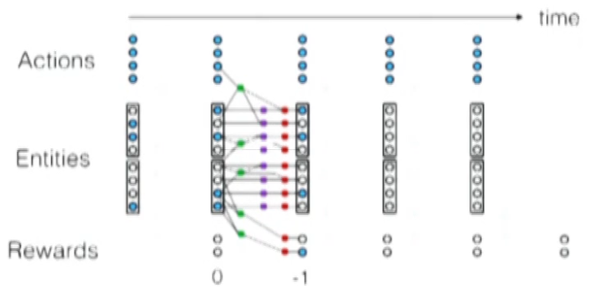
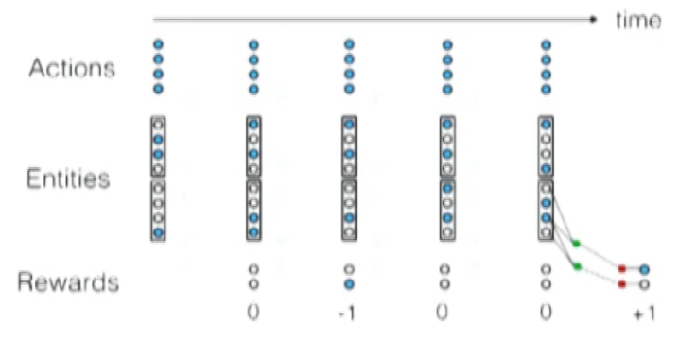
Planning
Step 1. Estimate reachable states: Perform MAP message (selecting each possible actions) passing forward in time

Slide 21
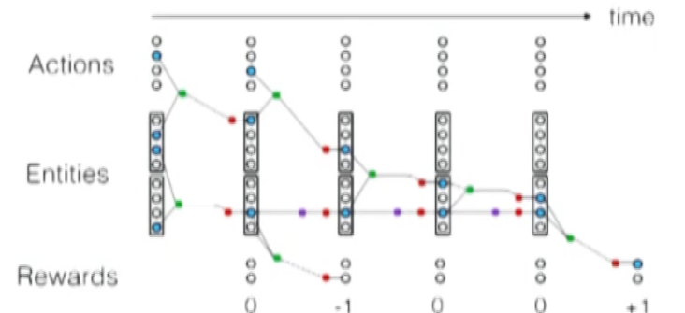
Planning
Step 2. Choose the potentially feasible reward that happens soonest within our explored window. Recursively clamp the conditions of schemas to achieve desired states in the next timestep. If backtracking fails, we will repeat for the remaining potentially feasible positive rewards.

Slide 22
Experiment and Results
The authors compare against:
A3C (Asynchronous Advanced Actor-Critic)
PNs (Progressive Networks), extension of A3C to handle transfer
On several variations of the Breakout game
Each entity contains 53 attributes (21 for bricks, 30 for paddle, 1 for wall and 1 for ball ) What about possition? Why 30 for paddle and 1 for wall? Only one of this part attributes was active per entity

Slide 23
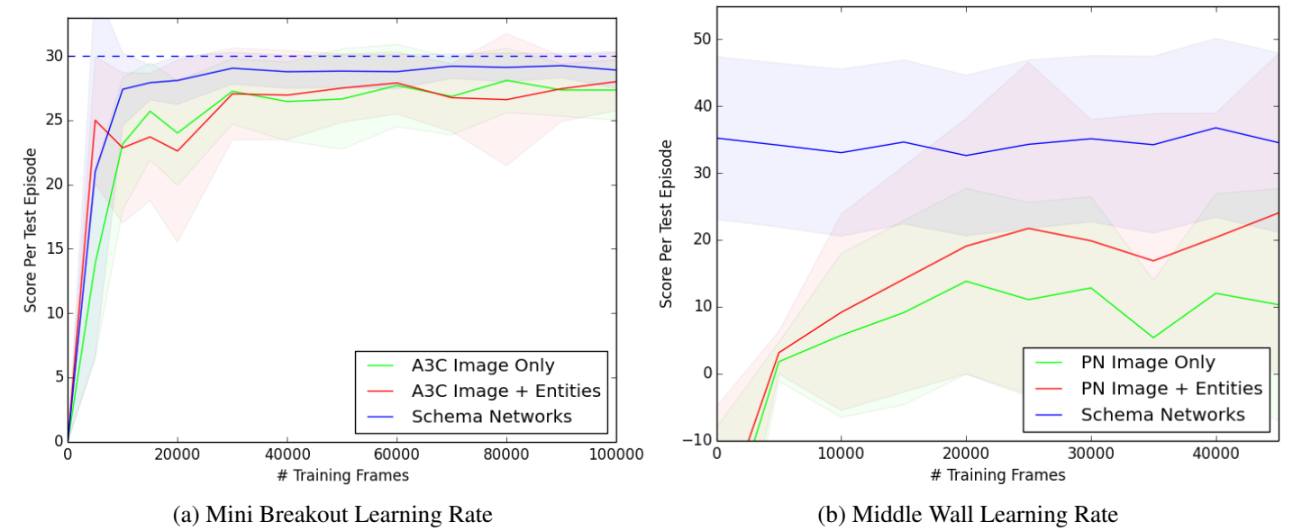
Experiments and Results – Transfer learning
A3C (Asynchronous Advantage Actor-Critic) PNs (Progressive Networks)

Slide 24
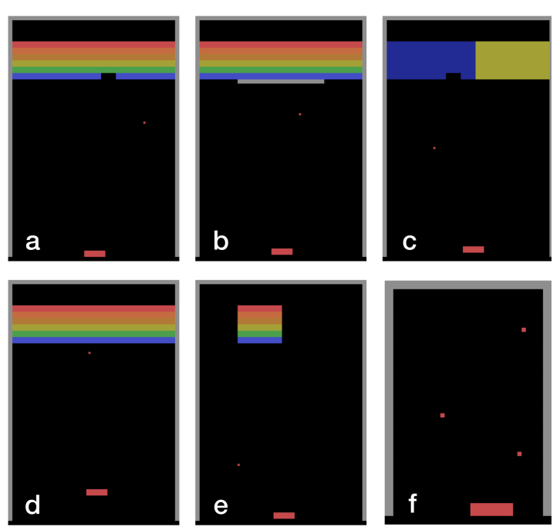
Experiments and Results – Zero shot generalization
Offset Paddle (Fig. 1d): The paddle is shifted upward by a few by a few pixels.
Middle Wall (Fig. 1b): A wall is placed in the middle of the screen, requiring the agent to aim around it to hit the bricks.
Random Target (Fig. 1e): A group of bricks is destroyed when the ball hits any of them and then reappears in a new random position, requiring the agent to deliberately aim at the group.
Juggling (Fig. 1f, enlarged from actual environment to see the balls): Without any bricks, three balls are launched in such a way that a perfect policy could juggle them without dropping any.

Slide 25
Experiments and Results - Zero shot generalization

Slide 26
Experiments and Results – Testing for learned causes

Slide 27
Conclusions
Schema Networks
Causal, probabilistic, object-oriented, interpretable
Learned structure
Plan as MAP inference and backward search
Outperform A·C and PNs at zero-shot generalizations
Learning causal relationships and using then to plan can result in better transfer than model-free policies

