Slide 1
Week 4. Validation and hypothesis testing
MSc Methodology Seminar I
Felipe Orihuela-Espina

Slide 2
VALIDATION

Slide 3
Contents
Ground truth
Gold standard
Types of validity
Mechanisms for showing validity

Slide 4
Recommended readings
¡Wikipedia!
  http://en.wikipedia.org/wiki/Validity_%28statistics%29
  For a gentle overview.
A bit more formal:
  Cronbach, L. J.; Meehl, P. E. (1955). "Construct validity in psychological tests". Psychological Bulletin 52 (4): 281–302
    >6000 citas
  Weiner H y Braun HI (1988) “Test validity” Routledge, 267 pgs.
  http://www.socialresearchmethods.net/kb/introval.php

Slide 5
Validity and validation
Validity and validation:
  Validity is the degree to which a certain measurement or model represents what it is supposed to represent; its equivalent in the real world or in nature. [self definition]
    Validity is the best approximation possible to the truth of a given proposition, inference or conclusion [http://www.socialresearchmethods.net]
  Validation is the process or mechanism for assessing validity.

Slide 6
Validity and validation
Validity and validation :
  Strictly; “Measures, samples and designs don't 'have' validity -- only propositions can be said to be valid. Technically, we should say that a measure leads to valid conclusions or that a sample enables valid inferences, and so on. It is a proposition, inference or conclusion that can 'have' validity.”
    [http://www.socialresearchmethods.net/kb/introval.php]
  Yet, for this unit I will abstract myself of this precision and will talk about validity as corresponding to measurements or models.

Slide 7
GROUND TRUTH

Slide 8
Ground truth
The ground truth refers to the real truth of the observable phenomenon or the reality occuring in nature. [Self definition]
Some alternative definitions:
  “the classification truth of each voxel” [Zou KH et al (2002), MICCAI, LNCS 2488, pp. 315–322,],
    …that is, the truth in each experimental unit for the effects of classification (positive or negative).
    This is particularly nice for machine learning.
  “the most useful representation of the information that one wishes to convey”. [Kolaczyk ED (2009) Statistical Analysis of Network Data: Methods and Models, Springer, pg.76]
    I like this one but requires the knowledge of the construct (i.e. that “information that one wishes to convey”)

Slide 9
Ground truth
Some more alternative definitions:
  “información collected on location” [http://en.wikipedia.org/wiki/Ground_truth]
    Personally I do not like this definition as it assumes that what you measure in the field (“on location”) is measured without bias, and if there is bias, then that would imply that the ground truth does incorporate those measurement errors
    …plus, it does not allow room for synthetic datasets.
    For different reasons, but other authors also share some concerns about this definition:
      “ground-truth data made by hand is usually inefficient and hard to compare from one’s work to another” [Jun-qiang et al (2011), The Journal of China Universities of Posts and Telecommunications, 18(Suppl. 1): 106-111]
        NOTE: “made by hand” here refers to the information collected by the researcher on location; not tio synthetic data
      “The usual way to obtain the ground truth is fragile, inefficient and not directly comparable from one’s work to another” [Canini et al 2009, TMA]

Slide 10
Ground truth
Even some more alternative definitions :
  “ancillary data” [https://www.fas.org/irp/imint/docs/rst/Sect13/Sect13_1.html]
    Best translation to Spanish of the word “ancillary” is auxiliar, subordinado or secundario
    …I cannot be more in disagreement with this definition…
  “a representation of the agreed correct result of the ideal layout analysis method (i.e. the result of the method that, if existed, would put an end to the research problem).” [Antonacopoulos et al (2006) Document Analysis Systems, 11pgs]
    This definition has 2 clear weaknesses:
      Assumes that truth depends on what the annotators think (in total opposition to objectivism).
        For instance; if a few clinicians agreed that a woman is not pregnant, then she is not pregnant despite the obvious fact that this does not depend on their opinion.
      Assumes that every method has its own ground truth, which for obvious reasons does not hold…

Slide 11
Ground truth
Yet a few more alternative definitions:
  “the actual facts of a situation and is used to determine, with certainty, whether information is accurate” [Vrij 2000 en Toma et al Pers Soc Psychol Bull 2008; 34; 1023]
    Hot! Best to my taste, and if I’m allowed close to my own definition

Slide 12
Ground truth
Regardless of the definition: the availability of a ground truth permits objective evaluation of criteria.
If it is available, validation involves comparing how far is our metric or model from the ground truth (ground truth approach).
  With synthetic data, ground truth is always available.

Slide 13
Ground truth
Problem:
  With real data, the ground truth is not always available, and often its acquisition is far from trivial.
Several methods have been developed for estimating the ground truth when it is not available:
  Beware! No matter how good is your estimation it is no longer the ground truth.
  A few methods for estimating the ground truth [LiX 2010]:
    Voting by several annotators or judges.
      Often, experts in the fields
    Maximum posterior probability
    Minimization of variance

Slide 14
Ground truth
Synthetic ground truth:
  Although being able to generate synthetic ground truth means that you are truly in posession of the ground truth, this is not exempt of problems;
  “ground-truth data made by hand is usually inefficient and hard to compare from one’s work to another” [Jun-qiang et al (2011), The Journal of China Universities of Posts and Telecommunications, 18(Suppl. 1): 106-111]
    NOTE: Here the authors are referring strictly to information collected on location by a researcher

Slide 15
GOLD Standard

Slide 16
Gold standard
The gold standard refers to a test, metric, or model that is widely accepted by the community as a currently valid representation of the reality. [Self definition]
Other definitions:
  “another measure that has been used and accepted in the field” [Young et al 1995, Arch Phys Med Rehabil 76:913-918]
    Relatively close to mine.

Slide 17
Gold standard
More alternative definitions :
  “a relatively irrefutable standard that constitutes recognized and accepted evidence that a certain disease exists.” [Brown et al 1996, NEJM 335(14):1049-1053]
    ¡Very good! ...shouldn’t it was because they use the word “standard” to define “standard”.
    …yet, it is NEJM!
  “a benchmark that is regarded as definitive” [Noel et al 2009, ATM]
    No gold standard is definitive; only until we get a more accurate one…

Slide 18
Gold standard
A few more alternative definitions:
  “the best available method, offering accuracy, reproducibility, feasibility and a justifiable cost-benefit interrelation” [Mariath et al (2007), JAOS 15(6):529-33]
    I miss the need to community consensus
    Also, I do not undestand very well why including the cost-efficiency relation.
  “based on the judgments of expert PIs and represent the carrier’s definition of what constitutes acceptable/unacceptable aircrew performance” [Baker y Dismukes (2003), NASA, NASA/TM—2003–212809]
    A bit limited to the context, but reading between lines, a very good definition.

Slide 19
Gold standard
Yet a few more definitions:
  “the most accurate method, procedure, or measurement that is known to represent the true value of what is being tested.” [Hudson, MSc thesis, Texas A&M University, pg 5]
    Very close to mine. (NOTE: I gave mine well before knowing this one…)
  “a diagnostic test or benchmark that is the best available under reasonable conditions. It does not have to be necessarily the best possible test for the condition in absolute terms.” [http://en.wikipedia.org/wiki/Gold_standard_(test)]
    I miss the need to community consensus.

Slide 20
Gold standard
When ground truth is not available, validation involves comparing how far is our metric or model from the gold standard (gold standard approach).
  This often links to convergent validity and to a extent nomological validity
  Note that you compare yourself not against the state of the art, but against what it is accepted by the community.
  Problem: Still, there isn’t a gold standard always accepted by the community.

Slide 21
TYPES OF VALIDITY

Slide 22
Types of validity
Types of validity:
  Construct validity
    Convergent validity
  Criterion validity
    Concurrent validity
    Predictive o empirical validity
    Discriminant validity
  Content validity
    Face validity
    Representation validity
    Intrinsic validity
  Internal validity
  External validity
  Logical validity
  Statistical conclusion validity
  Ecological validity
  Diagnostic validity
  Nomological validity

Slide 23
Types of validity
Construct validity
Criterion validity
Content validity
Fidelity to the phenomenon
Representative of the population
Fidelity to other metrics

Slide 24
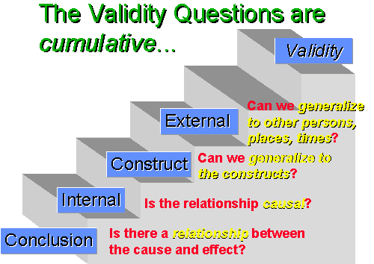
Types of validity
Figura de: [http://www.socialresearchmethods.net/kb/introval.php]

Slide 25
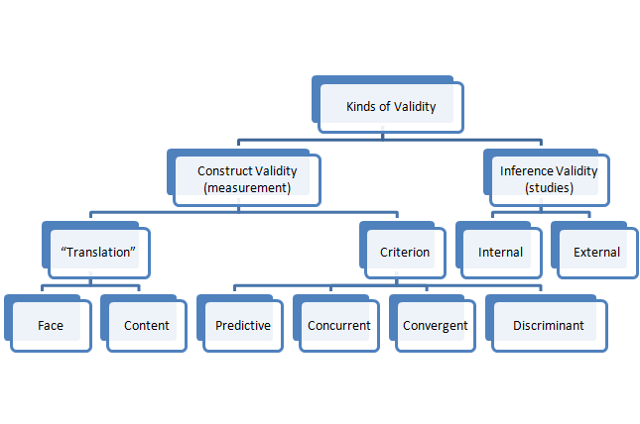
Types of validity
Figura de: [www.analytictech.com]

Slide 26
Types of validity
Construct validity:
  A construct is “some postulated attribute of people assumed to be reflected in the test performance” [Cronbach y Meehl, 1955].
    Cronbach and Meehl seminal paper was written for psychology, so when they speak of:
      people, they refer to the phenomenon under study.
      Test performance, they refer to a model or metric capturing some aspect of the phenomenon
  The development of the construct is not easy. Too narrow or too broad and it may nullify your experiment.

Slide 27
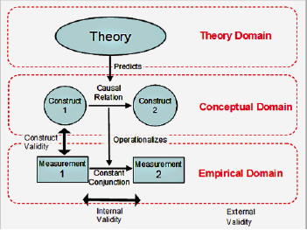
Types of validity
Construct validity:
  Construct:
    Example:
Research process and validation according to positivist research tradition
Figure from: [Johnston y Smith
http://epress.anu.edu.au/apps/bookworm/view/
Information+Systems+Foundations%3A+The+Role+of+Design+Science/5131/ch02.xhtml]

Slide 28
Types of validity
Construct validity:
  “…construct validity […] perceived as the most fundamental and embracing of all types of validity” [Weiner H y Braun HI (1988) “Test validity” Routledge, 267 pgs. (pg. 26)]
  Capacity of a metric or model to measure or represent faithfully the phenomenon under study and its legitimate inferences.
    In other words, that you are measuring or modelling what you should be measuring or modelling, and that you are free of bias (see also internal validity)
  It bacomes specially critical when a concomitant criterion or universe of content is lacking. [Cronbach y Meehl, 1955]

Slide 29
Types of validity
Construct validity:
  Construct validity should be equivalent to: “Tell the truth, all the truth, and nothing but the truth”
    [http://www.socialresearchmethods.net/kb/considea.php]
  We want our metric or model to represent “the construct, all the construct [content validity], and nothing but the construct”
    [http://www.socialresearchmethods.net/kb/considea.php]

Slide 30
Types of validity
Construct validity:
  Construct validity is a process, not a method [Weiner H y Braun HI (1988) “Test validity” Routledge, 267 pgs. (pg. 26)]
    It requires many lines of evidence
    It cannot be expressed by a single figure or coefficient
    It requires both quantitative and qualitative evidence

Slide 31
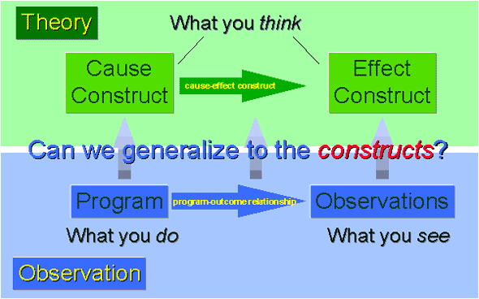
Types of validity
Figure from: [http://www.socialresearchmethods.net/kb/considea.php]

Slide 32
Types of validity
Construct validity:
  Construct validity is what allows us to build a universal truth. Consequently it can be compromised by many factors:
    Inadequate or ambiguous definition of the construct
    Altered behaviour of the construct (e.g. appearance of new treatments)
    Bias including that of the researcher
    Confusion or contamination by non-controlled or latent variables
    Confusion or contamination by factor interaction (non-main effects)
    Confusion or contamination by other constructs
    Breaching of the blinding by hypothesis guessing from patient or co-researchers
    Mono-operation bias (that is measuring a single dependent variable)
      A single dimension will be insufficient to express the construct
    Ofuscation/apprehension by evaluation (changes un the responses of the phenomenon just because it is being measured/observed)
      Remember; you can’t measure a phenomenon without distorting it!

Slide 33
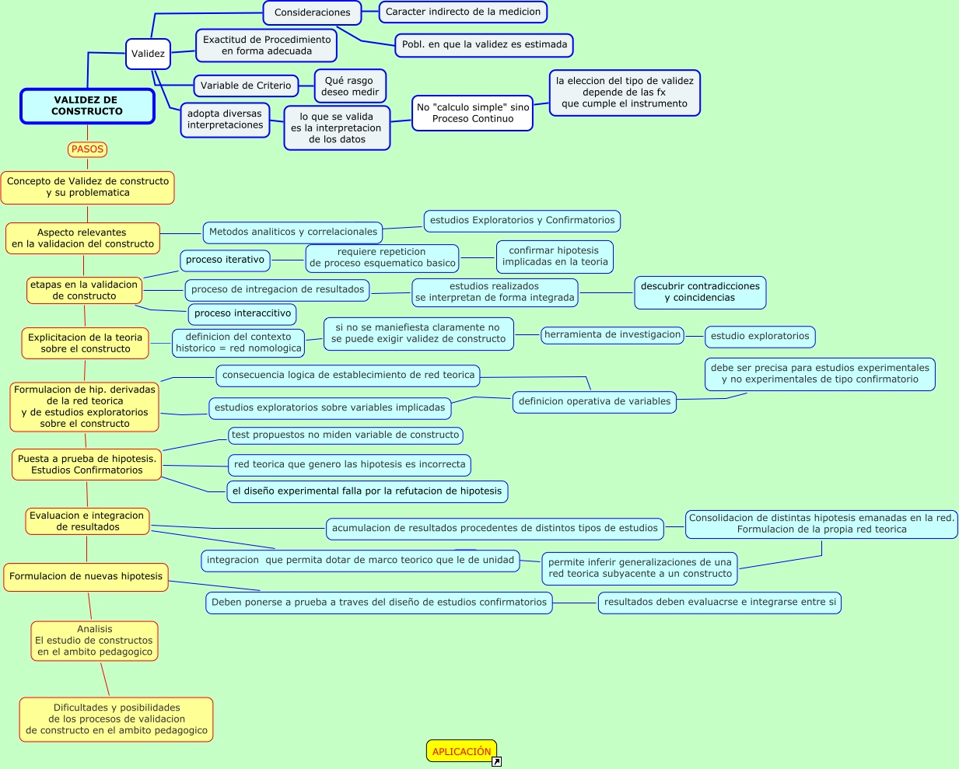
Types of validity
Figure from: [http://cmapspublic.ihmc.us/rid=1148264198734_1533533750_4916/Validez%20de%20Constructo.cmap]

Slide 34
Types of validity
Convergent validity:
  (Cor-)relation of the observations of our metric or model with those coming from other metrics or models develop for the same phenomenon.
    Watch out! There may be different constructs from the same phenomenon, and thus the model may be explaining just slightly different things
  It is a subtype of construct validity
    …but note how it is similar to criterion validity.
  All metrics/models of the same phenomenon must converge to a unique ground truth.

Slide 35
Types of validity
Criterion validity:
  (Cor-)relation of the observations of our metric or model with those coming from other metrics or models develop for the same phenomenon.
    Yep! Apparently the same as convergent validity
  Depending on the temporal relation of the sampling between the metrics or models, it may be:
    Concurrent: All observations are taken at once
    Predictive: Observations of the different metrics or models are acquired at different times
  All metrics/models of the same phenomenon must agree (to a extent) with the gold standard.

Slide 36
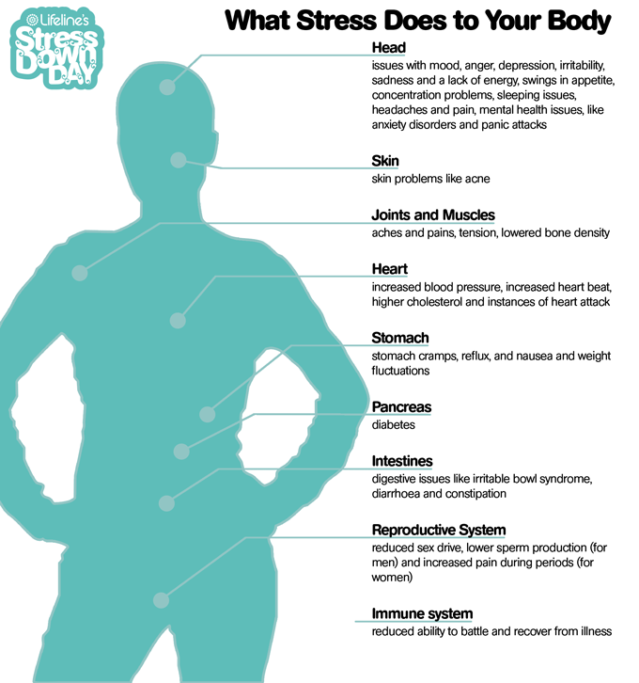
Types of validity
Criterion validity:
  Example: Suppose that you acquire a number of tests (salivary cortisol, heart rate variability, skin conductance, pupil dilation), to estimate a person’s stress. Let’s assume you get strong correlations between each pair of these.
    It is reasonable to think that these metrics share some common factor.
    Observation 1: Do not take for granted, that the common factor is the one you intended to measure originally (construct)
    Observation 2: The metrics do not measure the same feature of the construct (stress). Indeed, they measure different constructs, yet all evidence points to the same direction.
Figure from [positivemed.com]

Slide 37
Types of validity
Predictive or empirical validity:
  (Cor-)relation of the observations of our metric or model with those coming from other metrics or models develop for the same phenomenon taken at different times.
  A subtype of criterion validty.
  Closely related to concurrent validity;
    Predictive validity has to do with a priori predictions made by the model
    On the other hand, concurrent validity has to do with the correlation between already existing observations (or those made at the same time) and the a posteriori estimation of the model

Slide 38
Types of validity
Predictive or empirical validity:
  Although most times predictive and empirical validity are defined as one [e.g. http://www.britannica.com/EBchecked/topic/186144/empirical-validity], personally I think they may be subtly different:
    Predictive validity is often regarded in terms of observations made with other metrics/models
    Empirical validity is often regarded in terms of observations made in different contexts (e.g. different experimental conditions), and in this view is related to external validity.

Slide 39
Types of validity
Concurrent validity:
  (Cor-)relation of the observations of our metric or model with those coming from other metrics or models develop for the same phenomenon acquired at the same time.

Slide 40
Types of validity
Discriminant validity:
  Degree to which observations obtained from our metric or model differ from those obtained from other metrics or model built for a different construct.
  Implies a low corelation or high statistical independence with other metrics.
    i.e. you should resemble those metrics built to measure your same construct but differ clearly from those built for different constructs.
  This validity is critical to delimit the construct.
  “discriminant validity is […] perhaps a stronger test […] than convergent validity, becuase it implies a challenge from a plausible rival hypothesis” [Weiner H y Braun HI (1988) “Test validity” Routledge, 267 pgs. (pg. 27)]

Slide 41
Types of validity
Content validity:
  Capacity of the metric or model to represent the whole universe (or population) of the phenomenon.
    Note that you may have a construct intended to only partially describe the phenomenon.
  Maybe your model is valid only for a small portion of the sample space or universe. It is a partial, non universal, truth, although still valid within its boundaries.
  This is often obtained by non-statistical methods, and it is not necessarily solved by the experimental paradigm/design.
    Several experts decide on whether the observations are representative of the target universe or population.
    ¡Watch out! Experts may still be wrong …

Slide 42
Types of validity
Face validity:
  Degree to which a metric or model appears to be measuring the construct or phenomenon.
  Face validity is only the entrance point to the content validity. It does not guarantee that you are really measuring the phenomenon..
  It often incorporates a subjective load from expert/s
    NOTE: It has been suggested that face validity should be expressed or agreed specifically by non-experts rather than experts.
      [Holden, Ronald B. (2010). "Face validity". In Weiner, Irving B.; Craighead, W. Edward. The Corsini Encyclopedia of Psychology (4th ed.). Hoboken, NJ: Wiley. pp. 637–638.]

Slide 43
Types of validity
Representation validity:
  Limits of the conversion from a theoretical construct to a practical specific metric or model.
  Representation validity is a measure of abstraction; how feasible is the model as a surrogate of the theoretical construct?

Slide 44
Types of validity
Intrinsic validity:
  (Cor-)relation with a criterion (expert) that has been accepted as correct. [Gulliksen (1950) American Psychologist, 5(10):511-517]
  Closely related to face validity, although here there seems to be a consensus that the relation must be with an expert.
    …subjectivity has been reduced in the sense that it has been “accepted” by the community.
    The expert may be a gold standard.

Slide 45
Types of validity
Internal validity:
  Quality of a metric or model to allow sampling free of bias.
    Differently from the construct validity, it does not imply that what you are measuring is related to the modelled phenomenon; it is just concerned with measurement or modelling bias.
  Internal validity is achieved fully when there are irrefutable arguments showing that the intervention has had (or hadn’t) a certain effect.
    More often than not, it requires a controlled experiment (with a control group)
    Remember, there may be confusion; e.g. other alternative hypothesis, and thus there will be no construct validity, but you still may have internal validity.
    It confirms that your experiment is correctly performed
  It is concerned with causality (yet it does not represent causality!)
    Example:
      Everytime you change A under conditions C lead to a change in B (internal validity). That’s different of saying that B is caused by A (construct validty).

Slide 46
Types of validity
Internal validity:
  Internal validity guarantees that evidence can be communicated directly.
  Internal validity may be at risk when:
    The analysis does not support causal relations adequately
    Groups being compared are not sufficiently homogeneous
    Results may not reach statistical significance
    [http://ec.europa.eu/europeaid/evaluation/methodology/methods/mth_vld_es.htm#05]

Slide 47
Types of validity
External validity:
  Quality of a metric or model to permit observations that can be generalized to other metrics, models, groups, areas, periods, etc
  External validity is achieved fully when it is demonstrated that a similar intervention will get similar effects in a different context but still under the same conditions.
    Normally, it requires large number of observations, multi-center studies, random effects models, different datasets, etc.
  External validity permit transfer of knowledge and scientific evidence

Slide 48
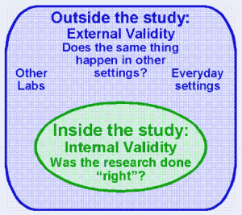
Types of validity
Internal and external validity seems to be in conflict;
  Internal validity requires you to control as much as you can (e.g. all intervining variables)
  …but that reduces the generalization capabilities, i.e. the external validity.
    (and sometimes collaterally the ecological validity)
Figure from: [http://prpj.wordpress.com/2012/03/11/threats-to-validity-of-experimental-research/]

Slide 49
Types of validity
Logical or deductive validity:
  A metric or model has logical validity if and only if can be deduced/ abduced/ induced by a logical system.

Slide 50
Types of validity
Logical system:
  A set of elements and objects allowing us taking decisions.
  It is composed by:
    An alphabet of symbols or primitives
    A grammar with construction rules made from elements of the alphabet
    A set of axioms
      …which in turn are also well formed rules
    A set of inference rules
    A formal interpretation
Syntactic
Semantic

Slide 51
Types of validity
Logical validity:
  Models of logical reasoning:
    Deduction or deductive inference: Find the effect given the cause and the rule.
    Abduction or abductive inference: Find the cause given the rule and the effect.
    Induction o inductive inference: Find the rules given the cause and the effect
[Cause] -> -> [rule] -> -> [Effect]
(abduction) (induction) (deduction)

Slide 52
Types of validity
Statistical conclusion validity:
  Degree to which conclusions (or interpretation) over the associational or causal relations are confined to the observations
    In other words, that there are no “leap of thinking”
    Note that it does NOT imply causality, it may be a simple correlation.
  Statistical conclusion validity requires:
    Adequate sampling (often this means randomisation),
    Appropriate statistical analysis (of course including but not limited to hypothesis testing)
    Experimental procedures reliable and reproducible

Slide 53
Types of validity
Ecological validity:
  Degree of similarity or relevance to which the experimental environment matches the real world
    [Rizzo, A. ''S. & Kim, G. J. A SWOT analysis of the field of virtual reality rehabilitation and therapy Presence, 2005, 14, 119-146]
    …in other words, that the research conducted can be extrapolated out of the research environment.
  To be ecologically valid, materials and methods must be close to those occurring in the original phenomenon under study.
  Contrast between observational and interventional studies.
    Observational studies naturally tend to have greater ecological validity.

Slide 54
Types of validity
Diagnóstic validity:
  Ability of a test, metric or model to achieve a certain goal; i.e. to reduce statistical errors Type I or II.
  “The most popular diagnostic validity statistics (DVSs) are undoubtedly sensitivity (SE), specificity (SP), positive predictive power (PPP), and negative predictive power” [Hsu LM (2002), Psychological Assessment, 14(4):410-422]
  The term “diagnostic” is inheritance from biomedicine, but diagnostic validity is NOT confined to biomedicine.

Slide 55
Types of validity
Nomological validity:
  Degree to which our metric or model supports established theories, existing evidence and/or previous research.
  Nomological validity may or may not occur, but it can be revealed with a good discussion in your paper.
    Remember that it may be the case that the reigning theory is not totally (or partially) truth, ergo lacking construct validity, and thus there isn’t an absolute demand for nomological validity
    …but admittedly, this is going to be difficult.

Slide 56
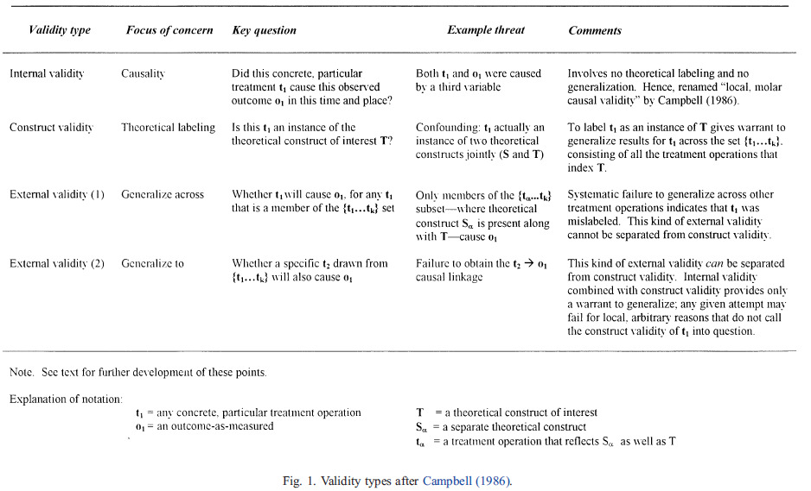
Types of validity
Table from: [McQuarrie EF (2004), Journal of Business Research 57:142-153]

Slide 57
MECHANISMS FOR SHOWING VALIDITY

Slide 58
Mechanisms of validity
The type of validity tells you how close are you to the construct you want to measure according to a particular dimension of it
The mechanism of validity are experimental tricks to establish some type of validity reducing or eliminating sources of bias.

Slide 59
Mechanisms of validity
Depending on how you use the mechanism –i.e. how do you design your experiment-, you may achieve different types of validation even if using a single mechanism
  Corollary: The mechanism are not associated to the type of intended validity
    …although, choosing the right mechanism facilitates achieving certain validity
Each science, because of the way they experiment, have favoured particular mechanisms over others.
  E.g. blocking for agriculture, blinding for psychology, randomization for medicine, cross-folding for machine learning and AI

Slide 60
Mechanisms of validity
Mechanisms for showing validity
  Randomization
    Meaning reshuffling your available observations
    …and of particular interest for CS, cross-folding
  Resampling
    Meaning acquiring new observations from the population
    Strongly founded in the Central Limit Theorem
    …and of particular interest for CS, bootstraping
  Regularization
    Meaning introducing noise or assuming the population distribution to eliminate degeneracies in the observations
    …and of particular interest for CS, synthetic resampling
  Blocking
    Meaning arranging your experimental units in groups a.k.a. blocks
  Blinding
    Meaning masking treatments to experimental actors (e.g. participants, observers, raters, etc)
  Multiple raters or judges
    Meaning having more than one metric
    Necessary for social phenomena where the ground truth is not governed by the laws of physics
    Not necessary (but at times benefitial) for physical phenomena

Slide 61
Cross-folding
Cross-fold validation
  It permits evaluating how your results from a certain analysis would be generalizable to an independent dataset,
    Most times it is a mechanism to show external validity
    …it also supports diagnostic validity
    …in clever experimental designs it may even support internal validity (do not try this at home!)
  Inherent limitation:
    Since all measurements are taken from the same population (e.g. dataset/s), if the original population is biased, so will the cross-fold procedure
    …in other words, if previously internal validity has not been demonstrated, then cross-fold validation is simple inconclusive.

Slide 62
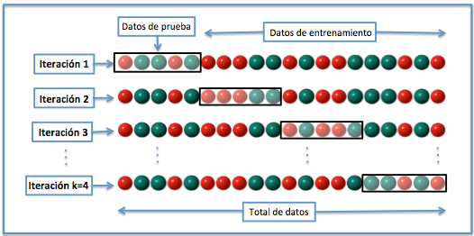
Cross-folding
Figure from: [Wikipedia.es: Validación_cruzada]

Slide 63
Cross-Folding
Variants:
  Random cross-fold
    NOTE: the common cross-folding uses blocking
  Leave one out
  Leave one subject out
  NxK folding
    N randomization exercises with K folds each
    Common 2x5
  With replacement / without replacement

Slide 64
Cross-Folding
There is NO BETTER way…each one has advantages, and disadvantages depending on what you intend to show.
  BTW, there is not a precise value for K, and the larger is not necessarily the better (beware of overpower!)
  Note that the limit is the Leave-one-out
You still have to follow your analysis with your hypothesis testing…

Slide 65
Bootstraping
The definition of bootstraping means launching a self-sustained process that after start (or boot) requires no further external input.
In statistics (ergo in experimental design), this means resampling to obtain estimates of summary statistics.

Slide 66
Bootstraping
Bootstrapping is the practice of estimating properties of an estimator (such as its variance) by measuring those properties when sampling from an approximating distribution. [Wikipedia: Bootstrapping_(statistics)]
It reduces variance and helps to alleviate overfitting.

Slide 67
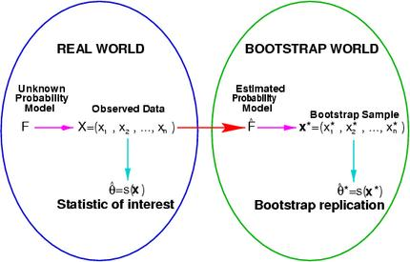
Bootstraping
Figure from: [http://www.spg.tu-darmstadt.de/res/researchprojects_1/bootstrapandcomputerbasedsignalprocessing_1/bootstrapandcomputerbasedsignalprocessing.en.jsp]

Slide 68
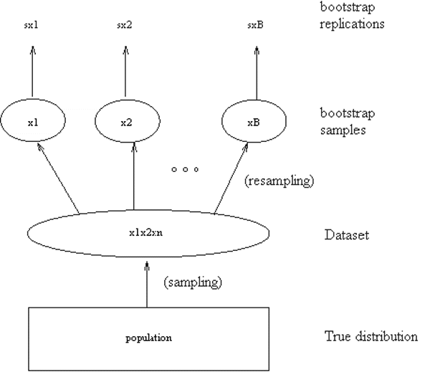
Bootstraping
Figure from: [http://www-ssc.igpp.ucla.edu/personnel/russell/ESS265/Ch9/autoreg/node6.html]

Slide 69
Bootstraping
Variants
  Monte Carlo
  Random Walk
  Bagging e.g. aggregating
  Boosting e.g. ensambles

Slide 70
Regularization
Useful for:
  Solving ill-posed problems
  Alleviating overpowering (and thus overfitting)
  Dealing with unbalanced problems
Variants
  Analytical; e.g. Tikhonov regularization
  Algorithmical: e.g. Levenberg–Marquardt algorithm
  Stochastic: e.g. synthetic resampling an assumed distribution

Slide 71
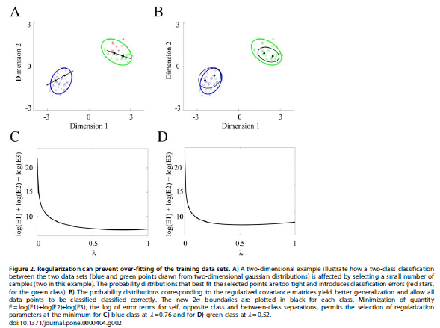
Synthetic resampling
Synthetic resampling implys generating new observations (not acquiring them!)
Figure from: [Osan, R. (2007), PlOS ONE, 2(5):e404]

Slide 72
Synthetic resampling
Synthetic resampling itself has several variants:
  Jackknifing (e.g. aggregating N-1 estimates of an statistics given a sample sized N)
    Particularly useful for estimating variance and bias
    Very close to bootstraping.
  Permutations a.k.a. re-randomization
  Oversampling
    SMOTE: Synthetic Minority Over-sampling TEchnique
  Undersampling
Beware! Unfortunately, more often than not, synthetic resampling in CS is simply referred to as resampling, which of course is ambiguous.

Slide 73
Hypothesis testing

Slide 74
Statistical Significance
“The statistical significance of a result is the probability that the observed relationship (e.g., between variables) or a difference (e.g., between means) in a sample occurred by pure chance ("luck of the draw"), and that in the population from which the sample was drawn, no such relationship or differences exist. [...] the statistical significance of a result tells us something about the degree to which the result is "true" (in the sense of being "representative of the population").” [http://www.statsoft.com/textbook/elementary-statistics-concepts/]

Slide 75
The (in)famous p-value
The p-value represents the probability of error that is involved in accepting our observed result as valid
p-values enable the recognition of any statistically noteworthy findings. The smaller the p-value, the less plausible is the null hypothesis that there is no difference between the treatment groups [DuPrelJB2009]
“The p-value represents a decreasing index of the reliability of a result [...]. The higher the p-value, the less we can believe that the observed relation between variables in the sample is a reliable indicator of the relation between the respective variables in the population.” [http://www.statsoft.com/textbook/elementary-statistics-concepts/]
NOTHING CAN BE CONCLUDED ON THE STRENGH OF THE EFFECT!!!
  You’ll need the confidence intervals for this.

Slide 76
Variable Types

Slide 77
Properties of a measurement system
A measurement system establishes the rules governing how are values assigned to the attributes of the objects so that relations among objects are preserved.
A property of the measurement system establishes a relation between the object’s attribute in the real world and its assigned value.
The different relations that can be preserved are referred to as properties of the measurement system:
  Magnitude
  Intervals
  Absolute zero (or rational)
Adapted from http://www.psychstat.missouristate.edu/introbook/sbk06m.htm

Slide 78
Variable types
Categorical / Nominal: One that has two or more categories without intrinsic ordering. Does not preserve any measurment property.
  Gender: Male / Female
  Hair color: Blonde, brown, brunette, red
Ordinal / Ranked: One that has two or more categories with intrinsic ordering. Preserve magnitude.
  Status: low, medium, high
  Likert scales
Discrete: One that can take any value of an exact list (often finite), and that does not exist at intermediate values. Preserve magnitude, and intervals
Interval: One that has order and there is a specific numerical distance between the intervals or categories.
  Age, Income,
Ratio: One for which measurements are continuous , and has an identifiable 0.
  Scale, mass
Cualitative
Cuantitative

Slide 79
Variable types
The type of variable determines the statistics that can be computed:
  e.g. it makes no sense talking about the mean of hair color.
Variable Type | Permissible Statistics
Categorical | Mode, χ²
Ordinal | Median, percentile
Interval | Mean, standard deviation, correlation, regression, ANOVA
Ratio | All
Table from http://en.wikipedia.org/wiki/Level_of_measurement

Slide 80
DISTRIBUTIONS

Slide 81

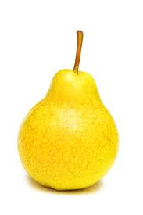

Distributions
Value or Interval | #Observations | Pr(X)
{} | 0 | 0/10
{ } | 4 | 4/10
{ } | 1 | 1/10
{ } | 5 | 5/10
{ , } | 5 | 5/10
{ , } | 9 | 9/10
{ , } | 6 | 6/10
{ , , } | 10 | 10/10
The frequency distribution (or simply distribution) of a variable is the probaility that the variable takes each one of the possible values
Table of frequencies with added probabilities

Slide 82
Distributions
Let S be a sample space, and C={c_{i}} the power set of all subsets of S.
Let X be a random variable defined over S.
The distribución of X is the collection of all the probabilities Pr(X=ci).

Slide 83
Distributions
There are different distribution functions:
  Probability function (over discrete variables)
  Probability density function (over continuous variables)
  Cumulative distribution function

Slide 84
Continuous vs Discrete Distributions
Variables types also determines the distribution.
  A continuous variable has a continuous distribution.
  A discrete variable has a discrete distribution

Slide 85
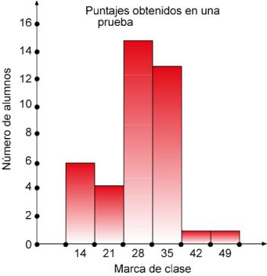
Distributions
The histogram is a graphical representation of the table of frequencies; and thus of a distribution.
Other popular representations for the distributions are the Boxplots.
Figure obtained from internet

Slide 86
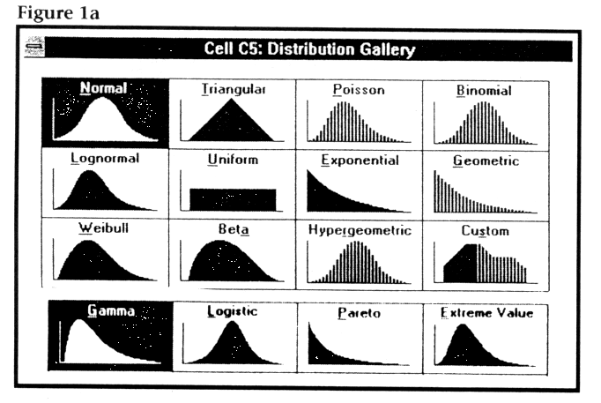
Some important distributions in hypothesis testing
Figura: [isomorphismes.tumblr.com]

Slide 87
Normal Distribution
Non-normal (skewed) data can sometimes be transformed to give a graph of normal shape by performing some mathematical transformation (such as using the variable's logarithm, square root, or reciprocal) [GreenhalghT1997 BMJ]

Slide 88
t Distribution
Increasing degrees of freedom
Degrees of freedom = Number of observations – Number of parameters
= Number of independent pieces of information

Slide 89
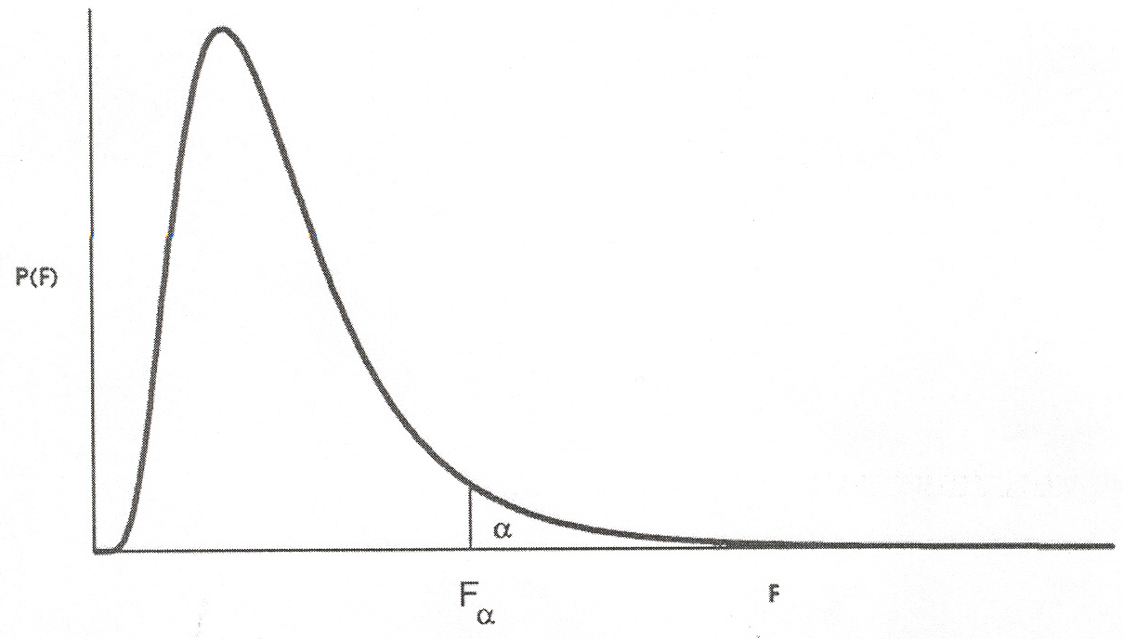
F distribution
The F distribution is an asymmetric distribution that has a minimum value of 0, but no maximum value. The curve reaches a peak not far to the right of 0, and then gradually approaches the horizontal axis the larger the F value is. The F distribution approaches, but never quite touches the horizontal axis.
The F distribution is a ratio of two chi-square statistics, each divided by their respective degrees of freedom
[Image from http://uregina.ca/~gingrich/f.pdf]

Slide 90
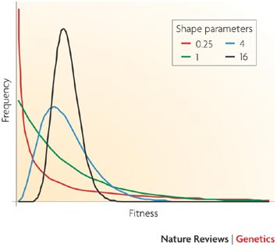
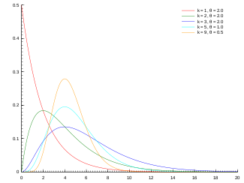
Gamma distribution
The Gamma distribution is chamaleonic; it can take the form of other distributions depending on the parameter values
θ>0 - scale
k>0 - shape
Figure from Wikipedia
Figure from [Eyre-Walker 2007 NatureReviewsGenetics]

Slide 91
Contingency table
A contingency table is a matrix that displays multivariate frequency distribution of two or more categorical values
  Allows for joint distributions to be expressed.
Example
 | Right Handed | Left Handed | Totals
Males | 43 | 9 | 52
Females | 44 | 4 | 48
Totals | 87 | 13 | 100
Example from Wikipedia

Slide 92
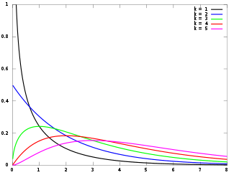
χ²
Many test statistics are approximately distributed as χ², e.g. tests of deviations of differences between theoretically expected and observed frequencies (one-way tables) and the relationship between categorical variables (contingency tables).
The χ² distribution is the distribution of the sum of squared standard normal deviates
k = degrees of freedom
Properties:
  Mean of the distribution is equal to the number of degrees of freedom: μ = k
  Variance is twice the number of degrees of freedom: σ² = 2 * k
  Total area under the curve is equal to 1
  The maximum value occurs when χ ² = k – 2 (for k>2).
  As the degrees of freedom increase, the chi-square curve approaches a normal distribution
The χ² distribution is a standardize distribution; i.e. no location or scale parameters
Figure from Wikipedia
Notes:
The Chi Square distribution is very important because many test statistics are approximately distributed as Chi Square. Two of the more commonly tests using the Chi Square distribution are tests of deviations of differences between theoretically expected and observed frequencies (one-way tables) and the relationship between categorical variables (contingency tables).

Slide 93
Regressions in a nutshell

Slide 94
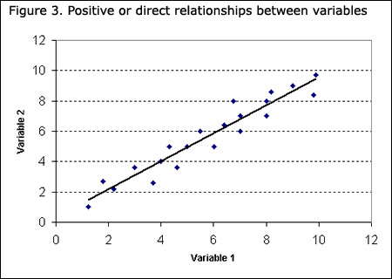
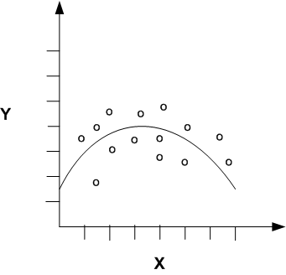
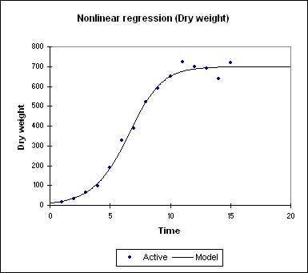
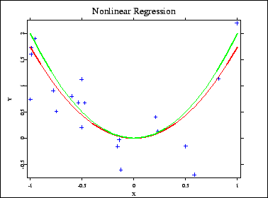
Scatter plots
Representation in a Cartesian coordinate system of an n-dimensional cloud of points
  For practical reasons n=2,3
  Often a trend line is added
  Sometimes confidence intervals are also represented
Figuras: fuentes varias

Slide 95
Modelling
Modelling is the development of mathematical expressions [from observations] somehow describing the behaviour of a variable of interest [RawlingsJO1998].
  The model may be deterministic or stochastic.
Simulation is the generation of synthetic observations from a mathematical model [self definition].
Modelling
Variables of interest (dependent variables)
Mathematical model
(independent variables)
Simulation

Slide 96
Modelling
Deterministic Model
Values of dependent variables
Funcional dependence
Values of independent and controlled variables
Stochastic dependence
Stochastic model
Expectation of dependent variables

Slide 97
Univariate linear regression
In stochastic dependence there are 2 closely related analysis
  Regression Analysis
    Defines the type (linear, exponential/logarithmic, hyperbolic, etc) of relation among the variables
    Yields an equation describing the relation among variables that is close the the functional dependence
  Correlation Analysis
    Assess the degree and consistency of the in/dependence or degree of association among the variables
    Summarizes the strength of the relation
  None imply causality

Slide 98


Univariate linear regression (deterministic)
Dependent variable
Slope
Independent variable
Intersection (with ordinate axes)
An slightly more general notation
Parameters
Notes:
El modelo más sencillo que se puede establecer es aquel donde sólo hay:
+ una variable dependiente
+ una variable independiente/controlada
y además, la relación entre estas es lineal.

Slide 99

The general linear model
nx1
nx(j+1)
(j+1) x1
nx1

Slide 100
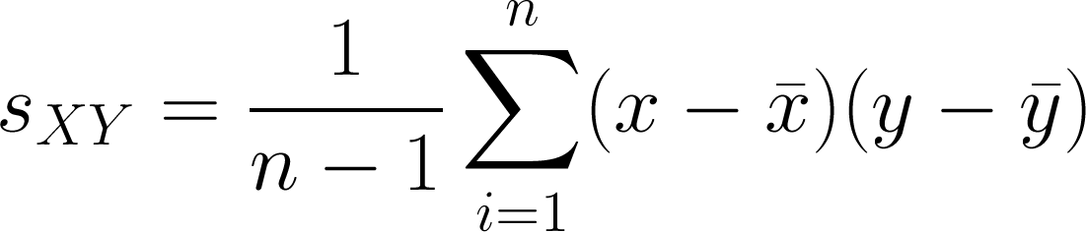
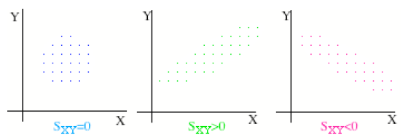
Covariance
Covariance express the trend of a (linear) relation among the variables
Figure from: [http://biplot.usal.es/ALUMNOS/BIOLOGIA/5BIOLOGIA/Regresionsimple.pdf]

Slide 101
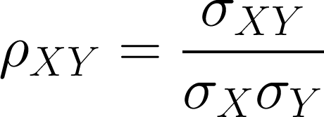
Correlation coefficient
Pearson correlation coefficient is an index measuring the magnitude of a linear association between 2 random variables (cuantitative) and corresponds to a normalization of the covariance:
Covariance
Standard deviations

Slide 102
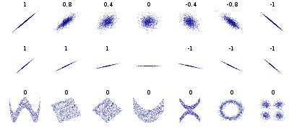
Correlation coefficient
Figure from: [en.wikipedia.org]

Slide 103
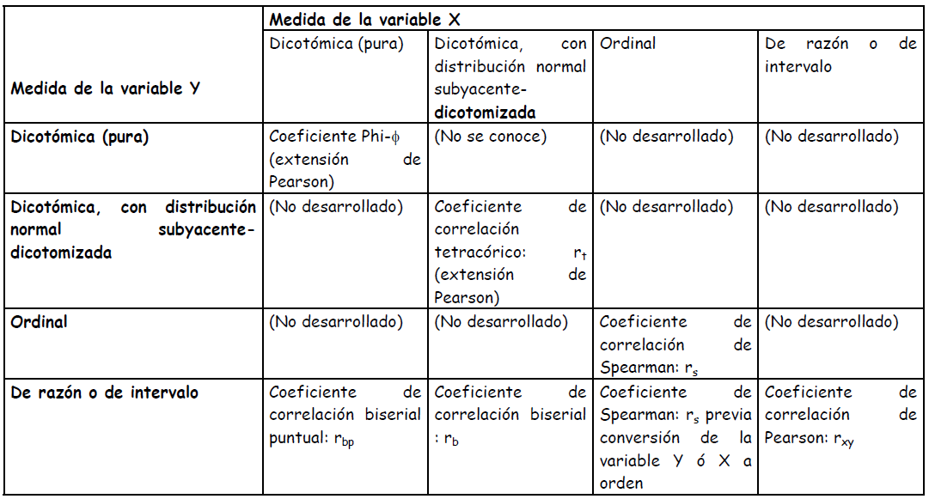
Correlation coefficient
Table obtained from: [http://pendientedemigracion.ucm.es/info/mide/docs/Otrocorrel.pdf]

Slide 104
Hypothesis testing and regression
A hypothesis test is nothing but a regression where your alternative hypothesis is that your TRUE model coefficients (the real betas) -as approximated by your ESTIMATED model coefficient (the calculated betas)- are different than 0;
  …that is, that your factor (the one accompanying the beta) is indeed an explanatory component of your observation.

Slide 105
The Foundamentals of HypothesIs TESTING

Slide 106
Null and Alternative Hypothesis
Statistical testing is used to accept/rejct hypothesis
  Null hypothesis (H₀): There is no difference or relation
    H₀: μ₁=μ₂
  Alternative hypothesis (H_{a}): There is difference or relation
    H_{a}: μ₁≠μ₂
  Example:
    Research question: ¿Are men taller than women?
      Null hypothesis: There is no height difference among genders
      Alternative hypothesis: Gender makes a difference in height.

Slide 107
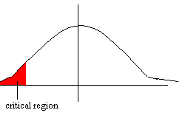
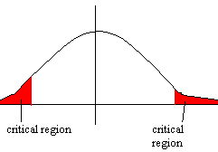
Hypothesis Type / Directionality:
One-tail vs Two-tail
One-tailed: Used for directional hypothesis testing
  Alternative hypothesis: There is a difference and we anticipate the direction of that difference
  H_{a}: μ₁<μ₂
  H_{a}: μ₁>μ₂
Two-tailed: Used for non-directional hypothesis testing
  Alternative hypothesis: There is a difference but we do not anticipate the direction of that difference
  H_{a}: μ₁≠μ₂
Example:
  Research question: ¿Are men taller than women?
    Null hypothesis: There is no height difference among genders
    Alternative hypothesis:
      One tail: Men are taller than women
      Two tail: One gender is taller than the other.
[Figures from: http://www.mathsrevision.net/alevel/pages.php?page=64]

Slide 108
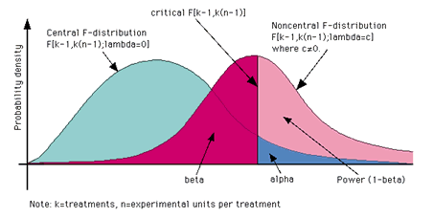
Significance Level (α) and test power (1-β)
Decision \ Reality | H₀ true / H_{a} False | H₀ false / H_{a} true
Accept H₀; Reject H_{a} | Ok (p=1-α) | Type II Error (β)
Reject H₀; Accept H_{a} | Type I Error (p=α) | Ok (1-β)
The probability of making Type I Errors can be decreased by altering the level of significance (α)
  Unfortunately, this in turn increments the risk of Type II Errors.
  …and viceversa
The decision on the significance level should be made (not arbitrarily but) based on the type of error we want to reduced.
Figure from: [http://www.psycho.uni-duesseldorf.de/aap/projects/gpower/reference/reference_manual_02.html]

Slide 109
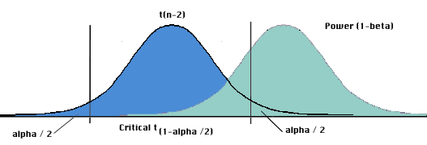
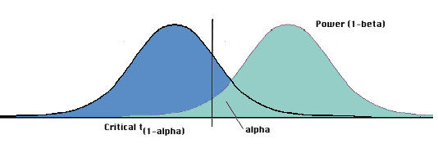
Hypothesis Type / Directionality:
One-tail vs Two-tail
Hypotheis directionality affect statistical power
  One tail tests provide more statistical power to detect an effect
    Choosing a one-tailed test for the sole purpose of attaining significance is not appropriate. You may lose the difference in the other direction!
    Choosing a one-tailed test after running a two-tailed test that failed to reject the null hypothesis is not appropriate.
Two tail test
One tail test
Source: [http://www.ats.ucla.edu/stat/mult_pkg/faq/general/tail_tests.htm]
Figure from: [http://www.psycho.uni-duesseldorf.de/aap/projects/gpower/reference/reference_manual_02.html]

Slide 110
Independence of observations:
Paired vs Unpaired
Paired: There is a one-to-one (biyective) correspondence between the samples of the groups
  If samples in one group are reorganised then so should samples in the other.
  Examples:
    Randomized block experiments with two units per block
    Studies with individually matched controls
    Repeated measurements on the same individual
Unpaired: There is no correspodence between the samples of the groups.
  Samples in one group can be reorganised independently of the other
Pairing is a strategy of design, not analysis (pairing occur before data collection!). Pairing is used to reduce bias and increase precision [DinovI2005]
Example of paired data:
  N sets of twins to know if the 1st born is more aggresive than the second
Twin Pair | Aggresiveness score
 | 1st born | 2nd born
1 | 86 | 88
2 | 71 | 77
3 | 77 | 76
… | … | …
N | 87 | 72
Example adapted from [DinovI2005]

Slide 111
The Central Limit Theorem (CTL)
Let X₁, X₂, … X_{N} be a set of N independent random variables and each X_{i} have an arbitrary probability distribution P(x₁,…,x_{n}) with mean μ_{i} and a finite variance σ_{i}². Then the normal form variate
…has a limiting cumulative distribution which approaches a normal distribution.
[Wolfram World of Maths]

Slide 112
The Central Limit Theorem (CTL)
Corollary: Keep sampling and you’ll get a normal distribution over the distribution of sample means
Leap of thinking: Everything has a normal distribution
Perhaps the most abused theorem ever!
A nice applet to demonstrate the central limit theorem
[http://www.math.csusb.edu/faculty/stanton/probstat/clt.html]

Slide 113
Parametric vs non-parametric
Parametric testing: Assumes a certain deistribution of the variable in the population to which we plan to generalize our data
Non-parametric testing: No assumption regarding the distribution of the variable in the population
  That is distribution free, NOT ASSUMPTION FREE!!
  Non-parametric tests look at the rank order of the values
Parametric tests are more powerful than non-parametric ones and so should be used if possible [GreenhalghT 1997 BMJ 315:364]
Source: 2.ppt (Author unknown)

Slide 114
One way, two way,… N-way analysis
Experimental design may be one-factorial, two factorial,… N-factorial
  i.e. one research question at a time, two research questions at a time, …N research questions at a time.
  The more ways the more difficult the analysis interpretation
One-way analysis measures significance effects of one factor only.
Two-way analysis measures significance effects of two factor simultaneously.
Etc…

Slide 115
Steps to apply a significance test
Define a hypothesis
Collect data
Determine the test to apply
Calculate the test value (t,F,χ²,p)
Accept/Reject null hypothesis based on degrees of freedom and significance threshold
[GurevychI2011]

Slide 116
Which test to apply?
Selecting the right test depends on several aspects of the data:
  Sample count (Low <30; High >30)
  Independence of observations (Paired, Unpaired)
  Number of groups or datasets to be compared
  Data types (Numerical, categorical, etc)
  Assumed distributions
  Hypothesis type (One-tail, Two tail).
[GurevychI2011]

Slide 117
Which test to apply?
Independent Variable |  | Dependent Variable |  | Test | Statistic
Number | Type | Number | Type
1 population | N/A | 1 | Continuous normal | One sample t-test | Mean
2 independent populations | 2 categories | 1 | Normal | Two sample t-test | Mean
 |  | 1 | Non-normal | Mann Whitney, Wilcoxon rank sum test | Median
 |  | 1 | Categorical | Chi square test, Fisher’s exact test | Proportion
3 or more populations | Categorical | 1 | Normal | One way ANOVA | Means
… | … | … | … | … | …
More complete tables can be found at:
http://www.ats.ucla.edu/stat/mult_pkg/whatstat/choosestat.html
http://bama.ua.edu/~jleeper/627/choosestat.html
http://www.bmj.com/content/315/7104/364/T1.expansion.html

Slide 118
THE TESTS

Slide 119
The t-test
Hypothesis | Difference in the mean value
Requirements | Numerical variables There are versions for one and two datasets There are versions for paired and unpaired datasets
Assumptions | Normal distribution Mean and deviation are independent Equal variances High sample count (>30)
Result | t value
One-sample t-test checks the difference between an expected and an observed mean, whereas Two-sample t-test checks the difference between the observed means of two independent samples.

Slide 120
From t value to p value
p-values are the 'area' under the curve greater than your t-score. So calculation of exact p-values requires integration of the distribution under study.
  …or look up in a pre-computed table! ☺
    Calculator: http://www.danielsoper.com/statcalc3/calc.aspx?id=8
    Calculator: http://www.graphpad.com/quickcalcs/pvalue1.cfm

Slide 121
The Mann-Whitney U or Wilcoxon Rank-sum test
Hypothesis | Location shift. Assess whether one of two samples of independent observations tends to have larger/lower values than the other
Requirements | Ordinal or Continuous
Assumptions | Random samples from populations Independence within samples Mutual independence between samples Measurement scale at least ordinal The distributions for the variables are the same except for their medians Large sample size (at least 42 for the z approximation) Unpaired data
Result | z value
When data is ordinal, the Mann-Whitney U test is perhaps the most well-known non-parametric test.
For paired data then the Wilcoxon signed rank test should be used.

Slide 122
From z score to p-value
Z scores are measures of standard deviation (a Z score of +2.5 it is interpreted as "+2.5 standard deviations away from the mean“)
p-values are the 'area' under the curve greater than your z-score. So calculation of exact p-values requires integration of the distribution under study.
  Small (positive or negative) z scores (i.e. center of a normal distribution) are associated to large p-values.
  Large (positive or negative) z scores (i.e. tails of a normal distribution) are associated to small p-values.
  …or look up in a pre-computed table! ☺
    Calculator: http://faculty.vassar.edu/lowry/ch6apx.html
    Calculator: http://www.graphpad.com/quickcalcs/pvalue1.cfm

Slide 123
The F-test
Hypothesis | A difference in the variance value
Requirements | Numerical variables
Assumptions | Normal distribution Homoscedascity (homogenoeus variances) Independency of cases
Result | F value
The F-test is designed to test if two population variances are equal. It does this by comparing the ratio of two variances. So, if the variances are equal, the ratio of the variances will be 1.

Slide 124
From F value to p-value
By hand, requires integrating to find the area under the F-distribution from your observed test statistic to infinity
  …or look up in a pre-computed table! ☺
    Calculator: http://www.danielsoper.com/statcalc3/calc.aspx?id=7
    Calculator: http://www.graphpad.com/quickcalcs/pvalue1.cfm

Slide 125
Univariate Analysis of Variance (ANOVA)
Hypothesis | A difference in the variance value across more than 2 groups
Requirements | Numerical variables
Assumptions | Normal distribution Homoscedascity (homogenoeus variances) Independency of cases
Result | F value
ANOVA is like an F-test of multiple groups
ANOVA is not one, but a collection of models.

Slide 126
χ² test (of contingency table)
Hypothesis | A difference in the frequency distribution of the contingency table (compared to the one expected)
Requirements | Categorical data
Assumptions | χ² distribution High sample count (>30) Independence of cases Others (More than 5 samples per cell, no 0 values, Yates correction)
Result | χ² value
Effects in a contingency table are defined as relationships between the row and column variables; that is, are the levels of the row variable diferentially distributed over levels of the column variables. Significance in this hypothesis test means that interpretation of the cell frequencies is warranted. Non-significance means that any differences in cell frequencies could be explained by chance. [http://www.psychstat.missouristate.edu/introbook/sbk28m.htm]

Slide 127
From χ² score to p-value
No idea, but surely something related to integration
  …but look up in a pre-computed table! ☺
    Calculator: http://www.graphpad.com/quickcalcs/pvalue1.cfm

Slide 128
A few other popular tests
Shapiro-Wilk normality test: Test that the sample comes from a normal distribution
Anderson-Darling test: To detect departure from a given probaility distribution (including normal distribution for which is regarded as one of the most powerful)
Kolmogorov-Smirnov test: Non-parametric testing that the samples comes from the same (or against a reference) distribution. Can also be used for test goodness of fit in a regression.
Kruskall-Wallis: Similar to one way ANOVA for non-parametric data
Welch’s T-test: For difference between observed mean of two independent groups
Fisher’s exact test: Like χ² for 2x2 contingency tables
McNemar test: Like χ² for 2x2 contingency tables and dependent data
Friedman test: Non-parametric repeated measures version of ANOVA
Variants of ANOVA: 1 way ANOVA between subjects, 2 way ANOVA between subjects, 1 way ANOVA within subjects, 2 way ANOVA within subjects, ANCOVA (Analysis of Covariance), MANOVA (multivariate version of ANOVA), MANCOVA,

Slide 129
Quotes on significance testing
[BlandM1996] “Acceptance of statistics, though gratifying to the medical statistician, may even have gone too far. More than once I have told a colleague that he did not need me to prove that his difference existed, as anyone could see it, only to be told in turn that without the magic p-value he could not have his paper published.”
[Nicholls in KatzR2001] “In general, however, null hypothesis significance testing tells us little of what we need to know and is inherently misleading. We should be less enthusiastic about insisting on its use.”
[Falk in KatzR2001] “Significance tests do not provide the information that scientists need, neither do they solve the crucial questions that they are characteristically believed to answer. The one answer that they do give is not a question that we have asked.”
[DuPrelJB2009] “Unfortunately, statistical significance is often thought to be equivalent to clinical relevance. Many research workers, readers, and journals ignore findings which are potentially clinically useful only because they are not statistically significant. At this point, we can criticize the practice of some scientific journals of preferably publishing significant results [...] ("publication bias").”

Slide 130
Confidence Intervals

Slide 131
Confidence intervals
The confidence interval is a range of values which includes the desired true parameter (mean, median, etc) [DuPrelJB2009]
  Confidence intervals provide an adequately plausible range for the true value related to the measurement of the point estimate. Statements are possible on the direction of the effects, as well as its strength and the presence of a statistically significant result.

Slide 132
Confidence intervals
The confidence interval depends on the sample size, the standard deviation and the level of confidence of the study groups
  Larger sample sizes leads to more confidence, i.e. narrower confidence intervals.
  Large standard deviations leads to higher uncertainty, i.e. wider confidence intervals.
  The confidence level of 95% is usually selected. This means that the confidence interval covers the true value in 95 of 100 studies performed

Slide 133
Confidence intervals and p-values
In contrast to p-values, confidence intervals indicate the direction of the effect studied.
Values outside confidence intervals are not excluded, only improbable.
In contrast to confidence intervals, p-values give the difference from a previously specified statistical level α.

Slide 134
Thank you, ¿Questions?

