Slide 1
Week 3. Writing Scientific Literature and Results Presentation
MSc Methodology Seminar I
Dr. Felipe Orihuela-Espina

Slide 2
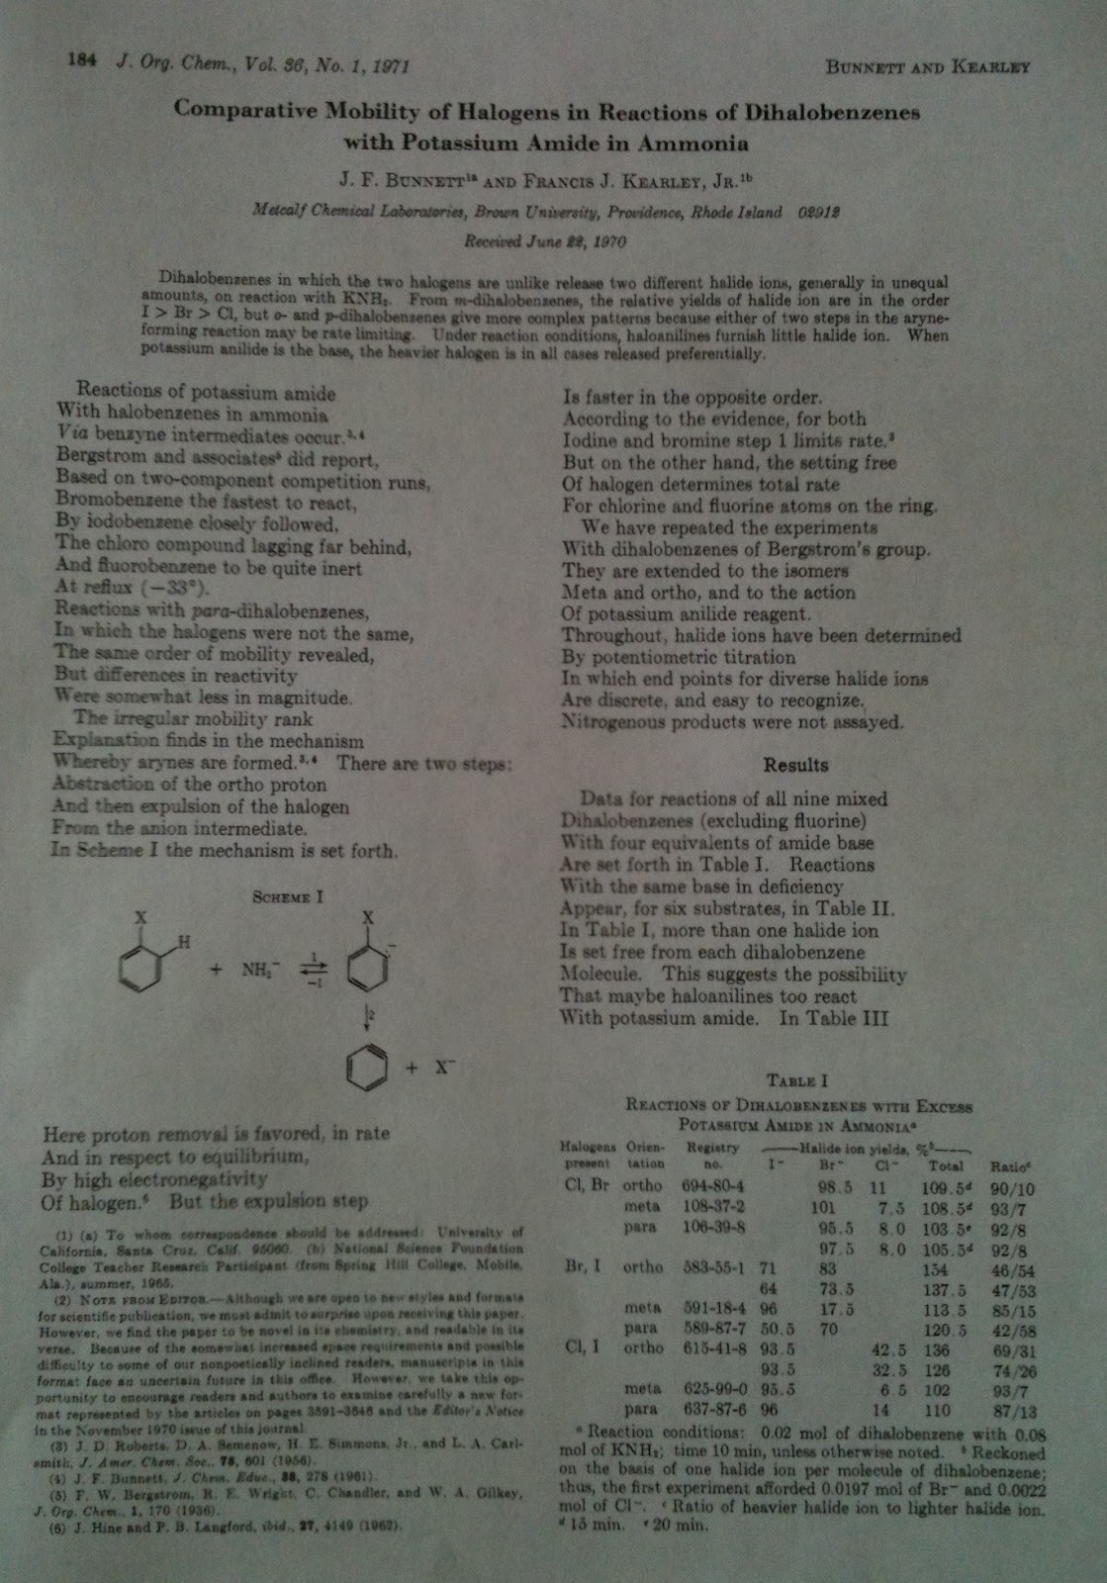
An unexpected paper…
A real paper written in poetry!!!
  Joseph F. Bunnett , Francis J. Kearley Jr. “Comparative mobility of halogens in reactions of dihalobenzenes with potassium amide in ammonia” J. Org. Chem., 1971, 36 (1), pp 184–186
    http://pubs.acs.org/doi/abs/10.1021/jo00800a036
IMPORTANT:
  The choice to write in verse did not prevent clear communication of science
  According to the editor: “…we find the paper novel in its chemistry and readable in its verse”

Slide 3
Scientific writing

Slide 4
Always remeber…
The reader does not know what you know!

Slide 5
Writing
The scientific text has to be:
  Accurate – Scroupulously faithful to science
  Correct – Well written according to the language norms
  Concise – Short and dense
  Precise – With the most accurate connotation and without ambiguities
  Clear – Explanations vs Equations
  Self-contained – It should need other texts to understand it; although it will still need it as support (references)
  Well balanced – Have the right level of difficulty according to the expected audience

Slide 6
Writing
The RICE test [Waal, P. (2013) Scientific Research Methods, Lecture 4; Reporting, Plagiarism and Fraud; http://www.computerscience.nl/docs/vakken/wo/handouts/methods4.pdf]:
  Rigor (use of scientific methods)
  Interest (sell your paper)
  Contribution (what is your contribution)
  Exposition (clear, comprehensible paper)

Slide 7
Writing
Scientific writing should concern about:
  Spelling (lexical errors*), sintax, semantic, morphology
  First-person style, connotation of verbs, jargon, level of detail
  Formal aspects; references to tables and figures, citations, etc
  Uniformity in the format of presentation
* Lexical errors is more than just spelling; it also includes phonology and decoding

Slide 8
Spelling
Science is written mostly by academics, ergo it is expected that you know how to write correctly. When it comes to spelling this is critical; you are expected not to have any mis-spelling.
  Not even if you are writing in a different language
  Occasional spelling errors are unavoidable (specially as you write fast on a keyboard); but consistent mis-spelling should be seriously disregarded
    …of course, if you are a literature Nobel prize winner you may intentionally mis-spell e.g. Juan Ramón Jimenez consistently used “j” instead of “g”, or Gabo’s recommendation to stop using accent marks

Slide 9
Spelling
Use a dictionary
  Don’t be lazy
  There is nothing embarrasing about using them
  If you no longer have one hard-copy, then use one online
Use a thesaurus
  You’ll enrich your vocabulary
  You’ll find the word with the right connotation

Slide 10
Spelling
There exist spell-checkers (ispell, word,…); use them!
  But beware! They are not perfect.
    They may make mistakes when the mis-spelled word also exist e.g. the/they, dear/deer, aye/eye, morning/mourning
    Their vocabulary may be extent, but perhaps not technical
      They often allow to create temporal dictionaries for the document, which may alleviate this issue
  You may want to review your spelling even after an automatic spell-checking
  DO NOT use your supervisor or panel advisor as spell checkers

Slide 11
Syntax and grammatical errors
Syntax errors are more difficult to detect than lexical errors
Nevertheless, there exist syntax checkers (Word)
  They are still far from satisfactory
  People in social sciences are, more often than not, better equiped in this regard than we people in physical sciences. Ask them for help!

Slide 12
Semantic and Morphology
As far as I know, there are no semantic nor morphological checkers…
…hence, you have no choice but to read your text several times
  …and while you are at it; further check spelling and syntax yet once more
Depending on the language, redundancy should be discouraged

Slide 13
First person style
Although third person style should be favoured for description of facts…
  Example:
    “We found that…” – First person
    “It was found that…” – Third person
…first person style is welcomed (and at times encouraged by journals) when speaking of your own experiments
  A informal but nice advice:
    http://www.realclearscience.com/blog/2012/03/first%20person%20in%20scientific%20writing.html

Slide 14
Connotation of the verbs
Verbs often has an associated connotation or intensity. Aim to use the most appropriate on each occasion.
  Example:
    Demonstrate/Prove/Evince
    Indicate/Establish/Evidence
    Suggest/Insinuate/Hint
The intensity of verbs often demand a deep knowledge of the language usage.
+
Intensity
-

Slide 15
Length of statements
When you are a novice writer, try to reduce the length of your sentences
  Rule of thumb: your sentence shouldn’t span beyond 2/3 lines
Longer sentences often lead to complex meanings and make reading difficult.
  …especially if you are not Shakespeare or Cervantes…

Slide 16
Jargon
Technical terms i.e. jargon, often has very precise meaning in each field
Use technical terms when necessary
  They confirmed that you know about what you are talking about…
  …but do not overuse them, as they may difficult reading
    …they are NOT for showing off.

Slide 17
Jargon
When a term has a different meaning outside the context in which you are using it; use it only in the most technical meaning and find synonims for the other meaning/usages
  Example
    “Class” in OOP has a clear connotation, but it also has different meanings in other contexts
    “Significantly” often highlights the importancy of the following term, but since in statistics has a very precise meaning, avoid using it in scientific writing.

Slide 18
Level of detail
Level of detail
  Basic concepts
    If trivial, skip them
    …yet remeber that the reader does not know exactly the same as you.
  Advanced concepts
    If they are mostly known, just indicate (but do not abuse the classical “the well-known…”
    Always provide a reference where it can be expanded.
  Novel, highly developed, state-of-the-art concepts
    Ensure that they are perfectly defined
    Avoid explaining more than once (redundancy), but do not sacrifice clarity
    …and do not expect the reader to remember a novel definition 10pgs from now.

Slide 19
Level of detail
Level of detail
  Description of experiments
    The reader does not know the details or nitty-gritty of your experiment.
    Painfully and scrupulously describe all the details
    If the experiment cannot be precisely replicated from what you write; then it is worthless.

Slide 20
Level of detail
Level of detail
  Mathematical demonstrations
    Skip if trivial; but they hardly ever are…
    …and avoid if
      you can explain things with your own words
      …or it has been already published and you can point to the reference.
    Do not rely on the classical “It is trivial to show…”
      That’s absolute non-sense and it is disrespectful with the reader who may not find it trivial!
    They must be explained and not only developed
    A scientific work is not better, more precise or more complex because it has more equations;
      …that only scares beginners, not hardened experts

Slide 21
Writing tips
There is no such thing as the perfect text.
  All texts can be improved.
Read your own text several times BEFORE submitting
Always try to find someone to read you manuscripts
  It is far more difficult for you to find you own mistakes than for others to spot it
Once finished your text, leave it aside for a few weeks. Then come back and read it again.
  You’ll spot a lot of errors that you missed before.
The reader does NOT know exactly what you know
  Do not assume knowledge
  Things which you may consider trivial, perhaps are not so.

Slide 22
Writing tips
Acronyms are valid
  …just remember to spell them out on first use
  …even if extremely well known in your field
    Exception; you write fMRI and you are targeting a neuroimage journal
  …and try to avoid them in titles and abstracts
Avoid colloquial expressions
  They tend to be ambiguous and possibly unfamiliar for non-native speakers
Do not allow yourself literary atmosphere
  It is often imprecise and ambiguous
  Nevertheless, mathematician and member of the Real Academia Española (RAE), Rey y Pastor advocated that a scientific writing was not at odds with proper writing

Slide 23
Results presentation

Slide 24
Document structure
It is often convenient to structure your scientific document in classical sections:
  Abstract
  Introduction
  Related work and or state-of-the-art
  Methods
  Results
  Discussion
  Conclusions
    …often includes future work
In CS these are often presented together under the heading Experiments and Results. Despite popular, this practice should be discouraged as it blurres the line between different stages of the scientific method (hypothesis emission, experimental design, acquistion of observations and analysis)

Slide 25
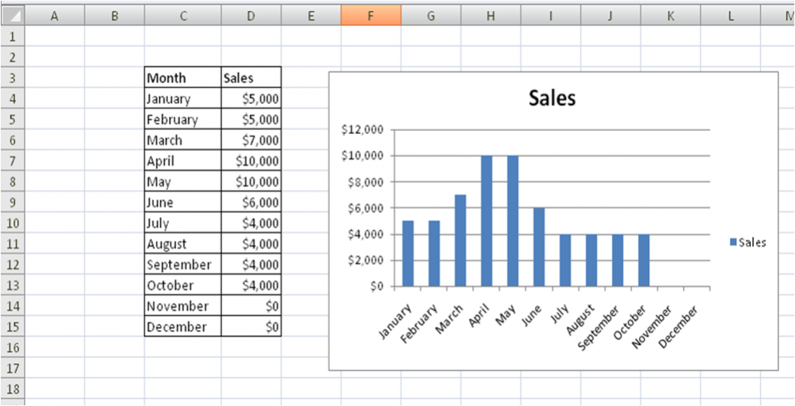
Data visualization
Which one is more quickly understood?
Figure from: [http://zenassignments.com/application-integration/2009/11/]

Slide 26
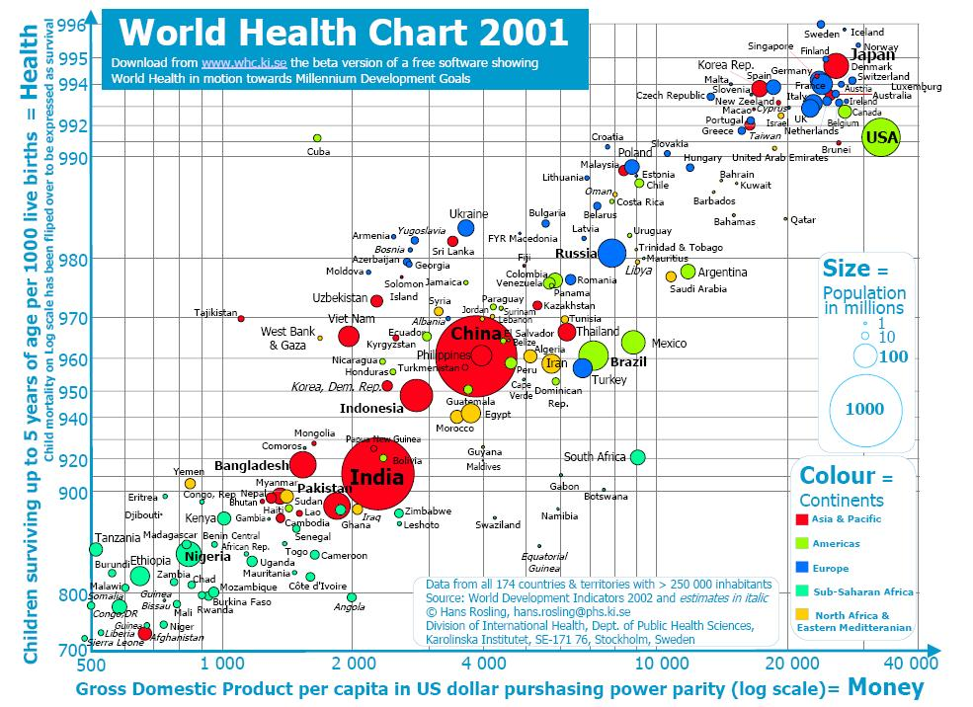
Data visualization
How would you present multidimensional complex data in a table?
  Data visualization techniques
Figure from: [visibledata.wordpress.com]

Slide 27
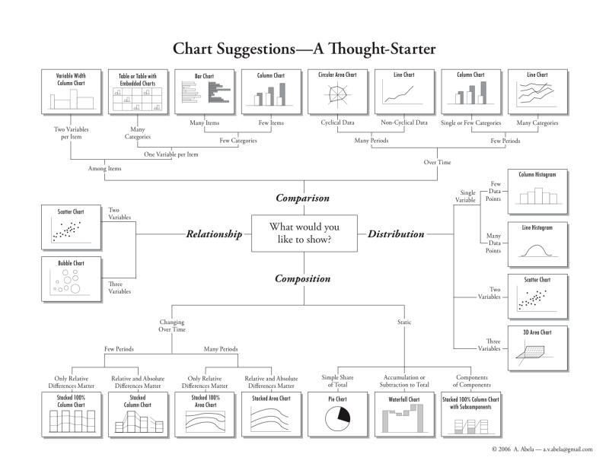
Data visualization
Figure from: [http://apandre.wordpress.com/2010/02/02/dimensionality/]

Slide 28
Reporting statistics
ALWAYS report an estimator of central tendency (mean, median, mode) and an estimator of variability (standard deviation, variance, inter quantile range)
Reporting only mean results is meaningless

Slide 29
Reporting statistics
Reporting hypothesis testing:
  ALWAYS report the objective finding e.g. effect size, and the statistical result e.g. test name and p-value
  Example:
    Experts (time: 1.23+\-0.45) significantly outperformed novices (time: 6.78+\-0.90) (MW-U: p<0.001)

Slide 30
Reporting results practices
Although different journals may have its own guidelines for reporting results [PLOS Medicine Editors (2013) PLoS Medicine 10(8): e1001504.];
  E.g.: PLOS Medicine (2013) Reporting Guidelines Collection homepage.
    http://www.ploscollections.org/reportingguidelines
…there are of course “standards” for reporting scientific research:
  E.g.:
    The CONSORT Statement. http://www.consort-statement.org/
    Begg C, Cho M, Eastwood S, et al. (1996) Improving the Quality of Reporting of Randomized Controlled Trials. The CONSORT Statement. JAMA 276:637–639
NOTE: Although there is plenty of scattered literature in the web, I’m unaware of a similar standard for CS. ☹

Slide 31
Referencing and citing

Slide 32
References
Researchers ought to reference those works made by other people.
Referencing helps for:
  Supporting statements and/or facts
  Allowing the reader to explore related material
  Being concise
    And collaterally saving precious room in your manuscript
  And above all, to acknolwegde authorship and intelectual property (that’s to avoid plagiarism)

Slide 33
References
When referencing; there are two parts:
  The citation in the text
  The reference containing the bibliographic information
    This is often given in a reference list at the end of your document

Slide 34
Reference styles
There exist many reference styles
  Almost each journal family and institution has its own.
Three major families are:
  Harvard: Author/date between parenthesis
  Chicago: Numbered as superscript e.g.^{1,2}
  Vancouver: Numbered between brackets e.g. [1]
It doesn’t matter which one you use; but be consistent! Stick to a single style.
DISCLAIMER: These slides are NOT a style manual; please refer to orginal style manual for accurate description of reference styles.

Slide 35
Vancouver
Citations are given with a number between brackets
  Example: Smith [1] suggests that … This was later extended by [2]. There have been to implementations [3-4] …
  …at times as superscript, but still in brackets to differentiate from footnotes e.g.^{[1],[3]}
References are numbered consecutively in order of appearance in the text

Slide 36
Vancouver
Pros
  Works well when author is not clear
  Does not break text as much as the Harvard system
  LaTeX uses this as a default
Cons
  The reader won’t be able to tell the reference just by looking at the citation

Slide 37
Harvard
Citations are formed by providing the author and year of publication between parenthesis, and if necessary a letter to differentiate several publications in the same year.
  Example: Smith (2001) suggests that … This was later extended by (Doe, 2004). There have been to implementations (Smith, 2005a, 2005b) …

Slide 38
Harvard
Pros
  Expert readers are likely able to tell the reference without looking at the reference list
  Often considered more elegant
Cons
  If several citations are made together it may break the text
  Does not work well when the author is unknown e.g. (FR83)

Slide 39
Citations
The citation is the entry point to the reference
Different styles exist, but they are all unambiguous to relate a citation with its respective reference item.
Simple examples (up to 3 authors):
  (Jones, 1996)
  (Jones and Jones, 1995)
  (Jones, Jones and Jones, 1994)

Slide 40
Citations
Some more complex examples
  Distinction among authors with the same surname
    (Sloman, A., 1999) and (Sloman, M, 1999)
  More than 3 authors
    (Jones et al, 1993)
  Corporative authors
    (SUN, 1999) o (SUN Microsystems, 1999)

Slide 41
Citations
Even more complex citations:
  Referencing a specific page
  …or a section, chapter, figure, table, equation, etc…
Examples
  (Smith, 2003, fig. 5)
  (Jones, Smith and Doe, 2010, pg. 76-81)
  (Fulano and Zutano, 2006, sec. 4.2)

Slide 42
Citations
Place the citation where it is “obvious” that it should go:
  Examples:
    It has been establish that the earth is round [1].
    Newton [1] formulated the law of universal gravitation.
    In its law of universal gravitation [1], Newton stated that...
In the case of Harvard style, sometimes the citation is part of the text
  Shannon (1948) introduced information theory…

Slide 43
References
A reference is a record that unambiguously permits identifying a source document.
Different types of documents e.g. journal articles, conference articles, books, etc, require different information to be reported.
  It is therefore necessary to know which information is necessary to keep for referencing.

Slide 44
Journal articles
For a journal article keep:
  Author/s
  Year
  Title
  Journal
  Volume
  Issue – may not be present
  Pages
  Other if available; month/date of publication, editor/s, ISSN
Example
  Smith, J. and Doe, J. (1999) “On the theory of more and more about less and less” Science 304(54):45-48
The formatting depends on the referencing style.

Slide 45
Journal articles
Important things to remember
  Do not translate titles or journal names
  When the dates of reception and acceptance are also indicated, the “valid” date is that of final publication.
  Not all journals have the same scientific reputation.
    Check indexes
    Check whether it is peer reviewed
    Check impact factor

Slide 46
Conference papers
For a conference paper keep:
  Author/s
  Year
  Title
  Conference name (and satellite workshop if necessary)
  Proceedings Editor/s or Conference Chairs
  Proceedings series
    e.g. Lecture Notes in Computer Science
  Volume
  Pages
  Other if available; date and place of the conference, association, body or institution holding the conference, etc
Example:
  Smith, J. and Doe, J. (1999) “On the theory of more and more about less and less” Medical Image Computing and Computer Assisted Intervention (MICCAI). Lecture Notes in Computer Science 4567(Part I):345-678, Seville (Spain), 2nd-5th Aug

Slide 47
Conference papers
Important things to remember
  Do not translate conference names
  Do not use conference name abbreviations in isolation
  Conferences sometimes publish the full length paper, and sometimes only an abstract.
    The quality of the conference has nothing to do with what they publish!
    Moreover, as conference grow and then grow more, they may change their policy from year to year.
  Not all conferences have the same scientific reputation.
    Check rejection indexes
    Check whether it is peer reviewed (particularly important for CS)
    Check conference size (number of attendants)
    Check the chairs

Slide 48
Books
For a book keep:
  Author/s and or Editor/s
  Year
    That of the copyright, or the most recent according to the edition
  Title
  Editorial
    It is not necessary to include the legal information e.g. “& Co.”, “Ltd.”, “Inc.”, “S.A.”, etc
    When published by different editorials in different countries, only report the one you have used.
  Pages
  City
  Other if available; series, chapter or section if you only want to reference a specific element, edition (especially if not the first), volume, ISBN
Example:
  Smith, J. and Doe, J. (1999) “On the theory of more and more about less and less” MIT Press, 3rd Ed. 457 pp. Cambridge, Mass, USA

Slide 49
Books
Important things to remember
  Books may be anonymous. Depending on the format; it may appear as anonymous or simply left blank
  There may be corporative authors.
  In science, it is common to write books where the important person is “not the author” but the editor
    The editor is the one coordinating the efforts of many authors working in the individual chapters.
    You may still want to cite a particular chapter, and the the authors of that chapter become the important element.
  Not all editorials have the same scientific reputation.
    Check whether you recognise the editorial (whether we like it or not, scientific literature is concentrated in a handful of editorials)
    Check the institution and affiliation of the authors;
      pay special attention to possible conflicts of interest

Slide 50
Technical reports
For a technical report keep:
  Author/s
  Year
  Title
  Institution
  Code or ID number
  (Total number of) Pages
  Other if available; date and location of the publication, department, country, etc
Example:
  Smith, J. and Doe, J. (1999) “On the theory of more and more about less and less” Instituto Nacional de Astrofísica, Óptica y Electrónica, Coordinación de Ciencias Computacionales, CCC-14-003, Sta. Ma. Tonantzintla, Pue, Mexico.

Slide 51
Technical reports
Important things to remember
  Beware! Technical reports are not peer reviewed and thus their reputation strongly depend on the institution backing them.
    Still some reports repositories are highly respected e.g. ArXiv from Cornell University.
  The advent of the WWW has reduced the popularity of technical reports, as now scientist directly output to the web for higher and quicker impact
    …but what whoever publish in their website is not backed by their institution
  Not all institutions have the same scientific reputation.
    Check whether you recognise the institution as a prestigious research center, higher education institution, governmental agency, reputed company, etc
      pay special attention to possible conflicts of interest

Slide 52
Thesis (MSc or PhD)
For a thesis keep:
  Author
  Degree
  Year
  Title
  Institution granting the degree
  (Total number of) Pages
  Other if available; date and location of the publication, department, country, etc
    Supervisor (do not report it, but keep it for your reference)
Example:
  Smith, J. (1999) “On the theory of more and more about less and less” Instituto Nacional de Astrofísica, Óptica y Electrónica, Coordinación de Ciencias Computacionales, PhD thesis, Sta. Ma. Tonantzintla, Pue, Mexico.

Slide 53
Technical reports
Important things to remember
  Do not attempt to “translate” the degree
  If it is in a good thesis, it is likely to have been published elsewhere. You may want to track the journal/conference publication
  Not all institutions have the same scientific reputation.
    Check whether you recognise the institution as a prestigious research center, higher education institution, governmental agency, reputed company, etc
  Not all supervisors have the same scientific reputation.
    Check whether you recognise the supervisor as a prestigious name in your field.

Slide 54
Websites
For a websites keep:
  Author or Institution
  Date of access
  URL
  Other if available; title
Example:
  INAOE. www.inaoep.mx Last accessed 26-Aug-2014

Slide 55
Websites
Important things to remember
  Beware! Websites are not peer reviewed and thus their reputation strongly depend on the institution or author backing them.
  A reference or two to websites is usually acceptable, but websites are hardly ever accepted as scientific literature and thus they should never be your main source of information
  Not all institutions and authors have the same scientific reputation.
    Check whether you recognise the institution or author as a prestigious research center, higher education institution, governmental agency, reputed company, etc
      pay special attention to possible conflicts of interest

Slide 56
General tips
Important things to remember
  Keep author names EXACTLY as they appear, including order, abbreviated middle names, etc
    Sometimes, depending on the formatting, when there are more than 3 authors, the formula et al* is used.
    Sometimes, names are made to “fit” an anglosaxon format; i.e. one single surname
      Latin names often use and intermediate hyphen (-), e.g. Orihuela-Espina
      Asian names are turned around, family names are given AFTER the given name
  Each journal and/or editorial has its own formatting; fit the reference style to the requirements of your target publication.
    Register ALL information even if they are not used under a particular style. It maybe useful for another style.
  In titles etc, always keep the original spelling even under cultural differences e.g. do not “re-spell” a British English into American English or the other way around
*et al. Comes from the Latin et alli meaning “and others”

Slide 57
Bad PRACTICES

Slide 58
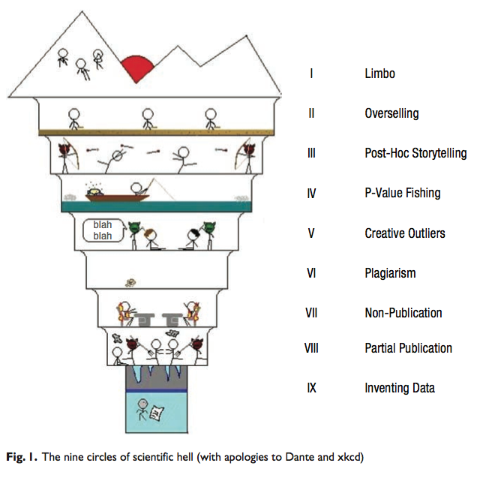
Writing scientific literature
Source: [http://io9.com/5959152/introducing-the-nine-circles-of-scientific-hell--a-real-figure-in-a-real-scientific-journal]

Slide 59
Bad practices
A coarse classification of bad practices [GrieneisenML (2012), PlOS One, 7(10): e44118];
  Publishing misconduct
    Plagiarism
      Self-plagiarism
    Salami slicing
    Authorship issues
      Failing to consult or inform all authors
      Excluding authors who substantially contributed to the work
    Overselling
  Research misconduct
    Data fraud
      inc. manipulation, fabrication, etc
    Breach of ethics
      Inc. failure to obtain permission from ethical committee or not complying with their approved protocol
  Questionable interpretation
    P-value fishing
    (un)intentionally biasing to favour a particular outcome

Slide 60
Plagiarism
Plagiarism is defined as imitating the ideas, language or thoughts of another author and presenting them as your own.
You commit plagiarism when you fail to acknowledge the authorship of a piece of work.
It is by far the most important offence in publishing misconduct
  …so much, that it is illegal in many countries and punished with jail.
    …and that includes Mexico!
  In academia, it is often punish with ejection.

Slide 61
Plagiarism
It is still plagiarism if
  Unintentional
    …though honest mistakes may occur; and must be ammended as soon as possible without hesitance.
  not intended to profitting from it
    use a disclaimer if necessary
Not knowing is NOT an excuse.

Slide 62
Plagiarism
Forms of plagiarism:
  The most obvious form of plagiarism is copying the written words of an author with using quotes nor a reference
  An indirect form of plagiarism is paraphrasing a.k.a. cloning, or imply reshuffling or just slightly modifying words but still failing to provide a reference
  Summarizing in specific cases can also be considered plagiarism if a citation is not provided.
  A more elaborated case of plagiarism is presenting a document like if you have read the original, but paraphrasis clearly corresponds to another author

Slide 63
How to avoid plagiarism?
Easy! Just acknowledge authorship!
The key is honesty.
  Each person who reads you work must be able to clearly and unambiguously differentiate your contribution from other people contributions.

Slide 64
Correct ascription
Acceptable usage AFTER you have sufficiently proved that you are an expert on the field
  Summarizing.
  Providing extra information on indirect citations
    You may skip the intermediate reference
In both cases, you still are better off providing the reference
    …and that includes the intermediate reference

Slide 65
Correct ascription
Proveer información extra sobre trabajo anterior para discutir puntos individuales
  Smalley [Smalley98] cita la afirmación de Crouch [Crouch93] de que al parsear frases centro-contenidas, esto debe hacerse mediante el uso de autómatas de estados finitos con un número limitado de transiciones, por tanto modelando la capacidad limitada de la memoria de corto término.
  Es necesario incluir ambos trabajos [Smalley98] y [Crouch93] en las referencias, este último indicado con la fórmula “citado en [Smalley98]”

Slide 66
Secondary sources and indirect citation
Access to secondary sources must be acknowledged with the same zeal as the primary source
  A common use is “[primary source] cited by [secondary source]…”
Indirect citation should be discouraged in scientific writing whenever possible
  You ought to have read the original document

Slide 67
Data fraud
Data fraud includes manipulation, fabrication of data and subjectively excluding inconvenient data.
It also refers to including observations which are not directly derived from experimental records.
It is dishonest to adjust data to fit self interests.

Slide 68
Writing abstracts

Slide 69
Writing Abstracts
There exist 3 major types of abstracts:
  Descriptive
  Informative
  Critical
A fourth type is the so called extended abstracts; a longer than normal informative abstract that acts as a substitute of a full document

Slide 70
Descriptive Abstracts
Short – Usually less than 100 words
Include:
  Purpose of the work (Goals)
  Methods
  Scope
Does not include:
  Results, conclusions nor recommendations
The reader will have to read the full document to decide whether it is relevant for him/her
The kind of abstract you include in a review

Slide 71
Informative Abstracts
Mid size - Between 200 words and 1 pg
Include:
  Background
  Aims
  Methods
  Results
  Conclusions and impact
Communicates the content of the document. Sufficient for a reader to decide its relevance.
The kind of abstract you include in a paper

Slide 72
Critical Abstracts
Long – 500 words to 1000 words
A non structured short summary of the document
Highlights the take away message of the content
The kind of abstract you include in your thesis

Slide 73
Characteristics of a good abstract
Concise
  Communication is effective and efficient
Informative
  Regardless of the type the reader gets a quick overview of the contents of the document
Connected
  Flow is smooth and without breaks
Conservative
  Does not include new material over the material contained in the main document

Slide 74
Common errors
Title repetition
  Well, the title is a different part of the document
  Boring
  Wasted invaluable space
Starting with “This work…”
  Isn’t it obvious that you’ll talk about this document?

Slide 75
Common errors
Making external references
  Title and abstracts should conform an self-contained unit
  They have to be used for indexing the document
  Avoid references to literature and figures or tables

Slide 76
Common errors
Use of acronyms and abbreviations
  Leave those for the main text
  Only extremely well known acronyms may be acceptable; USA, UK, etc
  Do you know what RTE, ATR, GSM, WAM or LFG mean? Well, they are extremely well known in their areas…so why should you expect that someone knows the acronyms/abbreviations in your field?

Slide 77
Reference managers

Slide 78
Reference Managers
Reference managers are software tools to help you keeping track of your references
Warning:
  Students often do not keep a proper track of the documents they read. When the time comes to write their thesis, or simply a paper, they are forced to go back and find the information again.
  As a rule of thumb, it is better to write the details of the literature at the time of reading it and not some time afterwards

Slide 79
Reference managers
Some pupular reference managers:
  EndNote
  Reference Manager
  Papers
  Mendeley
  Zotero
  JabRef
  BibDesk
  I, librarian
A comparison of reference manager software:
  http://en.wikipedia.org/wiki/Comparison_of_reference_management_software

Slide 80
EndNote
My subjective evaluation: My gold standard
Licence: Commercial (Thomson reuters)
Features:
  Seamless integration with Office
  Virtually every feature you can imagine is here:
    Sharing refs
    Search remote libaries
    Open and annotate PDFs
    Cloud support
  Formatting readily available for most JCR journals (if not all),
    …but capable of creating new templates as necessary

Slide 81
Reference Manager
My subjective evaluation: A slight variant of EndNote
  Not sure the “real” difference
Licence: Commercial (Thomson reuters)
Features:
  Seamless integration with Office
  Collect references from remote bibliographic databases (inc. web of science, pubMed, etc)
  Formatting readily available for most JCR journals (if not all),
    …but capable of creating new templates as necessary

Slide 82
Papers
My subjective evaluation: Haven’t tested
Licence: Commercial (Springer)
Features:
  25+ built-in search engines to find literature in your field of research, from PubMed, Scopus, to ArXiv, and Google Patents.
  Support document annotations
  Formatting readily available for most JCR journals (if not all)

Slide 83
Mendeley
My subjective evaluation: Good GUI but many useless features if you are not interested in the social network
Licence: Free
  Elsevier
Features:
  Academic social network
  Your library is in the cloud
  Generate citations and bibliographies in Microsoft Word, OpenOffice, and LaTeX.
  Formatting readily available for most JCR journals
  A nice (but of course biased) comparative:
    http://www.mendeley.com/compare-mendeley/

Slide 84
Zotero
My subjective evaluation: As your library grows, it seriously affect your browser performance
Licence: Free
Features:
  Superb GUI!!!
  Installed over your browser as a plugin (not web-based)
  Your library is in the cloud, storage capacity is limited to 300Mb (5 Feb 2014)
  Sharing refs
  Generate citations and bibliographies in Microsoft Word and OpenOffice.

Slide 85
JabRef
My subjective evaluation: Pragmatic and practical
Licence: Free
Features:
  A shell over Bibtex
    ..ergo, seamless integration with LaTeX
  Plug in bibtex browser for generating citations and bibliographies in Microsoft Word

Slide 86
BibDesk
My subjective evaluation: Pragmatic and practical
Licence: Free
Features:
  A shell over Bibtex
    ..ergo, seamless integration with LaTeX
  Plug in bibtex browser for generating citations and bibliographies in Microsoft Word
  For Mac only

Slide 87
I, librarian
My subjective evaluation: Haven’t tested
Licence: Free to use. Pay for support
Features:
  Powerful but non intuitive; connects directly to scientific search engines inc. PubMed, Scopus, Science Direct, ArXiv, IEEExplore, Springer, etc
  Web-based
  Your library is in the cloud. Not sure about your store capacity
  Sharing refs
  Permit pdf annotation, rich text notes,
  Generate citations and bibliographies in Microsoft Word and OpenOffice.

Slide 88
GRACIAS, ¿PREGUNTAS?

