Slide 1
Week 2. Search, Reading and Critical Analysis of Scientific Literature
MSc Methodology Seminar I
Dr. Felipe Orihuela-Espina

Slide 2
READING

Slide 3
Reading scientific literature
Reading is arguably one of the most important tasks in research
  Keeps you up-to-date
  Maintains your critical and creative thinking
  It is a source of ideas for further research
  Supports nomological validity (the evidence that structural relationships among variables/constructs is consistent with existing knowledge)

Slide 4
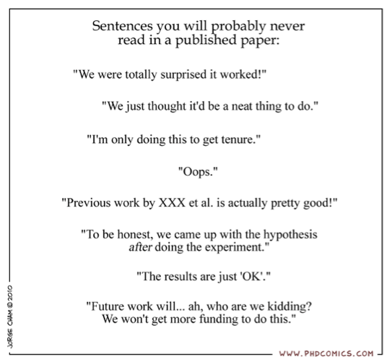
Reading scientific literature

Slide 5
Reasons for reading scientific literature
Bad ones:
  I was told to
    …but I don’t give a monkey
  I need a ref on the topic I’m talking about, and this one came across
  Find a supportive back to my statement
    …for which I cannot/won’t back with a proper experiment, and
    …that I know it is almost certainly false,
    …but since the ref is published it automatically can be accepted as “true”

Slide 6
Reasons for reading scientific literature
Good ones
  I was told to
    …and I’m convinced that it may be useful for my research
  Learn about a topic I’m novice
  Describes current research
  Allows replication of results
  Provides data
  Learn to write my paper / Get the journal writing style

Slide 7
How to decide whether to read a paper?
The decision whether to read a paper is based on several factors [http://web.stanford.edu/~siegelr/readingsci.htm]:
  Whether the article is of sufficient interest
  Whether the article is relevant to their work
  Whether the article is of general importance
  Whether the article is if high quality and or accurate
  Whether the article is clearly written and accessible at least after reasonable amount of effort
  Whether the article is "meaty“
  Whether the article is short.

Slide 8
Reading
Beyond the hard text.
  Talk to colleagues about the paper/document
  Can you give a seminar about the paper?
  Read papers that have cited this one
  Clarify “basic” concepts that are no so basic for you in other literature (e.g. dictionaries, wikipedia, introductory books, etc)

Slide 9
Reading: Tips
Reading a scientific paper:
  Start by reading the abstract
    Keep an eye on the authors; if the paper belong to authors important in your area, then you should read the paper
  If promising, then skim the rest of the article
  If of interest, then read the full article
    Several times!
  Quickly add the article to your reference library.

Slide 10
Reading: Tips
Reading a scientific book:
  Books are often the best entry point to a topic
  Do not try to read it as a novel; i.e. from start to end
  Go directly to the chapter or section of your interest
    …and only if you do not understand, then go back to previous chapters/sections

Slide 11
SEARCH

Slide 12
Proliferation of scientific literature
“A large fraction of [scientific] literature is of marginal value, but should not be excluded from comprehensive archives for possible retrieval. For awareness of significant current developments, however, scientists depend on a small number of core journals whose quality is maintained by editorial selectivity and competition.”
  [ZimanJM (1980), Science, 208(4442):369-371]

Slide 13
Proliferation of scientific literature
Proliferation of scientific literature [ZimanJM1980]:
  Makes the problem of searching a “needle in a haystack” problem
  Comprehensive search cannot be carried very far without seriously compromising the value of the collection
  Worsens the problem of maintaning awareness in a field
  Led to the “feeling” that quality of scientific literature has deteriorated in recent years.
    Actually, that is not a feeling but a fact! See:
      [Ioannidis JPA, PlOS Medicine, 2005 2(8):e124]
      [Stewart W.W and Feder N, Nature, 325:207-216]

Slide 14
Search: Sources
Search engines
Documents databases
  Digital or physical libraries
  …Yep! Physical libraries continues to be a good source of information.
References of an already read paper
Wild/Random search in Google
My supervisor and other colleagues
Attendance to conference and seminars

Slide 15
Search: Physical
Library catalogue
  Often you can check these online in advance…
Try different terms and combination of these
  When you become an expert, search becomes more easy as you know the vocabulary…

Slide 16
Search: Digital
Scientific engines
  Spending 15 mins in Google is NOT searching for scientific literature
Try different terms and combination of these
  When you become an expert, search becomes more easy as you know the vocabulary…

Slide 17
Search: Systematic search
Carrying out a systematic search:
  Defining the review question(s) and developing criteria for including studies
  Searching for studies
  Selecting studies
  Extracting information
  Assessing risk of bias in included studies
  Analysing information and organizing information
Extracted and modified from The Cochrane Handbook in [http://en.wikipedia.org/wiki/Systematic_review]

Slide 18
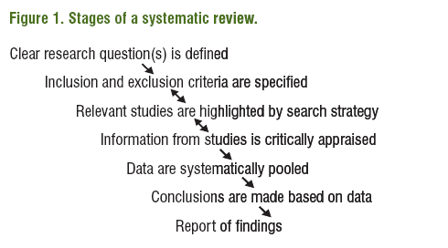
Search: Systematic search
Figure from: [http://www.ispor.org/news/articles/July09/CLR.asp]

Slide 19
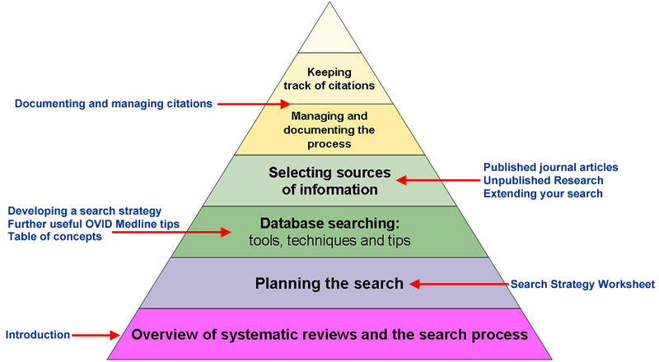
Search: Systematic search
Figure from: [http://wiki.ubc.ca/Library:Systematic_Review_Literature_Workshop_01Dec2011]

Slide 20
Co-citation
Co-citation is the frequency with which two items of earlier literature are cited together by the later literature [SmallH1973]
Co-citation measures the degree of the relationship or association between papers
  …ergo, co-cited papers are highly likely to be of your interest (that is, if one of them already is).
  NOTE: The Science Citation Index allow calculation of co-citation.

Slide 21
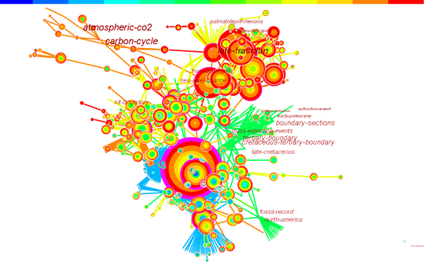
Detecting emerging trends in literature
A research front is defined as an emergent and transient grouping of concepts and underlying research issues [ChenC2006, JASIST]
  A research front represents the state-of-the-art thinking of a research field
  The base of a research front is its citation and co-citation footprint in scientific literature
Tools like CiteSpace may help
  http://cluster.cis.drexel.edu/~cchen/citespace/
Figure from [ChenC2006, JASIST 57(3):359–377]

Slide 22
CRITICAL ANALYSIS

Slide 23
Analysis
Keep a critical attitude
  Not because is published (and peer-reviewed) is true!
    …let alone worth!
Never judge a paper base solely on its abstract
Compare to other documents that you have read before

Slide 24
Analysis
Pay attention to the discussion, and not only on the results and conclusions
Take notes as you read
Check references for further source of information
You only understand it if you can:
  explain it in your own words to a layman,
  …without having the paper at hand for support and
  without using equations.

Slide 25
Analysis
Reduce your chance of misinterpretations:
  A correlation is not a causal relation
    …moreover, a significant correlation with low r is still meaningless.
  Evidence from a single experiment NEVER proves/demonstrates anything
  Maths should be obvious (not criptic) if you understand the text
  Ensure you understand the statistical implications, and do not go beyond them
  Detect any leap of thinkings by the authors

Slide 26
Reading: Critical questions
Reading a scientific document:
  What should you get out of the document?
    Is the information replicable?
  Where is that information located in the document?
    Note that what it is of interest to you might not be the main topic of the document!
  What’s the evaluation of that information? Is the information validated in any form?
  If the information is referenced from another source; do you have access to the original document to check whether the citation is appropriate and makes justice to the original statement?
  Is the source (journal, editorial, authors, etc) reliable/ trustable/ dependable? Is it methodologically solid?

Slide 27
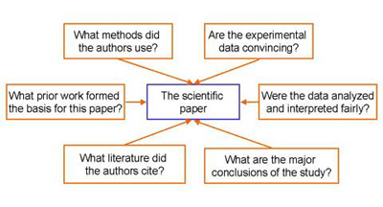
Reading: Critical questions
Figure from: [How Scientists Read - http://biology.kenyon.edu/Bio_InfoLit/how/]

Slide 28
Scientific search engines (And DIGITAL LIBRARIES)

Slide 29
Some features a good scientific search engine should have
Location of articles
  not only the reference but also a link to where the article is.
  Related to this; the search engine should also provide external links to articles in external databases
Full-text indexing
Citation indexes
(Meta-)information extraction (authors, affiliations, etc)
Query sensitive summaries (i.e. estimation of relevance to the user search)
Related documents
Overlapping documents
Citation graphs (e.g. network of scientific literature)
User profiling
This above list was given in 1999 for the CiteSeer Project [LawrenceS (1999), CIKM 139-146]

Slide 30
Scientific search engines
Web of Knowledge / Web of science
Google Scholar
PubMed
IEEExplore
ACM Digital Library
Scopus
Science Direct
Springer Link
Wiley-Blackwell
CiteSeerX
ArXiv

Slide 31

Web of Knowledge / Web of Science
Sources: All JCR journals into 2 databases
  (Physical) Sciences
  Social Sciences
Coverage: All fields of science
Performance: Highly sensitive and good specificity
Other:
  Can create citations report for a given search (that includes authors)
  Has additional tools such as the journal citation report
  Perhaps the most respected scientific search engine
  Access by subscription only

Slide 32

Google Scholar
Sources: Basically, the whole internet
Coverage: All fields of science
Performance: Highly sensitive but very poor specificity
Other:
  Has additional tools such as My Citations
  Retrieves not only scientific papers but also presentations and other documents
  Can find public copies of articles
  Not everything found is peer-reviewed

Slide 33

PubMed
Sources: NIH
Coverage: Medicine and everything closely or remotely associated to it (that includes biology, chemistry, or computer science applications, etc)
Performance: Highly sensitive but very poor specificity
Other:
  Has additional tools such as My Citations
  Retrieves not only scientific papers but also
  presentations and other documents
  Can find public copies of articles
  Not everything found is peer-reviewed

Slide 34

IEEExplore
Sources: IEEE journals and conferences
Coverage: Engineering; mostly electrical and electronic but also biomedical, informatics, etc
Performance: Good sensitivity but good specificity
Other:
  IEEE has good/strong but also terrible/weak journals and conferences
  ~30% of engineering journals in the area of interest
  The search engine is free, but access to papers is by subscription or pay-per-use

Slide 35

ACM Digital Library
Sources: ACM journals and conferences
Coverage: Computer Science and a bit of Statistics
Performance: Good sensitivity but good specificity
Other:
  ACM has good/strong but also terrible/weak journals and conferences
  The search engine is free, but access to papers is by subscription or pay-per-use
  GUI is not user friendly

Slide 36

Scopus
Sources: 50 million records | 21,000 titles | 5,000 publishers
  Not sure how these are chosen
Coverage: All fields of science
Performance: Good sensitivity but good specificity
Other:
  They claim to be “the largest abstract and citation database of peer-reviewed literature, features smart tools to track, analyze and visualize research.”
  The search engine is free, but access to papers is by subscription or pay-per-use
  It also includes books

Slide 37

Science Direct
Sources: Elsevier’s database
  2500 journals | 20,000 books
Coverage: Most fields of science inc. Physical and Engineering, Life, Health and Social and Humanities
Performance: Very high sensitivity but very high specificity
Other:
  The search engine is free, but access to papers is either by subscription or pay-per-use, or open access

Slide 38

Springer Link
Sources: Springer’s database
  > 8million documents
Coverage: Most fields of science inc. computer science, stats, economics, health, life, etc
Performance: High sensitivity and good specificity
Other:
  Includes journals, conferences, and books
  Lecture Notes in CS, AI
  The search engine is free, but access to papers is either by subscription or pay-per-use

Slide 39

Wiley Blackwell
Sources: Blackwell’s database
  > 4million documents from 1,500 journals, 9,000 books, and hundreds of multi-volume reference works
Coverage: Most (if not all) fields of science
Performance: Moderate sensitivity and moderate specificity
Other:
  RSS feeds
  Scientific and not so scientific literature (cooking and beverages??!!)
  The search engine is free, but access to papers is either by subscription or pay-per-use

Slide 40

CiteSeerX
Sources: NSF and Pennsilvania State University database
Coverage: Most fields of science
Performance: Good sensitivity but moderate specificity
Other:
  Some nice features
    Automatic notification of new citations
    Harvesting of papers
    Can also be use as a reference manager
    Citation statistics
  Free

Slide 41

arXiv
Sources: Cornell University database
  912,800 e-prints
Coverage: Physics, Mathematics, Computer Science, Quantitative Biology, Quantitative Finance and Statistics
Performance: Moderate sensitivity but good specificity
Other:
  Not everything is peer-reviewed
  Good taxonomy
  Open access

Slide 42
GRACIAS, ¿PREGUNTAS?

