Slide 1
Week 1. Scientific method, research methodology and experimental design
MSc Methodology Seminar I
Dr. Felipe Orihuela-Espina

Slide 2
Contents
Common excuses to attempt not abiding by the scientific method
Scientific method
Research methodology
Experimental design

Slide 3
COMMON excuses to attempt NOT abidING by the scientific method

Slide 4
Excuse No. 1
The archetypical speech:
  “The research method was conceived for other sciences e.g. physics. Computer science cannot be enforced to fit into the scientific method.”
The point attempted:
  CS is different, and shall be treated differently
The antidote:
  Be kind to yourself and read “The need for a hypothesis in informatics” by Prof. Alan Bundy.
    http://www.inf.ed.ac.uk/teaching/courses/irm/notes/hypotheses.html
  ALL sciences must abide by the scientific method; CS is no exception.
    …particularities are dealt with in the research methodology.

Slide 5
Excuse No. 2
The archetypical speech:
  “My research is theoretical, not experimental ergo the scientific method, which puts experimentation in its core, does not apply in my case.”
The point attempted:
  Theory is so far superior to experimentation that I cannot bother to express my research in those meaningless terms
The antidote:
  Drop your cynicism
  Theory is absolutely necessary and central to the scientific method
    …in fact; it was Galileo who first introduced mathematical demonstration to the scientific method.
    …so if Galileo could, so could you…
  Moreover; mind you but you “will eventually have to show that these theoretical predictions are borne out in practice” [Bundy, “The need for a hypothesis in informatics”]

Slide 6
Excuse No. 3
The archetypical speech:
  “My research is very specific, there is simply no way it shall fit into the scientific method.”
The point attempted:
  I’m too busy; I don’t have time for this rubbish
The antidote:
  Stop victimizing yourself.
  All scientific work is worth and has particularities… yours is no exception.
  …by the way; Prof is more busy than you, and he is not moaning.

Slide 7
Excuse No. 4
The archetypical speech:
  “Nobody follows the scientific method. Why should I?”
The point attempted:
  Option 1: I’m bl…y lazy, and I don’t want to waste my time on it
  Option 2: I couldn’t care less of the scientific method
The antidote:
  Check any groundbreaking/breakthrough paper in your area.
  See any traces of the scientific method on it?

Slide 8
Excuse No. 5
The archetypical speech:
  “All I need to do for publishing is to repeat the procedure other people have published before”
The point attempted:
  Science is irrelevant. Publishing is the only thing that matters
The antidote:
  If you only care for the publication…you may enjoy one or two successes
  …if you just happen to abide by the scientific method, you’ll enjoy far more success

Slide 9
Excuse No. 6
The archetypical speech:
  “I’m a hands-on guy; old Profs in their offices have forgot what real science is all about.”
The point attempted:
  The scientific method is just for old people in their offices and isolated from the real world; real science is in the lab
The antidote:
  While you are absolutely right that science must be proved in the lab…
  You may be surprised to know that “some” of those old fellows had been young once.
  It is their experience and hard work who get them where they are (not chance)…
  …not to mention that before they got there, they have had to proved themselves in the lab!

Slide 10
The scientific method (CLASSIC)

Slide 11
Scientific method
In general, science aims at providing explanations of phenomena observed in nature and society
This explanation is offered in terms of relations between an observed phenomena (effect) as a consequence of its possible origin (cause).
These relations are established by means of experimentation following the scientific method.
  i.e. experiments are central to science

Slide 12
Scientific method
Purpose:
  To build a representation of the world/nature/society that is accurate, reliable, consistent and not arbitrary

Slide 13
Objectivism
There exist an objective reality which is the same for everyone [Cotton and Sekula].
  Reality exists as an absolute goal: facts are facts regardless of feelings, desires, hopes or fears of people. Ayn Rand, “mother” of objectivism
  “If your own private reality includes a law of gravity that is different from Newton's, any predictions you make with it are not going to match reality.” [http://www.physics.smu.edu/pseudo/SciMeth/]

Slide 14
Objectivism
There exist [unchanging] laws by which the universe works [Cotton and Sekula]
  These laws can be discovered (not invented) through experimentation
  These laws may however not be deterministic; they might be stochastic.
  Unchanging does not mean static! This becomes especially clear in social research as society evolves with time.

Slide 15
Scientific method
Fact:
  A fact is an observation that has been confirmed repeatedly and that for all practical purposes it is accepted as true.
    Definition by the National Academy of Sciences
  "Everyone is entitled to his own opinion, but not his own facts.”
    Daniel Patrick Moynihan (1927-2003), Senador de los EEUU
  "Facts do not cease to exist because they are ignored.“
    Aldous Huxley

Slide 16
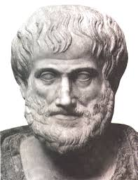
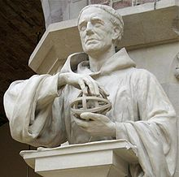
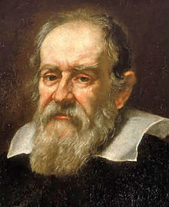
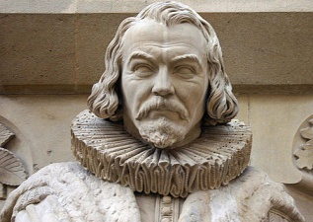
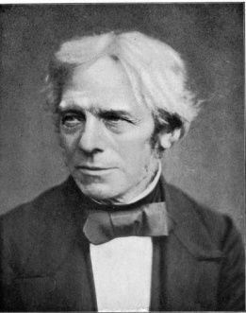
A brief (not exhaustive) history of the scientific method
384-322 BC: Aristotelic Empiricism
~700-1000. Arabs Ibn al-Haytham , Abū Rayhān al-Bīrūnī and Ibn Sina Avicenna among others develop different forms of experimentation and quantification to discriminate among competing theories
Aristoteles
Roger Bacon
1214-1294. Roger Bacon describes the cycle of observation, hypothesis, experimentation and verification
1561–1626. Fracis Bacon incorporates induction as a rational method to reach causality
1564-1642. Galileo uses mathematical demonstration as a form to obtain valid scientific results
Galileo Galilei
Francis Bacon
1791-1867. Faraday demands intelectual honesty and criticism from peer (peer review) together with scrupulous documentation of experiments so that they can be reproduced.
S XIX-XX. Several contributions from Hume (inductive reasoning), Mill (knowledge based on experience), Popper (necessity for falsability), Peirce (scheme for hypothesis testing and randomization)
Michael Faraday

Slide 17
Scientific method
The scientific method in a nutshell
  Observation of a phenomenon
  Formulation of a hypothesis or plausible explanation of the phenomenon that might explain the observations
  To carry out an experiment altering the conditions and measuring/observing the phenomenon under the changing environment
  Confirmation (or refutation) of the hypothesis based on evidence (observations) collected during the experimentation

Slide 18
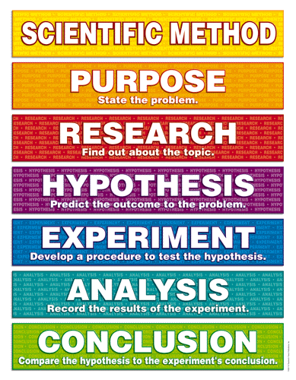
Scientific method
Figure from: [www.studyblue.com]

Slide 19
Scientific method
The scientific method reviewed:
  Observation and description of a phenomenon
  Formulation of a research hypothesis or plausible explanation of the phenomenon to explain the observations as a causal mechanism (induction)
    I really mean causal
    Use the hypothesis to predict the existence or ocurrence of other phenomena, or to quantify new observations (deduction)
  To carry out several experiments altering the conditions and measuring/observing the phenomenon under the changing environment
  Confirmation (or refutation) of the hypothesis based on evidence (observations) collected during the experimentation

Slide 20
Scientific method
¡YOU CAN’T DEMONSTRATE THAT A HYPOTHESIS IS CORRECT/TRUE!
To have positive evidence supporting a hypothesis is not equivalent to demonstrate a hypothesis, let alone to confirm a fact.
  …with positive evdience you only increase your confidence in the hypothesis
  The more experiments are made that result in evidence supporting your hypothesis, the bigger certainty you have on your hypothesis

Slide 21
Scientific method
The scientific method is an effort:
  Collective of all scientists
    Individual research is unavoidably influenced by personal and cultural bias
  Standardized to minimize bias
    Consensus among the scientific community is a central demand in empirical research [SwanbornPG1996]

Slide 22
Scientific method
The scientific method is an effort:
  Dynamic (time)
    It is subject to continuous revision
    The hypothesis that has been hold across many observations might still be refuted at any time by new evidence (facts)
      "When the facts change, I change my mind. What do you do, sir?"
        Atribuido a John Maynard Keynes
    Science is self-corrective

Slide 23
Scientific method
The scientific method is an effort:
  Critic and creative
    Critical thinking is capable of deciding whether an statement is always true, partially true or false.
    Creative thinking permits developing unique and useful ideas worth of consideration
      http://www.umich.edu/~elements/probsolv/strategy/crit-n-creat.htm
    Without these two thinkings we would be unable to formulate a hypothesis nor to confirm/refute them

Slide 24
Scientific method
The scientific method is an effort:
  Skeptical
    It requires experimental evidence before doing or accepting an statement
    …but it admits assumptions (lacking evidence) based on previous knowledge about the phenomenon
    Skeptical does not mean denier (available evidence is never enough)
    Trust is of utmost importance among scientist.
      In principle, you trust that others researchers are being honest
      …yet you have to test/review/challenge their evidence.

Slide 25
From hypothesis to facts
Hypothesis
Model
-
Scientific thoery
Evidence
Law
Fact
+

Slide 26
Scientific method
“In science, you encounter the disturbing fact that, if your "point of view" does not agree with reality as determined by experiment through the scientific method, then your point of view is simply wrong.”
  [Cotton y Sekula, http://www.physics.smu.edu/pseudo/SciMeth/]
Having said that:
  It is acceptable that our point of view changes as sciences gathers more reliable evidence
  …but that change must be guided by evidence.
  If a established theory (one that has passed many experiments) is in disagreement with new evidence, the theory has to be reviewed maybe even discarded as a description of reality
    It may still be valid within certain restrictions
    Classical examples: Newton’s gravity laws (reviewed), Copernicus’s heliocentric model (discarded).

Slide 27
Research methodology

Slide 28
Research Methodology
The scientific method give us a general framework to exert experimentation.
  …however, it does not get into details of how to carry out experiments
  …without it, we can’t make valid observations
The research methodology indicates how the experiments are to be conducted.
  …it tells us the details of how to carry out these experiments
  …without it we are likely to fail to comply with the scientific method.

Slide 29
Research Methodology
A research methodology ALWAYS has 3 main elements:
  Research Questions (RQs) indicate what phenomenon is being researched.
  Aims/Goals indicate what aspect of the phenomenon are you focusing
  Hypothesis (both research and experimental) represents your expected explanation for the phenomenon
    Hypothesis are “tentative, intelligent guesses” [NentyHJ2009]
    There is no thesis without a previous hypo-thesis!!!

Slide 30
Research Methodology
A good research methodology ensures that:
  Research questions (RQs) are correctly stated
    Research hypothesis ought to be falsifiable
  Aims/Goals are bounded by the RQs
  Experiments are correctly designed to answer the RQs
    Experimental hypothesis are formulated accordingly to the design

Slide 31
Research Methodology
A research methodology often has 2 parts:
  A description of your experiments
    By far the most important part
    Remember: the scientific method demands experimentation!
  A step-by-step plan of action
    An algorithm to achieve the above.
    Hopefully, it includes also a plan B
      …and perhaps also a plan C
    Just a collateral necessity…

Slide 32
Research methodology
Description of your experiments:
  For each experiment, the research methodology should aim to include:
    Its clear and univocal relation with the RQs
    Its clear and univocal relation with the Aims
    Its research hypothesis
    Its experimental hypothesis
    Its experimental design
      inc. units, factors, sessions, groups, etc
    Variables (dependent, independent and controlled)
    Possible sources of bias
      And efforts to reduce them
    The intended analysis strategy
    The validation efforts
      Both types and mechanisms

Slide 33
A template for a thesis research methodology
Thesis topic (1-3 words max)
Each RQ results in one experimental chapter. The thesis is often completed with an introductory chapter including other important elements; e.g. justification, significance, scope, etc, a chapter with the literature review, and a chapter with conclusions and future research
Often addresses a particular aspect of the main topic
In addition to your experimental publications, you may also publish your literature review
RQ1: Research Question?
RQ2
RQ3
RQ4
Associated goal
Associated goal
Associated goal
Associated goal
RH1: Research Hypothesis
RH2
RH3
RH4
EX2.1
EX1.1: Experiment
EX3.1
EX3.1
EH2.1
EH3.1
EH1.1: Experimental Hypothesis
EH3.1
EX2.2
P3.1
P4.1
P1.1: Publication
HE2.2
P3.2
Indicates a target conference or journal
P2.1

Slide 34
Experimental DESIGN

Slide 35
Experimental design
“It can be proven that most claimed research findings are false.”
  [Ioannidis JPA, PlOS Medicine, 2005 2(8):e124]
  >2000 citas (Google scholar)

Slide 36
Contents
Classical scientific method
Experimental elements
Caracteristics of a good experimental design
Randomization
Classical design
Quantitative and qualitative observation
Aproximation
Data analysis
Statistical power analysis
Interpretation of results
Causality (Presentación aparte)

Slide 37
Experimental
Elements

Slide 38
Experimentation
The statistical design of a study consists of elaborating an experimental plan, methodically organized so that the quality and amount of information obtained from it is maximized
  [Madero R 2006, An Pediatr Contin. 2006;4(6):401-4]

Slide 39
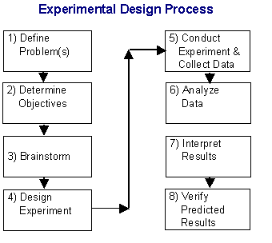
Experimentation
Figure from: [https://www.moresteam.com/toolbox/design-of-experiments.cfm]

Slide 40
Experimentation
Experiment:
  In general: Test involving replicating or observing a certain phenomenon under constrained circumstances, often controlled, so that its effects can be analyzed and a hypothesis may be verified or refuted.
  In statistics: A process which outcomes might be identified before its execution (not necessarily foreseen or predicted)
  In Computer Science: That collection of related simulations that you actually call experiments.
Outcome (a.k.a. result):
  The “result” of an experiment.

Slide 41
Experimentation
An experiment always:
  Aims at answering a research question
  Has an associated goal
    Occasionally, the research question and the goal are the same thing
  It is designed to verify or decide over the validity of an hypothesis
The goal of a study has to be expressed in terms of the hypothesis y determines the particulars of all other steps involved in the study design.
  [Madero R 2006, An Pediatr Contin. 2006;4(6):401-4]

Slide 42
Experimentation
Factor
  A controlled or independent variable in an experiment whose values have been chosen by the researcher.
    http://www.stats.gla.ac.uk/steps/glossary/anova.html#factor
  An explanatory variable manipulated by the investigator
    http://stattrek.com/statistics/dictionary.aspx?definition=treatment
  Each of the subdivisions of the factor are referred to as levels.

Slide 43
Experimentation
Factor
  A factor A is nested in another factor B if all the levels of A are different for each level of B.
    Nested factor have hierarchical relations.

Slide 44
Experimentation
Treatment
  A combination of specific values across the factors
  Note that a treatment is NOT a case; the treatment is applied to several objects, and each of these is a case.

Slide 45
Experimentation
Experimental unit
  Each one of the recipients (objects, algorithms, subjects, etc) over which an experimental treatment is applied.
  When the recipients are people or animals, often they are referred to as participants or subjects.
    In clinical trials, sometimes they are also called patients.

Slide 46
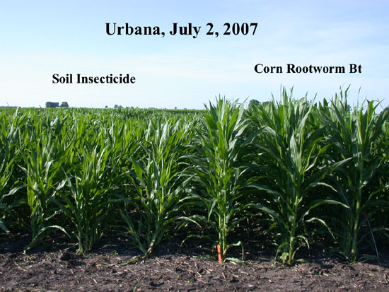
Experimentation
Example:
  A researcher in agriculture wants to know the effect of a certain fertilizer in corn.
  He designs an experiment in which he controls the amount of fertilizer (factor) that he will use in each plant (experimental unit).
  He divides the plot of land in 4 areas, and in each area he uses a different dose of fertilizer (treatment).
Figure from: [bulletin.ipm.illinois.edu]

Slide 47
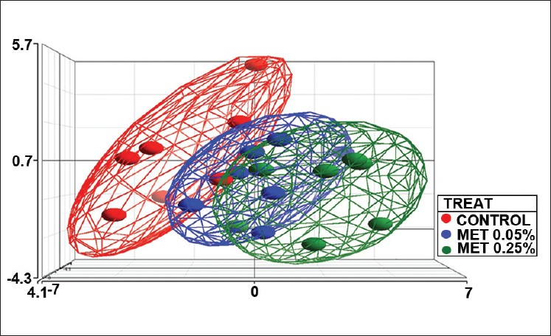
Experimentation
Ejxample:
  A researcher in pharmacoloy wants to know the optimal dose for a new drug.
  He designs an experiment in which he controls the dose of the drug (factor)
  He splits the participants (experimental units) into 3 groups; one group receives a placebo, whilst the other two receive the drug in different concentrations (treatments).
Figure from: [ZhuZ et al, 2011, Journal of Carcinogenesis, 10:17]

Slide 48
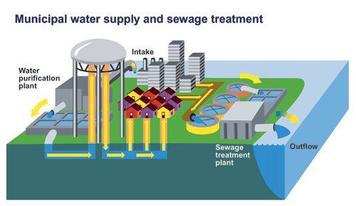
Experimentation
Example:
  A researcher in public policy wants to know about which policy of water management (factor) is more efficient.
  He observes (measure indicators) of a total of 50 municipalities (experimental units)
  Then he considers the different policies by the size of the populations in those monicipalities; below 10k, between 10k and 50k and over 50k (treatment).
Imagen de [www.ec.gc.ca]

Slide 49
Experimentation
Example:
  A researcher in computer science wants to know how to get the better classification of a dataset (experimental unit) described by a number of features.
  He designs an experiment in which he classifies the dataset according to different feature selection techniques (factor 1) and different classifiers (factor 2).
  Each simulation, he chooses a pair <feature selection technique, classifier> with a specific parameterization (treatment).
Figure [Self elaborated; project LACCIR]

Slide 50
Experimentation
Design matrix:
  The design matrix is a matrix whose rows represent experimental units and whose columns correspond to the different factors (both controlled and independent) of the experimental design.
    It is often named X.
  The design matrix permits representation of most experimental design in a concise form
    Moreover, it is explicitly used in several statistical models (e.g. the general linear model).

Slide 51
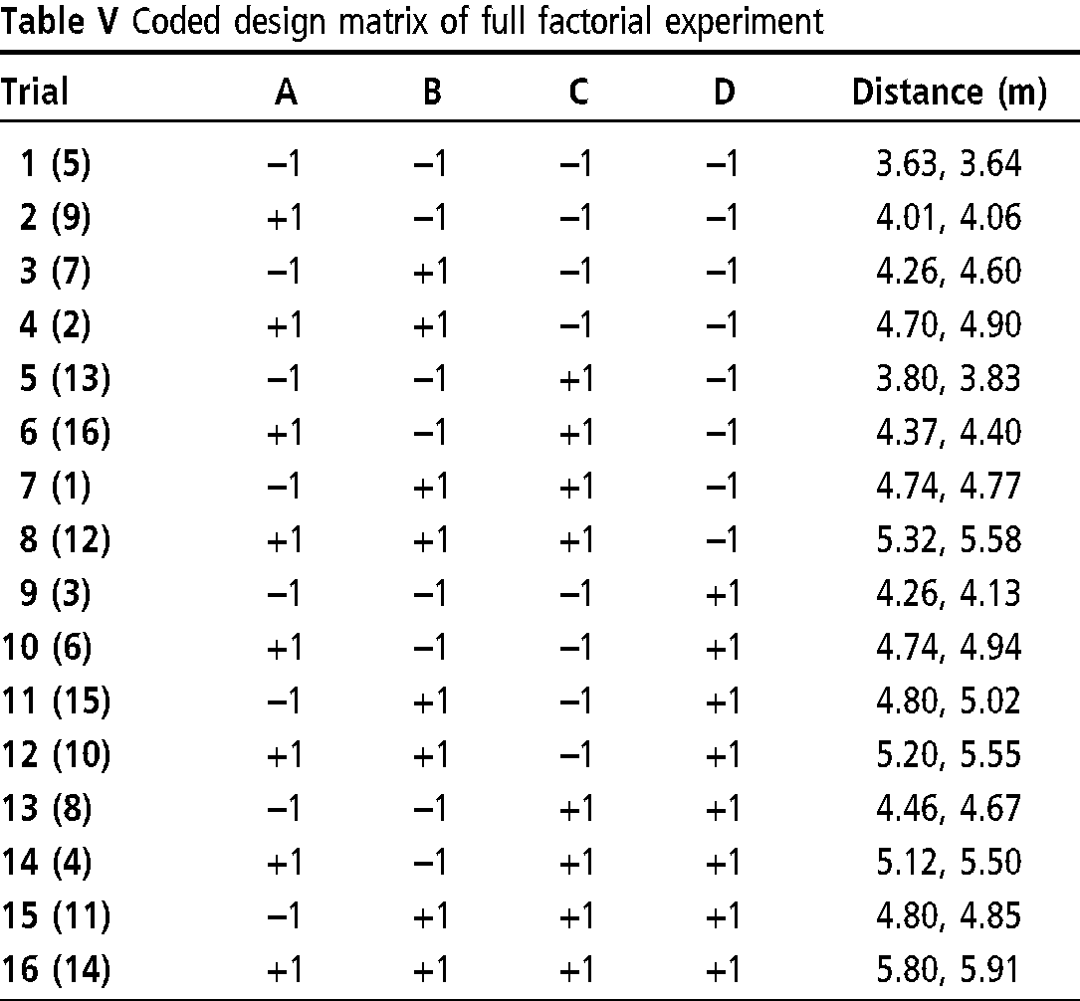
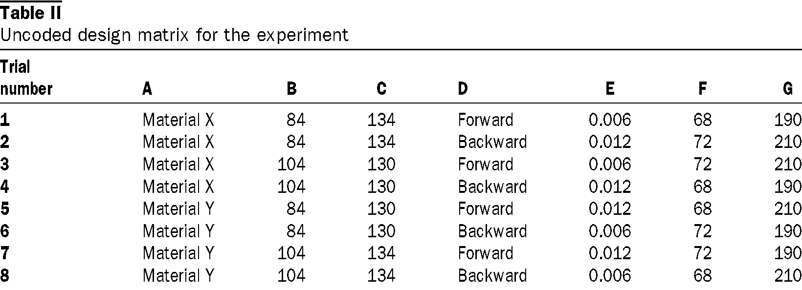
Experimentation
Ejxample:
Figure from: [http://www.emeraldinsight.com/journals.htm?articleid=1454574&show=html]

Slide 52
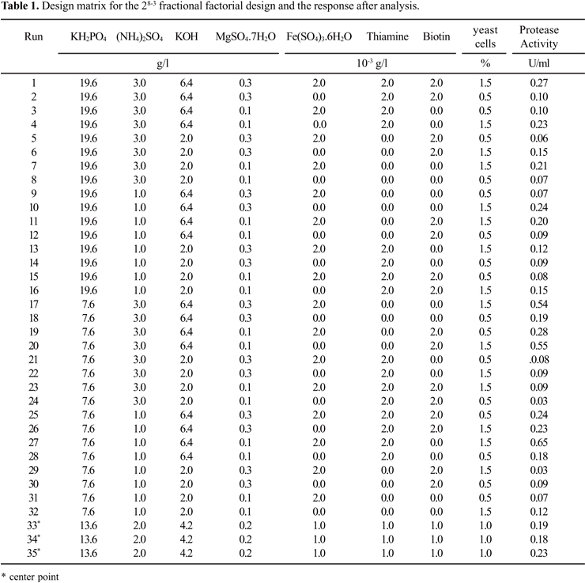
Experimentation
Example:
Figure from: [Ferracini-Santos, y Sato, Brazilian Journal of Microbiology (2009) 40:54-60]

Slide 53
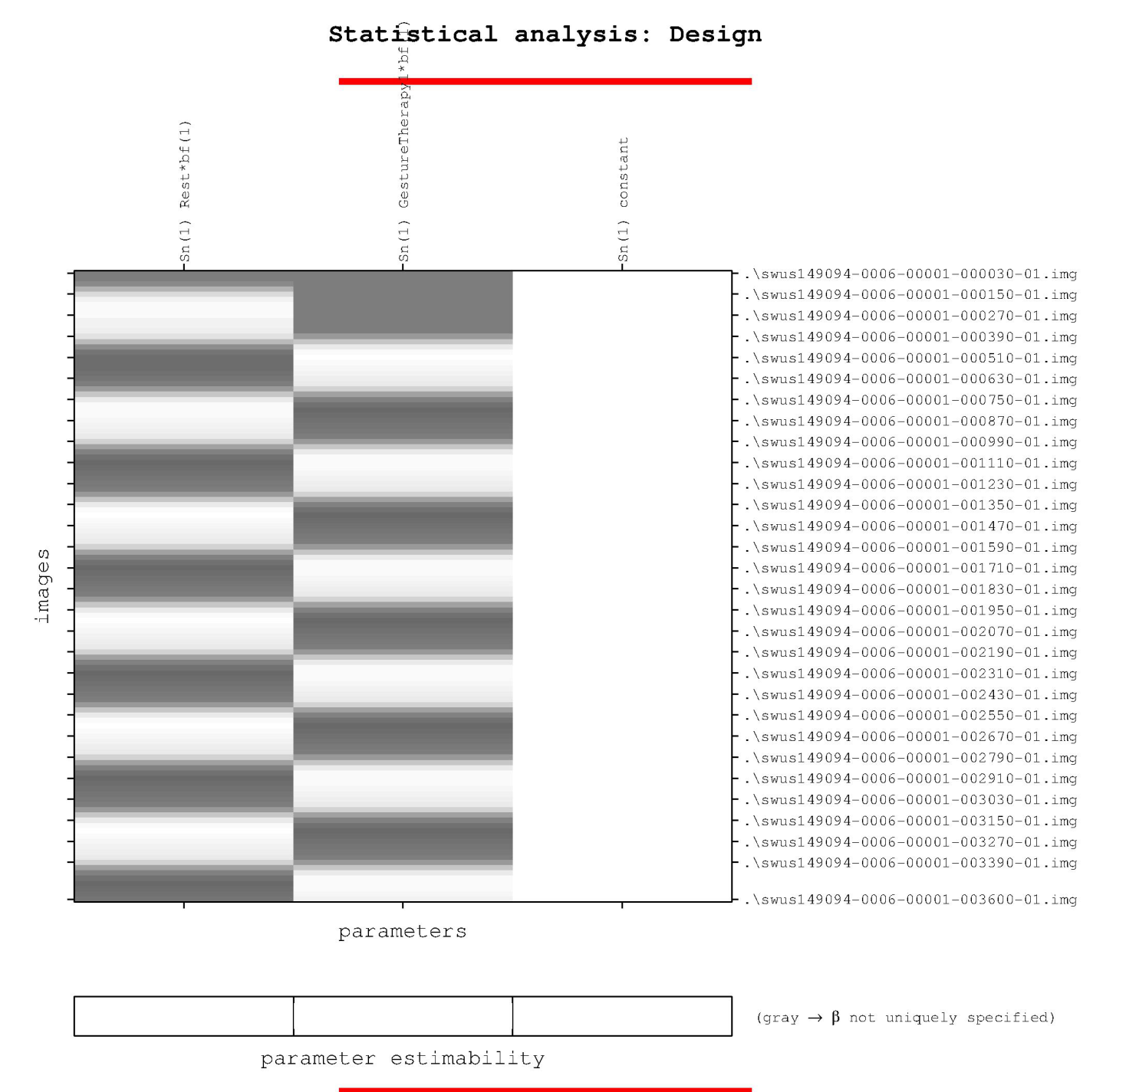
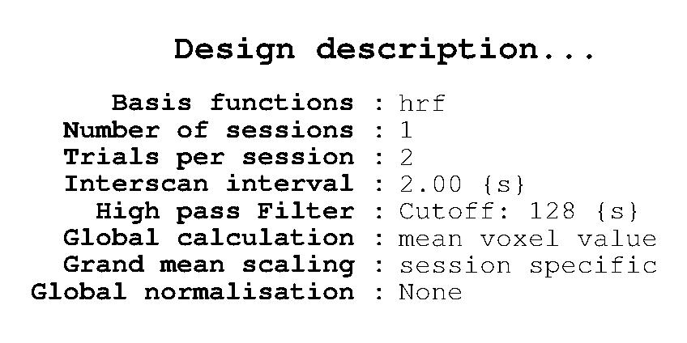
Experimentation
Example:
Figure: [Self elaborated]

Slide 54
Experimentation
Group
  The different treatment are applied to a number of experimental units to which we often refer to as groups.
    Example: Control group, intervention group, etc
  The group might as well refer to a set of cases sharing a specific level of a certain factor
    Example: Experts vs novices

Slide 55
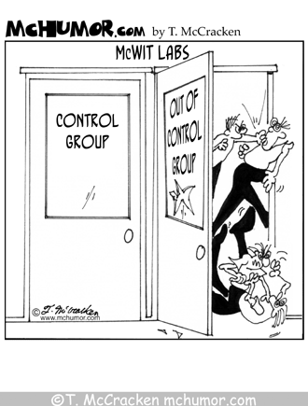
Experimentation

Slide 56
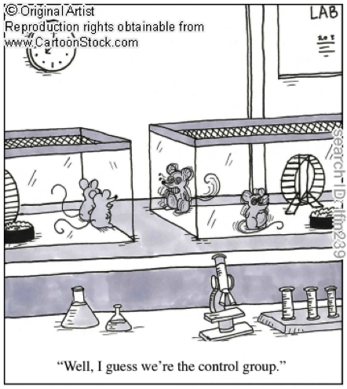
Experimentation

Slide 57
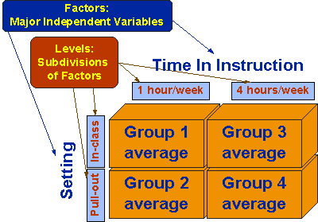
Experimentation
Example:
Figure from: [http://www.socialresearchmethods.net/kb/expfact.php]

Slide 58
Experimentation
Session:
  Each of the times a single experimental unit is interrogated or sampled [my own definition]
  NOTE: The concept of a session as such is common and necessary in experimentaiton, however the term session is not so widespread or universally accepted. Often, other authors simply speak of “repeated measures” or “pairings”. Personally, I prefer not to used those terms as they suggest more than 1 measurement per experimental unit; then how would you refer to the single “sesssion” onan experimental design without repetitions?
  The session can be:
    Concurrent in time (as for instance in within-subject designs)
      Concurrent is not to be taken literally; it only means that the observation time is irrelevant
    At different times (example: longitudinal designs)
    …and of course a combination of the above

Slide 59
Experimentation
Data source (a.k.a. measuring instrument)
  Each one of the devices for interrogating/sampling an experimental unit [my own definition]
  NOTE: The concept of a data source as such is common and necessary in experimentaiton, however the term session is not so widespread or universally accepted. Often , other authors simply speak of “sensors”, “evaluations” or simply “variables” and even “factors”. I do not find any of these satisfactory as a single data source may yield several evaluations and/or variables.
    Example: A device of functional optical topography might take two or more signals or variables (at different wavelengths) and reconstruct several variables or signals; HbO₂, HHb, HbT, aa₃
    They are also sometimes referred to “judges”, “observers”, “raters” etc… I like these better than the others when the source is a human.
  If at the end of the day I am only interested in variables and factors; why should I care about the data source that generates them?
    Ignoring this concept may lead to measurement bias and instrumental bias
    Example: cross-talk

Slide 60
Experimentation
¿Who or what object is observed?
What property and where do we measure?
How do we measure?

Slide 61
Experiment …as a tree

Slide 62
Data sources

Slide 63
Data sources
Example:
  A diffuse optical neuroimaging (fNIRS) device registers the dynamic changes (temporal) of two haemoglobin species, HbO2 and HHb (signals) in a set of channels or pixels (spatial)

Slide 64
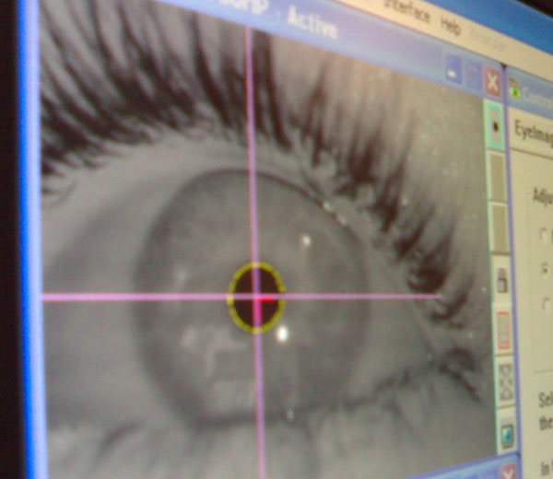
Data sources
Example:
  An eye-tracker records gaze and pupillmetric data (spatial or signal) from both eyes –left and right- (signal or spatial) during a certain period of time (temporal)
Figures: [self elaborated and http://cdn.thenextweb.com/files/2010/09/eye-tracker.jpg]

Slide 65
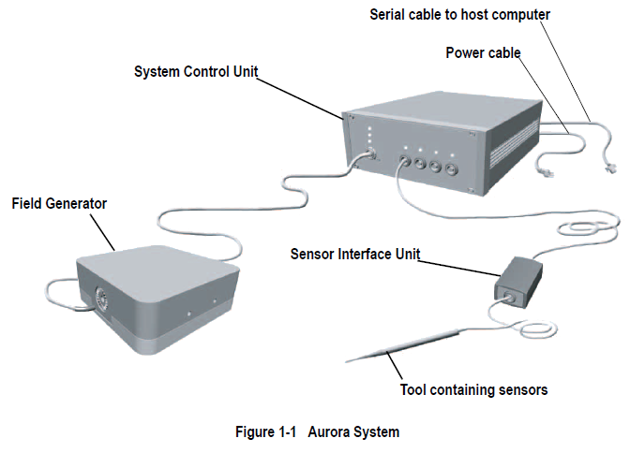
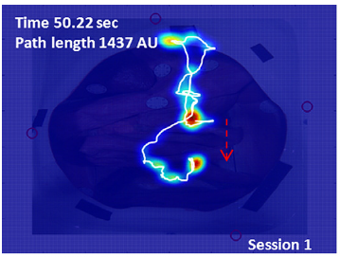
Data sources
Example
  A magnetic tracker records the location of several coils (signals) in a 3D space (spatial) over a period of time (temporal)
Figures: [self elaborated and NDI Aurora User Guide]

Slide 66
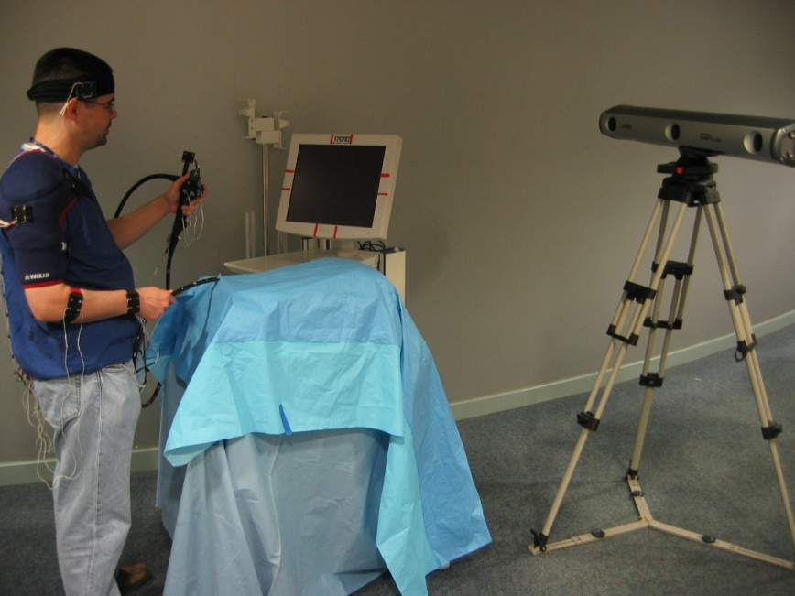
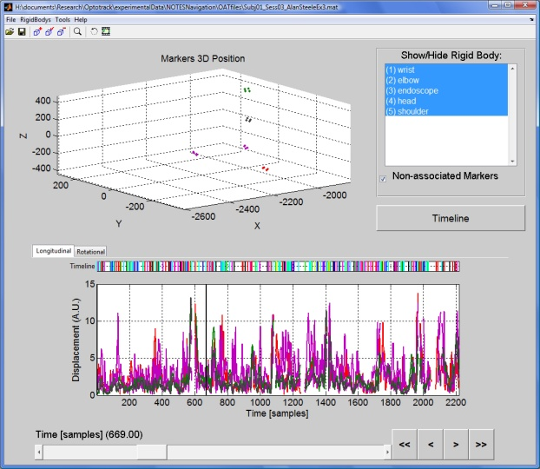
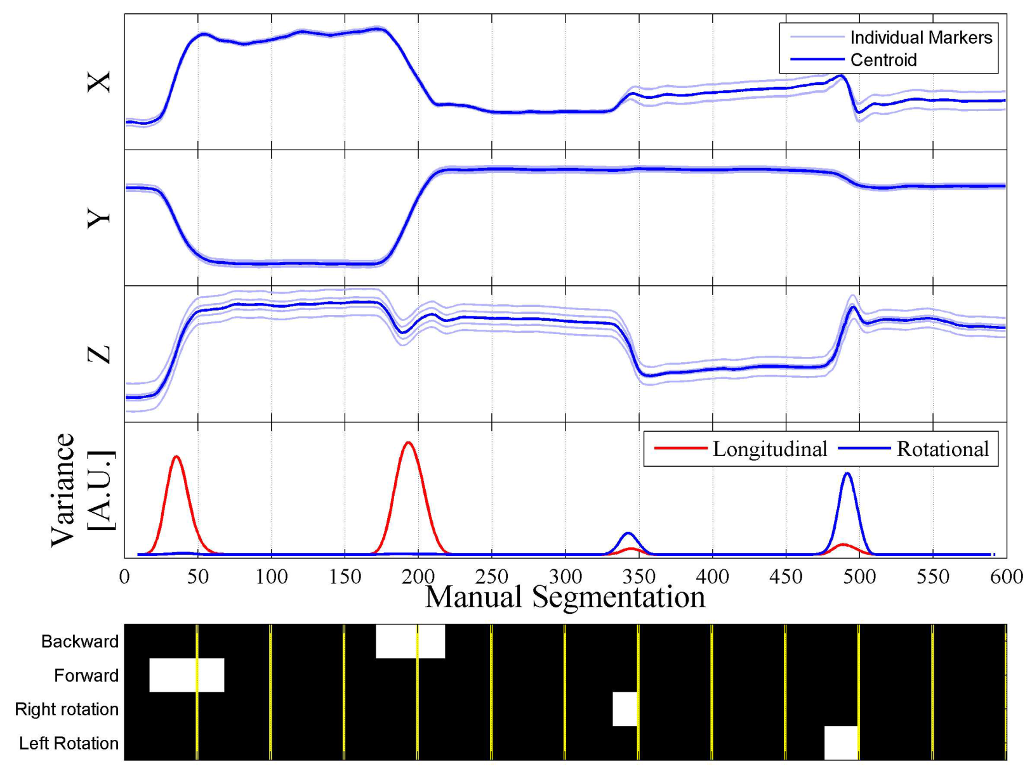
Data sources
Example:
  An optical tracker registers the 3D location (spatial) of several reflectors (signals) during a period of time (temporal)

Slide 67
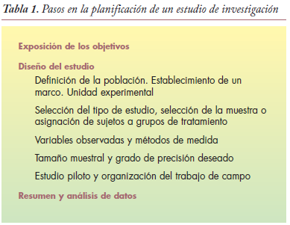
Experimentation
Figure from: [Madero R 2006, An Pediatr Contin. 2006;4(6):401-4]

Slide 68
CHaracteristics OF A GOOD EXPERIMENTAL DESIGN

Slide 69
Characteristics of a good experimental design
Experimental errors may have different nature:
  Random:
    Example: Inherent to the measurement instruments (they are far from random, however they are often modelled as such)
    Example: Distractions, researcher mistakes, etc
  Systematic
    …those responsible for experimental biases
Any measurement without an error estimation is useless
  Example: An observation without an estimator of variability

Slide 70
Characteristics of a good experimental design
Experimental bias:
  Combination of experimental design, data analysis, and presentation and interpretation factors that lead to a systematic error in research.
    [Ioannidis, PlOS Medicine, 2(8):e124]
    …whether positive associations when they do not exist, or negative associations when they do exist (inverse bias)
  Obviously, this is closely related to the statistical bias…
    An experimental bias unavoidably leads to an statistical bias

Slide 71
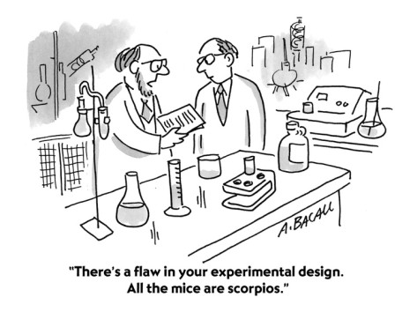
Characteristics of a good experimental design

Slide 72
Characteristics of a good experimental design
Confounding:
  There exists confounding when the experimental design does not allow to reasonably eliminate plausible alternatives to an observed relation
    Confounding provides an alternative explanation for an association between an exposure and an outcome. [http://www.healthknowledge.org.uk/public-health-textbook/research-methods/1a-epidemiology/confounding-interactions-methods]
  Covariates or confounding factors (a.k.a. hidden variables, latent variables, confounder, lurking variable) are those variables which distort the metric of association between any other two variables.
  Much of achieving a good experimental design is oriented to eliminate, reduce or control confounding.

Slide 73
Characteristics of a good experimental design
Example: Confounding
  A researcher in pharmacology design an experiment with 2 groups split by gender; 100 men receive the drug and 100 woman do not receive the drug. At the end of the experiment, the group of men report less colds than the group of women.
  This experiment is confounded. It is impossible to determine whether the drug was effective since gender may be influencing the outcomes.
    Perhaps men are less likely to catch the virus
    If you really want to demonstrate that the drug works in men and not in women, then gender should have been a controlled factor; e.g. 4 groups (men with drug intake, men without drug intake, women with drug intake and women without drug intake).
Example from: [http://stattrek.com/experiments/what-is-an-experiment.aspx]

Slide 74
Characteristics of a good experimental design
Replication:
  Involves assigning the same treatment to many experimental units
  In general, the more experimental units per treatement the lower the standard error
    …beware of overpowering effects though!

Slide 75
Characteristics of a good experimental design
Balanced design:
  An experiment has a balanced design if each treatment is applied to the same number of experimental units.
    If replication is low, then the number should be exactly the same.
      Example: If two treatments are applied 0 and 1 times, then the design is unbalanced.
    If replication is high, then it is often enough if they are approximate.
      Example: If two treatments are applied 1000 and 1001 times, then the design is balanced.
  Many hypothesis tests require a balanced design as an assumption

Slide 76
Characteristics of a good experimental design
Balanced design:
  Many of the decisions regarding the experimental design are made trying to ensure a fair comparison between treatments
    When the comparison between treatments is fair, then groups are said to be comparables.
  A balanced design often favours comparable groups.

Slide 77
Characteristics of a good experimental design
Balanced design:
  Orthogonality of factors
    In an experimental design, factors T₁ with I levels and T₂ with J levels are orthogonal if in the groups of the design, each level i∈I of factor T₁ appear in the same proportion the j∈J levels of factor T₂.
    The property of orthogonality permits separating the effects of each one of the factors over the variables of interest.
      The estimation obtained under orthogonality for the effects of a factor are not affected by the effects of other factors, thus allowing to separate the simple or main effects of each individual factor studied.
    Recommended reading:
      http://www.udc.es/dep/mate/estadistica2/sec5_6.html

Slide 78
Characteristics of a good experimental design
Balanced design:
  Latin square
    A latin square is a kxk matrix conformed by k vectors concatenated in such a way that:
      Each vector contains all elements 1 to k (or with letter, A, B, C, etc)
      Neither in the rows or in the columns, the elements are repeated
      [http://mathworld.wolfram.com/LatinSquare.html]
    Recommended readings:
      Armitage P (2002) “Statistical Methods in Medical Research” Blackwell, 4th Ed
      http://www.udc.es/dep/mate/estadistica2/sec5_6.html
      http://www.statsdirect.com/help/analysis_of_variance/latin.htm

Slide 79
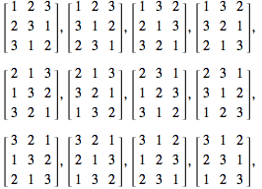

Characteristics of a good experimental design
Balanced design:
  Latin square
    Examples: Latin squres of order 2 and 3
Figures from: [http://mathworld.wolfram.com/LatinSquare.html]

Slide 80
Characteristics of a good experimental design
Balanced design:
  Latin square
    Number of possible latin squares according to the number of groups (k)
k | #L_{k}
2 | 2
3 | 12
4 | 576
5 | 161280
6 | 812851200
7 | 61479419904000
8 | 108776032459082956800
Refs: [http://oeis.org/A002860] and [Alter R, 1975, Amer Math Monthly, 82(6):632-634 ]

Slide 81
Characteristics of a good experimental design
Balanced design:
  Latin square
    The experimental designs based on latin squares are used for assigning treatments when:
      Repeated measurements and two other factors are considered,
      As a generalization of a randomized design with blocks according to two factors.

Slide 82
Characteristics of a good experimental design
Balanced design:
  Latin square
    Example: We want to try 5 recipes to make a chocolate cake (labelled A, B, C, D y E) and 5 baking temperatures (150, 175, 200, 225 y 250 degrees).
    During 5 days (repeated measures), we cook 5 cakes each day, each cake with one of the different recipes, and alternating the temperatures.
 |  | Days
 |  | 1 | 2 | 3 | 4 | 5
Temperatures | 150 | A | B | C | D | E
 | 175 | B | A | D | E | C
 | 200 | C | E | A | B | D
 | 225 | D | C | E | A | B
 | 250 | E | D | B | C | A

Slide 83
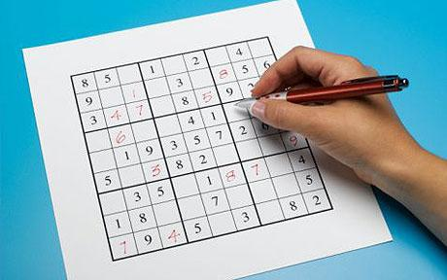
Characteristics of a good experimental design
Balanced design:
  Latin square
    Anecdote:
      Latin squares are known at least since Euler
      In statistics, they were use by the first time by Fisher in agriculture
      They do have application not only in experimentation and statistics, but also in graph theory, parallel computing, linear algebram etc.
      The popular pasttime Sudoku is a particular example of a latin square
Figure from: [peacelight14.blogspot.com]

Slide 84
Characteristics of a good experimental design
Blinding or masking:
  Blinding is the practice of not telling:
    The participants which treatment they are receiving,
    Personnel helping with data collection (e.g. therapist) which participant are receiving which treatment. Only the researcher knows the group assignment.
    The data analyst which participant are receiving which treatment. Only the researcher knows the group assignment.
  If only one of these is met, then the experimental design is said to be blind.
  If two are met, then it is said to be double blind.
  If all three are met, then it is said to be triple blind.
    Often this is the standard expected in a randomized controlled trial (RCT).

Slide 85
Characteristics of a good experimental design
Blinding or masking:
  Blinding reduces the observer bias and the experimenter bias, and in general it also reduces the information bias ensuring that the support personnel does not introduces bias.
    In clinical trials it further reduces the placebo effect.
  …but the double blind, specially in clinical trials may have moral implications that have to be considered.
    http://www.filociencias.org/wiki/index.php?title=Dise%C3%B1o_ciego_y_doble_ciego
  In computer science, studies are often naturally double blind since a software piece should not interferen with the measurements

Slide 86
Characteristics of a good experimental design
Blinding or masking:
  Recommended readings:
    Schulz KF y Grimes DA “Blinding in randomised trials: hiding who got what” Lancet 359:696-700
    Altman DG, Schulz KF “Concealing treatment allocation in randomised trials” BMJ, 323:446-447

Slide 87
Characteristics of a good experimental design
Control:
  It enompasses all the efforts to ensure experimental units receive treatments that are as homogeneous as possible.
  Control reduces the risk of latent variables and confounding in general
  Blinding and randomization are forms of control

Slide 88
Characteristics of a good experimental design
Control:
  Controlled designs often involve a special treatment called control (leading to a control group or baseline)
    This may be a neutral treatment e.g. a placebo.
  The design of the control group is often as complex and difficult as the design of the intervention group. However, unfortunately they often receive less attention than their intervention counterparts.

Slide 89
Characteristics of a good experimental design
Control:
  Control is necessary to gurantee the consensus of the scientific community.
  It is a necessary but not sufficient condition to obtain a good experimental design [SwanbornPG1996]

Slide 90
Characteristics of a good experimental design
Reliability:
  An experiment is reliable if it is independent of [SwanbornPG1996]:
    The researcher
    The time of its execution
    The measuring device

Slide 91
Characteristics of a good experimental design
  Validity:
    The validity of an experiment indicates how the propositions, claims or statement constitute and/or explain the empircal world in a correct way, free of bias and systematic errors.
    Due to its importnace, validity has been referred to as “the ultimate criterion” [SwanbornPG1996]
    There is a week dedicated to validation, so we will not go into more in detail here.

Slide 92
Characteristics of a good experimental design
Experiment:
  Experiments should be
    Valid
      They ought to represent the empirical world
    Reproducible
      An experiment which cannot be reproduced is useless and meaningless.
    Fair
      Ensuring that all treatments have the same chance of succeeding
      Randomized, balanced, replicated, blind, controlled, etc
    Controlled for covariates or confounding factors

Slide 93
Randomization

Slide 94
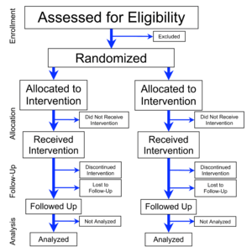
Randomization
Randomization:
  Consists of assigning the experimental units to the treatments in a random manner.
  ALWAYS has to be carried out a priori BEFORE the observation is done (a random sequence is generated before the data acquisition starts), and never on demand
    …however, sometimes this is not an option
Figure from: [http://en.wikipedia.org/wiki/Randomized_controlled_trial]

Slide 95
Randomization
Randomization:
  Reduces (and with a bit of luck, removes) the selection bias and/or accidental bias and tends to produce comparable groups [Suresh KP 2011]
  It permits balancing the covariates
    “anything short of proper randomisation courts selection and confounding biases.” [Schulz KF 2002]
  It guarantees the internal validity in the hypothesis testing. It is a necessary but not sufficient condition.
    It does not affect external validity.
  ¡Watch out! Randomization is related but not the same as random sampling

Slide 96
Randomization
Types of Randomization (more common):
  Random
    Simple or without constraints
  Pseudo-random
    Block
    Stratified
    Adaptive (of covariate minimization)
  …there are other more ad-hoc forms of randomization but they are beyond the scope of this presentation.
    Example: Urn randomization, outcome or answer adaptive, etc

Slide 97
Randomization
Types of Randomization:
  Simple or without constraints:
    The assignment sequence is generated in a totally random manner
      It may be generated using a dice, or a random number generator, etc
    It ensures an assignment free of bias
      “Simple (unrestricted) randomisation, [...], no other approach, irrespective of its complexity and sophistication, surpasses simple randomisation for prevention of bias” [Schulz KF 2002]
      Having said that it may suffer of bias by chance
    It can’t guarantee a balance design in terms of experimental units, nor ensure that groups are comparable in terms of covariates (chance bias)
    It does not always produce the desired effects, especially when the sample size is small

Slide 98
Randomization
Types of Randomization:
  By block or restricted:
    The assignment sequence is generated in 2 steps;
      An assignment list with blind blocks is generated
        Example of a block assigment sequence: ABAB, AABB, BABA, BBAA
      Each blind block is assigned a treatment
        The initial blind sequence is often generated by the researcher, but the second step is often achieve by a truly random method (tossing a coin, throwing a dice, using a random number generator, etc)
    It guarantees a balanced design
    It can’t guarantee that groups are comparable in terms of covariates.

Slide 99
Randomization
Types of Randomization:
  Stratified:
    The assigment sequence is generated as follows:
      A block is generated separatedly for each factor and covariate
      Then the expeirmental units are assigned to each block
      Finally, simple randomization is applied within each block
      Similarly as in block randomization, the initial blind sequence is often generated by the researcher, but the second step is often achieve by a truly random method (tossing a coin, throwing a dice, using a random number generator, etc)
    It guarantees that groups are comparable in terms of the considered factrs and covariates.
    It gets more complex as the number of factors and covariates increases
    It requires knowing a priori the baseline characteristics of the population
      …which for obvious reasons is not always available.
      It is difficult to apply if the experimetal untis are “recruited” one a time

Slide 100
Randomization
Types of Randomization:
  Adaptive of minimization:
    The assignment sequence is generated with a pseudo-random value each time
      A first initial assignment is generated by means of a truly random value (e.g. dice), and a first experimental unit is assigned
      While there remains experimental units for assigment, a new experimental unit is pick and assigned the treatment that guarantees minimizating the unbalanced of covariates. If there are more than one option, then a psedo-random number is generated.
      Only the first assignment is truly random.
    It cannot guarantee a balanced design, but any unbalanced is often not too serious.
    It guarantees that the groups are comparable in terms of covariates.
    It requires knowing a priori the baseline characteristics of the population
      …which for obvious reasons is not always available.
    It can be argued that it is not really a random assignment

Slide 101
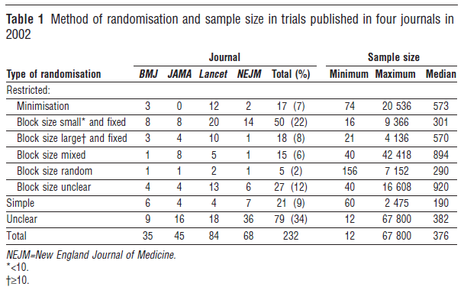
Randomization
Summary of “current” practice(2002) in the clinical domain.
Figure from: [Hewitt CE, 2006, BMJ, 332:1506-8]

Slide 102
Randomization
The famous cross-fold, leave-one-out, leave one-subject-out, etc, are just a particular randomization strategies
…which happens to be very convenient for common machine learning experimental designs
…they are not an end; just a mean.

Slide 103
Quantitative vs qualitative Observation

Slide 104
Quantitative vs qualitative observation
Empirical research might be:
  Quantitative: Based upon numerical analysis of observations
    Observations are numerical in nature (beware! qualitative variables e.g. ordinal variables like in a Likert scale, still yield quantitative research)
  Qualitative: Based upon appreciation of the observations
    Observations are no numerical; e.g. common language
  Hybrid: A combination of the two above.
¡Watch out! Do not confuse qualitative/quantitative with objective/subjective
  The former has to do with the type of analysis, the latter with bias

Slide 105
Quantitative vs qualitative observation
 | Qualitative | Quantitative
Goal or purpose | Exploratory Understand the underlying principles Generating plausible hypothesis for a posterior quantitative investigation Reveal patterns | Quantify associations Ad-hoc research followed by qualitative interpretation
Sample size | Often small | Representative of the population of interest
Data collection | Not structured or semi-structured techniques | Structured techniques
Data analysis | Non statistical | Statistical and mathematical in general
Results and conclusions | Exploratory. Non conclusive and not generalizable to the whole population. Preliminary understanding. | Accumulative evidence
Pros and cons | Particularly useful in social sciences Greater depth and wealth in the observations High risk of bias | Particularly useful in exact sciences Facilitates the confirmation or refuting the hypothesis Inappropriate for special cases and exceptions.
Table modified and enlarged from: [http://www.snapsurveys.com/techadvqualquant.shtml]

Slide 106
Quantitative vs qualitative observation
Types of experiments and studies according to the degree of intervention:
  Observational: The researcher observes the phenomenon and measures its outcomes. The researcher does not manipulate any of the variables directly, however he might still choose the time (wait for) and conditions (look for) that he is interested in.
    The researcher is a mere passive observer that interferes the less as possible with the phenomenon being studied.
    Sometimes, these experiments are also called not interventional.
  Interventional: The researcher directly manipulates the conditions assumed to be the cause of the phenomenon and controls or fixes all other variables that he thinks might affect the outcome.
    Often this implies comparing among treatments.
    Sometimes these are referred to as experimental but that suggests the observational os not an experiment. Indeed, in some observational experiments some authors prefer not to speak of experiments but of studies.

Slide 107
Quantitative vs qualitative observation
Observer’s effect:
  This effect is concern with the fact that just by watching/studying a phenomenon, we are already distorting it.
  It is often related to Heisenberg’s principle of uncertainty (although it is not exactly the same)
  We will not get into further details.

Slide 108
Quantitative vs qualitative observation
Empirical science (that based on the observation of a phenomenon; that is in facts) requires both observational and interventional research. [SwanbornPG1996]
Regardless of whether the experiment is observational or interventional, the research might still be qualitative or quantitative.
  …although, naturally the qualitative research tends to be observational in nature.

Slide 109
Quantitative vs qualitative observation
En general, se debe favorecer la investigación con intervención sobre la observacional, pero…
“The popular belief that only randomized, controlled trials produce trustworthy results and that all observational studies are misleading does a disservice to patient care, clinical investigation, and the education of health care professionals.”
  [Concato, 2000, NEJM 342:1887-92]

Slide 110
Quantitative vs qualitative observation
Recommended readings:
  Concato J et al “Randomized, Controlled Trials, Observational Studies, and The Hierarchy Of Research Designs” New England Journal of Medicine 342:1887-92
    >2000 citas
  Bryman, A (1984) “The Debate about Quantitative and Qualitative Research: A Question of Method or Epistemology?” The British Journal of Sociology, 35(1):75-92
    >500 citas
  Firestone WA (1987) “Meaning in the method: The rethoric of quantitative and qualitative research” Educational researcher 16(7):16-21
    >500 citas
  Bryman, A (2006) “Integrating quantitative and qualitative research: how is it done?” Qualitative Research 6(1) 97-113
  Lilly CM 2007 “The Healing Power of Listening in the ICU” New England Journal of Medicine, 356(5):513-514
    Un buen ejemplo de los diferentes roles de ambos tipos de experimento en particular en investigación clínica.
  http://longevity.about.com/od/researchandmedicine/f/what-are-observational-studies.htm

Slide 111
aproximaTIOn

Slide 112
Aproximation
The experimental design and the subsequent analysis of data can be:
  guided by hypothesis: Involves the stating of an educated hypothesis around which an specific purpose experiment is designed
    a.k.a. confirmatory, or model guided
    It first induces a plausible truth and then acquires the data
  guided by data: The experimental design is more os less generic without a preconceived model (i.e. hypothesis).
    a.k.a. exploratory, descriptive, or hypothesis-free
    First data is acquired and then a plausible truth is deduced

Slide 113
Aproximation
 | Guided by hypothesis | Guided by data
Pros | Strongly linked to the sicentific method Easy to reproduce Highly controlled Universally accepted Capitalizes on statistical rigour and the natural use of inferential statistics Efficient and effective | The endpoint is often a hypothesis (that has to be evaluated with a design guided by hypothesis) Allows for a thorough exploration (although in practice it is often limited to publishing boundaries) Permits data mining It takes advantage of the huge computational power that we have now. Low conceptual demands Free of bias(? – Personally I do not agree with this; it is doomed to suffer the researcher bias)
Cons | May ignore latent variables Limited exploration Difficult to generate good hypothesis High conceptual demands | Often subjective At times criticised as pseudo-scientific (? – Personally I do not agree with this; as long as claims remain appropriately bounded) High risk of finding spurious relationships Weak link with the scientific method Low control; high confounding
Self elaborated from several sources; it does not pretend to be exhaustive

Slide 114
Aproximation
Recommended readings:
  Friston KJ “Modes or models: a critique on independent component analysis for fMRI” Trends in Cognitive Sciences 2(10):373-374
    ...and the answer by McKeown et al in Trends in Cognitive Sciences 2(10):375
  http://www.linkedin.com/groups/Hypothesis-Driven-Vs-Data-Driven-35222.S.140746223
    Una interesante discusión con diferentes puntos de vista.
  Kell DB y Oliver SG (2003) “Here is the evidence, now what is the hypothesis? The complementary roles of inductive and hypothesis-driven science in the post-genomic era” BioEssays 26:99-105
    Not convinced by this one…
  http://www.analyticsearches.com/wps-data-driven-science-is-a-failure-of-imagination/
    An interesting point of view
  http://scienceblogs.com/purepedantry/2008/05/19/hypothesisfree-research/
    A defence of research guided by hypothesis

Slide 115
Classical experimental designs

Slide 116
Longitudinal vs cross-sectional
Depending on the number of sessions along the time the experiment may be::
  Transversal, vertical or more commonly cross-sectional: A single session, that is data from a experimental unit is acquired once.
  Longitudinal: More than one measurements from the same experimental unit along a period of time.
    Pre-post studies are a particular case in which the measurements are taken before applying the treatment, and after the application of the treatment.
  ¡Remember! You may still have more than one session per experimental unit, but time might not matter (within-subjects designs)

Slide 117
Unifactorial vs multifactorial
A factorial design is that which focuses on observing the effect of a number of levels of a factor i.e. different treatments
A covariance design is an experiment of type pre-post focused on establishing how does a metric covaries
  Often an ANCOVA model is used for analysis
A block design is including several homogeneous groups that all will receive the same treatment/s. The experimental units with each group are then assigned to the treatments in a random manner according to the variable controlled by the researcher.
These designs are non exclusionary.
Sources: [http://www.socialresearchmethods.net/kb/expclass.php y
http://www.stats.gla.ac.uk/steps/glossary/anova.html#factor]

Slide 118
Unifactorial vs multifactorial
Unifactorial and multifactorial:
  A design is unifactorial if it only tests one factor.
    It has greater statistical power than a multifactorial counterparts.
    Observed effects are attributable to the single source of variation.
  A design is multifactorial if it tests more than one factor at a time.
    It sacrifices statistical power but permits observation of combined effects and interactions
    The independent marginal effects of the individual factors are called main or simple effects.

Slide 119
Independent and repeated measures
Independent and repeated measures:
  An experimental design is said to be of related or repeated measures or within subject if different treatments are applied over the same experimental unit
    This design leads to paired data
  An experimental design is said to be of independent measures or between subject if the different treatments are applied to different experimental units
  Of course there is also hybrid designs
    Example: 2 factorial, one teste within- and the other between-
  There is a 3rd variant, named matched pairs in which the experimental units for the treatments are not the same but are “matched or paired” with others sharing some similarity.

Slide 120
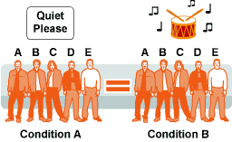
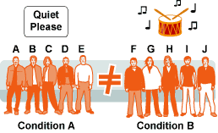
Independent and repeated measures
Repeated measures
Independent measures
Figures from: [http://www.ngfl-cymru.org.uk/vtc/ngfl/psychology/learn_train/alternative_designs/]

Slide 121
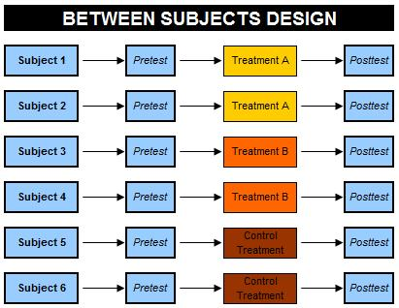
Independent and repeated measures
Figure: [http://explorable.com/within-subject-design]

Slide 122
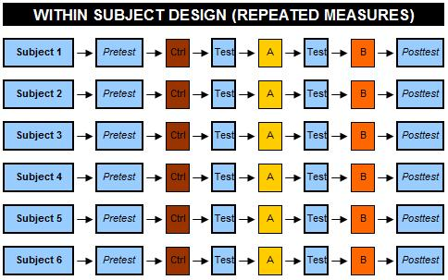
Independent and repeated measures
Figure from: [http://explorable.com/between-subjects-design]

Slide 123
Independent and repeated measures
Repeated measures | Independent measures
Require less experimental units. Consequently, they also require lower cost, recruiting time, training, etc Less variability (since there are less experimental units), permitting more agressive stats to be used. Higher statistical power. Covariates inherent to the experimental units e.g. intelligence of the participant, hardness of the rock, etc, remain constant across groups Lower risk of participation bias when the experimental units are humans. | Less inteference among conditions or factors. Not exposed to the order of the effects Reduce fatigue, learning effect, habituation, etc Randomization is much easier
Self-elaborated

Slide 124
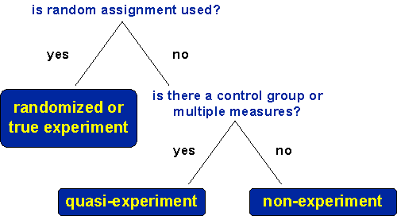
Randomized experiments
Figure from: [http://www.socialresearchmethods.net/kb/destypes.php]

Slide 125
Randomized experiments
Randomized experiments:
  An experiment in which the assignment of treatments has been carried out by means of some kind of randomization.
  If it further involves a control group, then it is known as randomized controlled trial.
    These are the gold standard in clinical investigations
    In general, in biomedical research these are considered the most reliable form of scientific evidence.

Slide 126
Randomized experiments
Randomized controlled trials:
  Pros:
    Virtually all…
  Cons
    None? Just some peccata minuta….
      http://en.wikipedia.org/wiki/Randomized_controlled_trial#Disadvantages

Slide 127
Quasi-experiment
Quasi-experiment:
  An experimento lacking randomization.
  It has several uses:
    Allow full control of the assignment of treatments
    Necessary when there is no control over the assignment of treatments.
    Common in “pre-post” designs as you cannot randomized time.
  With this design it is difficult (but not impossible) to demonstrate relations between dependent and independent variables
    Unfortunately, the term is derogatory, and often (due to ignorance) they are rejected or look upon as non scientific

Slide 128
Quasi-experiment
Quasi-experiment:
  Note that the only difference between a randomized controlled trial and a quasi-experiment is the in the former the assignment of at least 2 treatments are randomized.
  Everything else (blinding, blocking, replication, covariate control, etc) remains equally rigorous.

Slide 129
THANKS, QUESTIONS?

