Slide 1
Putting technologies to work: Sensing and analysis in medical applications
Felipe Orihuela-Espina
Winter School on Ubiquitous Computing
Puebla, 14th Jan 2014

Slide 2
Lecture Goals
By the end of this lecture, the student shall be able to:
Reason the biomedical foundations leading to an observable biosignal.
Understand the principles of several sensing technologies, and imagine different scenarios where they can be applied to.
Design an analysis strategy to retrieve a hidden biomedical state from a given sensed biosignal.
Interpret computational and statistical results in biomedical terms.

Slide 3
Conclusions
Different technologies can provide useful and meaningful information regarding very different aspects of the physical and cogntive status of people as well as their working environment.
Ergonomic and neuroergonomic reality can and should guide technology developments.

Slide 4
Overview
Lecture Goals
Conclusions
Working scenario I: Minimally invasive surgery
Eye tracking
Sensing and Data
Revealing attention, cognitive activity, disorientation and fatigue
Gaze contingent motor channelling
Collaborative gaze channel
Optical tracking
Sensing and Data
Maneouvre assessment in NOTES
Magnetic tracking
Sensing and Data
Assessing surgeons spatial awareness in NOTES
Measuring volumetric requirements in laparoscopy
Force sensing
Sensing and Data
Evaluation of robotic laparoscopy instrumentation force requirements
(Optical) Functional neuroimaging
Sensing and Data
Assessing surgical skill acquisition
Evaluating surgeon’s neuroergonomics
oBCI: A new communication channel between the surgeon and the robot
Working scenario II: Ophthalmology
Visible/NIR spectrography
Sensing and Data
Recovering histological parameters by physics based modelling
Demands
Technologies
Note the similarity of these two; basically the same technology

Slide 5
Working Scenario I: Minimally INVASIVE SURGERY

Slide 6
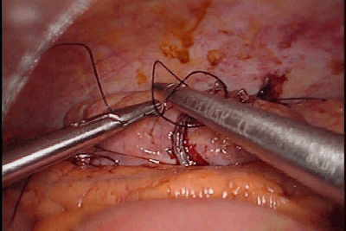
Minimally Invasive Surgery: Laparoscopy
[http://www.rfay.com.au/laparoscopic.html]
[http://laparoscopyhospital.com/membersgellery/v/Laparoscopy+Hospital_s+Training13.JPG.html]
[http://www.gastrointestinalatlas.com/English/Colon_and_Rectum/Laparoscopic_Surgery_of_Coloni/laparoscopic_surgery_of_coloni.html]

Slide 7
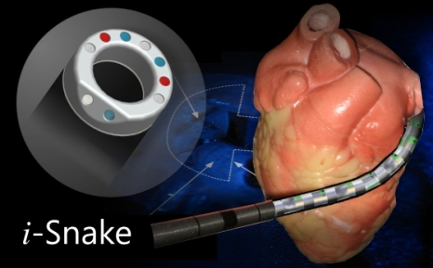
Minimally Invasive Surgery: Robotic surgery
[Hamlyn Center – Imperial College]
[http://docmo.hubpages.com/hub/Robotic-Surgery-The-Technology-Benefits-and-Risks]

Slide 8
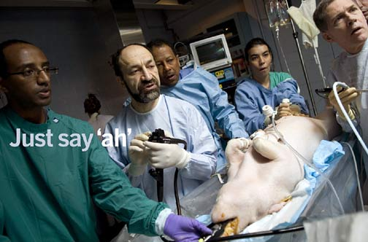
Minimally Invasive Surgery: NOTES
[http://www.hopkinsmedicine.org/hmn/S07/feature2.cfm]
[http://www.mizozo.com/health/08/2010/21/notes-surgery-through-body-s-natural-openings-like....html]
[ShafiBM 2006 Seminars in Pediatric Surgery]
[BazziWM 2012 Urology Annals]

Slide 9
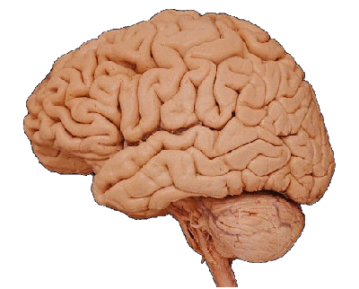
Working scenario I: Minimally invasive surgery
Neuroimaging
In order to provide the surgeons with the best useful technology it is necessary to understand their necessities.
Different technologies can help us to understand their ergonomic and neuroergonomic requirements across different modalities of minimally invasive surgery.
Eye tracking
Optical tracking
Force sensing
Main Figure: [http://www.rfay.com.au/laparoscopic.html]
Magnetic tracking

Slide 10
EYE TRACKING

Slide 11
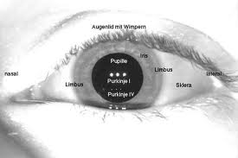
Eye-tracking: Sensing
Figure from: [www.opt.indiana.edu]
Figure from: [advancement.sdsu.edu]
Figure from: [www.uak.medizin.uni-tuebingen.de]

Slide 12
Eye-tracking: Data
Information returned by (most) eye-trackers:
Eyes point of regard
Pupil size
Validity codes (e.g. eye detection)
Information that can be derived from an eye-tracker
Eye movements: fixations, saccades
Number of, frequency, duration, length
Point of regard, search path
Pupillometry
Size, (oval) deformation, entropy
Blinks
Number of, frequency, duration,…
Microsleeps

Slide 13
Eye-tracking: Example of Eye Movement Data

Slide 14
Eye-tracking: Example of Eye Movement Data

Slide 15
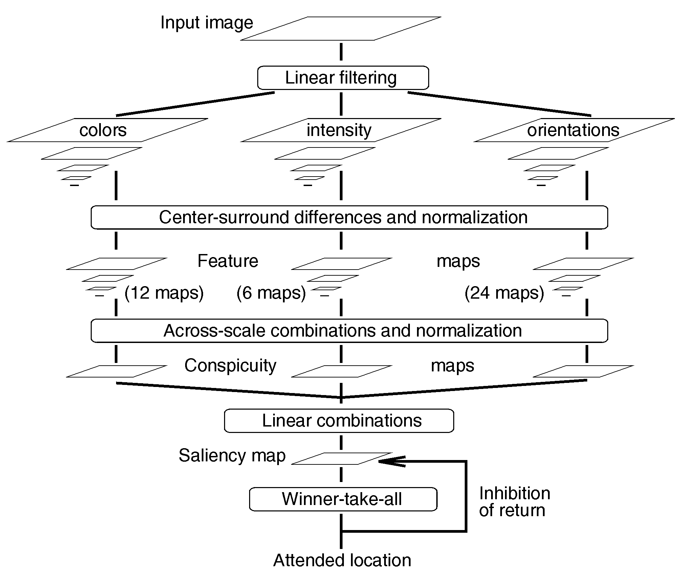
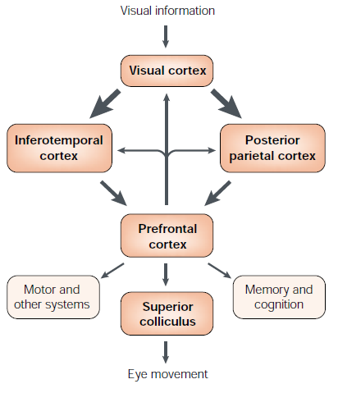
Eye-tracking as biosignal
Eye-tracking as a proxy of attention:
Neuronal mechanisms for the control of attention [Itti, L. 2001]
A Model of Saliency-Based Visual Attention [Itti, L. 1998]

Slide 16
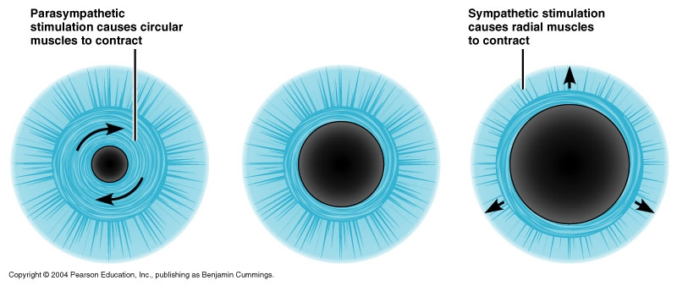
Eye-tracking as biosignal
Blink-removal
Eye-tracking as a proxy of cognitive activity:
Observable principle: Pupil dilates as a subject gazes at a point which stimulates cognition [MarshallSP2000]
Identify observations having cognitive workload
Wavelet decomposition (Daubechies)
Denoising
2nd Wavelet decomposition (Daubechies)
Look for discontinuities
(Manual) indication of AOI
Matching observation with AOI
Figure from: [www.apsu.edu]

Slide 17
Revealing Orientation
Orientation with everyday objects. Model Validation
Orientation strategies in laparoscopy
Annals of Surgery 2010
Orientation strategies in NOTES
Annals of Surgery 2011
Cognitive Processing 2009
Is orientation training possible?
BJS 2011

Slide 18
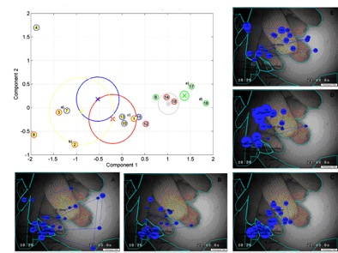
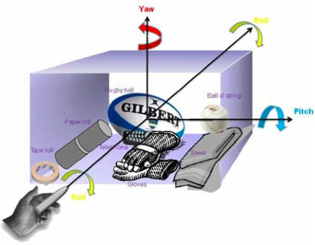
Orientation 1: Everyday objects HMM Model validation
NOTES-inspired model
HMM based mathematical modelling
Performance behaviour appears to involve a strategy whereby subjects re-orientate by determining relative positions of peripheral objects to a central one, on which a significant amount of re-orientation time is spent
Peripheral object
Anchor object
[Sodergren MH et al, Cog. Proc. 2009b]

Slide 19
Orientation 1: Everyday objects HMM Model validation
The HMM-based visual behaviour profiling algorithm:
Construct the set of observed sequences O of ROIs according to the fixations
The fixation-based ROIs are the observabe alphabet
Train one HMM λ_{i}(A,B,π,S) for each sequence O_{i}.
Number of hidden states can be empirically found by trial and error or exhaustive exploration over a range of states.
Compute a distance matrix D = {d_{ij}(O_{i},O_{j})} where d_{ij}(O_{i},O_{j}) = log P(Oi|λ_{i}).
Matrix D represents the non-symmetric similarity between sequences.
Using the whole set of sequences as references (R = O), build a new representation space H, where each sequence O_{i} is represented by a vector of features H_{R}(O_{i}).
Compute a symmetric matrix of pairwise distances among pattern represented sequences in H, and embed
(Opt) classic k-means algorithm can be used to compute the centroids of the groups of interest

Slide 20
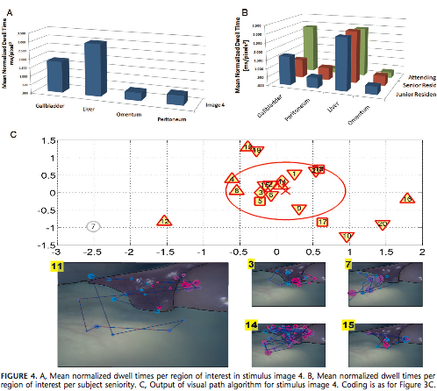
Orientation 2: Laparoscopic Orientation strategies in Laparoscopic
Laparoscopic cholecystectomy divided into 4 stages
For each stage, there are discernable and quantifiable visual attention strategies used by surgeons associated with successful orientation.
Anchor/peripherals-based strategies
There was no difference in success in reorientation between different seniorities and laparoscopic experience of the surgeon subjects.
Peripheral object
Results for image group
“Close up of right upper
quadrant structures”
Anchor object
[Sodergren MH et al, Annals of Surg. 2010]

Slide 21
Orientation 3: NOTES Orientation strategies in NOTES
[Sodergren MH et al, Annals of Surg.2011]

Slide 22
Orientation 3: NOTES Orientation strategies in NOTES
4 NOTES scenarios
Saliency independent modelling
Identification of the most important visual cues
High-performance subjects had a lower number of fixations and normalized dwell time per ROI compared with the other performance groups, suggesting a more structured and focused approach to orientation
Results for image group “Limited view of right upper quadrant structures through pelvic access “
[Sodergren MH et al, Annals of Surg.2011]

Slide 23
Orientation 4: Laparoscopic RCT Is orientation training possible?
An RCT, with half cohort randomized to a tutorial teaching orientation strategies at specific stages of laparoscopic cholecystectomy and half to a control group without any teaching.
SVM classifier
The intervention group was significantly more likely to orientate correctly than the control group
difference in visual attention behaviour between the two groups was apparent
Results for image group “Close up of right upper quadrant structures”
Different gaze behaviour and improved performance;
Differences due to taught strategy (training)
[Sodergren MH et al, BJS 2011]

Slide 24
Revealing Fatigue
Fatigue fingerprint
In progress

Slide 25
Constructing the feature vector
Processing includes resampling to a commonlength and normalization
Signals are columns, samples are rows
IMPORTANT: Upon normalization, whenever a signal is always valued 0 (e.g. slow blinks), normalization yields NaN and thus the resulting feature vector is invalid. It is possible to circumvent most cases by dropping the slow blinks signal.
Remember signals are normalized, so color scale is fixed!. Redder are higher values (~1), blueish are lower values (~0)

Slide 26
Embedding with time window 5 sec
IMPORTANT: Invalid feature vectors do not have a corresponding point in the embedding (i.e. <subj1,sessPlacebo>)
The black line helps in quickly identifying all the sessions for a certain subject

Slide 27
Late stage
Intermediate stage
Early stage
Initial stage

Slide 28
Fatigue
<↓#Fix,↓FD,↑#S,↓SL,↑#Bl>
↑#Bl
↑#S
↓SL
↑SL
↓#S
↓#Bl
↑#Fix.
↑FD
↓#Fix.
↓FD

Slide 29
Classifiying fatigue
Different fatigue models: Classification done by R. Ramezani [unpublished results, draft in progress]

Slide 30
Eye tracking technologies
Gaze contingent Motor Channelling (GCMC)
Collaborative Gaze Control (CGC)
Ann BioM Eng 2012
MedIA 2012

Slide 31
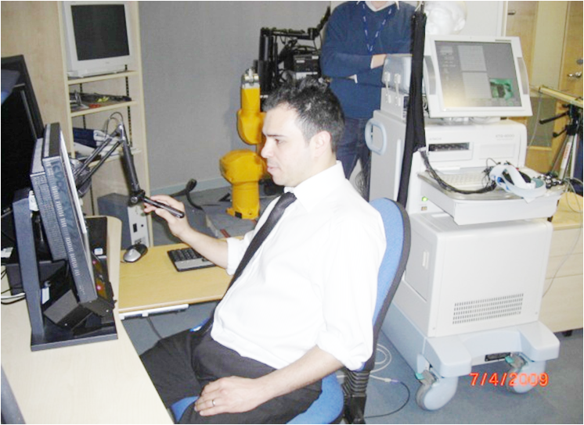
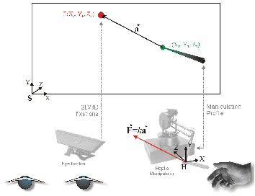
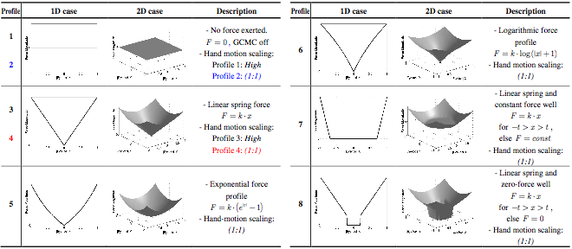
Gaze contingent motor channeling (GCMC)
[Mylonas G et al, MedIA 2010]

Slide 32
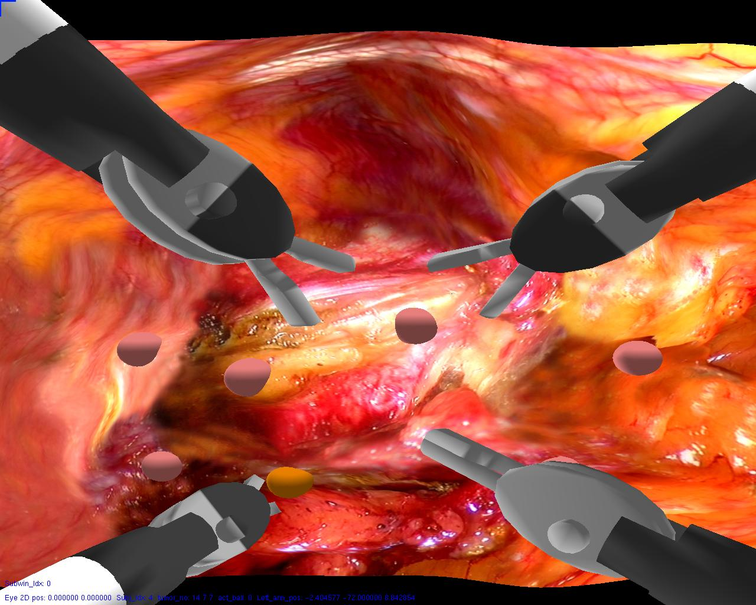
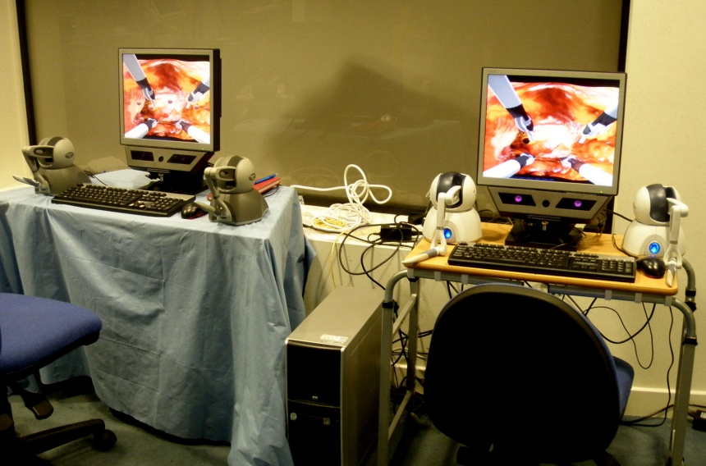
Collaborative Gaze Channel (CGC)
[Kwok K et al, ABME 2012]

Slide 33
Optical TrACKING

Slide 34
Optical tracking: Sensing

Slide 35
Optical tracking: Data

Slide 36
Manoeuvre assessment in NOTES
[Clark J et al, MITAT 2012]

Slide 37
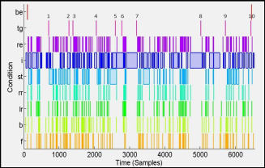
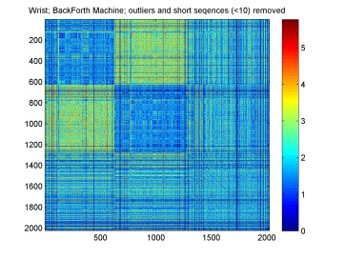
Manoeuvre assessment in NOTES
Analysis:
Manual segmentation of training sequences by an expert
Feature selection
Normalization
Learn of movement templates
Dynamic Time Warping for online automatic segmentation of sequences
Classification by Neural Networks
2 machines; back/forth and rotation R/L

Slide 38
Manoeuvre assessment in NOTES
[Clark J et al, MITAT 2012]

Slide 39
Manoeuvre assessment in NOTES
[Clark J et al, MITAT 2012]

Slide 40
MAGNETIC TRACKING

Slide 41
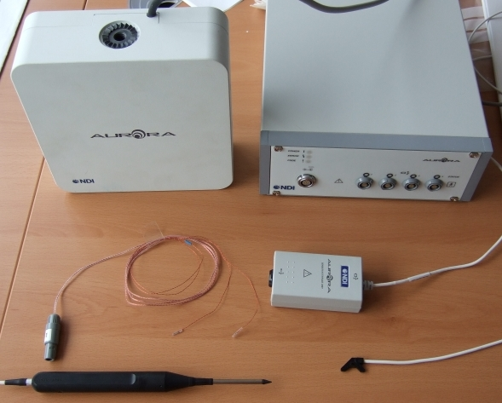
Magnetic tracking: Sensing
Figure from: [Aurora User Guide]
Figure from: [www.ndigital.com]
Figure from: [magrit.loria.fr]

Slide 42
Magnetic tracking: Data
Information returned by (most) eye-trackers:
Local x,y,z for each coil
Port status
Information that can be derived from an eye-tracker
Tool positions
Number of coils, tool skeleton, etc
Figure from: [Aurora Tool Design Guide]

Slide 43
Magnetic tracking
Spatial awareness in NOTES
Measuring volumetric requirements in laparoscopy
In progress
IJS 2012

Slide 44
Magnetic tracking
Spatial awareness in NOTES
IJS 2012

Slide 45
Spatial awareness in NOTES
Analysis
Spatial smoothing (Gaussian)
Extraction of bivariate histograms
Histogram similarity based on Earth Mover’s Distance (EMD)
Multidimensional Scale (MDS)
Patterns of navigation by embedding region segmentation

Slide 46
Spatial awareness in NOTES

Slide 47
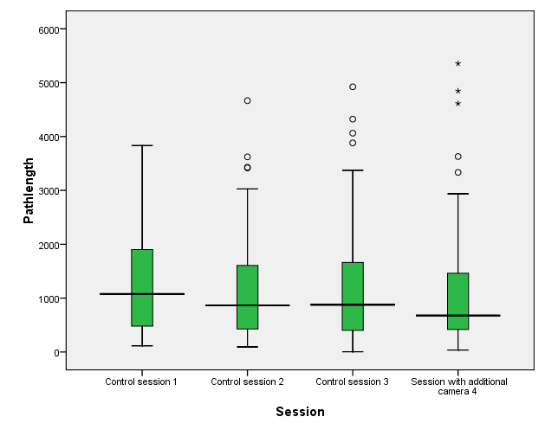
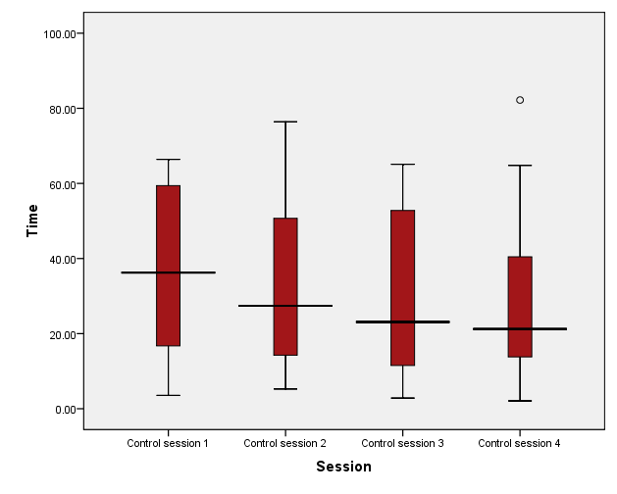
Spatial awareness in NOTES
Pathlength
Time
[Karimyan V et al, IJS 2012]

Slide 48
Spatial awareness in NOTES
[Karimyan V et al, IJS 2012]

Slide 49
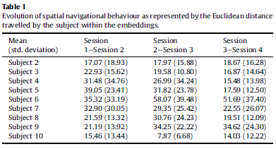
Spatial awareness in NOTES
Patterns of navigation and learning:
Consistent navigation and performance
Improvement in navigation and performance
Inconsistent navigation but improvements in performance
Inconsistent navigation and performance
[Karimyan V et al, IJS 2012]

Slide 50
Magnetic tracking
Measuring volumetric requirements in laparoscopy
In progress

Slide 51
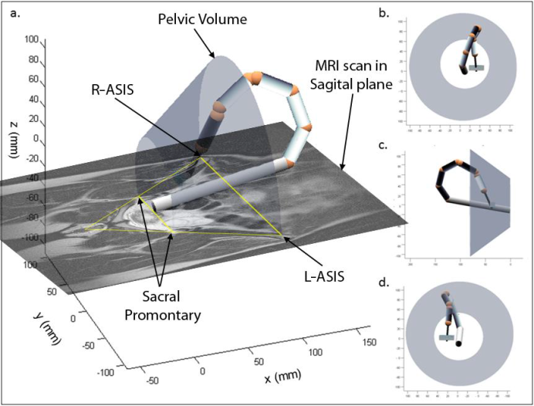
Measuring volumetric requirements in laparoscopy
Constrained workspace analysis of a kinematically accurate computer generated model of the robot.
[Clark J, PhD Thesis]

Slide 52
Measuring volumetric requirements in laparoscopy

Slide 53
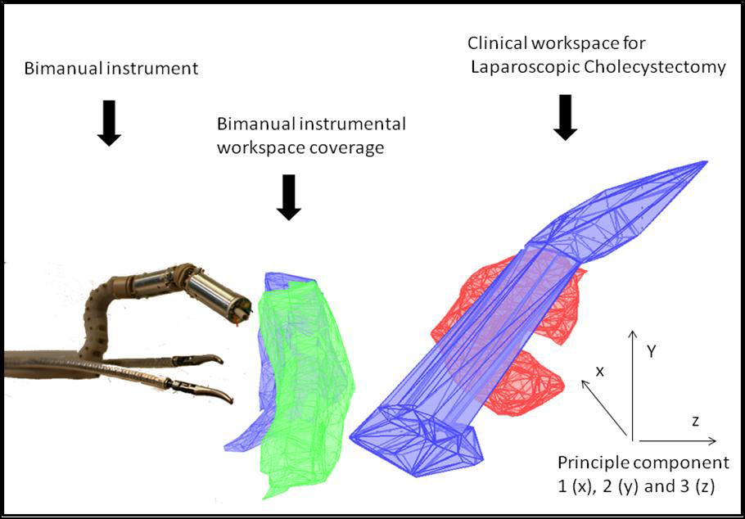
Measuring volumetric requirements in laparoscopy
[Clark J, PhD Thesis]

Slide 54
Measuring volumetric requirements in laparoscopy
Displacement to cover clinical workspace
[Clark J, PhD Thesis]

Slide 55
FORCE SENSING

Slide 56
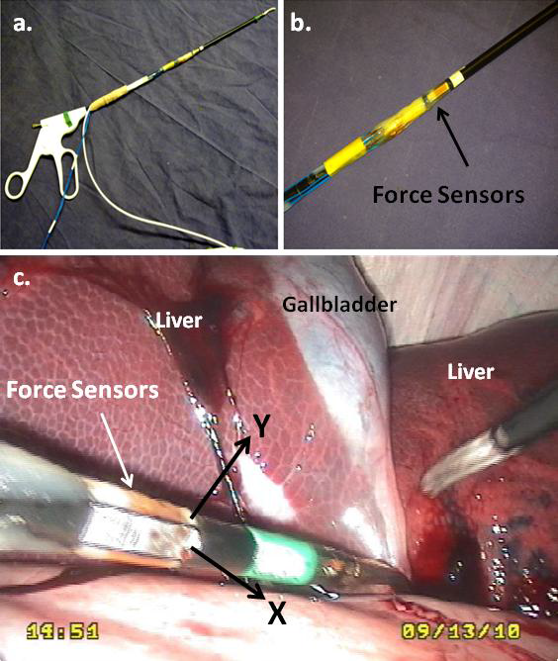
Force: Sensing
Uses strain gauges attached to instruments
[Clark J, PhD Thesis]

Slide 57
Force sensing: Data
Force exerted along the X, Y (and perhaps Z) axis
…and from these, the force direction.
[Clark J, PhD Thesis]

Slide 58
Force Sensing in a laparoscopic tool: Evaluation of robotic laparoscopy instrumentation force requirements
The level of force required to manipulate tissue is at a maximum of 6 Newtons within a porcine model with an optimum force triangulation of around 60 to 90 degrees

Slide 59
Force Sensing in a laparoscopic tool: Evaluation of robotic laparoscopy instrumentation force requirements
The degree of tool-tissue interaction clearly differentiates junior trainees and intermediates from the expert laparoscopic surgeon
[Clark J, PhD Thesis]

Slide 60
(Optical) FuNCTIONAL NEUROIMAGING

Slide 61
(Optical) Functional Neuroimaging: Sensing

Slide 62
(Optical) Functional Neuroimaging: Sensing
2.5-4cm

Slide 63
(Optical) Functional Neuroimaging: Sensing
Time resolved (TRS)
Frequency domain (FD)
Continuous-wave (CW)
Figure from [UCL, BORL]

Slide 64
(Optical) Functional Neuroimaging: Sensing
[StrangmanG2002]

Slide 65
(Optical) Functional Neuroimaging: Sensing
[FerrariM2012]

Slide 66
(Optical) Functional Neuroimaging: Data
Neural
activation
Ions flux
Increment in
metabolism
Cell swelling
Neurovascular
coupling
Timings: 1 ms
Cambio en la
hemodinámica
Timings: 3-15 s
Changes in
scattering
Changes in
absorption
Fast optical signal
Haemodynamic
response
NIRS

Slide 67
(Optical) Functional Neuroimaging: Data
Effects of brain activity
CBF
CBV
Cerebral Blood Oxygenation
Intracellular energy status
Ion and water flux across membranes
Physiological parameter
Blood cell velocity
HbT
HbO₂ / HHb
Cytochrome oxydase
Membrane potential (Early signal)
Cell swelling (Late signal)
Optical parameter
Doppler shift
Absorption
Scattering
Modified from [VillringerA1997]

Slide 68
(Optical) Functional Neuroimaging: Data
Brain connectivity refers to how different areas of the brain communicate with each other.
Segregation
Integration
Plasticity
Anatomical
Connectivity
Efficiency
Activation
Studies
Laterali-
sation
Effective
connectivity
Functional
Connectivity
Which part of the brain
is responsible to
perform a simple task
How different parts of the
brain collaborate to
perform a complex task

Slide 69
Where to look for brain signals?
Main Figure from
[www.wizardofads.com.au/storage/BrainMap.jpg]

Slide 70
Where to look for brain signals?
Coordination of complex
and bi-manual movements
Motor intention
and visual feedback
Motor
guidance
Movement
execution
Main Figure from
[thebrain.mcgill.ca]

Slide 71
(Optical) Functional Neuroimaging: Data
Blood
oxygenation
HbO2
CBV
HHb
CBF
HbT
CMRO2
Notes:
Cerebral haemodynamics as computed with analytical modelling.
HHb and HbO2 are measured, the rest are derived from these two.
The different topograms correspond to different snapshots in a temporal sequence (every 2 secs starting at task onset).

Slide 72
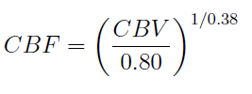
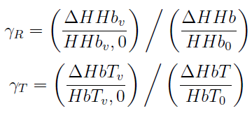
Analytical Modelling
CBV
CBF
CMRO₂
Notes:
CBV – Cerebral blood volume
CBF – Cerebral blood flow
CMRO2 – Cerebral Metabolic Rate of Oxygen
The modelling equations can be found: CBF in [WyattJS1990]; CBF in [GrubbRL1974] and CMRO2 in [BoasDA2003].
ρ is the brain tissue density, which has been estimated to be 1.05 gr/ml
M is the molecular weight of the haemoglobin taken to be 64500 gr/mol
H is the large vessel haemoglobin concentration. Wyatt et al took a blood sample to calculate this value. If a blood sample was not taken the absolute value for each patient is unknown. A plausible assumption is 15 gr/dl
R is the cerebral to large vessels haematocrit ratio, which has been assumed to be 0.69 by several authors. This value is base
on Lammertsma et al work but subjects in that study present either a brain tumor or cerebrovascular disease except one normal subject as pointed out by Okazawa et al. In this sense, Okazawa et al reported a value of 0.88±0.06 based on 12 healthy subjects.
If the haematocrit is considered to remain constant during haemodynamic response to activation, then HbT is proportional to CBV
γR and γT represent the correspondent factors which relates the fractional haemoglobin changes in the venous compartment to those across all vascular component.
ΔHHbv is the variation of deoxyhaemoglobin concentration in the localized venous compartment
HHbv, 0 is the baseline deoxyhaemoglobin concentration in the localized venous compartment
ΔHbTv is the variation of total haemoglobin concentration in the localized venous compartment
HbTv, 0 is the baseline total haemoglobin concentration in the localized venous compartment
None of these four values are known and therefore we cannot calculate the values of γR and γT. Boas et al have simply allowed these coefficients to be 1 leading to arbitrary units.

Slide 73
A summary of analysis approaches
Type of Connectivity | Hypothesis driven | Data driven
Functional | Require an a priori HRF and/ or a contrast to compare with Classical statistical inference (ANOVA like) Classical regression PLS (Covariance based) SPM (GLM+GRF) | Blind Source Separation (PCA, ICA, CCA,…) Coherence based (Plain coherence) Manifold Embedding and dimensionality reduction (Isomap, LLE, Laplacian Eigenmaps, Hessian Eigenmaps, manifold charting, ...)
Effective | Require an a priori model Structural Equation Modelling Dynamic Causal Modelling | Granger’s causality Coherence based (DTF, PDC)
Efficiency |  | Graph theory (Mental workload, Cognitive burden)
Graph Theory
Notes:
The hard partition (hypotheis vs data driven) is somehow blurry in reality
PLS – Partial Least Squares
SPM – Statistical Parametric Mapping; GLM – General Linear Model; GRF – Gaussian Random Field
BSS - Blind Source Separation; PCA – Principal Component Analysis; ICA – Independent Component Analsysis; CCA – Canonical Component Analysis
LLE – Locally Linear Embedding

Slide 74
SPM – The general linear model
Y=Xβ+ε
Where:
Y is the observed data
X is the design matrix
β are the regressor coefficients
ε is the error
Notes:
SPM is a mass univariate approach where each pixel/voxel is treated as a separate column vector of data using the general linear model (GLM). The GLM can model virtually any experimental design.
The design matrix holds the components that explain the observed data. It incorporates the timing information, i.e. the stimulus train (onset and duration of events) convolved withthe HRF, as well as other regressors (movement, etc).
The HRF is not known but SPM assumes this to be a linear combination of basis functions (e.g. two gamma functions). A typical function set comprise the HRF and its partial derivatives with respect to time and dispersion.
The error in SPM is not assumed to be spherical.

Slide 75
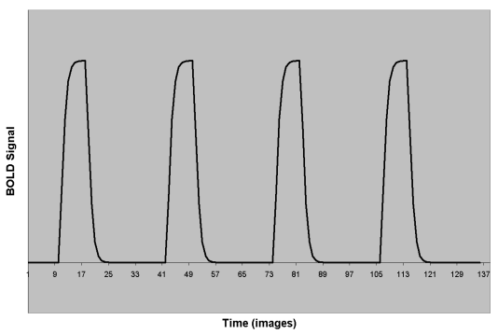
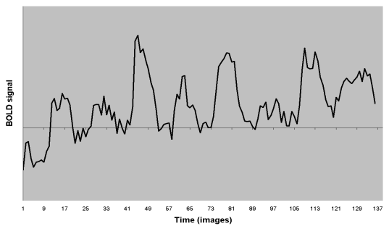
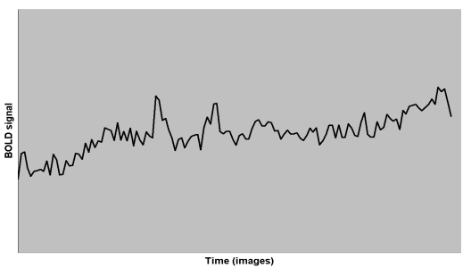
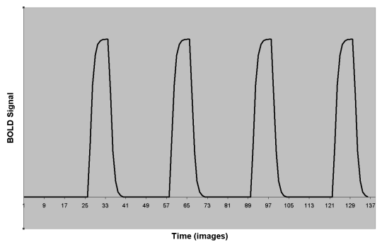
SPM-GLM: Example with 2 predictors
× β₁
=
+
+
× β₂
fMRI Signal
=
Design Matrix
x
+
Betas
Residuals
“what we CAN explain”
“how much of it we CAN explain”
“what we CANNOT explain”
“our data”
=
x
+
Statistical significance is basically a ratio of explained to unexplained variance
Slide reproduced from [Culham 2008, fMRI course]

Slide 76
SPM-GRF: Correction for multiple comparison
Figure from [Ye et al,2009]
Notes:
The Gaussian random field (GRF) assumption in fMRI analysis is based on the Gaussian kernel smoothing on a dense lattice. However, the situation is drastically different in NIRS since only a sparse number of optodes are located irregularly. NIRS-SPM first interpolates the data using inhomogeneous interpolation kernel and calculates the excursion probability using inhomogeneous Gaussian random field theory.

Slide 77
Graph Theory
Figure from [Bullmore & Sporns,2009 ]
Notes:
Structural and functional brain networks can be explored using graph theory through the following four steps (see the figure) [Bullmore & Sporns, 2009]:
1) Define the network nodes. These could be defined as electroencephalography or multielectrode-array electrodes, or as anatomically defined regions of histological, MRI or diffusion tensor imaging data.
2) Estimate a continuous measure of association between nodes. This could be the spectral coherence or Granger causality measures between two magnetoencephalography sensors, or the connection probability between two regions of an individual diffusion tensor imaging data set, or the inter-regional correlations in cortical thickness or volume MRI measurements estimated in groups of subjects.
3) Generate an association matrix by compiling all pairwise associations between nodes and (usually) apply a threshold to each element of this matrix to produce a binary adjacency matrix or undirected graph.
4) Calculate the network parameters of interest in this graphical model of a brain network and compare them to the equivalent parameters of a population of random networks.

Slide 78
Assessing surgical skill acquisition
Changes in brain activity depends on task familiarity
NeuroImage (2008) 39:805-813
Characterization of cortical activity according to experience
MICCAI 2007
Learning related plasticity after a week of practice
Learning related changes associated with new skills acquisition
CAS 2008
MICCAI 2008
Changes in the cortical signature in technical and cognitive skills due to sleep deprivation (on calls)
Annals of Surg 2011
Depth perception and hand eye coordination in surgical robotics (DaVinci Robot)
OHBM2010
Psychomotor vigilance
OHBM2011
Draft in progress for Cogn. Proc
Surgical Decision Making
OHBM 2012
Visuomotor Misalignment
PENDING
Laparoscopic Intracorporeal Suturing
Draft in progress
SARS 2012

Slide 79
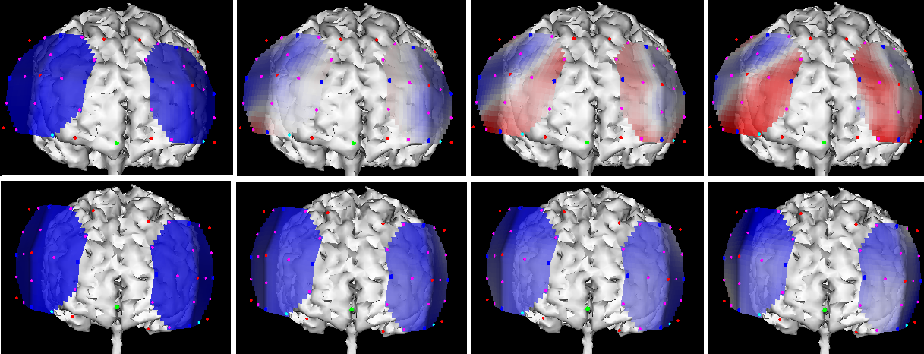
Prefrontal Construct Validity (PCV): Cortical response depends on task familiarity
Cortical response
[Leff et al, Neuroimage 2008]
Novice
Registrars
Consultants
Novice
Expert
Rest
2s
6s
10s
[Leff et al, MICCAI 2007]

Slide 80
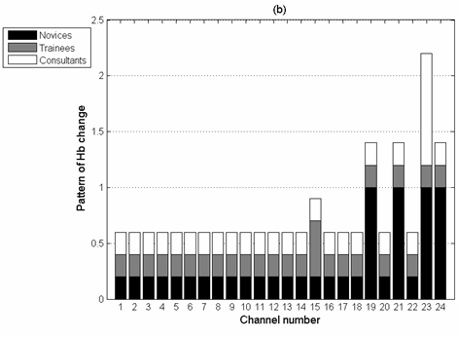
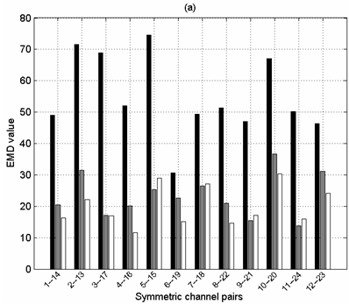
Prefrontal Construct Validity (PCV): Characterization of haemodynamic responses
[Leff et al, MICCAI 2007]

Slide 81
Prefrontal Plasticity Study (PPS) : Learning related changes
[Leff et al, CAS 2008]

Slide 82
Two point touch in MIS (TP-MIS): Changes in fronto-parietal haemodynamic flow associated with new skill acquisition
[Leff et al, MICCAI 2008]

Slide 83
Sleep deprivation: Is the Prefrontal Cortex modulator of attention during episodes of fatigue ?
Epworth sleepiness scale
*
**
Technical Performance
Abnormal
* Statistical improvement
** Statistical deterioration
Normal
Technical (Knot-Tying)
Cognitive (Arithmetics)
Attentional strategy is compatible with cortical compensation

Slide 84
Neuroergonomics: Causes and effects of performance
Neuroergonomic assessment of NOTES navigation with the traditional endoscope
Static cognitive workload due to GCMC in novice
MedIA 2010
Longitudinal changes in the cognitive burden associated with learning assisted with GCMC
MICCAI 2010
Surgery 2011
Mental workload modulation associated with attention in collaborative tasks CGC
1st stage: fNIRS 2010
PFC Dynamics; Yang’s curve confirmation/refute
In progress
2nd stage: Annals of Biomedical Engineering 2012

Slide 85
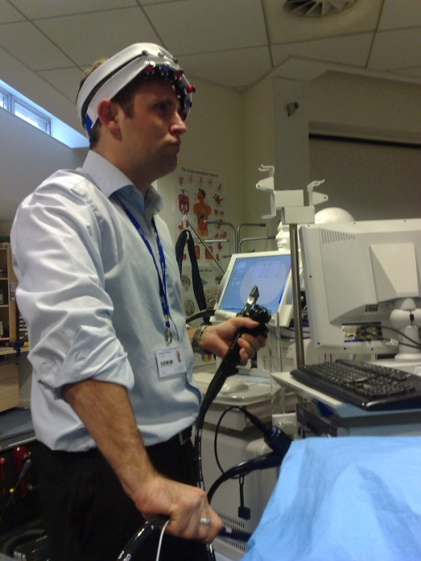
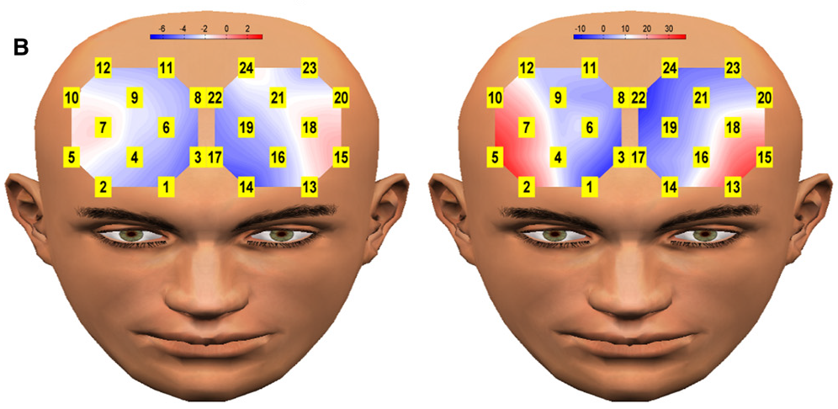
NOTES navigation assessment (NN)
IMAGE UNPUBLISHED
Novices
Experts (Surgeons and Gastro)
[James DRC et al, Surgery]
Novices
Experts
Greater PFC activity associated with expert performance was unforeseen as classically, attenuation within this region is observed in line with increasing task proficiency.
The neurocognitive basis for these findings is likely to be reliant on the stage of the learning process

Slide 86
GCMC: Neuroergonomic assessment of a surgical tool (Static Cognitive Burden)
[Mylonas G et al, MedIA 2010]

Slide 87
Longitudinal GCMC: Longitudinal Neuroergonomic assessment of a surgical tool (Dynamic Cognitive Burden)
S1
S4
S6
Concept of cognitive burden and associated graph-theory based metric
Enhanced tracking accuracy is indexed by a functional increase in cognitive burden and attenuation in cortical haemodynamics across a F-P network.
Control
GCMC
High efficiency and low cost
GCMC
strategy
Default
strategy
Low efficiency and low cost
Low efficiency and high cost
[James DRC et al, MICCAI 2010]

Slide 88
Collaborative Gaze Channel (CGC): Modulation of cortical activity induced by CGC
Verbal guidance (Control)
Visual guidance (CGC)
[Kwok K et al, Ann BioM Eng 2012]
 | completion time (sec) |  | Latency of gaze (sec) |  | Convergence (mm) |  | Accumulated distance travelled (m) |  | No. of nodules (unit per 30 sec)
 | mean | sd | mean | sd | mean | sd | mean | sd | mean | sd
control experiment | 7.3 | 3.8 | 1.8 | 0.6 | 20.9 | 15.1 | 0.6 | 0.2 | 4.7 | 1.0
CGC | 4.5 | 1.1 | 0.9 | 0.4 | 16.5 | 13.6 | 0.4 | 0.1 | 7.4 | 2.6

Slide 89
Neuroergonomics hypothesis: Yang’s curve

Slide 90
Perceptual docking (HCI / oBCI): Augmenting communication
Computational framework for brain haemodynamic signal differentiation and identification of propective applications
Depth perception in surgical robotics
OHBM2010
IROS 2009
DaVinci Robot
oBCI in Surgical Robotics
Submitted to Annals of Surgery

Slide 91
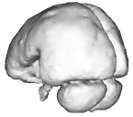
Channels in the surgical console
Brain / BCI ?
Eyes /
GCMC
Hands
Foot/ pedal
Adaptive automation and switch selector
Fatigue alarm systems
Mechatronic control
Adaptive automation matched needs of the operator
Monitor patterns of brain activation to infer levels of attention and cogntive engagement
Detection of hypovigilance
Monitor operator fatigue and sleepiness
Although possible, it has strong legal, ethical and moral implications
Manipulation of the robotic arms
Notes:
We would like to explore BCI as a complementary channel

Slide 92
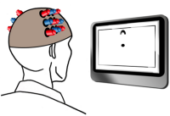
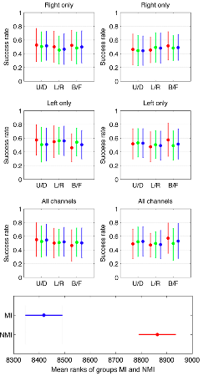
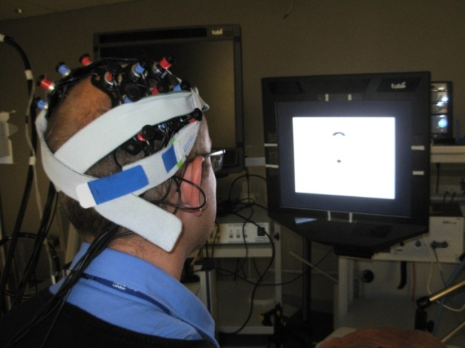
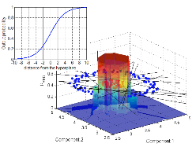
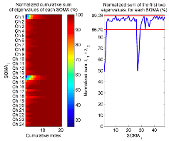
BCI Offline: Feasibility in Surgical Robotics
2 instruction paradigms (MI/NMI)
3 feature selection strategies, inc. rSOMA-SFFS
3 aggregation policies tested (MV, WMV, CC)
[Caproni M et al, IROS 2009]
Correction functions for SVM and AdaBoost used for the correcting classifiers

Slide 93
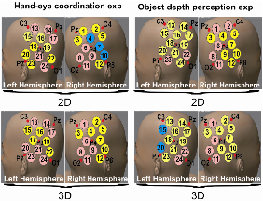
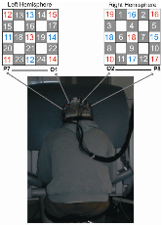
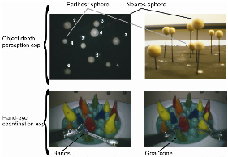
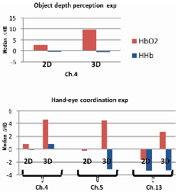
Depth Perception (DP) in DaVinci surgical Robot
Journal draft in progress
[Paggetti G et al, OHBM 2010, ECVP2010]

Slide 94
Working Scenario II: OPTHALMOLOGY

Slide 95
Anatomy of the eye (II)
[Figure modified from ??]

Slide 96
Anatomy of the eye (IV)
Fundus cross section picture: http://med.mce.ntu.edu/anatomy/eye&ear.htm

Slide 97
Visible/NIR SPECTROGRAPHY

Slide 98
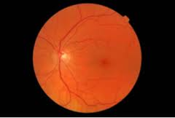
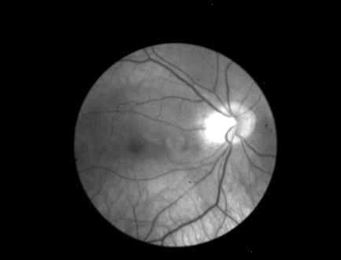
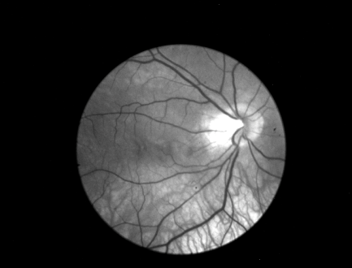
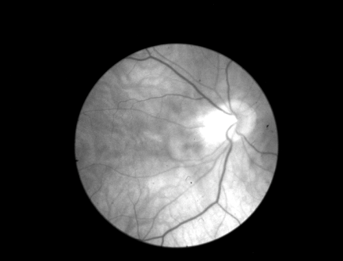
Visible/NIR Spectrography: Sensing
Sensing technology:
Photodetectors
CCDs
Images
RGB image
Multispectral image
Hyperspectral image

Slide 99
Visible/NIR Spectrography: Sensing
[OrihuelaEspina]
[HebdenJC1997]

Slide 100
Visible/NIR Spectrography: Data
Voltage amplitude as a proxy of light intensity at a given detector location (channel/ pixel/voxel)

Slide 101
Visible/NIR Spectrography: Analysis
[Orihuela-Espina, PhDThesis]

Slide 102
Visible/NIR Spectrography: Analysis
[Orihuela-Espina, PhDThesis]

Slide 103
Visible/NIR Spectrography: Analysis
[Orihuela-Espina, PhDThesis]

Slide 104
Visible/NIR Spectrography: Modelling
The kind of creatures and creepy crawlers you’ll face …
RTE; “The unsolvable”
Diffusion theory; “The friendly approximation”
Cthulhu [H.P. Lovecraft]; a mere amateur
The Jacobian; “Your worst nightmare bigger cousin”

Slide 105
Pathway of light remitted from the eye
[Orihuela-Espina, PhDThesis]

Slide 106
Recovering histological parameters by physics based modelling
[Orihuela-Espina, PhDThesis]

Slide 107
Recovering histological parameters by physics based modelling
Parametric maps detail
[Orihuela-Espina, PhDThesis]

Slide 108
Physics-based (spectroscopy) analysis
Your medical image (set) at hand
Physics-Based Modelling (Spectroscopy)

Slide 109
Same analysis can be carried out in other tissues: Example; model on the skin
[Work by Claridge et al, several publications]

Slide 110
Same analysis can be carried out in other tissues: Example; model on the skin
(a)
(b)
(c)
(d)
(e)
(a) A colour image of a melanoma; Parametric maps showing (b) total melanin (darker = more); (c) dermal melanin (black = none, brighter = more); note that dermal melanin is present; (d) thickness of the papillary dermis (brighter = more); note the increased amount on the periphery and also a ”collagen hole” in the centre of the lesion where collagen was displaced by melanin; (e) blood (darker = more); note the absence of blood in the centre of the lesion - white area - and increased amount of blood on a periphery - an erythematous reaction. From [Claridge et al, MedIA, 2003]

Slide 111
Same analysis can be carried out in other tissues: Example; model on the adult head
Figures from: [Okada and Delpy 2003]

Slide 112
Same analysis can be carried out in other tissues: Example; model on the colon
Figures from: [Hidovic and Claridge 2005]

Slide 113
Acknowledgements
Prof. Guang-Zhong Yang, Prof. Lord. Sir Ara Darzi, Prof. Ela Claridge
Clinical team: Daniel R. Leff, Dave RC James, James Clark, Mikael Sodergren, Vahe Karimyam, Antonio Calcagni
Engineering team: George Mylonas, Louis Atallah, Ka-Wai Kwok, Michael Sun, David Noonan, Su-Lin Lee, Iain Styles, Stephen Preece, Mark O’Dwyer
Several funding bodies; EPSRC, Wellcome Trust, Leverhulme Trust, EU-FP7, CONACYT

Slide 114
BACK UP SLIDES

Slide 115
GCMC
[Mylonas G et al, MedIA 2010]

Slide 116
Sleep deprivation: Is the Prefrontal Cortex modulator of attention during episodes of fatigue ?
Technical Performance
Cognitive Performance
Epworth sleepiness scale
*
Abnormal
**
Normal
* Statistical improvement
** Statistical deterioration
Technical (Knot-Tying)
Cognitive (Arithmetics)
Attentional strategy is compatible with cortical compensation

Slide 117
Sleep deprivation: Attentional strategy compatible with cortical compensation
Technical /
Knot-Tying
Maximal haemodyamic response (HbT)
Cognitive / Arithmetic

Slide 118
Optical BCI in a nutshell
Feedback
Extraction –
Signal Processing
Action –
Output
NeuroImaging Measurement -
Brain Activity Measure
Decision -
Command Classification

Slide 119
Making oBCI pervasive: Challenges
BCI General
Single-trial, asynchronous behaviour
Gaming Applicability
Bi-directionality
Optical neuroimaging
Better understanding of the neurovascular coupling and/or reliable and robust fast optical signal detection
Tomographic imaging
Wireless/wearable fNIRS devices exist but further miniaturization required
Incorporation of mental status; escaping mere “joystick/mouse” substitution
Bandwidth and Error rate
Ameliorating training

Slide 120
Channels in the surgical console

